Slide 2

College-Going and
Career-Focused Culture
This Is How We Do It

Slide 3
Essential Question
How can school leaders and educators promote a college-going and career-focused culture that helps students prepare for and pursue postsecondary education (PSE)?

Slide 4
Learning Objectives
Analyze key components of a college-going and career-focused culture that foster student aspirations for postsecondary education.
Apply tools and models from GEAR UP activities to design or enhance initiatives that promote a college-going and career-focused culture in schools.

Slide 5
What Comes to Mind?
What do you think of when you hear the following?
College-Going and
Career-Focused Culture

Slide 6

Let’s Dream Big!
Complete the following prompt as many times as possible to suggest fantastic things that could improve the college-going and career-focused culture in your school.
Wouldn’t It Be Fantastic If…
Notes:
K20 Center. (n.d.). Round robin. Strategies. https://learn.k20center.ou.edu/strategy/2183

Slide 7

Card Sort
Read each statement.
Determine in which layer of the iceberg you think each statement belongs.

Slide 8
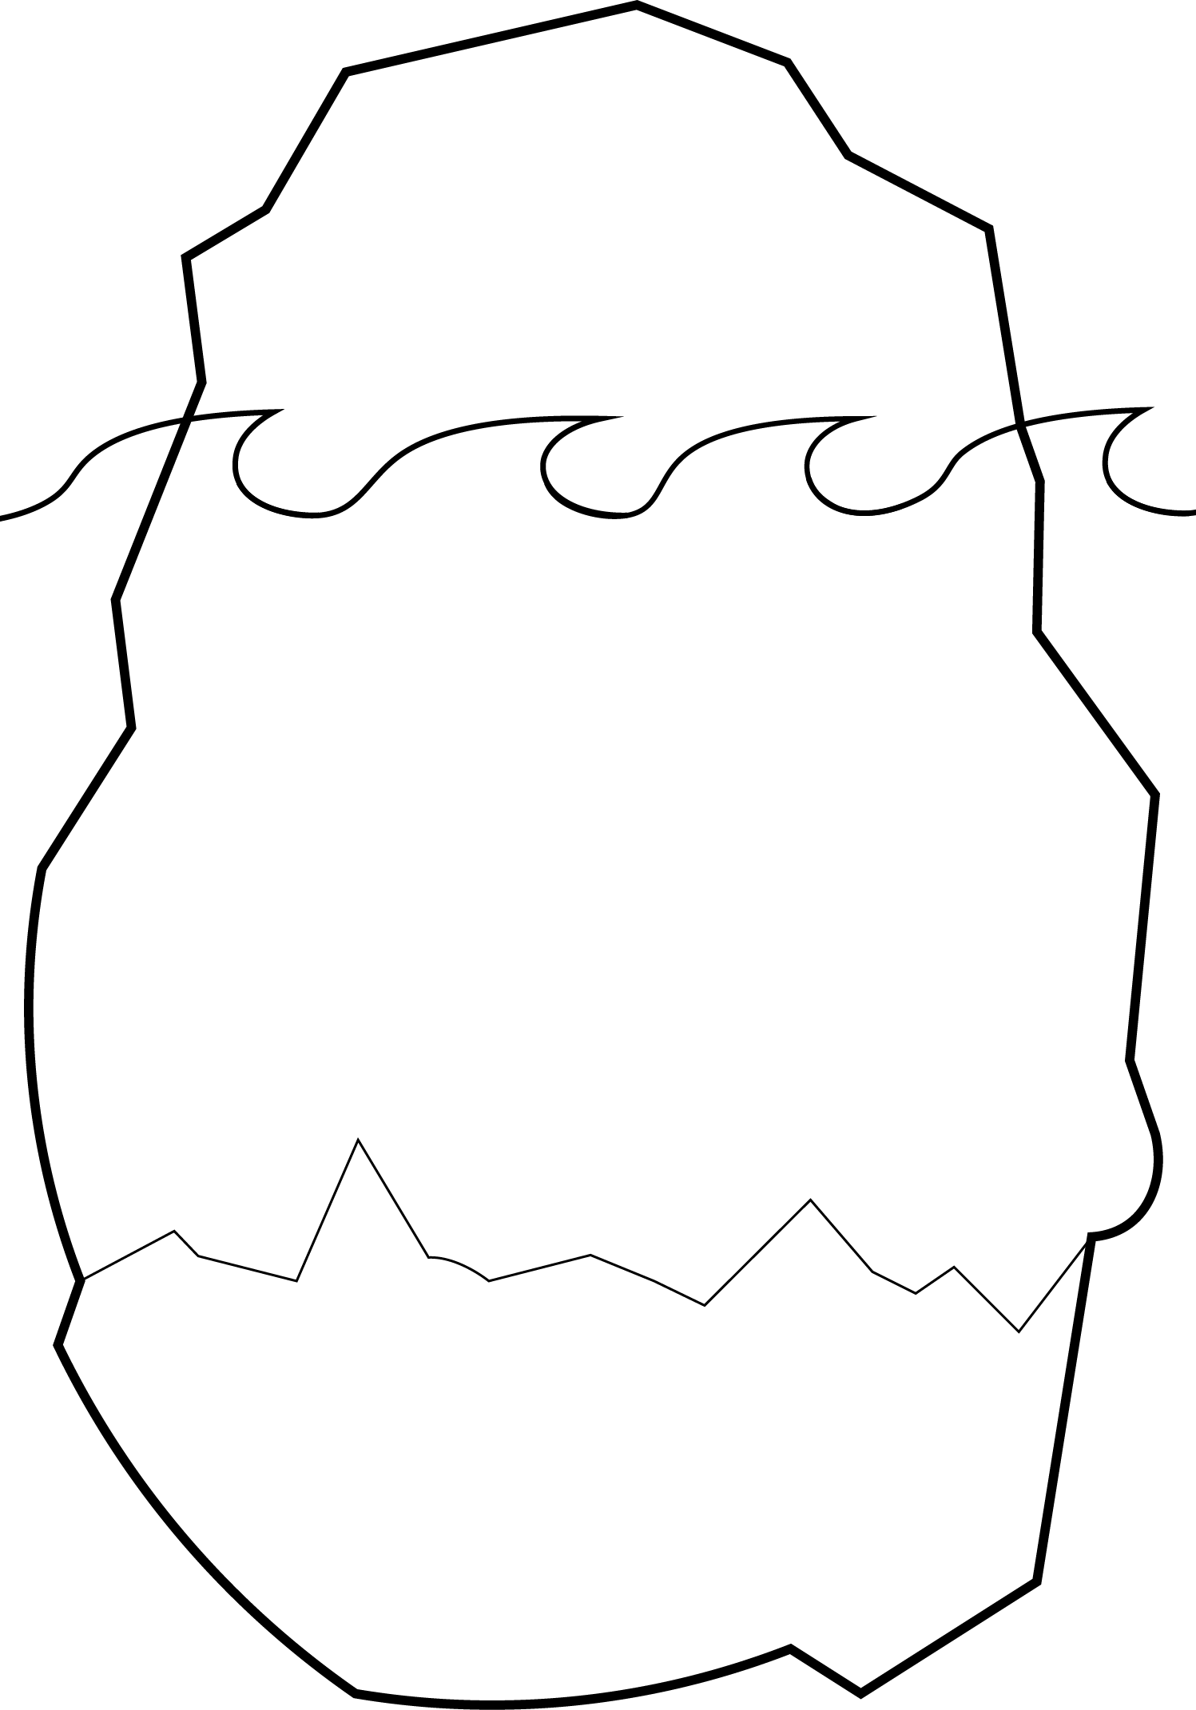
Organizational Cultures
Artifacts
“…cultures are learned patterns of beliefs, values, assumptions, and behavioral norms that manifest themselves at different levels of observability.”
Values
– Edgar Schein’s
Organizational Culture and Leadership
Assumptions
Notes:
Schein, E. H. (2016). Organizational Culture and Leadership (5th ed., Ser. The Jossey-Bass Business and Management Series). John Wiley & Sons.

Slide 9
College-Going & Career-Focused Culture
As educators, we each have our own sphere of influence and contribute to the levels of culture that Schein describes with:
Artifacts
Visual Cues
Values
Making Connections
Assumptions
High Expectations

Slide 10
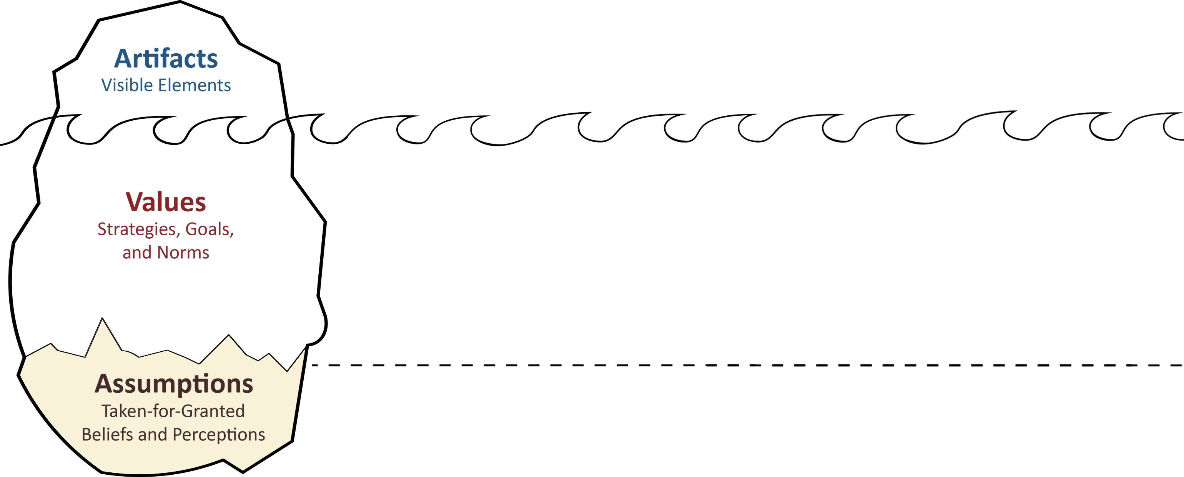
This Is How We Do It
Benefits of Postsecondary Education
Ownership for Planning for Your Future

Slide 11
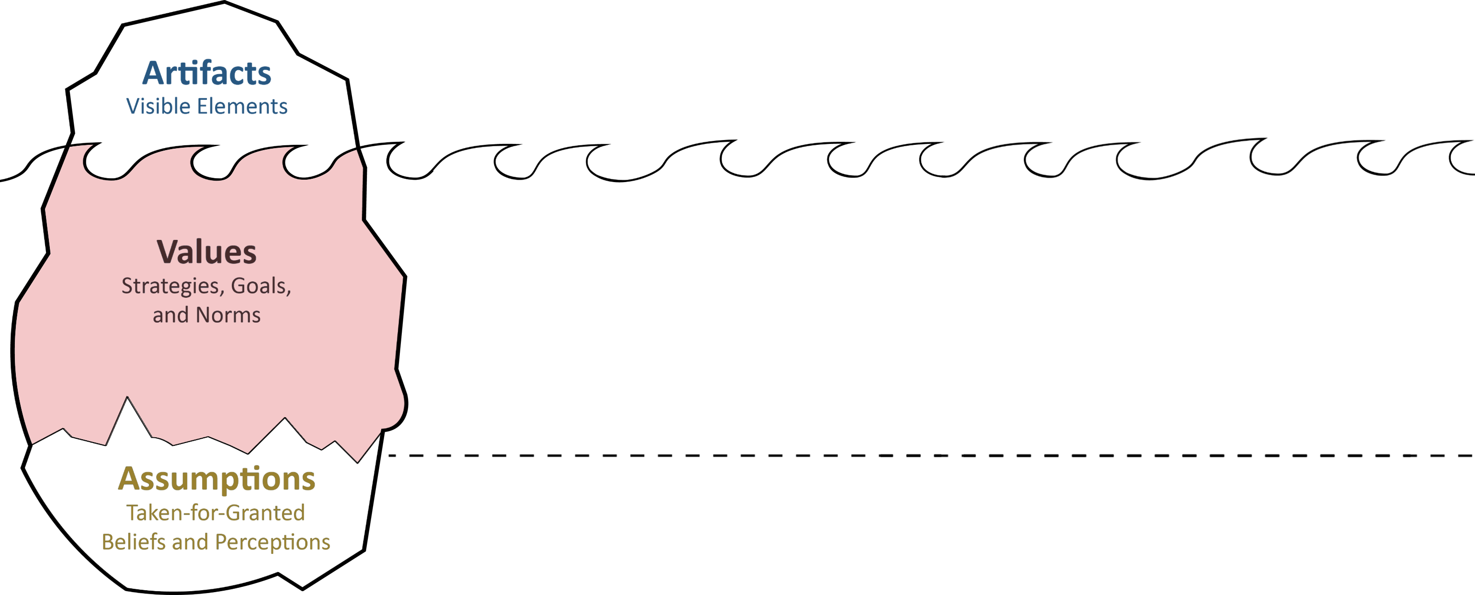
This Is How We Do It
Student Tours of Postsecondary Institutions
Student Activities Aligning to College and Career Preparation Standards
Benefits of Postsecondary Education
Ownership for Planning for Your Future

Slide 12
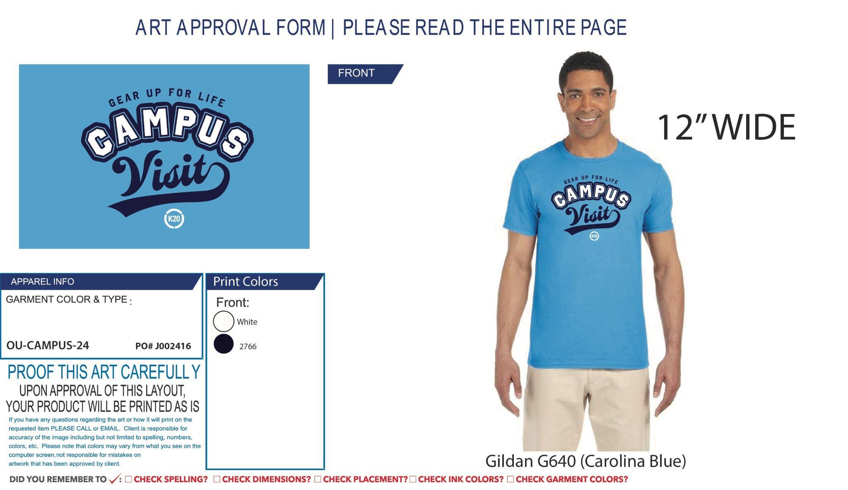
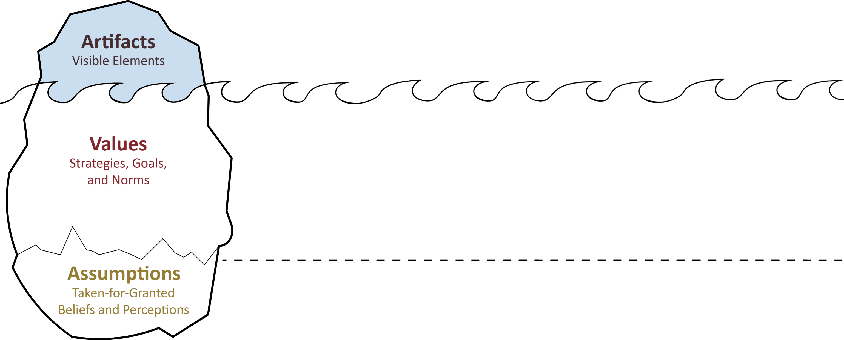

This Is How We Do It
Campus Visit T-Shirts
College and Career Stickers/Badges
Student Tours of Postsecondary Institutions
Student Activities Aligning to College and Career Preparation Standards
Benefits of Postsecondary Education
Ownership for Planning for Your Future

Slide 13
College-Going and Career-Focused Culture
Visual Cues
  What We See
Making Connections
  What We Say and Do
High Expectations
  What We Believe

Slide 14
Card Re-Sort
Based on Schein’s Theory and the GEAR UP model re-sort the statements.

Slide 15
What We Believe
All students are encouraged to challenge themselves academically and take rigorous coursework.
Teachers believe that all students can succeed in
higher-level academic classes when the appropriate strategies and support structures are put in place.
Your school sponsors or provides professional development on the topics of college and career readiness and success.
Educators, administrators, and staff members encourage, counsel, and emphasize the importance of pursuing education and training beyond high school to all students.

Slide 16

What We Say and Do
College- and career-readiness activities are integrated into regular coursework.
Family college planning events occur at least
twice per year, outside of regular school hours.
Students visit career technical centers, community colleges,
and/or universities for
educational field trips.
Lessons include real-life connections
to career pathways and postsecondary options.

Slide 17
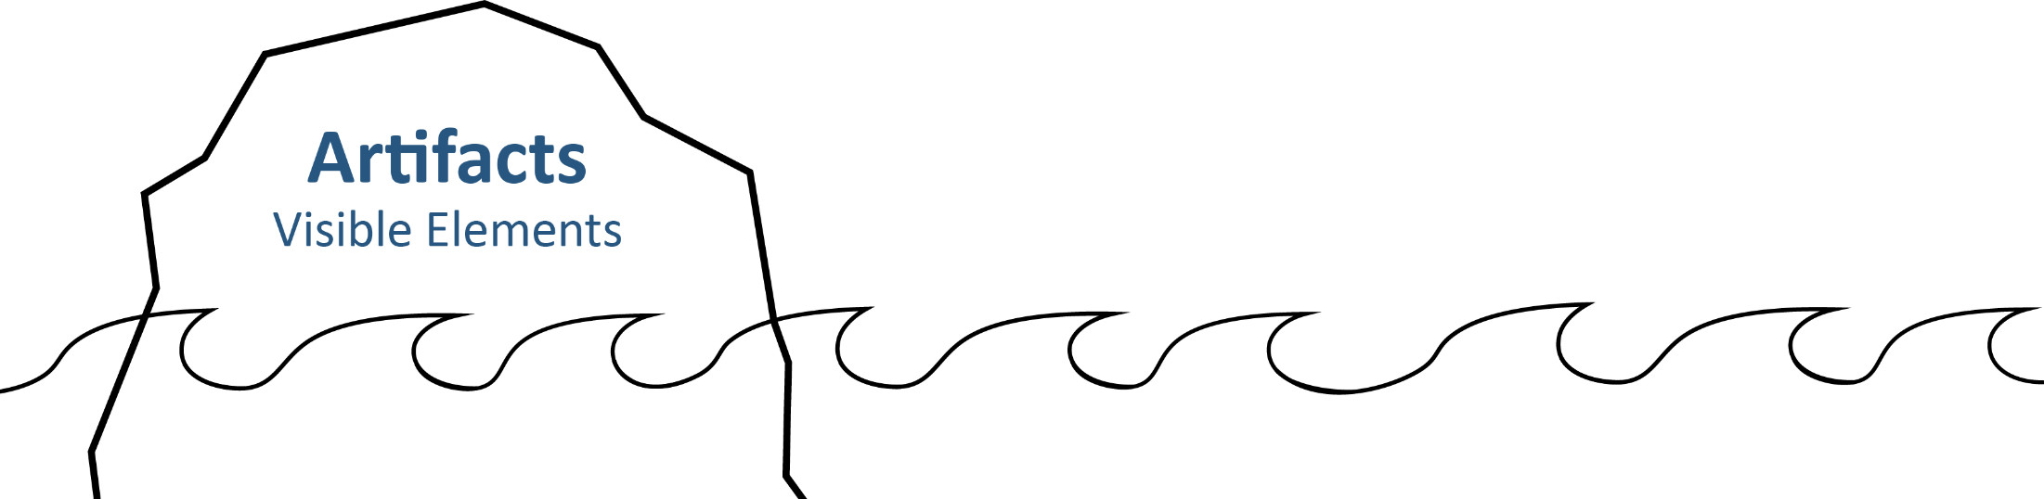
What We See
College pennants, banners, and posters are visible in most classrooms, halls, and common areas.
Information about career pathways is visible and part of everyday discussions.
Teachers include visual cues to encourage discussions about their college experience with their students.
College and career success stories are prevalent
throughout the school.

Slide 18
Assessment Rubric
Now that we have shown you how we create a
college-going and career-focused culture, use the Assessment Rubric to rate your school and its culture.
Let’s look at your iceberg—your sphere of influence!

Slide 19
Assessment Rubric
Write a score for each statement.
3: We are already doing this.
2: We could do this easily or with a little effort.
1: This would require a major change or a lot of time.

Slide 20
Assessment Rubric: Section Total Scores
Find the total score for each section.
  Visual Cues: What You See
  Making Connections: What You Say and Do
  High Expectations: What You Believe
Use the information on your handout to reflect on your total scores for each section.

Slide 21
Assessment Rubric: Overall Total Score
Add the total scores from all three sections together to get your overall total score.
  23–28 = Beginner
  39–53 = Intermediate
  54–69 = Advanced

Slide 22
Assessment Rubric: Summary
Consider:
In what areas are you doing well?
Which areas need the most improvement?

Slide 23
College and Career Culture Tool Kit
Now that you have measured your school’s college-going and career-focused culture, we have some resource that may help you strengthen any areas of weakness.
There are three sections to address the three areas of the iceberg.

Slide 24

College and Career Culture Tool Kit
Use your Assessment Rubric results to focus your attention to the section to address your area(s) of need.
  Visual Cues: <insert URL>
  Making Connections: <insert URL>
  High Expectations: <insert URL>

Slide 25
College and Career Culture Tool Kit
To conclude, jot down at least
one tangible strategy that you can
take from the tool kit to make improvements in your school.

