Slide 2

Snap, Clap, Pop
If… Stand up and…
You’ve attended a K20 event or PD before… Give a wave!
You think quality PD should model strategies… Say, “Here, Here!”
You teach social studies or ELA… Pose as if you’re writing an essay/story.
You teach science or math… Pose as if you’re pondering a problem.
You teach another subject… Act out your subject.
You are a first-generation college student… Raise a number 1!
You have participated in GEAR UP before… Shout out your role!
Middle school is your jam… Say a phrase you hear everyday.
Notes:
K20 Center. (n.d.). Snap, clap, pop. Strategies. https://learn.k20center.ou.edu/strategy/190

Slide 3
Objectives
      Identify characteristics and generate questions about K20 and its research-based professional development approaches.
      Identify characteristics and generate questions about goals, benefits, and expectations of participation in the GEAR UP the METRO grant.
      Connect the benefits and potential impact of college to the real-life experiences of a student you know.
      Examine upcoming grant events and register for those that align with supporting GEAR UP goals.

Slide 4
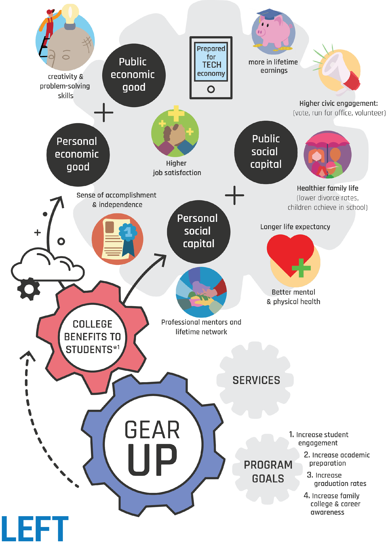
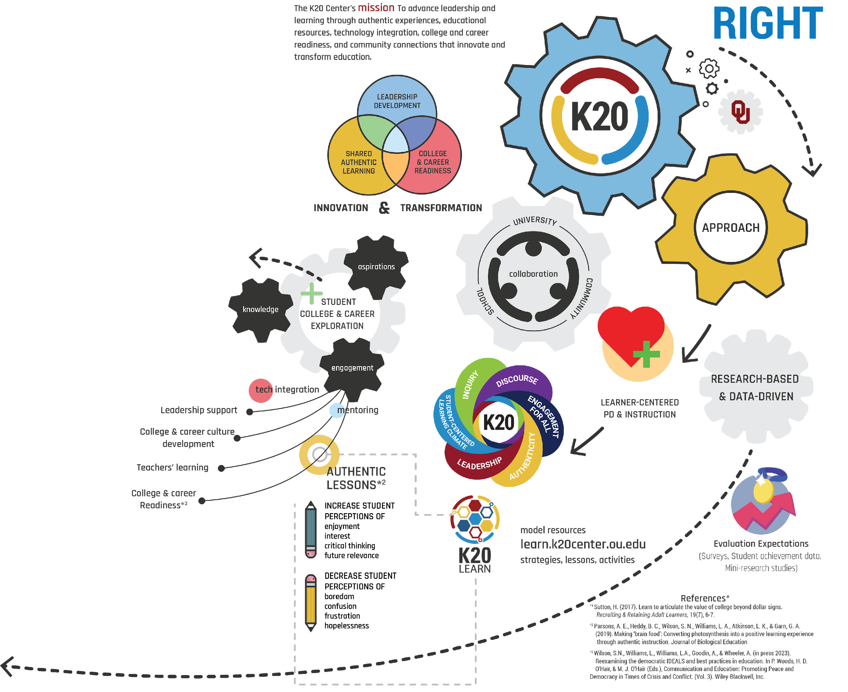
Notes:
K20 Center. (n.d.). I notice, I wonder. Strategies. https://learn.k20center.ou.edu/strategy/180

Slide 5

I Notice, I Wonder – Left Side, Right Side
      Individually (on your assigned side) create at least one I notice statement, and one I wonder statement.
Notes:
K20 Center. (n.d.). I notice, I wonder. Strategies. https://learn.k20center.ou.edu/strategy/180

Slide 6
Notes:
K20 Center. (n.d.). I notice, I wonder. Strategies. https://learn.k20center.ou.edu/strategy/180

Slide 7
I Notice, I Wonder – Group
      As a group:
      Choose or synthesize ONE I notice and ONE I wonder statement.
      Write each statement on a different colored sticky note.
        I Notice – Yellow
        I Wonder – Blue
      Place each sticky note on the corresponding section of the larger poster.
Notes:
K20 Center. (n.d.). I notice, I wonder. Strategies. https://learn.k20center.ou.edu/strategy/180

Slide 8
What did you notice and wonder about…
The K20 Center and research-based approaches?

Slide 9
K20 Center & Research-Based
Approaches
      Statewide education research and development center
      Professional development opportunities to educators across the state
      Free resources to educators (lessons, strategies, etc.) on our website

Slide 10
What did you notice and wonder about…
College benefits to students?

Slide 11

College Benefits to Students

Slide 12
Top Ten Benefits of Post Secondary Education
Research Says…
      Earn $1M more over your lifetime.
      Be happier in your job.
      Connect with peers and mentors.
      Make a difference in your community (volunteer, vote, run for office).
      Develop your creativity and problem-solving skills.
      Feel a sense of accomplishment.
      Grow your career independence.
      Prepare for success in a technology-driven world.
      Live longer and healthier.
      Have a more satisfying family life.

Slide 13
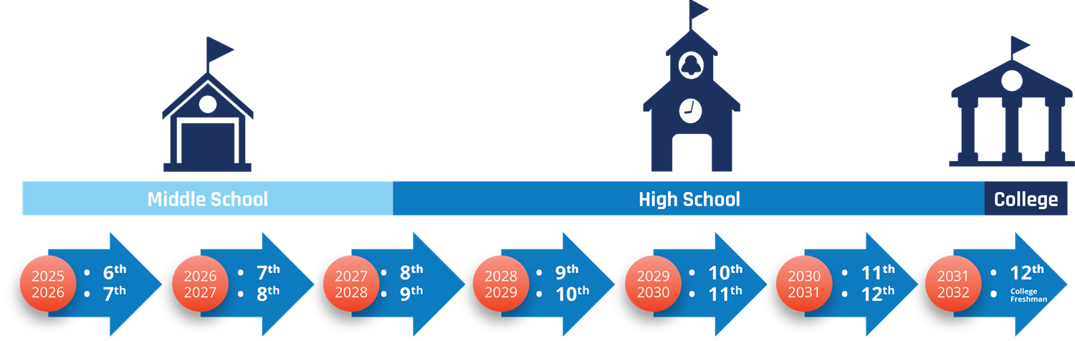
What is GEAR UP?
Gaining Early Awareness & Readiness for Undergraduate Programs
The GEAR UP Cohort Model

Slide 14
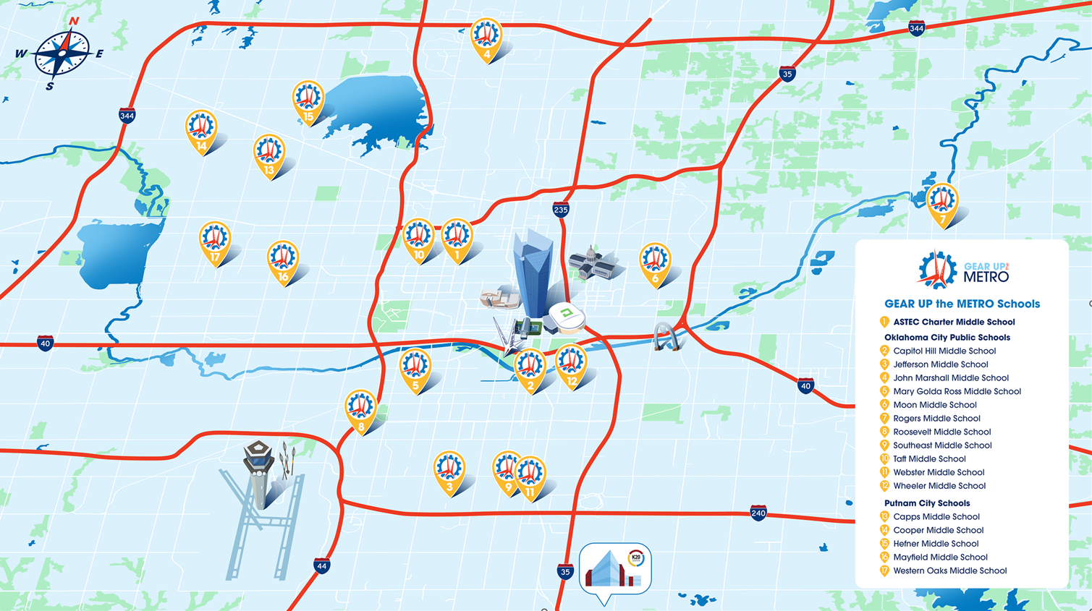

Slide 15
What does GEAR UP the METRO mean for our schools?

Slide 16
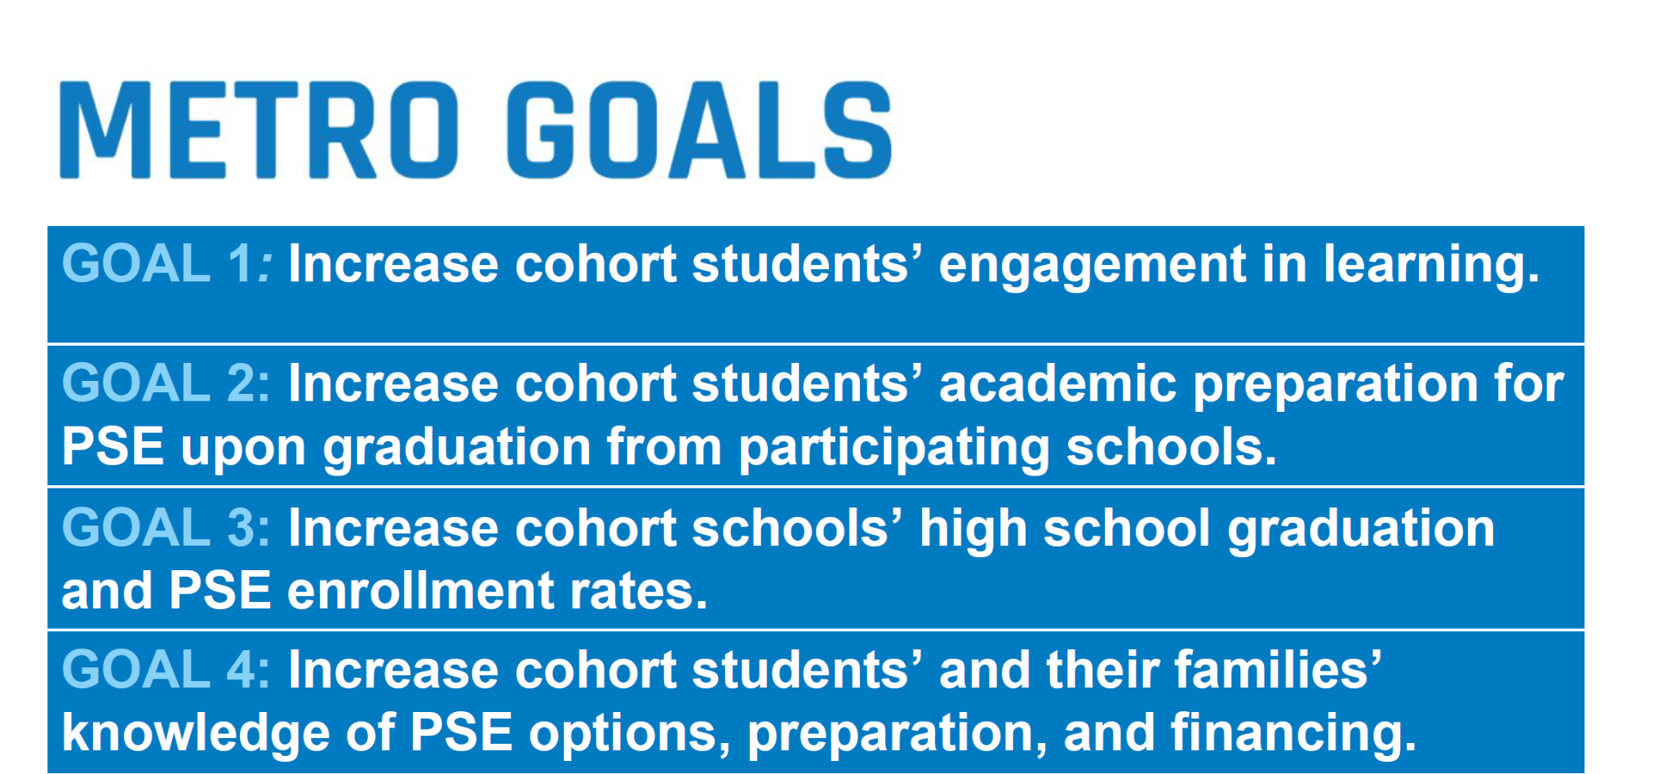

Slide 17
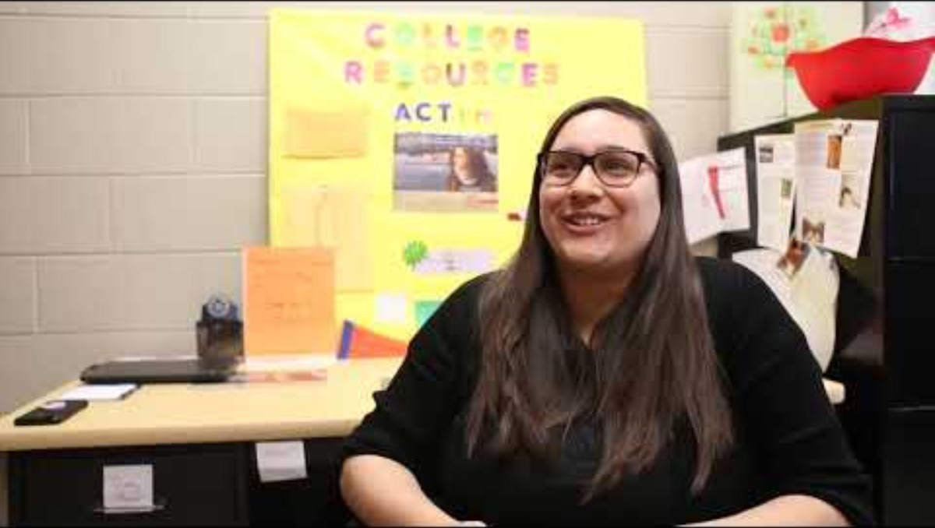
GEAR UP Overview
Play Video
Notes:
K20 Center. (2023, November 8). GEAR UP Overview. YouTube. https://www.youtube.com/watch?v=MaDO99ncRrk

Slide 18
Micro-credentialing
      Online Professional Development
      Earn a badge and a stipend per course
      90-minutes of self-paced learning
      Swivl a lesson to demonstrate learning
      Three tracks that offer a variety of courses
        Teaching and Instruction to Maximize
        Engagement (T.I.M.E.)
        Build-A-Badge
        Beyond Basics
Add Your QR Code Here
Add your shortened URL

Slide 19
ADEPT Live
(Authenticity and Discourse for Engagement using Pedagogy and Technology)
      Two teacher leaders from each school will be selected
      Work quarterly with an instructional coach
      Attend an in-person summer institute
      Mark your calendar for July 8th - 10th!
Add Your QR Code Here
Add your shortened URL

Slide 20

Coming Soon! In-class Mentoring Opportunities
      Career Cafe
      Zoom Into Your Career
      Career Fair support

Slide 21
GEAR UP the METRO Services
Students | Teachers and Staff | Families
College Campus Visits every year | Authentic Teaching and Learning Support K20 LEARN Website | Family Nights
Career Forums and Expos | Micro-Credentialing/ Learning badges (Spring 2026 6th grade only) | Family Leadership Academy
Individual Student Mentoring | Professional and Leadership Development | Financial Aid resources
Site based action plans

Slide 22
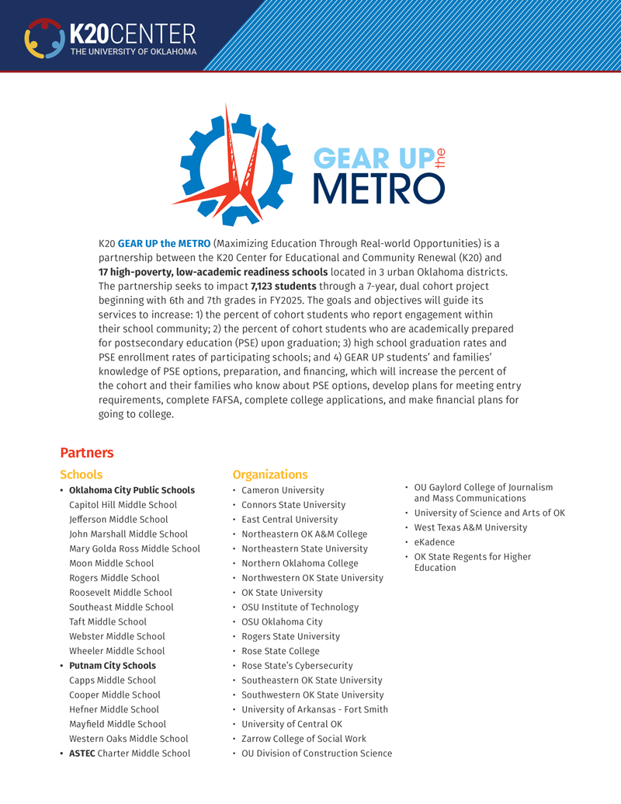
3-2-1
      Record 3 student benefits of postsecondary education.
      Identify 2 benefits the METRO grant provides your school.
      Think of 1 student or group of students you envision this grant affecting
        (write a pseudonym or description).

Slide 23

Cognitive Comic
      Draw a one-frame comic representing the student, or group of students, who will benefit from the GEAR UP the METRO grant.

Slide 24

Interested?
Add Your QR Code Here
      Sign up to receive more information:
Add your shortened URL

Slide 25



LEARN Strategies
      Fill in the Instructional Strategy Note Sheet in the back of your booklet.
      Snap, Clap, Pop
      I Notice, I Wonder
      3-2-1
      Cognitive Comics

Slide 26


1
Go to
2
Add QR Code
Sign in
School email
( No Participation ID is required.)
School Name
Tell us how we did!
Join us in research
3
4

Slide 27

Questions & Answers

Slide 28





Follow us on social media!
Facebook.com/
K20Center
YouTube.com/
K20Center
Instagram.com/
K20Center
LinkedIn.com/
Showcase/
K20-Center

