Slide 2
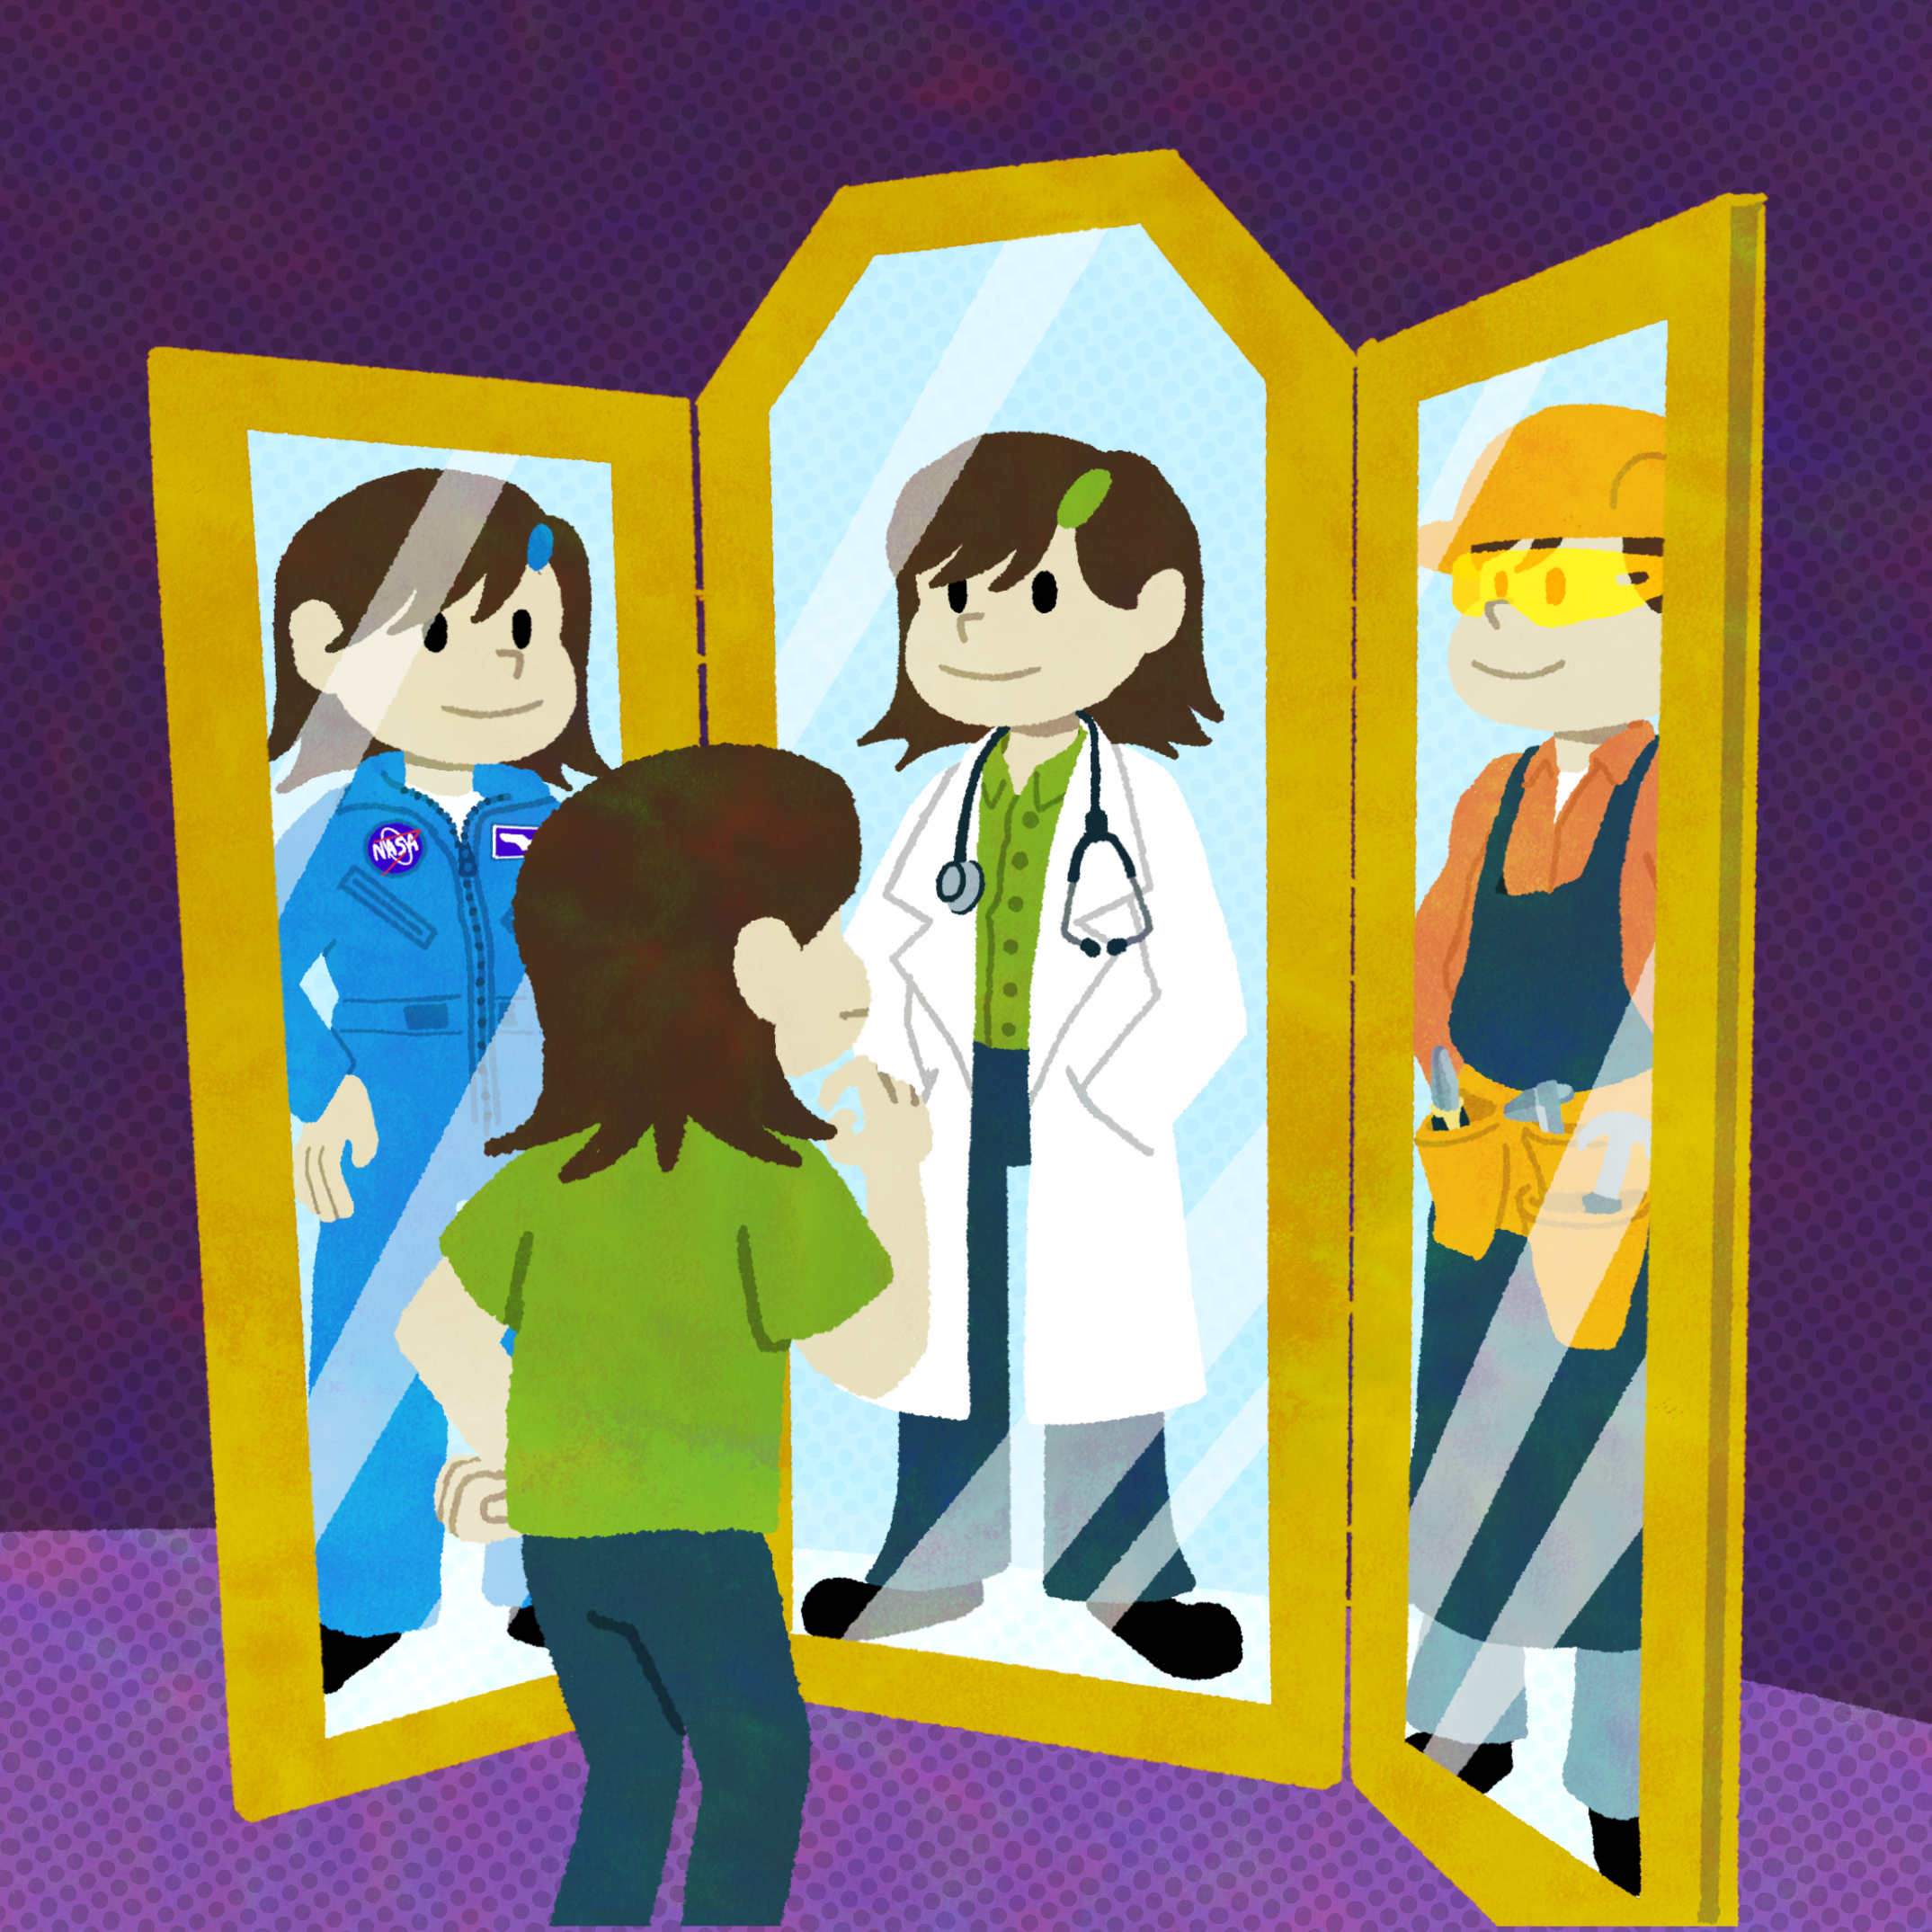
Unlocking STEM Futures
First-Generation College Students

Slide 3
What Comes to Mind?
When you hear
“first-generation,”
what comes to mind?

Slide 4
What Comes to Mind?
“First-generation” can have different meanings.
For this session:
  A college student would be considered a “first-generation” student if neither of their parents nor guardians have attended college.

Slide 5
What Comes to Mind?
When you hear “STEM,”
what comes to mind?

Slide 6
What Comes to Mind?
Students wanting to go into a “STEM” field focus on a degree plan related to science, technology, engineering, or mathematics.
  Examples: Biology, Computer Science,
  Civil Engineering, Statistics

Slide 7
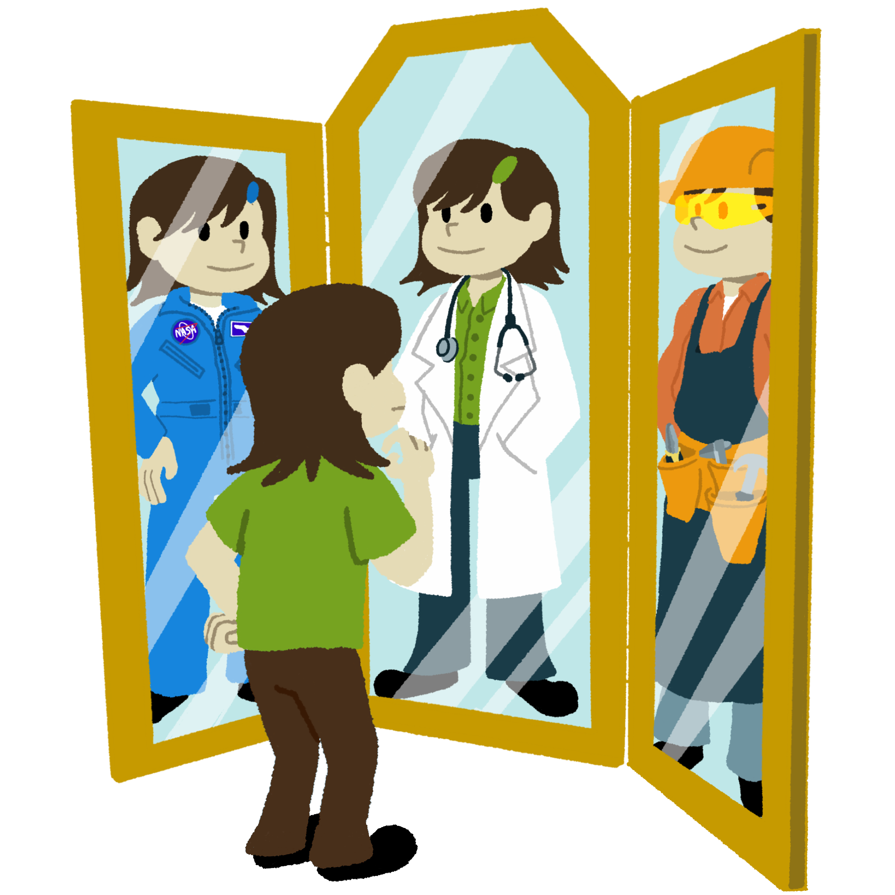
Essential Question
How do we get students interested
in STEM degree plans?

Slide 8
Learning Objective
Identify different types of interventions to support first-generation students’ interests in STEM degree plans.

Slide 9

Magnetic Statements
Read the statements around the room.
Move to the statement that most repels you.
Notes:
K20 Center. (n.d.). Magnetic statements. Strategies. https://learn.k20center.ou.edu/strategy/166

Slide 10

Magnetic Statements
In your group, discuss the following:
Why did you choose
this statement?
What is one way it can be reversed, solved, or fixed?
What is something we can do?
5-Minute Timer
Notes:
K20 Center. (n.d.). Magnetic statements. Strategies. https://learn.k20center.ou.edu/strategy/166
K20 Center. (2021, September 21). K20 Center 5-minute timer. [Video]. YouTube. https://www.youtube.com/watch?v=EVS_yYQoLJg

Slide 11
Making a Difference
Representation
  When students see real examples of people with similar backgrounds succeed in STEM careers
Exposure
  When students have hands-on STEM learning such as mentoring, internships, and enrichment programs
Coursework
  When students complete rigorous STEM classes that help bridge the gap between high school and PSE

Slide 12

Representation
When students completed assignments featuring a variety of scientists, first-generation students increased
their ability to relate, which provided
a stronger sense of belonging.
— Metzger et al., 2023
Notes:
Metzger, K. J., Dingel, M., & Brown, E. (2023). “No matter what your story is, there is a place for you in science”: Students’ Ability to Relate to Scientists Positively Shifts after Scientist Spotlight Assignments, Especially for First-Generation Students and Women. CBE Life Sciences Education, 22(1), ar12. https://doi.org/10.1187/cbe.22-06-0103

Slide 13
Exposure
Students with experiences in STEM during secondary school impact college STEM success.
— Bettencourt et al., 2020
Notes:
Bettencourt, G. M., Manly, C. A., Kimball, E., & Wells, R. S. (2020). STEM degree completion and first-generation college students: A cumulative disadvantage approach to the outcomes gap. The Review of Higher Education, 43(3), 753–779. https://doi.org/10.1353/rhe.2020.0006

Slide 14
Coursework
High school students who completed courses that were similar to the rigor of college-level courses were better prepared for STEM coursework. This preparation helped students finish challenging coursework despite obstacles.
– Carver et al., 2017
Notes:
Carver, S. D., Van Sickle, J., Holcomb, J. P., Jackson, D. K., Resnick, A., Duffy S. F., Sridhar, N., Marquard, A., Quinn, C. (2017). Operation STEM: Increasing success and improving retention among mathematically underprepared students in STEM. Journal of STEM Education, 18(3), 20–29. https://www.jstem.org/jstem/index.php/JSTEM/article/view/2182/1891

Slide 15
Making a Difference
Representation
  Spotlight STEM Success
  First-generation educators you know or in your community
Exposure
  STEM Challenge Curriculum & College2Career Forum
Coursework
  Advanced Placement and Concurrent courses
  Power Up ACT Prep Curriculum

Slide 16

Chalk Talk
Think of things you could do related
to representation, exposure,
and coursework in STEM.
Silently visit the 3 posters.
Record your ideas on the poster.
Respond to what your peers wrote.
  Write words or draw arrows, circles, pictures,
  lines connecting ideas, etc.

Slide 17

Reflection
What?
What stood out to you regarding what you learned today?
So What?
Why do you think first-generation college students need tailored supports?
Now What?
In what ways can you support first-generation college students interested in STEM degrees?
Notes:
K20 Center. (n.d.). What? So what? Now what? Strategies. https://learn.k20center.ou.edu/strategy/95

