Slide 2

Empowering Students
Pre-Campus and Campus Visit Activities

Slide 3
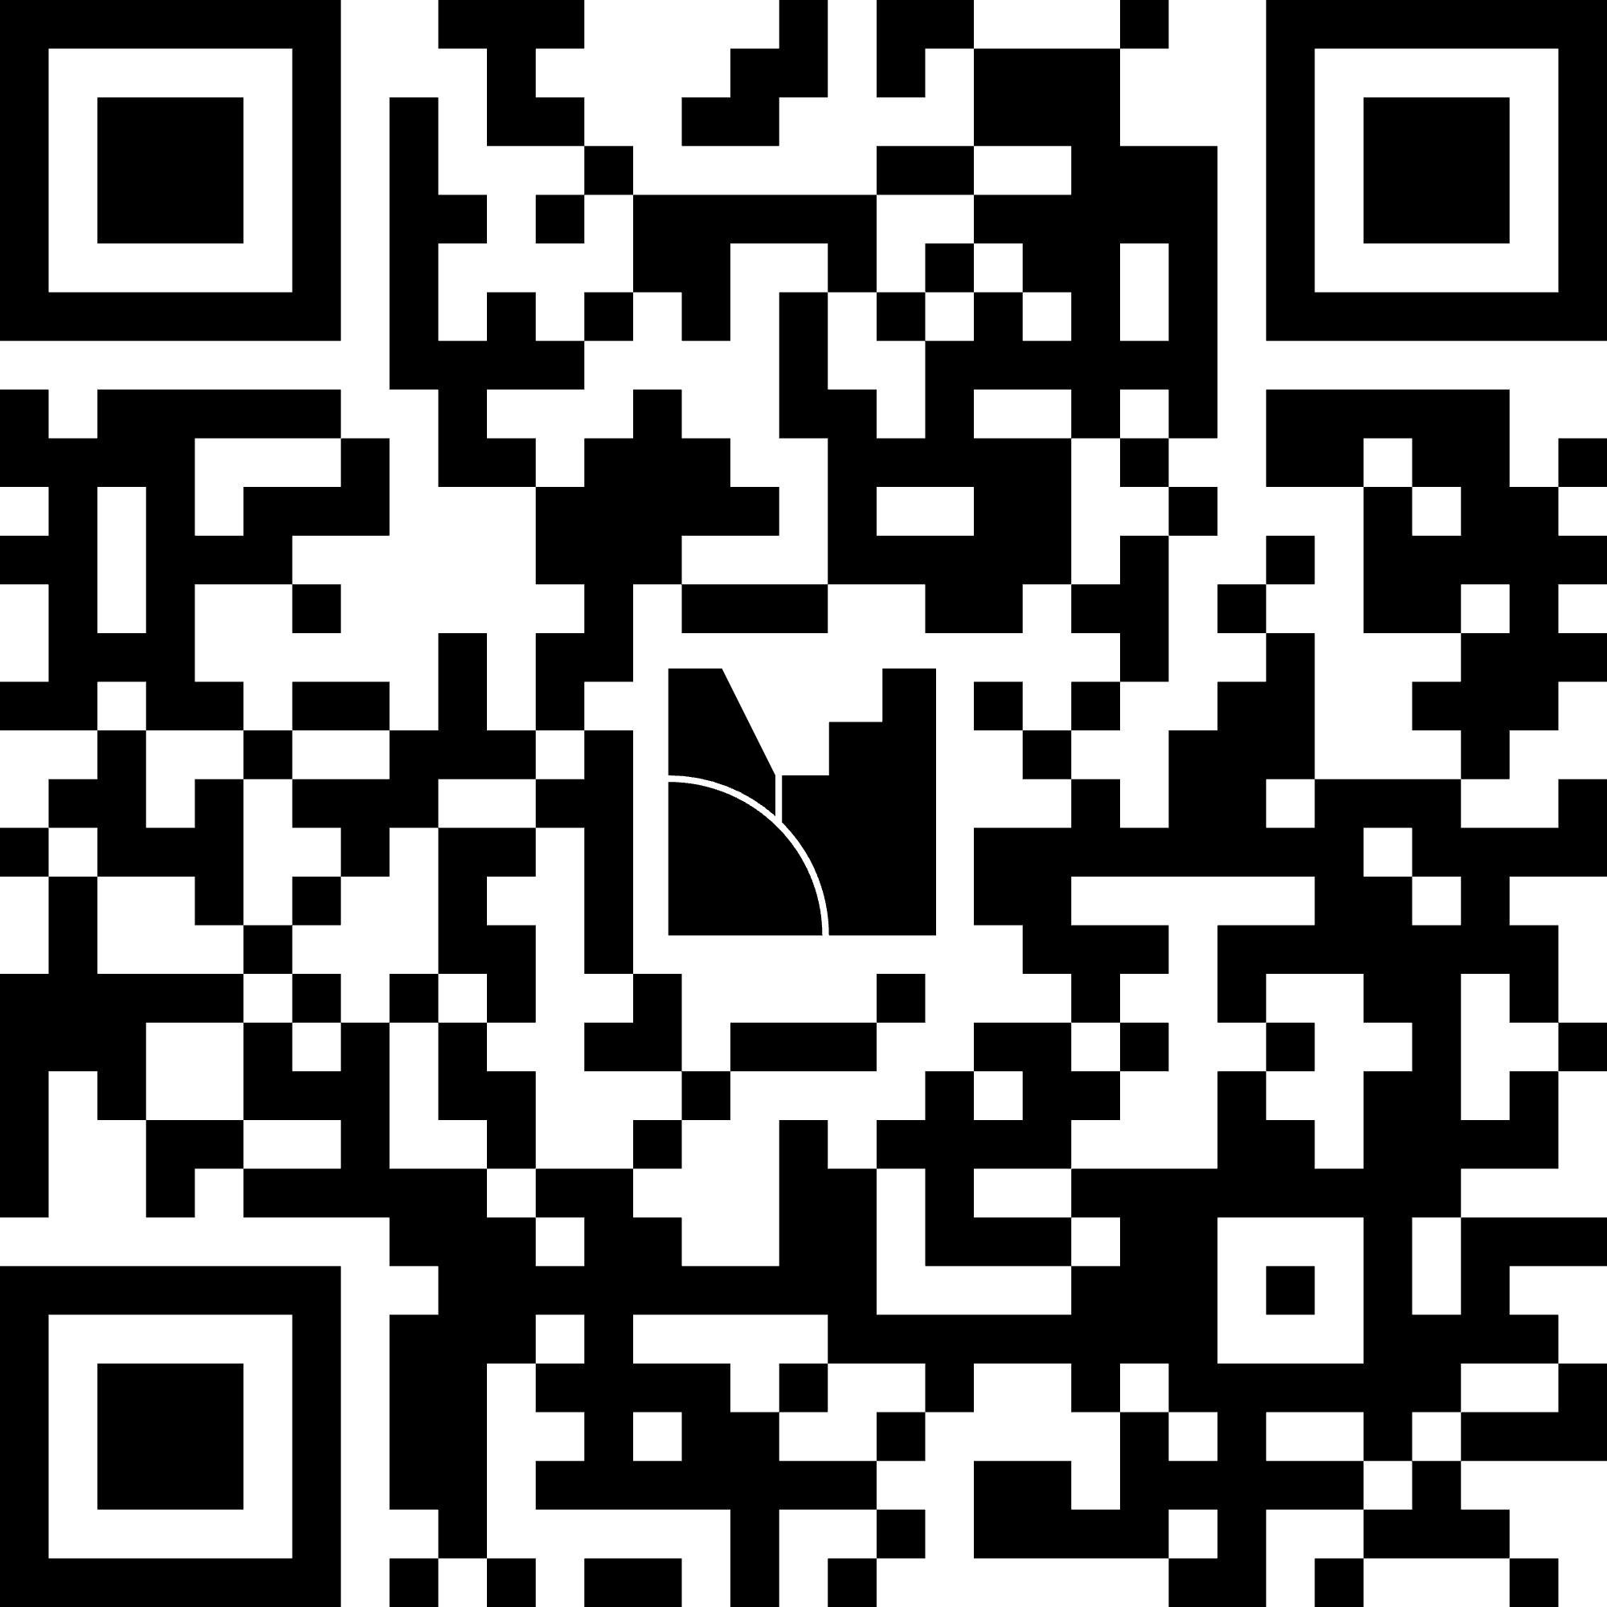
Menti
Navigate to: [add link here]
Read each question carefully.
Respond based on your assessment of how well your school prepares students for postsecondary pathways.
Notes:
K20 Center. (n.d.). Mentimeter. Tech Tools. https://learn.k20center.ou.edu/tech-tool/645

Slide 4
Essential Questions
What knowledge, skills, and experiences best prepare students for success in college and careers?
How can Educators use student pre-campus and campus visit activities to engage students in intentional postsecondary planning?

Slide 5
Learning Objectives
Understand the CCP standards and their role in college and career readiness.
Explore the structure and purpose of pre- and post-campus visit activities for high school students.
Plan how to implement activities aligned with the CCP standards to engage in postsecondary planning.

Slide 6

Exclaim and Question
Read the snapshot of the CCP Standards with others at your table.
On your handout, write things you find interesting and things you have questions about.
Notes:
K20 Center. (n.d.). Exclaim and question. Strategies. https://learn.k20center.ou.edu/strategy/94

Slide 7

Jigsaw
Read your assigned lesson with the group at your table.
Determine the purpose of the lesson, the skills or concepts present, and the activity.
Match the lesson to one of the CCP Standards.
Notes:
K20 Center. (n.d.). Jigsaw. Strategies. https://learn.k20center.ou.edu/strategy/179

Slide 8
Jigsaw
Share your lesson with the whole group.
How do the lessons connect to each other?
How do the lessons support students’ postsecondary readiness skills?
Notes:
K20 Center. (n.d.). Jigsaw. Strategies. https://learn.k20center.ou.edu/strategy/179

Slide 9

Roots and Routes
Navigate to the link: k20.ou.edu/hh
Read the remaining CCP Student Standards with others at your table.
Identify standards that would be beneficial to your school.
Notes:
K20 Center. (n.d.). Roots and routes. Strategies. https://learn.k20center.ou.edu/strategy/3743

Slide 10

ACTIVITY
ROUTES →
ROOTS →
CCP Standard

Slide 11
Roots and Routes
Roots: Write down two standards or skills that you want to implement in your school.
Routes: With others at your table, brainstorm action steps to implement the standards in your school.
Notes:
K20 Center. (n.d.). Roots and Routes. Strategies. https://learn.k20center.ou.edu/strategy/3743

Slide 12
Reflection
How can the CCP Student Standards help support students’ postsecondary readiness?
Notes:
K20 Center. (n.d.). Roots and routes. Strategies. https://learn.k20center.ou.edu/strategy/3743

