Slide 1
K20 LEARN Icon

Slide 2

Participants to Partners
Strengthening Family Leadership to Support Postsecondary Pathways

Slide 3

Collective Word Cloud
Join the Mentimeter:
  Go to menti.com.
  Enter the code: [code]
  Share one word that describes what family leadership currently look like at your school.
Notes:
K20 Center. (n.d.). Collective word cloud. Strategies. https://learn.k20center.ou.edu/strategy/103

Slide 4
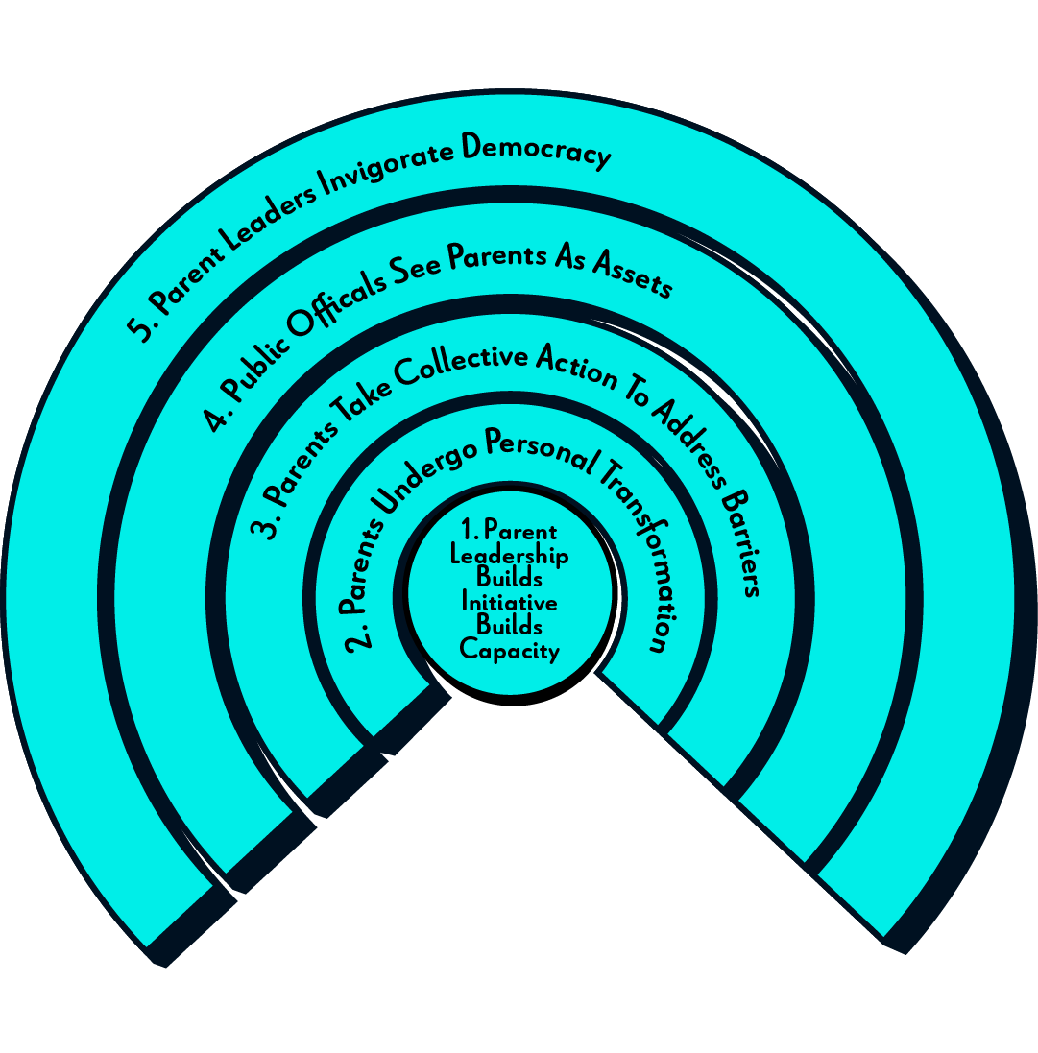
The Ripple Effect

Slide 5
Learning Objectives
Reflect on current FLA strengths and challenges
Identify promising practices for family recruitment
Collaborate to design a targeted recruitment plan
Commit to concrete next steps for building a sustainable FLA team

Slide 6
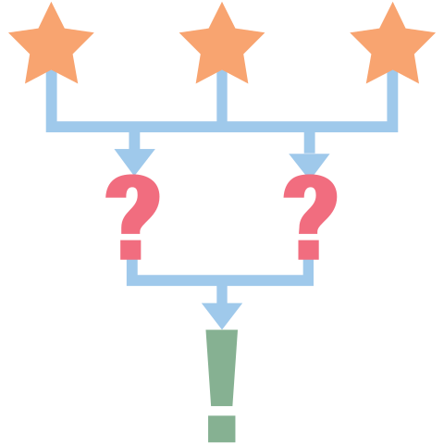
Affinity Process, Part 1
Write down reasons that families volunteer less when their student in high school than younger grades.
  Use a separate sticky note for each idea.
Notes:
K20 Center. (n.d.). Affinity process. Strategies. https://learn.k20center.ou.edu/strategy/87

Slide 7

Affinity Process, Part 2
With your partners, review all of your responses.
Group similar items together.
  These can be exact matches or ideas you feel are similar enough to go together.
If needed, use sticky notes to create category labels.
Notes:
K20 Center. (n.d.). Affinity process. Strategies. https://learn.k20center.ou.edu/strategy/87

Slide 8
Affinity Process, Part 3
With your large group, review all of your responses.
Group similar items together.
  These can be exact matches or ideas you feel are similar enough to go together.
If needed, use sticky notes to create category labels.
Notes:
K20 Center. (n.d.). Affinity process. Strategies. https://learn.k20center.ou.edu/strategy/87

Slide 9
Affinity Process, Part 4
As a group, choose one of your identified barriers or categories of barriers.
Brainstorm ideas for how to address this barrier or category of barriers to improve family engagement and volunteerism when their student is in high school.
Notes:
K20 Center. (n.d.). Affinity process. Strategies. https://learn.k20center.ou.edu/strategy/87

Slide 10
What Does the Research Say?
Reasons families volunteer less when their student is in high school:
  Intimidation with secondary campuses
  Belief that they lack expertise
  Lack of relational connection to staff
  Scheduling barriers
  Not knowing leadership opportunities exist

Slide 11
Family Leadership Indicators
Read the research brief about family leadership indicators.
As you read, star any ideas that resonate with you.
When you get to the “Three Big Ideas About Family Leadership” section, respond to the prompts with ideas you could try at your school site.

Slide 12
Three Big Ideas About Family Leadership
Families join when initiatives are designed to support broad participation.
Families stay when they feel valued and made to be a part of decision-making.
Families flourish when initiatives create community.

Slide 13
The Three-Tier Recruitment Model
Tier 1: Awareness
  Attend events, receive information.
Tier 2: Engaged
  Attend multiple events, help occasionally.
Tier 3: Leadership
  Co-design events, recruit others, serve as connectors.

Slide 14
Developing an FLA Recruitment Plan
Take 10 minutes to get started today.
Take what you start back to your school and continue working on it as your next semester school plans develop.

Slide 15

Triangle-Square-Circle
Triangle: Three main takeaways.
  One should be an action you will take.
Square: Up to four things that “square” with your thinking.
Circle: Ideas that are still “circling” your head. These can be ideas for your site or concerns you may have.
Notes:
K20 Center. (n.d.). Triangle-square-circle. Strategies. https://learn.k20center.ou.edu/strategy/65

