Slide 2

Developing Hopeful Minds
Strengthening Student Resilience and Well-Being

Slide 3

Self-Reflection
With an elbow partner, discuss a time when you or someone else succeeded despite significant obstacles.
What helped you or them to keep going?
Notes:
K20 Center. (n.d.). Elbow partners. Strategies. https://learn.k20center.ou.edu/strategy/116

Slide 4
Hope Survey

Slide 5
Hope Survey
What surprised you?
What contributed to your own sense of Hope?
How might a low Hope score affect a student?

Slide 6
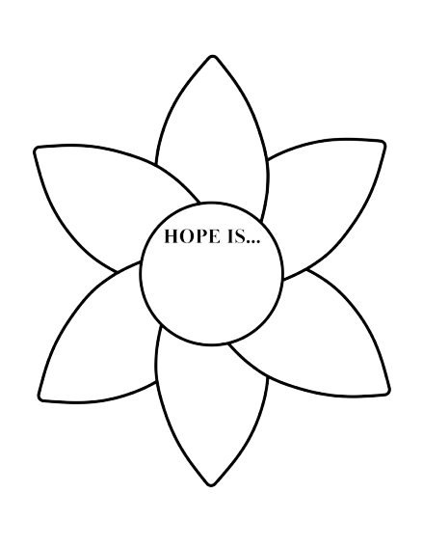
Sunflower Petal
Petal #1
A key component for Hope is…

Slide 7
Essential Question
Why does Hope matter in education?

Slide 8
Learning Objectives
Explore the research behind the science of Hope.
Distinguish between optimism and Hope.
Recognize the three components of Hope (Goals, Pathways, Agency) and how to support these.
Develop practical strategies to build Hope in students.

Slide 9

Card Sort
With your group, sort the cards into which are optimism versus Hope.
Consider how we use the word “Hope” in everyday conversation.
Notes:
K20 Center. (n.d.). Card sort. Strategies. https://learn.k20center.ou.edu/strategy/147

Slide 10
Sunflower Petal
Petal #2
A key difference between optimism and Hope is…

Slide 11
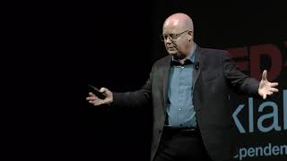
TEDx Talk video
Notes:
TEDx Talks. (2021, June 21). The science and power of hope | Chad Hellman | TEDxOklahomaCity [Video]. YouTube. https://www.youtube.com/watch?v=qt0fRSx5Kl4

Slide 12
Article Summaries
Read your article summary.
As you read, note at least five words, phrases, or ideas from the summary.
Put each word, phrase, or idea on a separate sticky note.

Slide 13

Affinity Process
When your group is done reading and has their sticky notes ready, move to your poster.
Group all of the sticky notes into similar themes.
Create theme titles for each group of sticky notes.
Notes:
K20 Center. (n.d.). Affinity process. Strategies. https://learn.k20center.ou.edu/strategy/87

Slide 14
Sunflower Petal
Petal #3
An important dimension of Hope is…

Slide 15
The Simplicity of Hope
Hope has three components:
  Goals
  Pathways (Waypower)
  Agency (Willpower)

Slide 16




The Simplicity of Hope
Write the Hope component at the top of your poster.
Divide the poster paper into four quadrants.
  Top left: Choose a color.
  Top right: Write a summary.
  Bottom left: Draw an image.
  Bottom right: Leave blank.
Component
Color | Summary
Image
Notes:
K20 Center. (n.d.). Color, symbol, image. Strategies. https://learn.k20center.ou.edu/strategy/161

Slide 17
The Simplicity of Hope
Share your CSI poster with the whole group.
Be prepared to explain why you chose your color, summary, and image for your component.
Notes:
K20 Center. (n.d.). Color, symbol, image. Strategies. https://learn.k20center.ou.edu/strategy/161

Slide 18
Sunflower Petal
Petal #4
The three components of Hope are…

Slide 19
Supporting Our Students
Read the scenario on the card with your group.
Working together, determine the following:
  Goal: What goal could the students work towards?
  Pathway: What strategies or supports could help?
  Agency: How can educators and schools strengthen the students’ belief in their own abilities?
Be prepared to share your scenario and solutions!

Slide 20
Sunflower Petal
Petal #5
Educators build
Hope when they…

Slide 21

Commit and Toss
On your paper answer the following question:
Why does Hope matter in Education?
Notes:
K20 Center. (n.d.). Commit and toss. Strategies. https://learn.k20center.ou.edu/strategy/119

Slide 22
Commit and Toss
Crumple up the paper with your problem on it.
Toss the crumpled paper across the room.
Collect a crumpled paper that is not your own.
Read what is written and share with a partner.
Prepare to share out what you talked about.

Slide 23
Hope Summary
In the bottom right quadrant write your group’s definition of Hope.
Component
Color | Summary
Image | Hope is…
Notes:
K20 Center. (n.d.). Color, symbol, image. Strategies. https://learn.k20center.ou.edu/strategy/161

Slide 24
Sunflower Petal
Petal #6
I build Hope in others by…

Slide 25
Sunflower Petal
Center
Hope is…
-OR-
In this classroom, we build Hope by…

Slide 26
What is Hope?
Hope is the belief that your future will be better than today and you have the power to make it so.
Dr. Chan Hellman

Slide 27

LEARN Strategy Reflection
Elbow Partners
Card Sort
Affinity Process
CSI
Commit and Toss
Notes:
K20 Center. (n.d.). Affinity process. Strategies. https://learn.k20center.ou.edu/strategy/87
K20 Center. (n.d.). Card sort. Strategies. https://learn.k20center.ou.edu/strategy/147
K20 Center. (n.d.). Color, symbol, image. Strategies. https://learn.k20center.ou.edu/strategy/161
K20 Center. (n.d.). Commit and toss. Strategies. https://learn.k20center.ou.edu/strategy/119
K20 Center. (n.d.). Elbow partners. Strategies. https://learn.k20center.ou.edu/strategy/116

