Slide 2
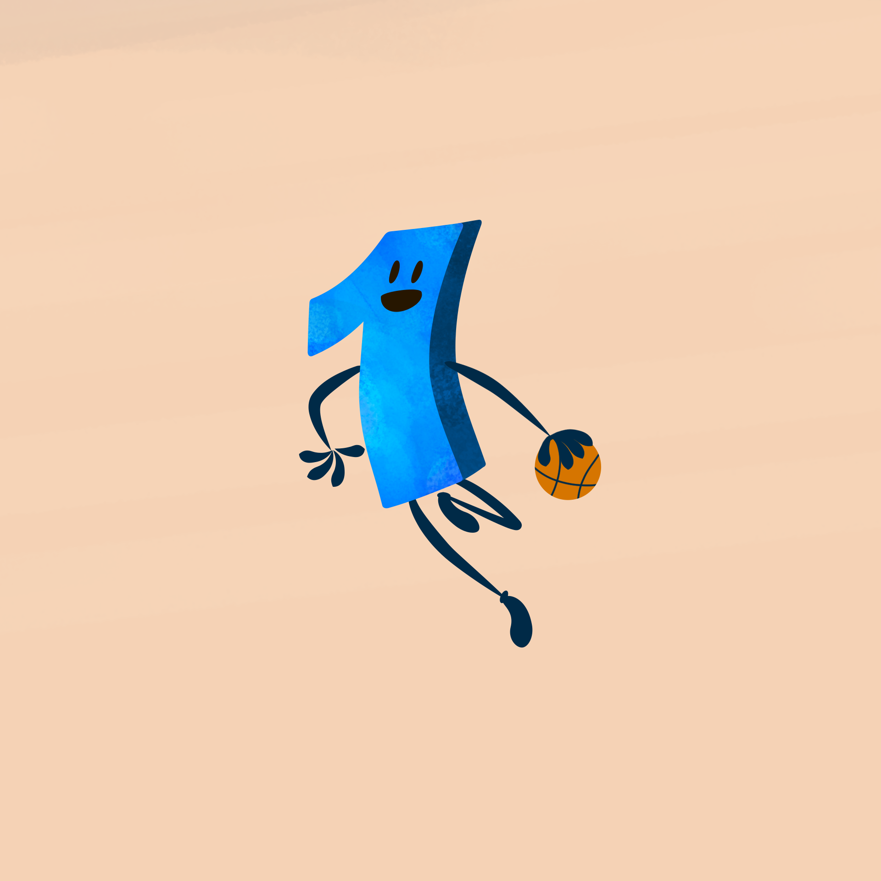
Less is More -
Math Professional Learning
Implementation

Slide 3
Essential Question
How can movement be intentionally incorporated into math lessons to deepen students’ understanding, engagement, and problem-solving skills?

Slide 4
Learning Objectives
Explore K20 LEARN website resources for math physical movement strategies.
Analyze a K20 physical movement strategy.
Synthesize how to adapt movement-based learning for specific domains of math.

Slide 5

Looks Like, Sounds Like, Feels Like
On a sticky note, answer the provided prompt.
Share with your table and synthesize all your answers into one response.
Place your new note in the provided space.
Notes:
K20 Center. (n.d.). Looks like, sounds like, feels like. Strategies. https://learn.k20center.ou.edu/strategy/88

Slide 6
Looks Like, Sounds Like, Feels Like
What do motivated students look like?
Notes:
K20 Center. (n.d.). Looks like, sounds like, feels like. Strategies. https://learn.k20center.ou.edu/strategy/88

Slide 7
Looks Like, Sounds Like, Feels Like
What do motivated students sound like?
Notes:
K20 Center. (n.d.). Looks like, sounds like, feels like. Strategies. https://learn.k20center.ou.edu/strategy/88

Slide 8
Looks Like, Sounds Like, Feels Like
What do motivated students feel like?
Notes:
K20 Center. (n.d.). Looks like, sounds like, feels like. Strategies. https://learn.k20center.ou.edu/strategy/88

Slide 9

Why Move?
Physical movement activities in math classrooms increase motivation in students and enhance student retention.
Students increase their socialization and cooperation skills when adding movement to lessons.

Slide 10
Are You Smarter Than a Calculator?
Order of Operations

Slide 11
Are You Smarter Than a Calculator?
Summary
Students compare methods to evaluate numerical expressions with and without the use of a non-scientific calculator. Students begin by discussing the pros and cons of modern technology. They then explore the limitations of a non-scientific calculator by using one to evaluate numerical expressions.
Students develop a method for solving these expressions using the calculator and complete an escape room themed activity using the methods they discovered. To conclude the lesson, students solve an expression and evaluate the work of their peers in a Commit and Toss activity.

Slide 12
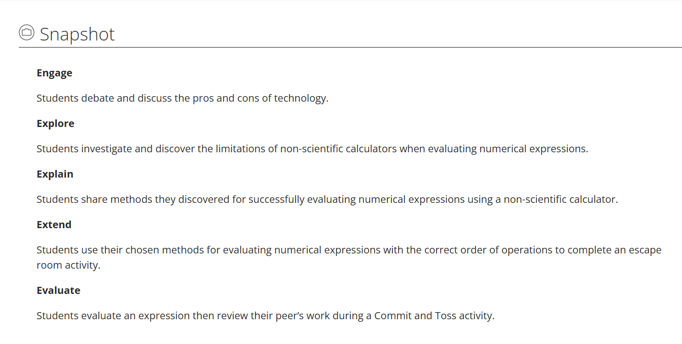
Are You Smarter Than a Calculator?

Slide 13

Commit and Toss
Complete the following problem on a piece of paper.
3 - 6 + (64 ÷ 8 + 15)
Show all of your work.
Do not write your name on your paper!
Notes:
K20 Center. (n.d.). Commit and toss. Strategies. https://learn.k20center.ou.edu/strategy/119

Slide 14
Commit and Toss
Crumple up the paper with your problem on it.
Toss the crumpled paper across the room.
Collect a crumpled paper that is not your own.
Silently review your peer’s work and compare it to your own.
Prepare to share what you noticed about your peer’s work.
Notes:
K20 Center. (n.d.). Commit and toss. Strategies. https://learn.k20center.ou.edu/strategy/119

Slide 15

Walk and Talk
Now that you’ve been introduced to why physical movement in math lessons is important, let’s talk about it!
Find a partner.
Read the provided prompt.
Walk around the room discussing both of your answers.
Stop when the timer goes off and share highlights with the group.
Notes:
K20 Center. (n.d.) Walk and talk. Strategies. https://learn.k20center.ou.edu/strategy/1741

Slide 16

Walk and Talk
How does your brain feel? How does physical movement change that mental state?
Notes:
K20 Center. (n.d.) Walk and talk. Strategies. https://learn.k20center.ou.edu/strategy/1741
K20 Center. (2021, September 21). 1-Minute Timer. YouTube. https://www.youtube.com/watch?v=6ilD555O_RE

Slide 17
Walk and Talk
What is one way physical movement might actually help a student grasp an abstract math concept?
Notes:
K20 Center. (n.d.) Walk and talk. Strategies. https://learn.k20center.ou.edu/strategy/1741
K20 Center. (2021, September 21). 1-Minute Timer. YouTube. https://www.youtube.com/watch?v=6ilD555O_RE

Slide 18
Walk and Talk
How do students’ moving around the room impact classroom management and overall student engagement?
Notes:
K20 Center. (n.d.) Walk and talk. Strategies. https://learn.k20center.ou.edu/strategy/1741
K20 Center. (2021, September 21). 1-Minute Timer. YouTube. https://www.youtube.com/watch?v=6ilD555O_RE

Slide 19

Gallery Walk
Read the instructional strategy description. You will use this strategy for all three rounds of the Gallery Walk.
Read the scenario provided.
Discuss how your strategy can be used in the scenario. Write notes on the chart paper.
When the timer goes off, rotate clockwise to the next scenario.
Read the previous group's notes.
Repeat steps 2-5 until you have completed each scenario.
Return to your original scenario and read through the other group’s responses.
Notes:
K20 Center. (n.d.). Gallery walk/carousel. Strategies. https://learn.k20center.ou.edu/strategy/118

Slide 20
Gallery Walk
Break into 3 groups/partners with one set staying at the original scenario and the other two moving to a different scenario.
Now each scenario should have a mix of different strategy experts. In your new group, explain what your strategy was and how you saw it working within that scenario.
Notes:
K20 Center. (n.d.). Gallery walk/carousel. Strategies. https://learn.k20center.ou.edu/strategy/118

Slide 21

Scenario 1
Math Standard:
Represent mathematical situations using equations and inequalities involving variables and rational numbers.
Algebraic Situation:
Ms. Smith and Mr. Jones are co-planning a lesson to tackle inequalities. Students tend to treat inequalities like equations. They struggle to understand the range of the situation. The teachers need to design a lesson addressing this struggle. How can your instructional strategy be used in a lesson to address this?
Notes:
K20 Center. (n.d.). Gallery walk/carousel. Strategies. https://learn.k20center.ou.edu/strategy/118

Slide 22
Scenario 2
Math Standard:
Developing and understanding the concepts of surface area and volume of rectangular prisms with rational-valued edge lengths.
Geometry Situation:
Mrs. Jenkins is introducing surface area and volume. In the past, she has given students the formulas (v-lwh and sa= 2lw + slh +2wh). However, students haven't quite understood what they are measuring. How can your instructional strategy be used in a lesson to address this?
Notes:
K20 Center. (n.d.). Gallery walk/carousel. Strategies. https://learn.k20center.ou.edu/strategy/118

Slide 23
Scenario 3
Math Standard:
Interpreting and analyzing data, and creating the most appropriate display (e.g., bar graphs, histograms, dot plots, or box plots) using a variety of tools.
Statistics Situation:
Mr. Davis is trying to help his students understand that if you change the visual tool, then the way the data is interpreted is altered. His students know the different types of graphs, but when given specific data sets, they struggle to choose the most appropriate display for the data set. How can your instructional strategy be used in a lesson to address this?
Notes:
K20 Center. (n.d.). Gallery walk/carousel. Strategies. https://learn.k20center.ou.edu/strategy/118

Slide 24

Importance of Movement
When the pace of the lesson intentionally incorporates movement, students are able to process the content deeply and experience a rich understanding of concepts.
Students are able to foster a stronger cognitive bond when airing intention movement and math concepts strategically.

Slide 25
What to Consider
Why are you having students engage in a physical activity?
How does integrating movement help students process content?
What point in the learning process would movement support collaboration and learning?

Slide 26


K20 LEARN Website
Find a lesson.
Read through the lesson.
Notes:
K20 Center. (2021, September 21). 10-Minute Timer. YouTube. https://youtu.be/9gy-1Z2Sa-c?si=mZT8we776f2Oew46
K20 Center. (n.d.). K20 Center LEARN. https://learn.k20center.ou.edu/

Slide 27

Moved by Math Collection
Choose a strategy.
Determine where in the lesson you can add the strategy.
Share your thoughts with a partner.
Fill out your handout.
  Hint: Use the strategy card “Procedure.”
Notes:
K20 Center. (n.d.). Moved by math. Collections. https://learn.k20center.ou.edu/collection/5501 .

Slide 28
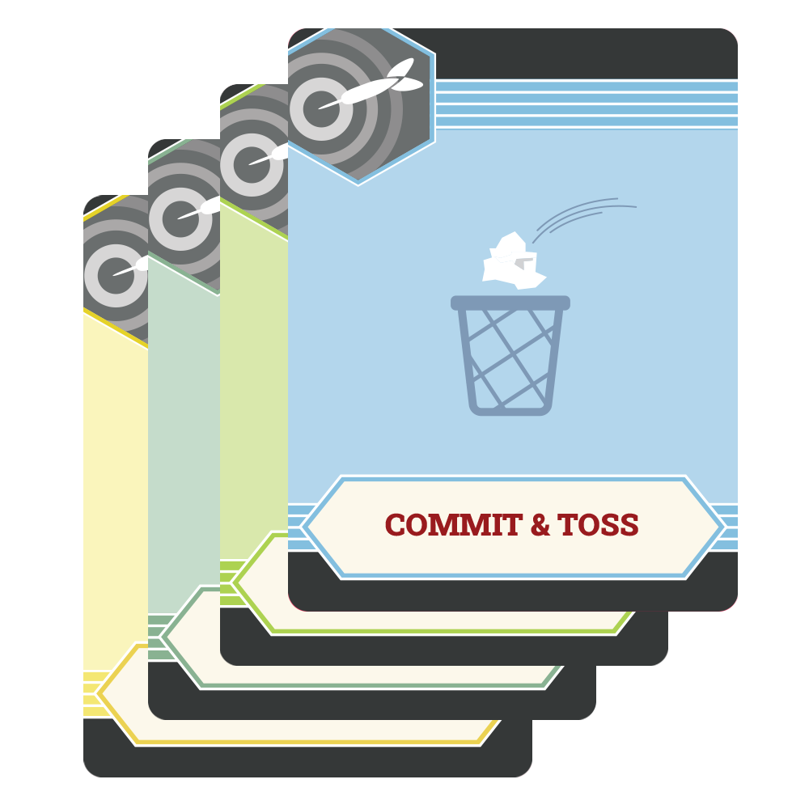
Strategy Reflection
Looks Like, Sounds Like, Feels Like
Commit and Toss
Walk and Talk
Gallery Walk
Still Pictures
Human Bingo
ABC Graffiti

Slide 29

Think-Pair-Share
After reflecting on how strategies were used in this session, answer the following questions on your handout:
  Which three strategies do you plan to implement in your classroom this quarter? Why?
  How can you modify these strategies to work with your students? Explain.
Get with a partner and share your answers.
Notes:
K20 Center. (n.d.). Think-Pair-Share. Strategies. https://learn.k20center.ou.edu/strategy/139

