Slide 2
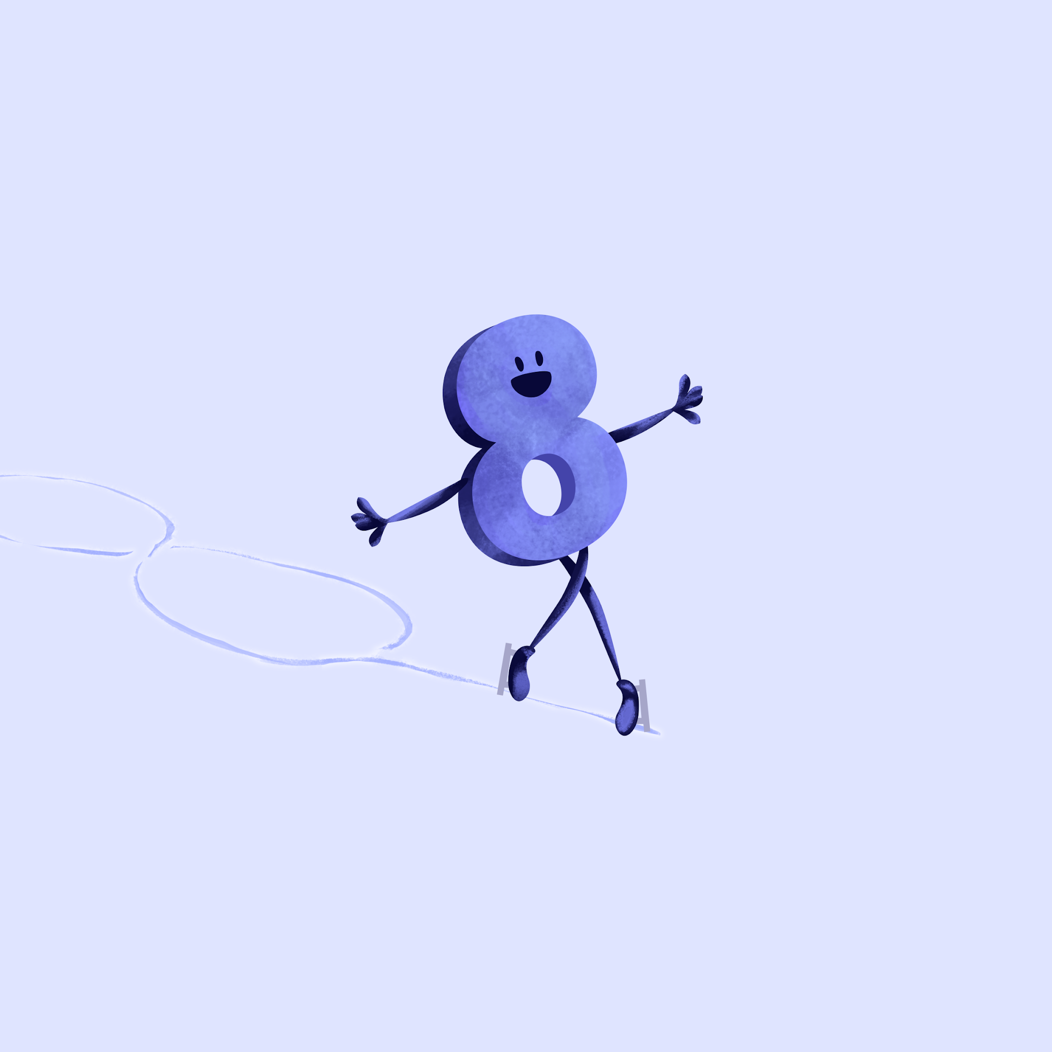
Less is More
Math Professional Lesson Series
Analyzing Implementation

Slide 3
Essential Questions
How can movement be intentionally incorporated into math lessons to deepen students' understanding, engagement, and problem-solving skills?
How do we transition from 'trying out' movement to intentionally designing it as a primary strategy for deepening mathematical reasoning and classroom management?

Slide 4
Learning Objectives
Analyze past implementation of physical movement lessons.
Evaluate integrated movement in math lessons.
Design an active learning experience by modifying an existing lesson.

Slide 5
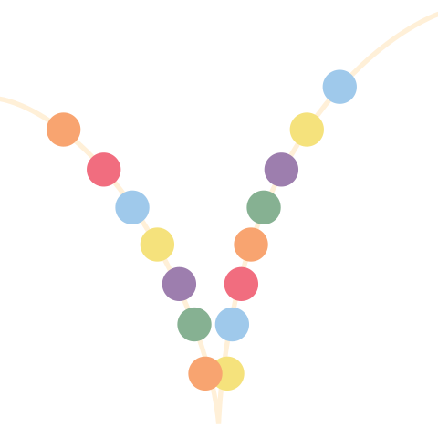
Fold the Line
While movement strategies look great on paper, the instructional payoff rarely outweighs the time it takes to transition students back to focus.
Do Not
Agree
Somewhat Agree
Agree
Notes:
K20 Center. (n.d.). Fold the line. Strategies. https://learn.k20center.ou.edu/strategy/171

Slide 6
Teachers can be overwhelmed by the complexity of integrating movement while striving for learning outcomes. However, teachers who incorporated physically active learning into their math classroom expressed high confidence and perceived the approach as feasible when given support with other educators.
̶ González‑Pérez et al. (2025)
Notes:
González‑Pérez, M., Grao‑Cruces, A., Bandera‑Campos, F. J., Chalkley, A., Camiletti‑Moirón, D., & Sánchez‑Oliva, D. (2025). Less is more: Qualitative insights into physically active learning in secondary math education. PLOS ONE, 20(11), e0336641. https://doi.org/10.1371/journal.pone.0336641

Slide 7

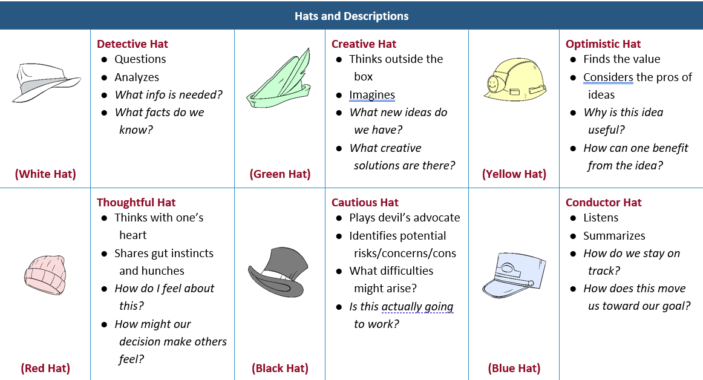
Thinking Hat
Discuss the topic through different perspectives depending on what “hat” you’re wearing.
Notes:
K20 Center. (n.d.). Thinking Hats. Strategies. https://learn.k20center.ou.edu/strategy/3434

Slide 8

Thinking Hat
Within your group, choose your first “hat.”
Go to your assigned chat station.
Read the prompt.
Using your chosen perspective, respond/discuss the prompt within your group.
After the timer, go to a new station and choose a new “hat.”
Repeat steps 3 & 4.
Notes:
K20 Center. (n.d.). Thinking Hats. Strategies. https://learn.k20center.ou.edu/strategy/3434
K20 Center. (2021, September 21). 5 minute timer: https://k20.ou.edu/5min
https://youtu.be/EVS_yYQoLJg?si=4VHb4BWfyxBSvfqU

Slide 9
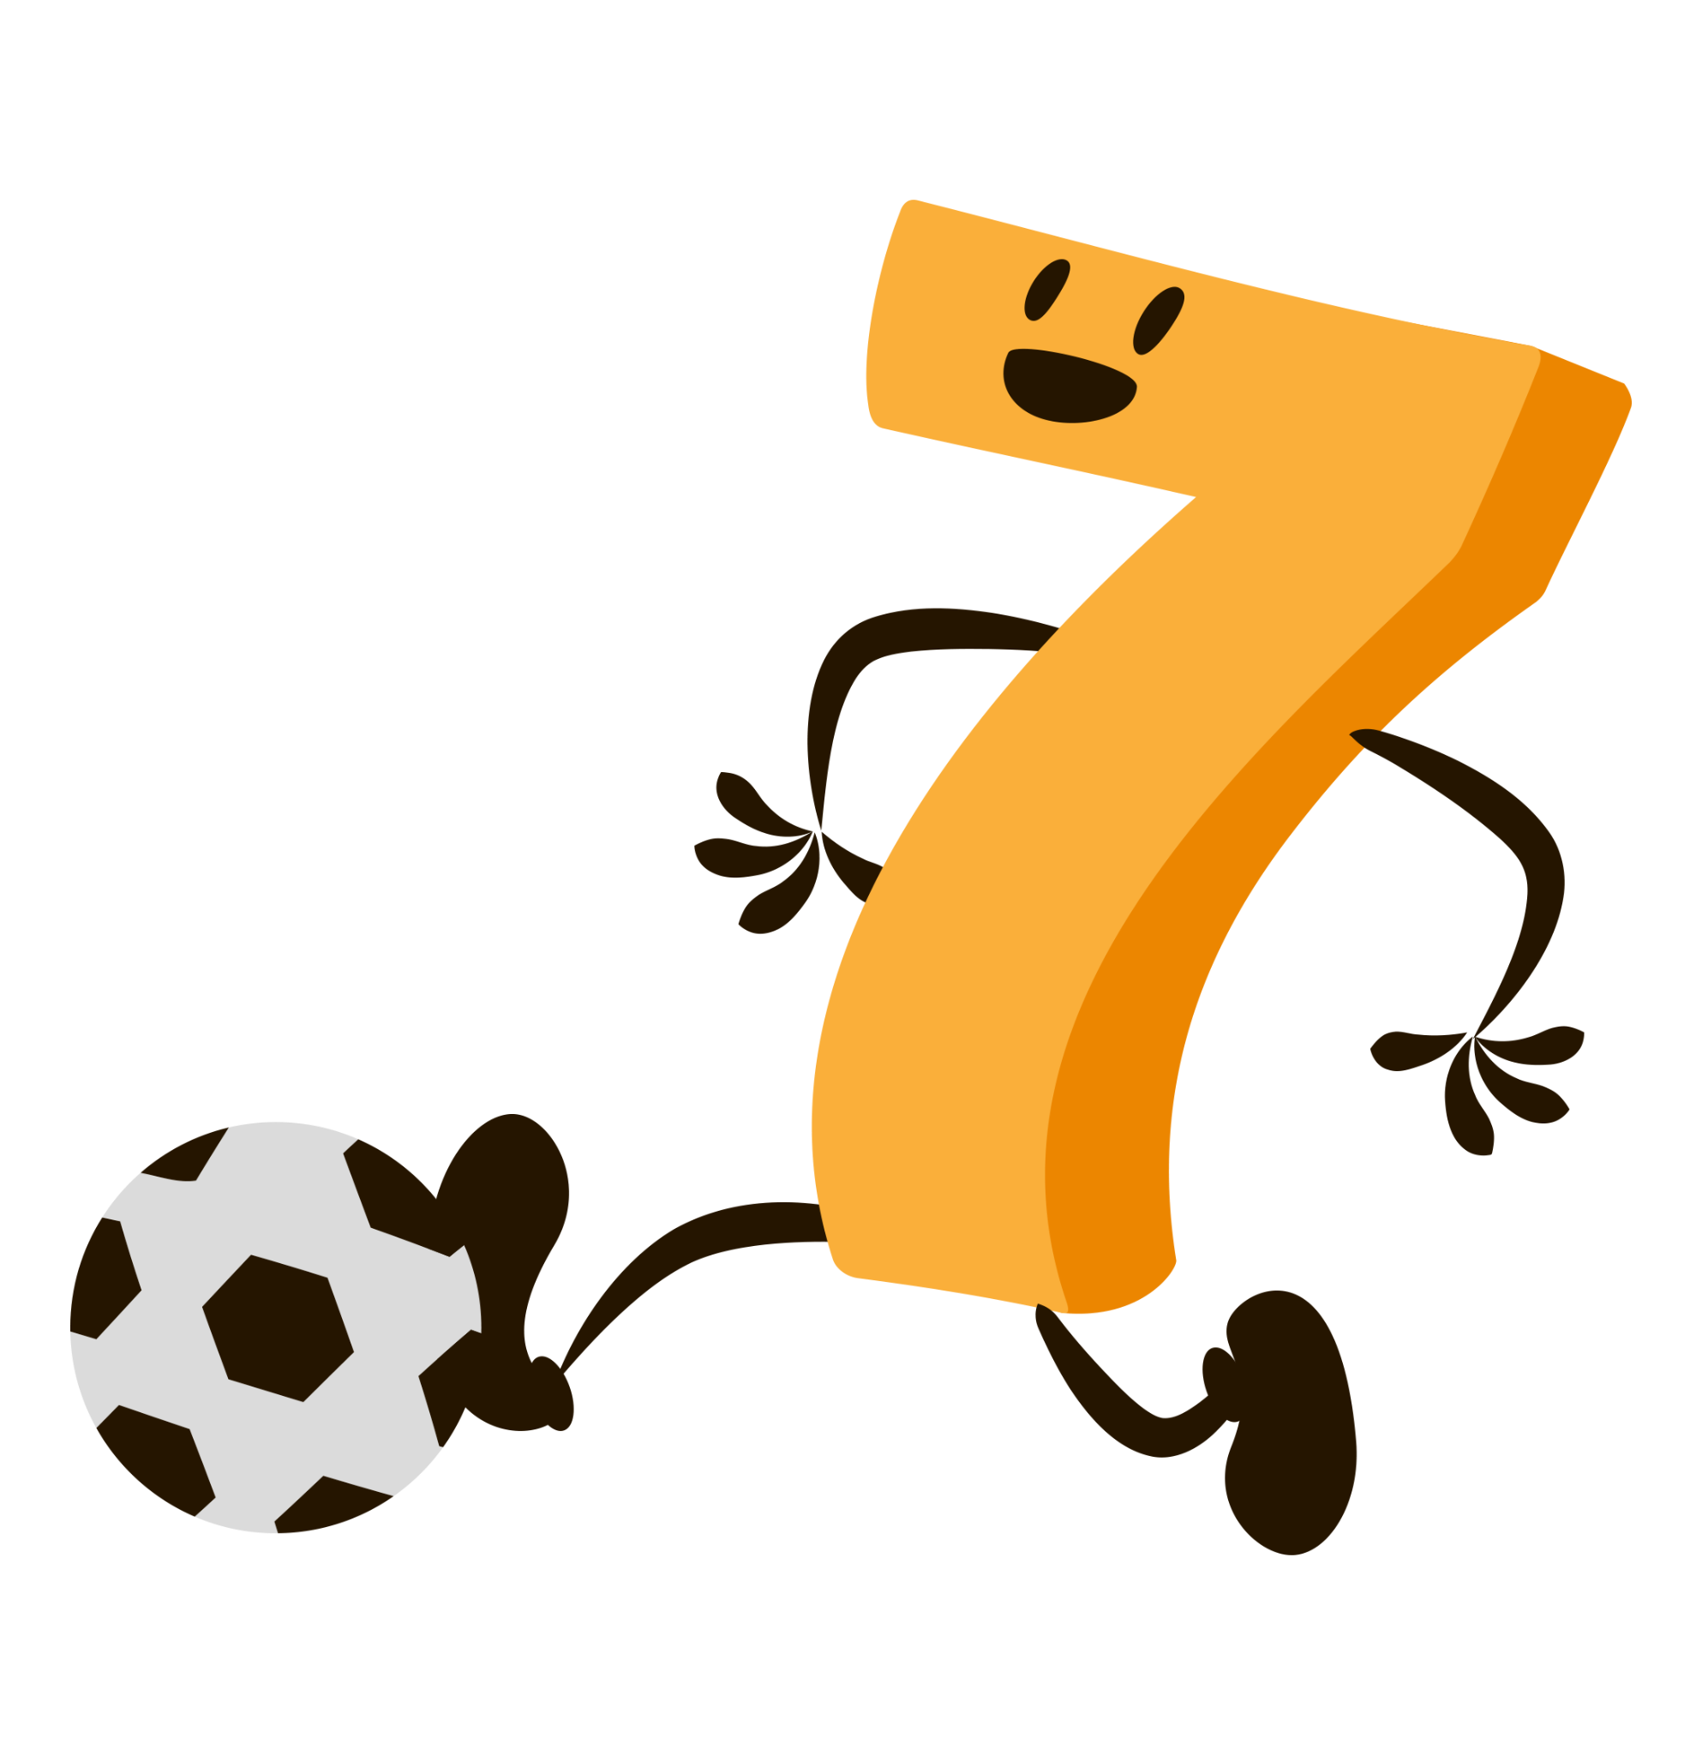
Discussion
Which scenario do you most identify with?
What solutions do you believe can address these barriers to movement in the classroom?

Slide 10

Math Lessons with Movement
Explore the collection.
Answer the prompt:
What are characteristics of a high-quality movement based math lesson?
Notes:
K20 Center. (n.d.). Math Lessons with Movement. Collections. https://learn.k20center.ou.edu/collection/5517?rev=47665

Slide 11
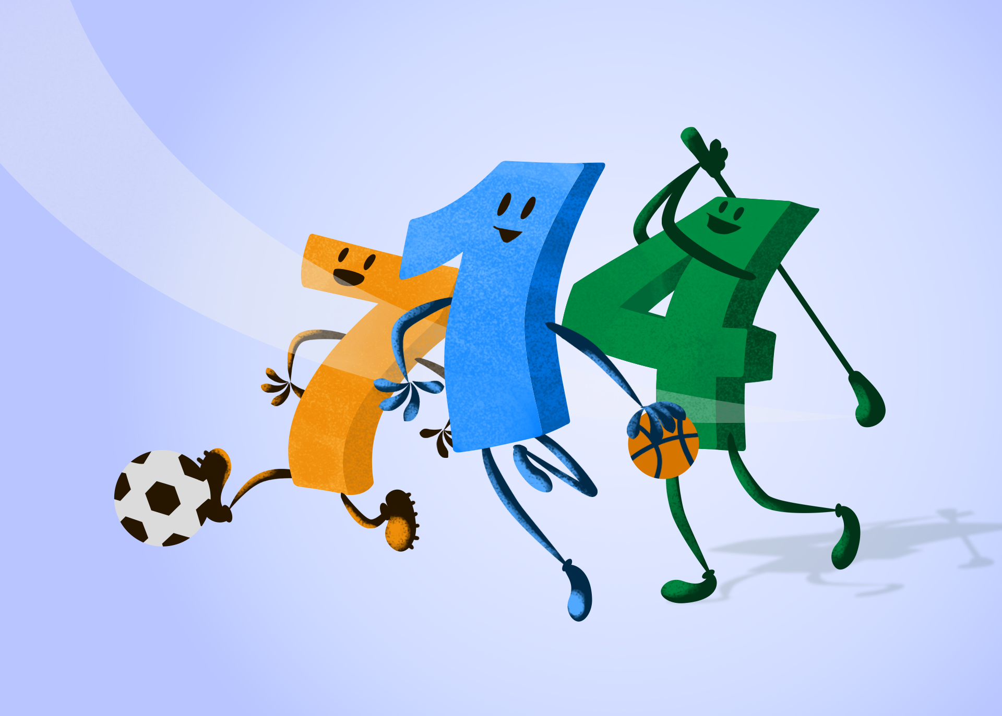
Top Characteristics
In your group, create a short list of top characteristics for a high-quality movement based math lesson.
Read all responses.
Sort responses into categories.
Create a short list of your top 3 characteristics.

Slide 12
Lesson Revamp
Using your own lesson plan…
Identify 2-3 sections where movement could have a high impact.
Rewrite the lesson to include a movement strategy intentionally.

Slide 13
Remember
Movement needs to be purposeful.
When planning, consider:
Where does this lesson traditionally lose student attention?
Is there a concept that is abstract or hard to grasp?
Does the room layout and time frame realistically support movement around this specific moment?

Slide 14
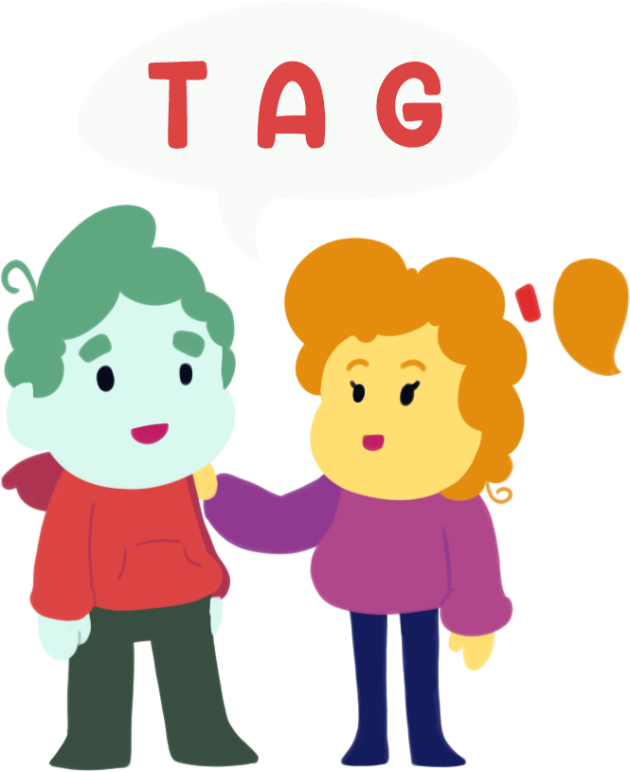
TAG Me!
Partner A outlines their 2-3 movement moments that they designed, while Partner B gives feedback. Then switch!
T - tell (or write) something you like.
A - ask a question.
G - give one suggestion.
Notes:
K20 Center. (n.d.). TAG me!. Strategies. https://learn.k20center.ou.edu/strategy/2873

