Slide 2
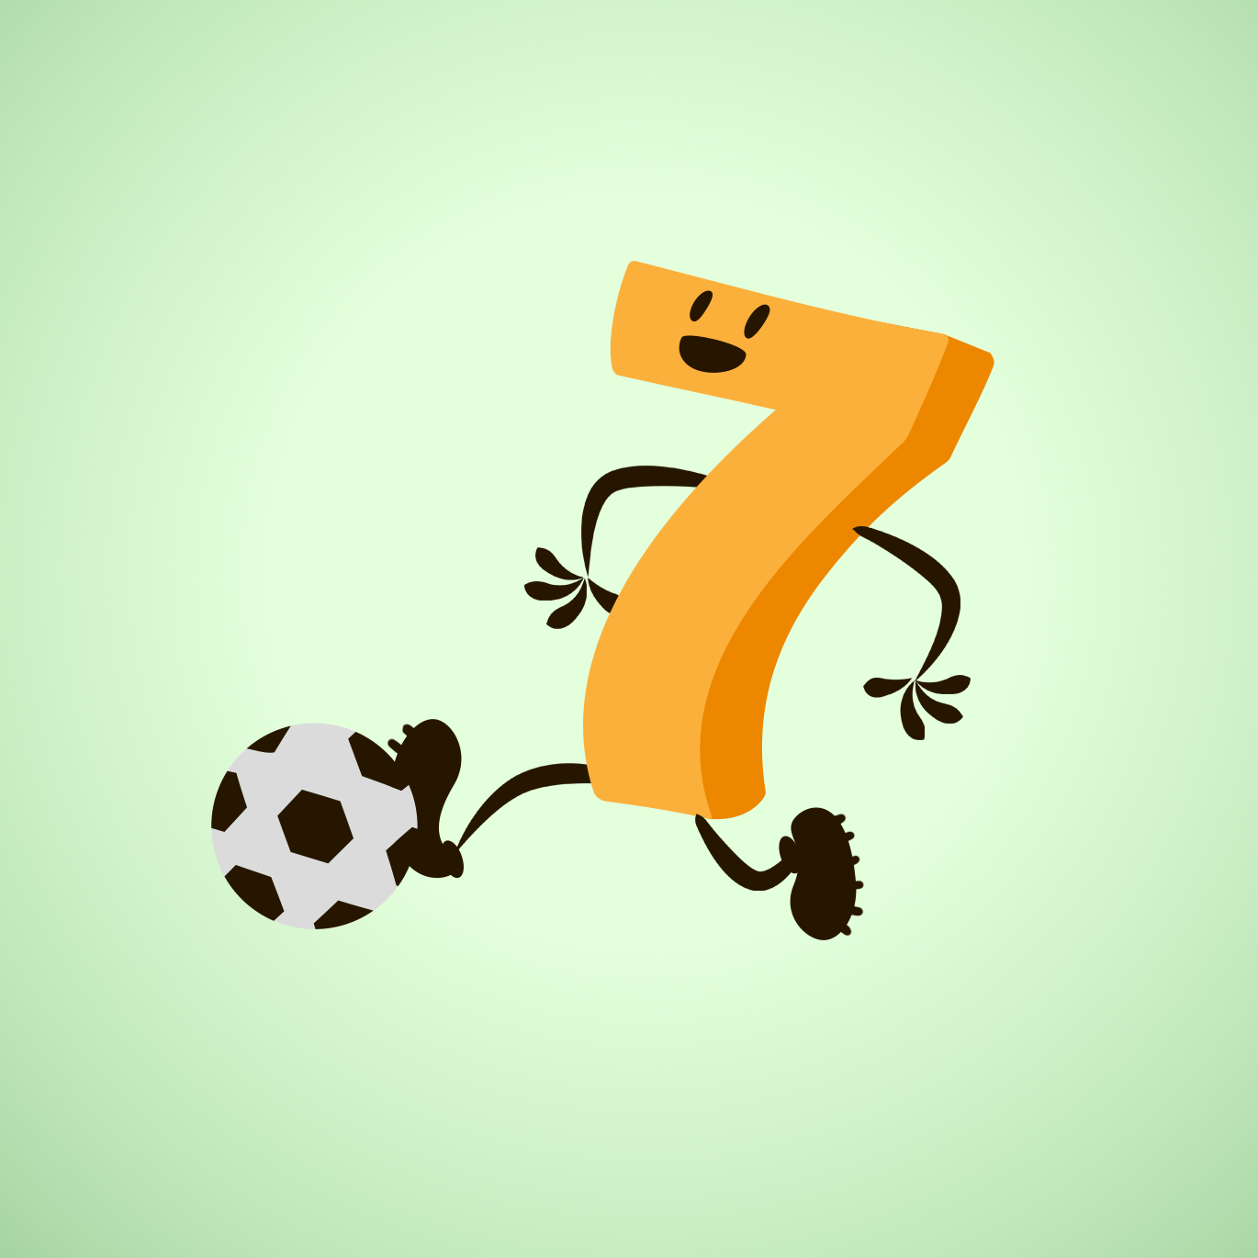
Less is More
Math Professional Learning Series
Peer Coaching

Slide 3
Essential Questions:
How can I intentionally incorporate movement to my math lessons to deepen students' understanding, engagement, and problem-solving skills?
How can we strategically leverage movement to manage cognitive load?

Slide 4
Learning Objectives:
Collaboratively identify parts of lessons where disengagement tends to happen.
Analyze physical movement strategies and the required cognitive load it requires of students.
Apply kinesthetic learning as the primary method of instruction.

Slide 5
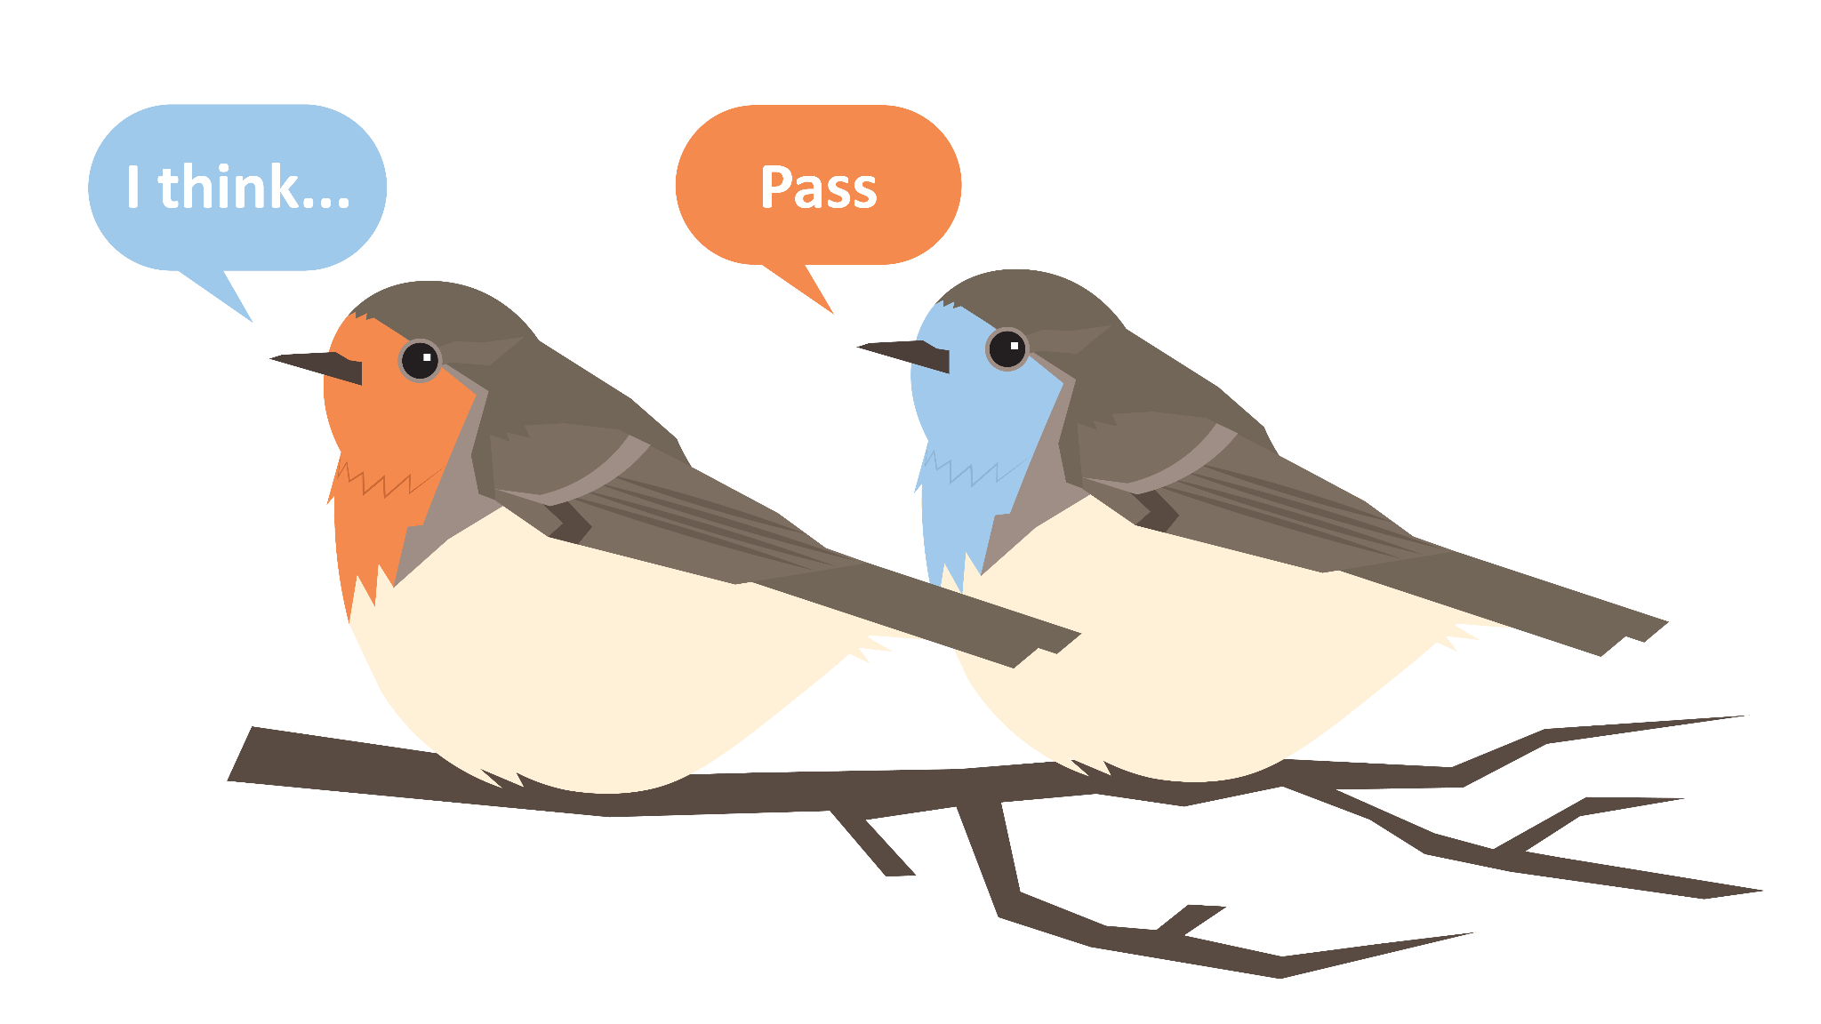
Round Robin
Answer the question individually first.
Next, share an idea from your list.
  While another participant is sharing, the group must refrain from interrupting.
Repeat until everyone has shared an idea from their list.
If an idea has already been shared, say, “Pass.”
Notes:
K20 Center. (n.d.). Round robin. Strategies. https://learn.k20center.ou.edu/strategy/2183

Slide 6
Round Robin
What are specific stagnant hotspots in a traditional lesson structure?
Create a list that identifies when disengagement occurs.
Notes:
K20 Center. (n.d.). Round robin. Strategies. https://learn.k20center.ou.edu/strategy/2183

Slide 7
Round Robin
Looking at this list, what are some reasons students would be disengaged?
Notes:
K20 Center. (n.d.). Round robin. Strategies. https://learn.k20center.ou.edu/strategy/2183

Slide 8
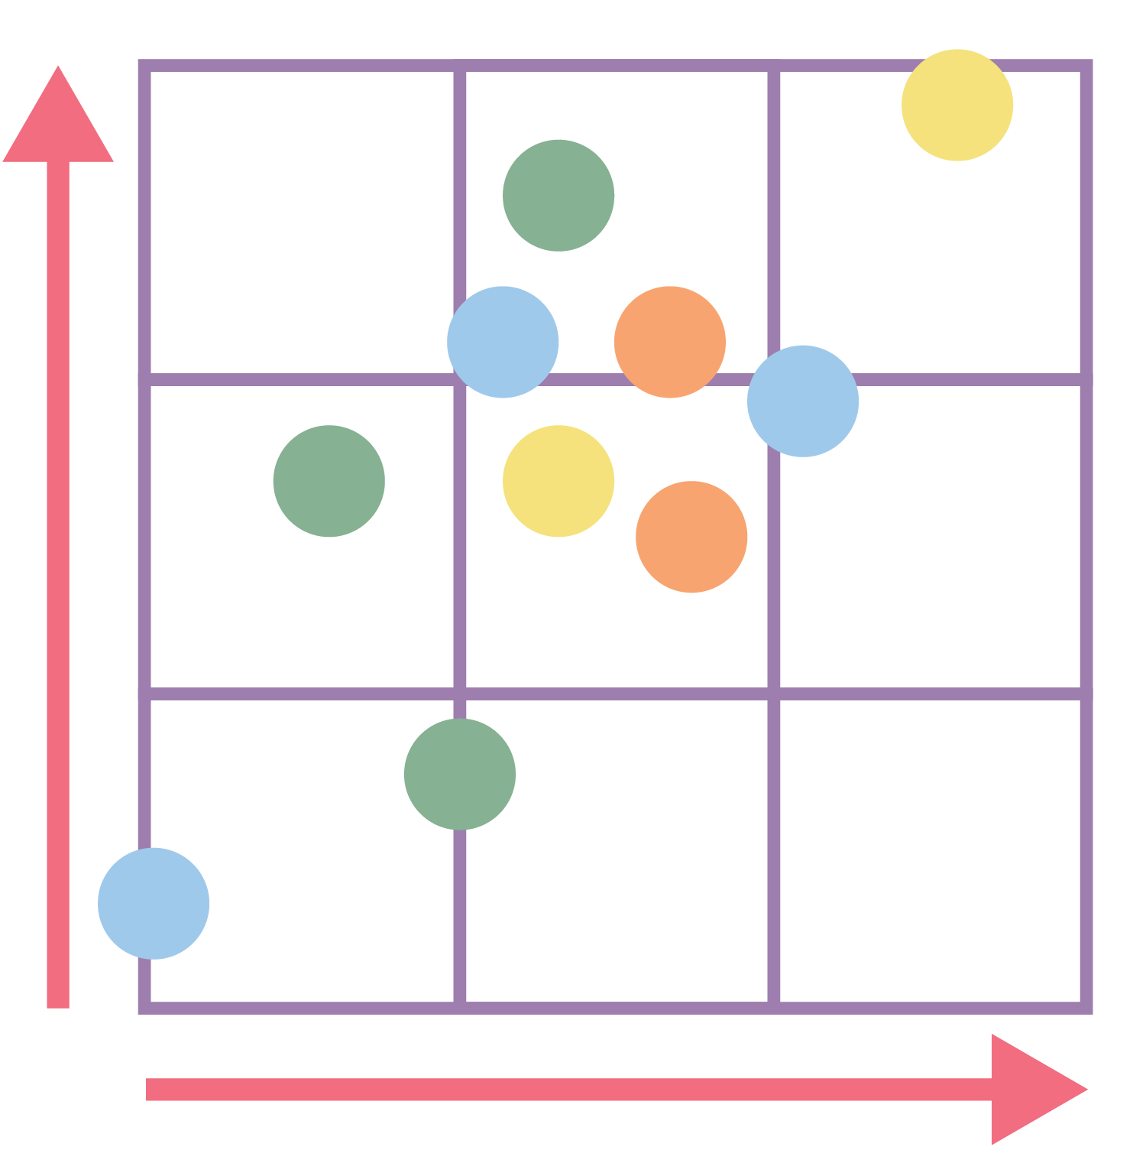
Human Scatter Graph
Use your supplies to create an x and y axis graph on the floor.
Be sure to make it large enough so that people can stand in multiple spaces.
Notes:
K20 Center. (n.d.). Human scatter graph. Strategies. https://learn.k20center.ou.edu/strategy/172

Slide 9
Human Scatter Graph
Math Objective: Students will physically model a linear equation on a coordinate plane to represent the constant rate of change and the initial value.
In small groups, graph your linear equation.
Now show your inverse (i.e. If you had a positive equation, you’re now negative).
When everyone has a spot, freeze and notice what part everyone played in the equation.
Notes:
K20 Center. (n.d.). Human scatter graph. Strategies. https://learn.k20center.ou.edu/strategy/172

Slide 10
Debrief
Where did you feel the productive struggle in the activity?
What did your brain have to do during physical activity?

Slide 11


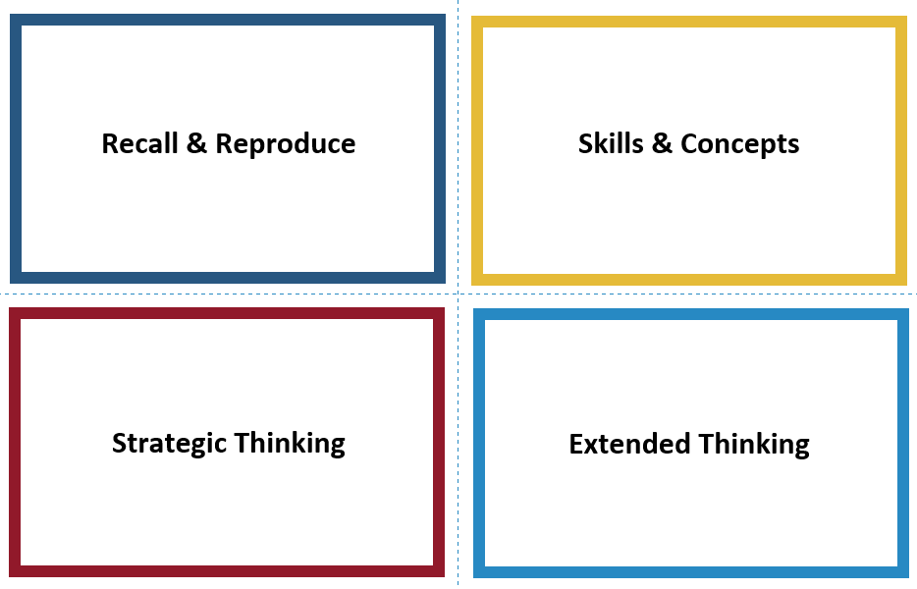
Card Sort
Sort the physical movement strategies into Webb’s 4 different “depths of knowledge” categories.
Use the handout as a guide.
Come to a common agreement before moving on to the next card.
Notes:
K20 Center. (n.d.). Card sort. Strategies. https://learn.k20center.ou.edu/strategy/147
K20 Center. (2021). 5-Minute Timer. YouTube. https://www.youtube.com/watch?v=EVS_yYQoLJg

Slide 12
Debrief
Looking at your card sort, what patterns do you see?
How can this help you when you are designing a lesson?

Slide 13

Brainstorm a Potential Lesson
With a partner, think about the following:
What is the concept?
What part of the concept is your physical activity highlighting: activating prior knowledge, introducing the concept, reviewing, etc.?
What depth of knowledge would your students engage in?
What physical movement strategy aligns with that depth of knowledge?
Notes:
K20 Center. (n.d.). Elbow partners. Strategies. https://learn.k20center.ou.edu/strategy/116

Slide 14
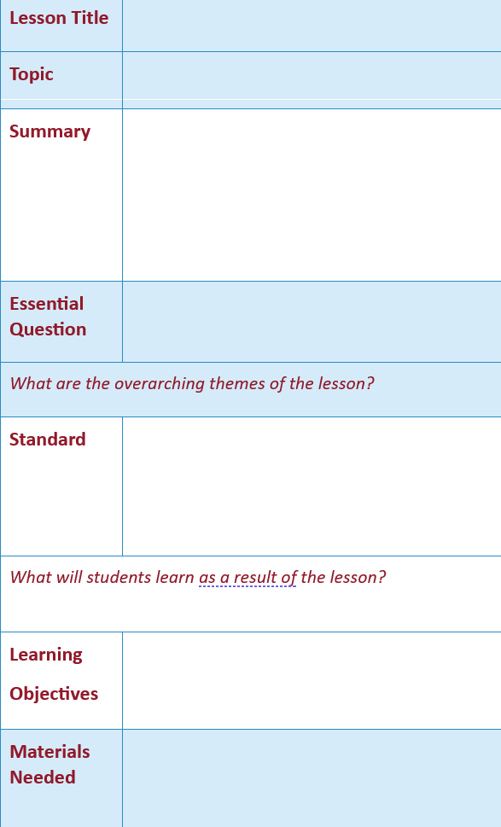
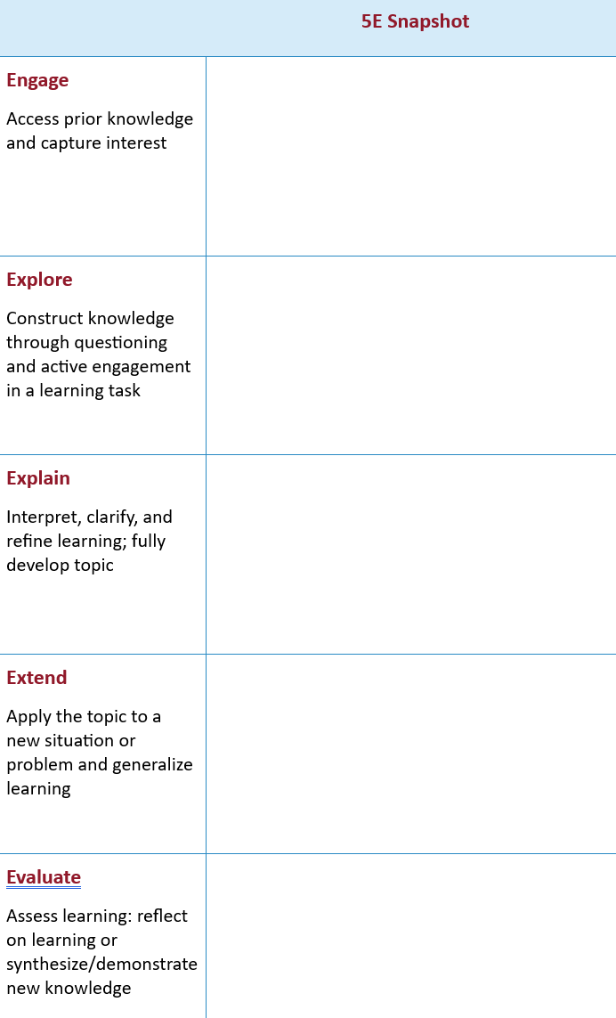
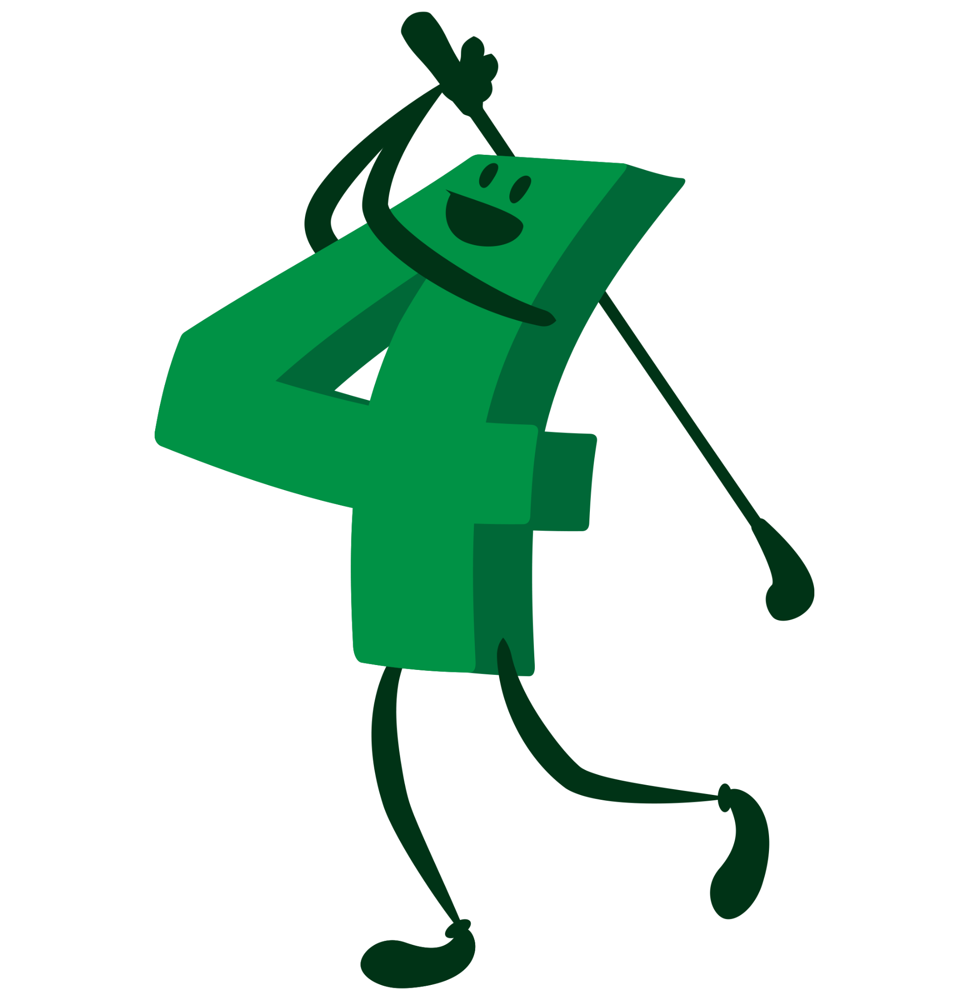
Make a Lesson
Using your brainstorming, start drafting your lesson!
Add as much detail as you can.

Slide 15


Plus Delta Feedback
Write one “plus” for your peer’s lesson on one color of sticky note.
  What went well? What do you like about the lesson?
Write one “delta” for your peer’s lesson on the other color of sticky note.
  What would you change? Be specific and action-oriented.
Notes:
K20 Center (n.d.). Plus Delta Chart. Strategies. https://learn.k20center.ou.edu/strategy/2904
K20 Center. (2021). 2 Minute Timer. YouTube. https://youtu.be/HcEEAnwOt2c?si=KGD2iBg1LSLOGQQq

