Slide 2


Less is More
Math Professional Learning Series
Train the Trainer

Slide 3
Essential Questions:
How can I intentionally incorporate movement to my math lessons to deepen students' understanding, engagement, and problem-solving skills?
How can we effectively communicate the 'why' behind movement-based math to empower our colleagues to adopt these strategies in their own classrooms?

Slide 4
Learning Objectives:
Analyze the 4-Part Less is More Professional Learning series to examine andragogical moves.
Construct a miniature professional learning session over one physical movement strategy used with a math concept.

Slide 5

Beach Ball Talk and Toss
Take turns passing the ball to one another.
As you catch the ball, whichever color your right thumb lands on determines the question you will answer.
After you answer the question, toss the ball to another member.
Repeat the process until everyone has had a chance to answer a question.
Notes:
K20 Center. (n.d.). Beach Ball Talk and Toss. Strategies.https://learn.k20center.ou.edu/strategy/3049

Slide 6
Beach Ball Talk and Toss
Red: Share a time you rewrote a lesson based on your understanding of how students process content with movement. | Yellow: Describe a time where students engaging with a physical activity helped their understanding better than a traditional worksheet. | White: How has using movement changed your approach to classroom management?
Green: How comfortable were you initially with the noise and unpredictability of a moving classroom, and where are you now? | Blue: How has your physical classroom setup evolved to accommodate movement? | Orange: How has incorporating movement changed your own energy levels by the end of the school day?
Notes:
K20 Center. (n.d.). Beach Ball Talk and Toss. Strategies.https://learn.k20center.ou.edu/strategy/3049

Slide 7

Categorical Highlighting
Read and Annotate your assigned Professional Learning session:
  Facilitator Actions - blue
  Participant Actions - yellow
Share with your group your notes to check your understanding.
Notes:
K20 Center. (n.d.). Categorical highlighting. Strategies. https://learn.k20center.ou.edu/strategy/192

Slide 8

Jigsaw
Find a new group with 2 other people who read and annotated a different professional learning narrative from you.
Share your notes and observations with them.
Notes:
K20 Center. (n.d.). Jigsaw. Strategies. https://learn.k20center.ou.edu/strategy/179

Slide 9
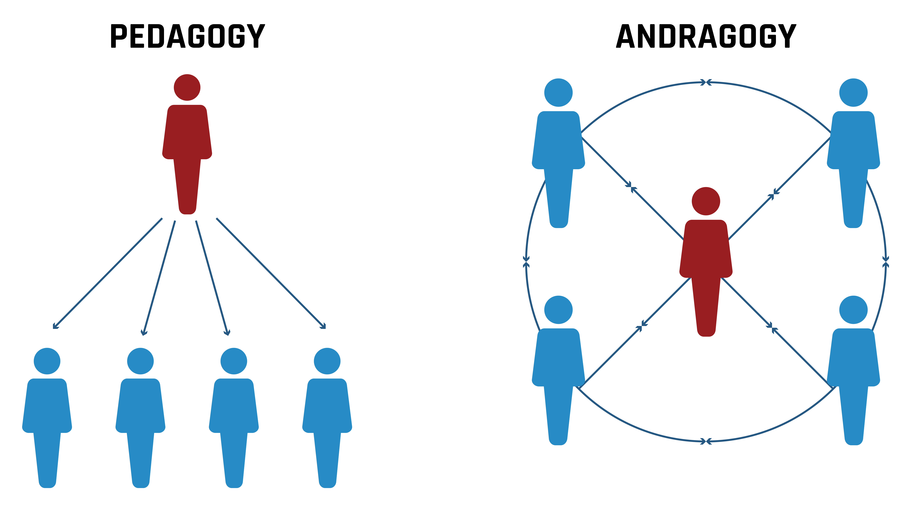

Slide 10

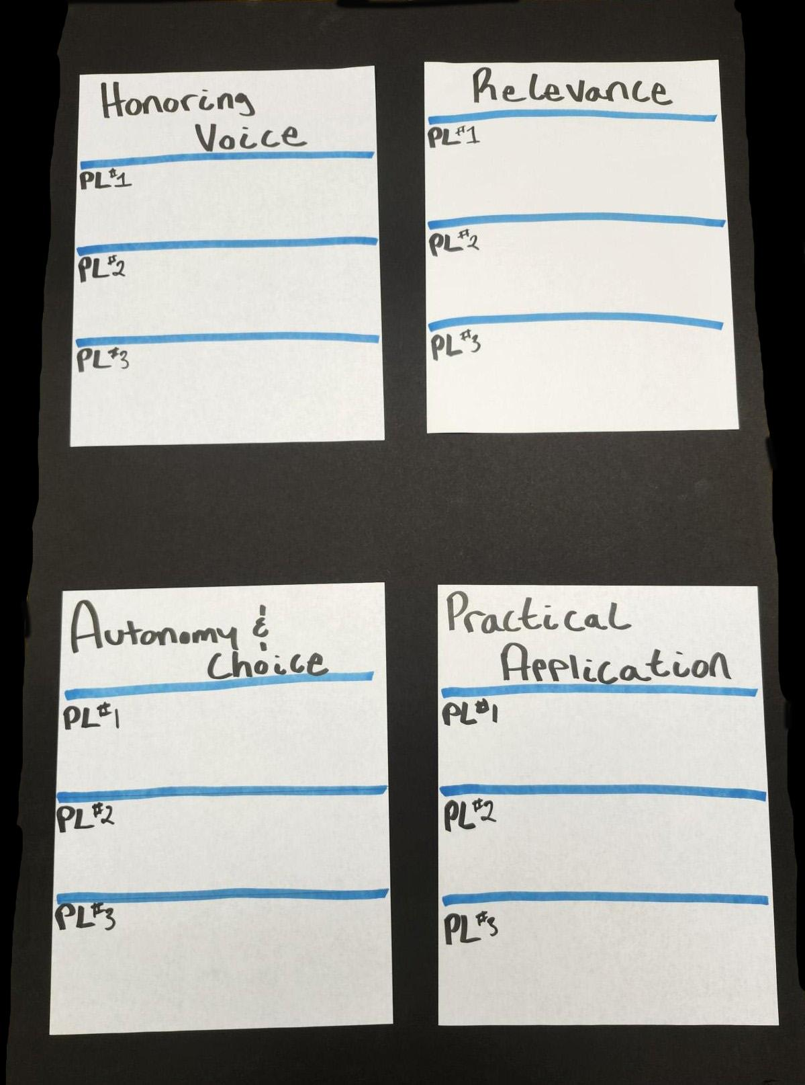
Anchor Charts
With your Jigsaw group…
Write your component of andragogy at the top of your chart.
Create space for examples of this component from each PL.
Add evidence from each PL.
Notes:
K20 Center. (n.d.). Anchor charts. Strategies. https://learn.k20center.ou.edu/strategy/58

Slide 11
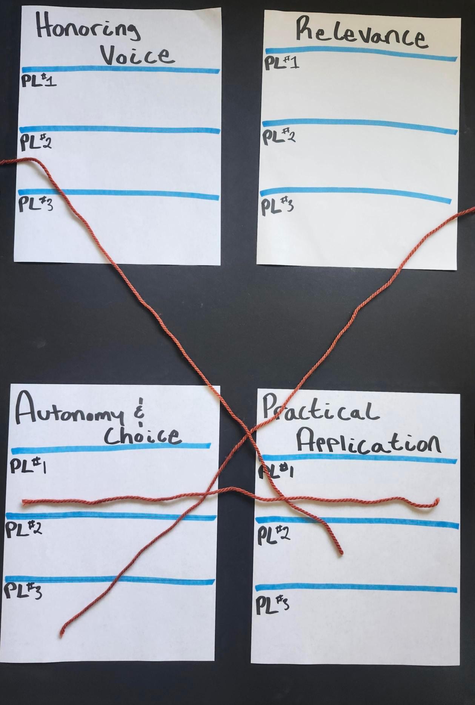
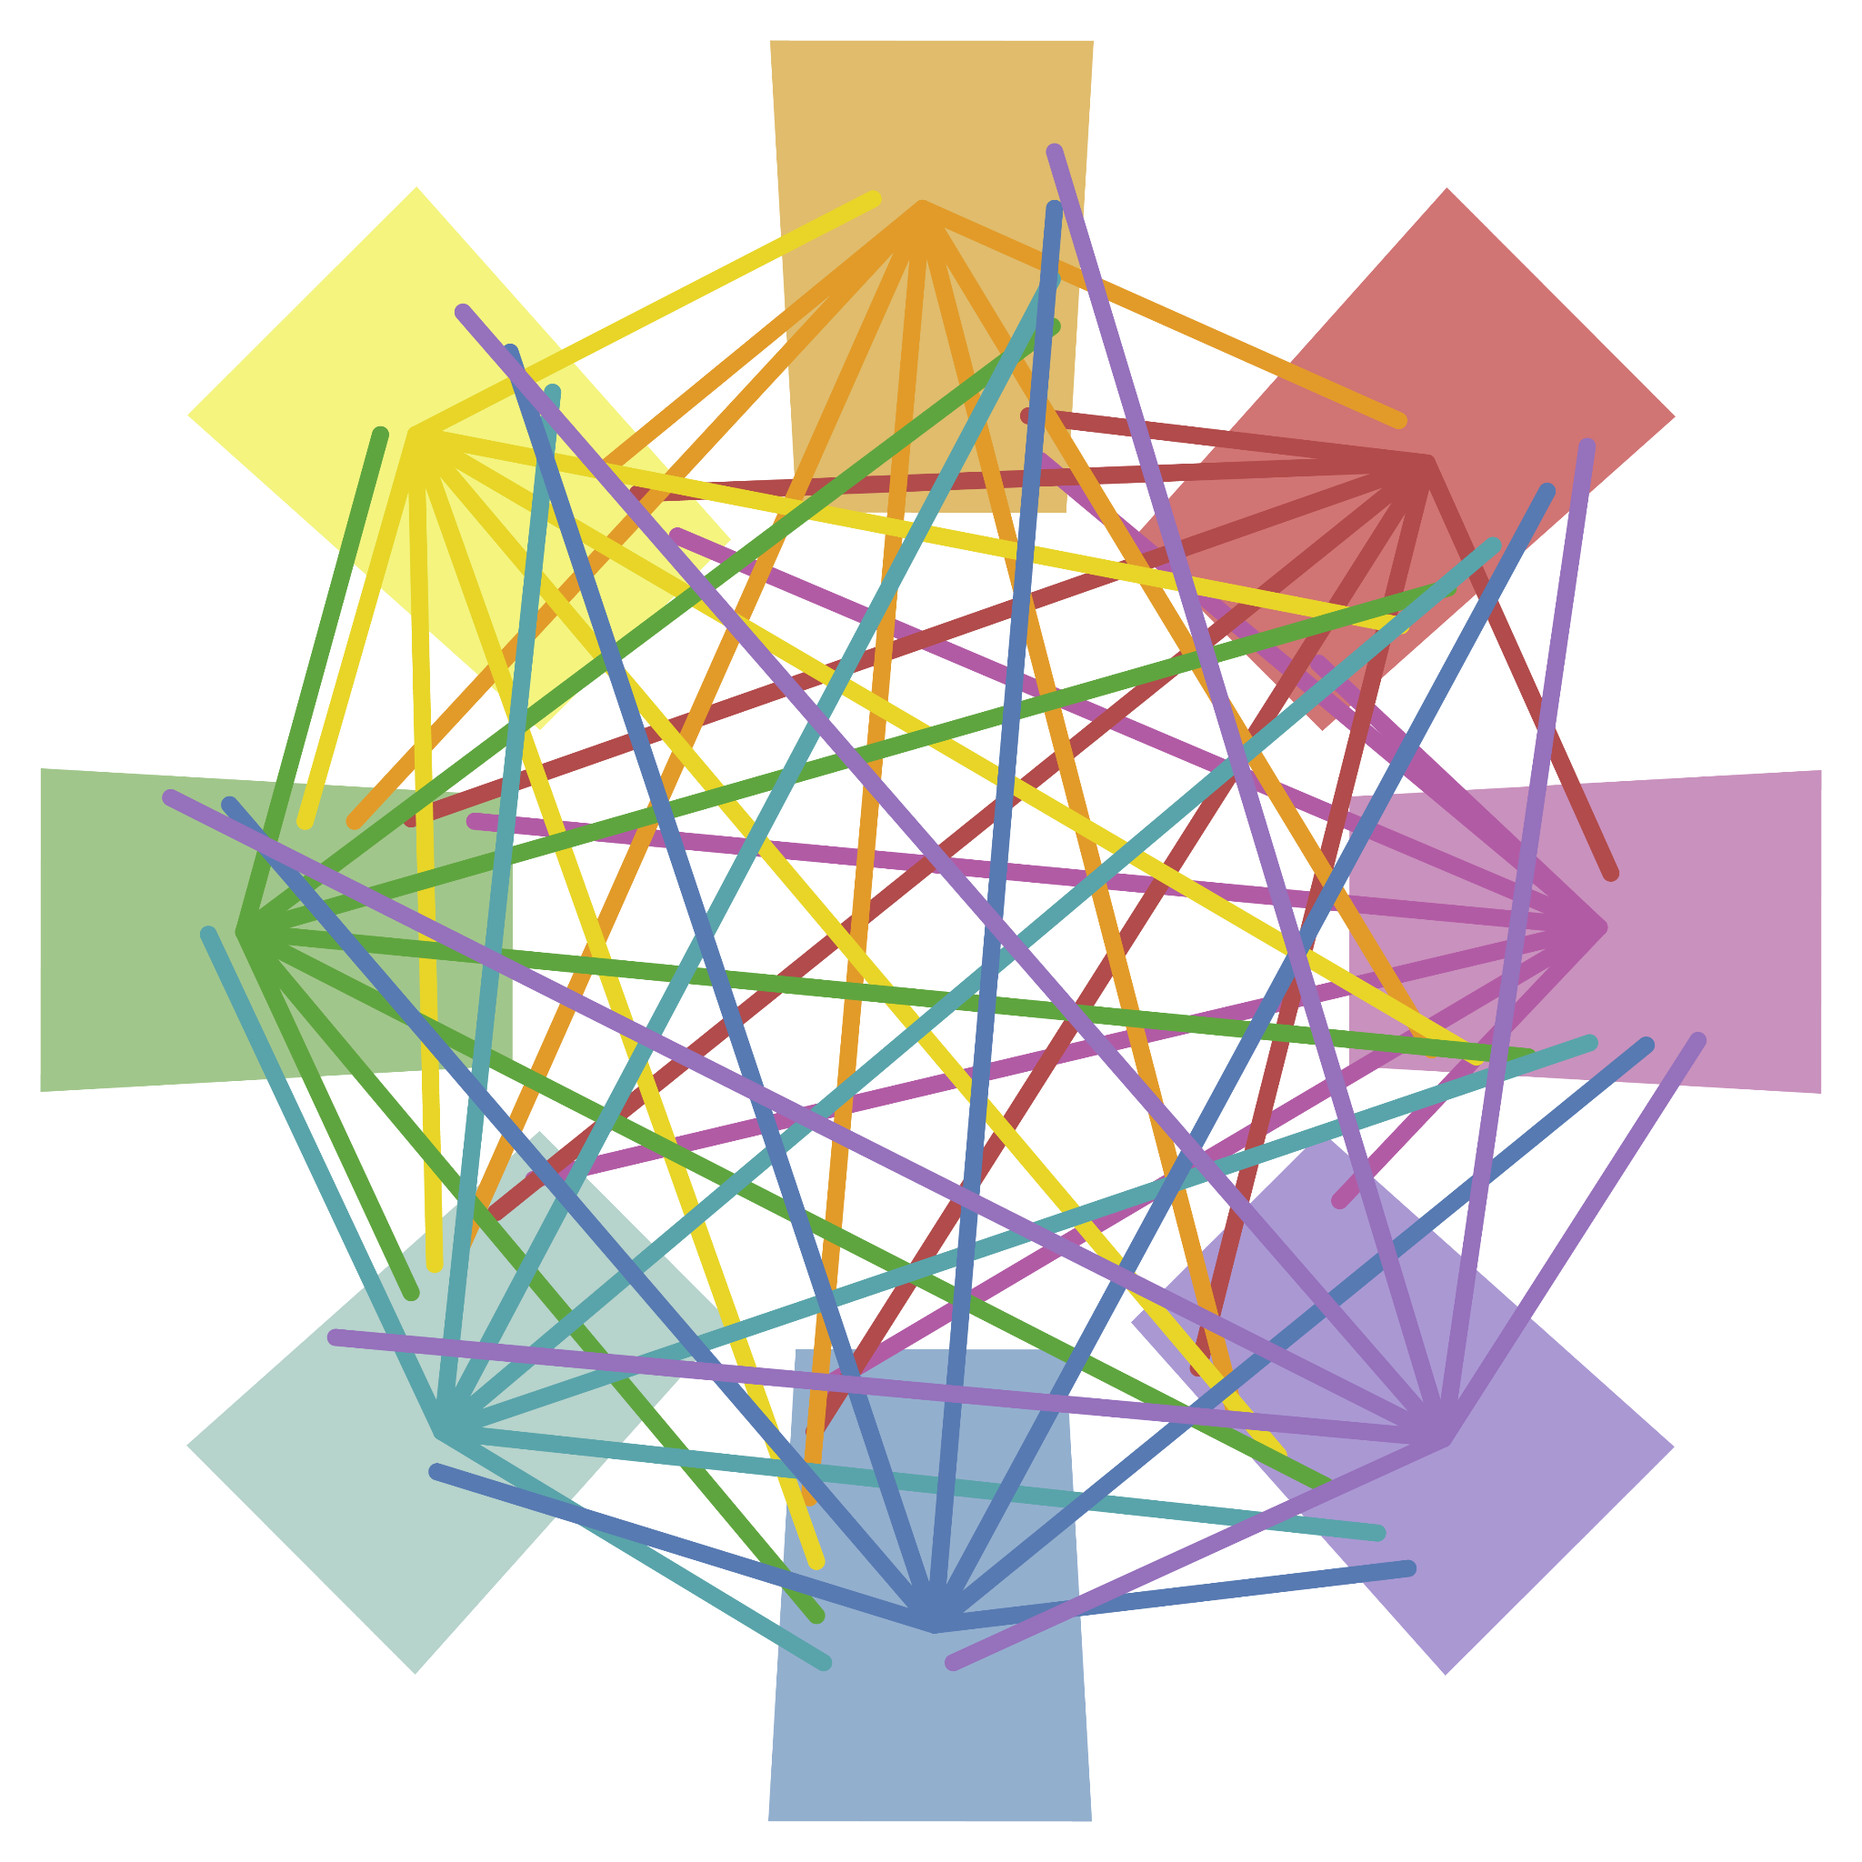
Detective Board
With your group examine each anchor chart and look for connections.
These connections can be with your poster or others.
Use string to connect ideas!
Notes:
K20 Center. (n.d.). Detective board. Strategies. https://learn.k20center.ou.edu/strategy/3530

Slide 12
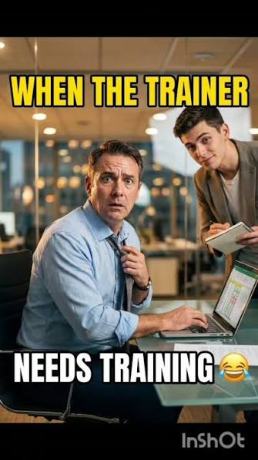
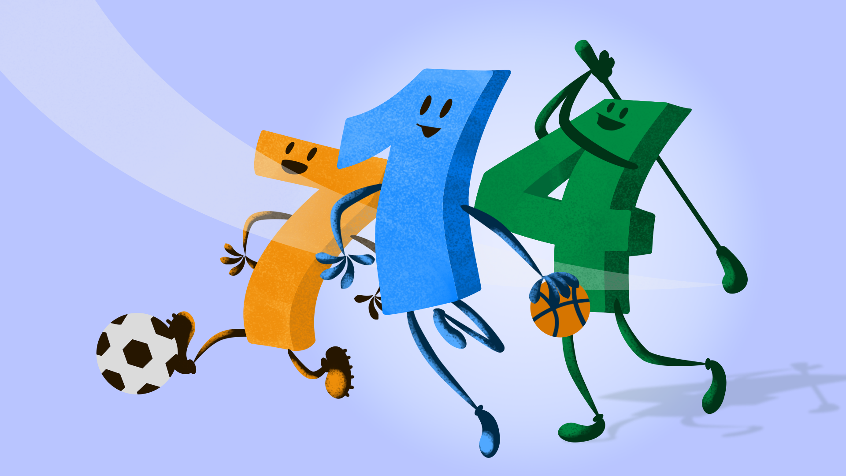
You are now a
Movement Ambassador!
Notes:
Vstraveller75. (2026 Aug. 6). Train the trainer [Meme]. Instagram. https://www.instagram.com/reel/DbtZngloz80/

Slide 13
Access a Slidedeck
[PLACEHOLDER for copy of 30 Second Activity slides]
Navigate to one of the following:
Google Slides
Canva.com
Notes:
K20 Center. (n.d.). Canva. Tech tools. https://learn.k20center.ou.edu/tech-tool/612
K20 Center. (n.d.). Google slides. Tech Tools. https://learn.k20center.ou.edu/tech-tool/2335

Slide 14

30 Second Spotlight
Brainstorm 1 physical movement lesson you’ve implemented successfully!
Create 1 slide describing the movement as if you were presenting this at a PL session.
Include how your strategy connects with:
  Autonomy & Choice
  Practical Application
  Honoring Voice
  Relevance
Notes:
K20 Center. (n.d.). 30 second spotlight. Strategies. https://learn.k20center.ou.edu/strategy/3748

Slide 15
30 Second Spotlight
Present your idea to your group. You only have 30 seconds!
After each presentation group members offer positive feedback.
  What are the strengths?
  What are potential areas of improvement?
Notes:
K20 Center. (n.d.). 30 second spotlight. Strategies. https://learn.k20center.ou.edu/strategy/3748

Slide 16
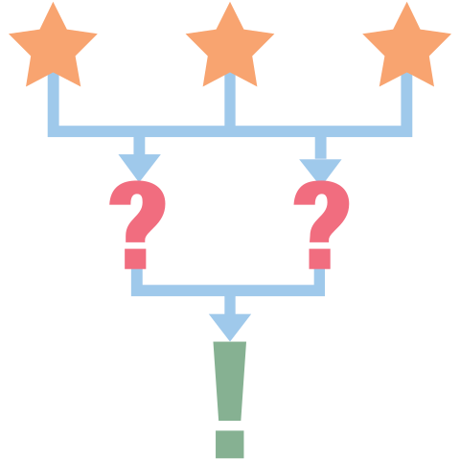
3-2-1
What are three things you learned during the professional learning series and the physical movement lessons in your classroom?
What are two questions you still have?
What is one thing you found interesting?
Notes:
K20 Center. (n.d.). 3-2-1. Strategies.https://learn.k20center.ou.edu/strategy/117

