Slide 2
Find Your Route
Navigating Post Secondary Options

Slide 3

Menti
Thinking back to yourself as a middle schooler, what career or major were you interested in?
Go to menti.com
Code: [INSERT CODE]
Notes:
K20 Center. (n.d.). Mentimeter. Tech Tools. https://learn.k20center.ou.edu/tech-tool/645

Slide 4
Essential Question
How can exploring postsecondary institutions and planning campus visits support informed college and career decision-making?

Slide 5
Learning Objectives
Explore a variety of postsecondary institutions and educational pathways.
Identify programs, opportunities, and features available at different postsecondary institutions.
Recognize how the College Edge Campus Visit Checklist and ICAP planning tools support exploration of postsecondary opportunities and future career pathways.
Use a campus visit checklist to identify important factors to consider when planning a campus visit and exploring postsecondary options.

Slide 6
Virtual Scavenger Hunt
Use the Virtual Scavenger Hunt Deep Dive handout to explore items about your assigned PSI.
Rose State College
Oklahoma City Community College (OCCC)
The University of Oklahoma (OU)
Southwestern Oklahoma State University (SWOSU)
University of Central Oklahoma (UCO)

Slide 7

Three Stray, One Stays
One person in the group will represent the table group as the expert of your PSI.
Experts will stay at the table.
  The expert will be in charge of presenting what the group learned about your chosen PSI to the those who have “strayed” from other groups.
Notes:
K20 Center. (n.d.). Three stray, one stays. Strategies. https://learn.k20center.ou.edu/strategy/85

Slide 8

Three Stray, One Stays
Others at the table will “stray” or go to another PSI table.
  Make sure the table is different from your other group members.
At the new table, the table expert will share information they have learned about their assigned PSI.
Strays use a sticky note to write down key information from the new PSI to report back to your original table group.
Notes:
K20 Center. (n.d.). Three stray, one stays. Strategies. https://learn.k20center.ou.edu/strategy/85
K20 Center. (2021, September 21). 5-Minute Timer. YouTube. https://youtu.be/EVS_yYQoLJg?si=XZd5SIPmZx-yhrug

Slide 9
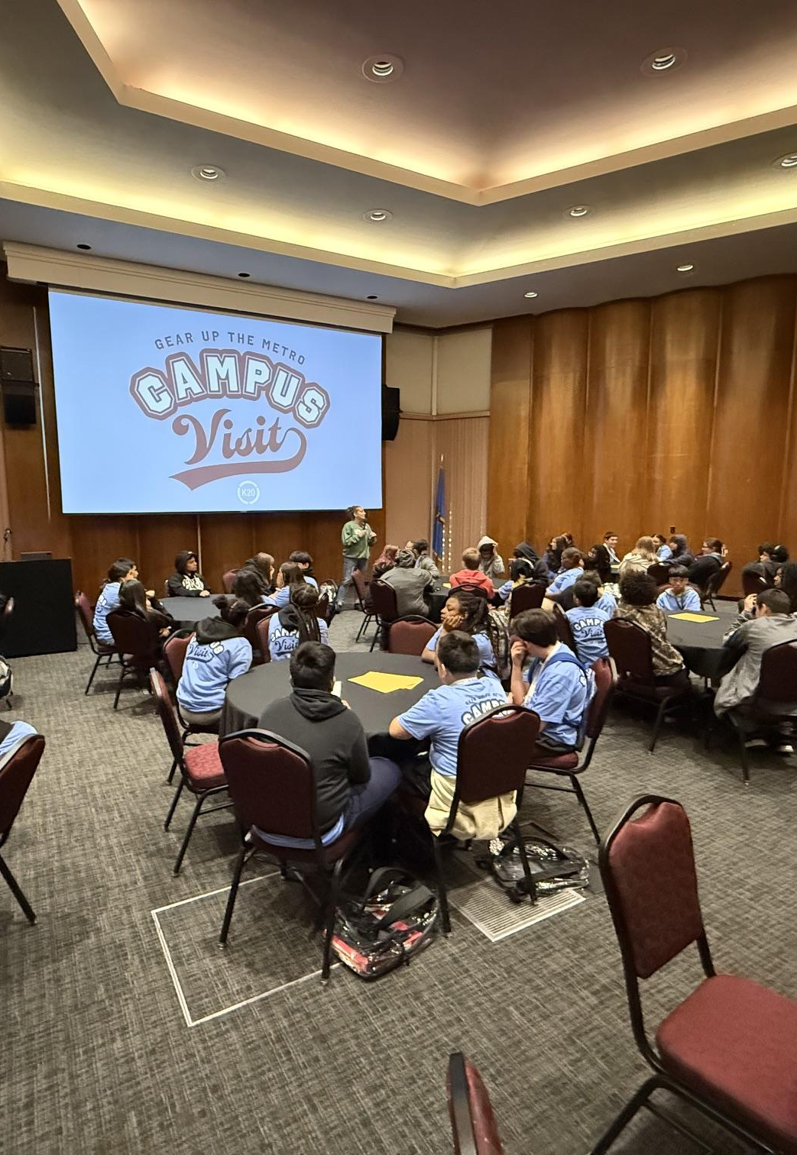
Why Campus Visits?
Campus visits and direct college information were the top influences on students’ decisions to attend college (Xing et al., 2019).
Early and repeated visits beginning in middle school significantly improve college readiness and aspirations (Smith et al., 2022).
Through GEAR UP, annual campus visits allow every student to explore 5+ postsecondary institutions throughout middle and high school.
Notes:
Smith, M. C., Gosky, R. M., & Li, J. T. (2022). Campus visits as predictors of postsecondary enrollment in low-income, rural school districts. Journal of College Access, 7(1), 130-144.
https://files.eric.ed.gov/fulltext/EJ1345622.pdf
Xing, X., Huerta, M., & Garza, T. (2019). College and career preparation activities and their influence on post-high school education and work attainment. Journal of Career and Technical Education, 34(1), 8. https://doi.org/10.21061/jcte.v34i1.a1

Slide 10
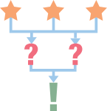
OK Edge: Campus Visit Checklist
Look over the OK Edge: Campus Visit Checklist
Using the sticky notes, write:
3 benefits of using this resource
2 questions you have
1 way can you implement this resource before or after a campus visit
Notes:
K20 Center. (n.d.). 3-2-1. Strategies. https://learn.k20center.ou.edu/strategy/117

Slide 11
Checklist for Campus Visits
Read the Checklist for Campus visits.
Underline tasks that you feel can easily be completed with little bandwidth.
Circle tasks you feel may be challenging or a barrier.
Notes:
Check out this Educator Resource: Campus Visit Scavenger Hunt: Be a Recruiter. K20 LEARN | Campus Visit Scavenger Hunt: Be a Recruiter

