Slide 2
Paving the Path
Career Readiness Practices

Slide 3
Essential Question
How can professional career talks and site visits support informed college and career decision-making?

Slide 4
Learning Objectives
Analyze GEAR UP Mentoring services and their long-term sustainability.
Evaluate how GEAR UP services support ICAP and College and Career Pathway development.
Connect Mentoring services to your school by identifying potential school partners and applicable resources.

Slide 5

Career Cluster Card Matching
Get into groups of 2-3.
Arrange your set of cards on the table, face down.
Each person will take turns flipping two cards at a time, trying to match a career with its Career Cluster. Keep any matching pairs.
Play until you match all the careers and Career Clusters.
The person with the most matches wins!
Notes:
K20 Center. (n.d.). Card matching. Strategies. https://learn.k20center.ou.edu/strategy/1837

Slide 6
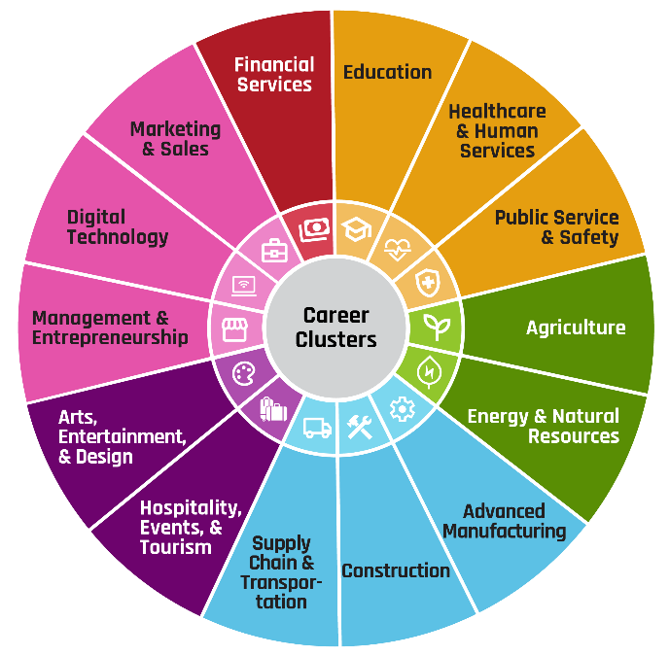
Mentoring Services Overview
Zoom Into Your Career (ZIYC)
  Students meet professionals from multiple industries.
Career Cafe (CC)
  Focused professional goes deeper into one
career cluster.
College2Career Forum (C2CF)
  Students see a real workplace in action.
School-Based Mentoring Plans
  Additional services implemented by your school.

Slide 7
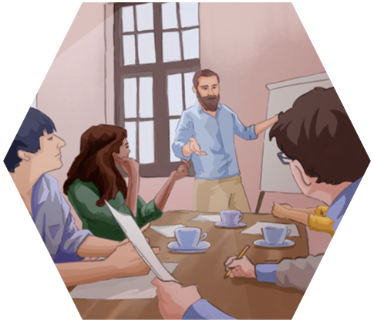
Zoom Into Your Career Activity
Pretend to be a student as you watch a segment of a Zoom Into Your Career video.
Use the Career Talk Organizer as a guide for gathering information and taking notes.

Slide 8

Zoom Into Your Career - Building & Moving with Kaden Stratton
Notes:
K20 Center. (2026, May 26). Building & Moving with Kaden Stratton. Youtube. https://www.youtube.com/watch?v=_TF8mOe4AMw

Slide 9
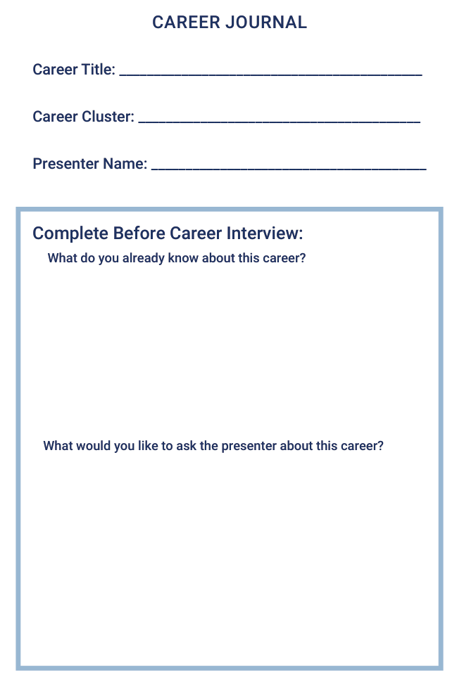
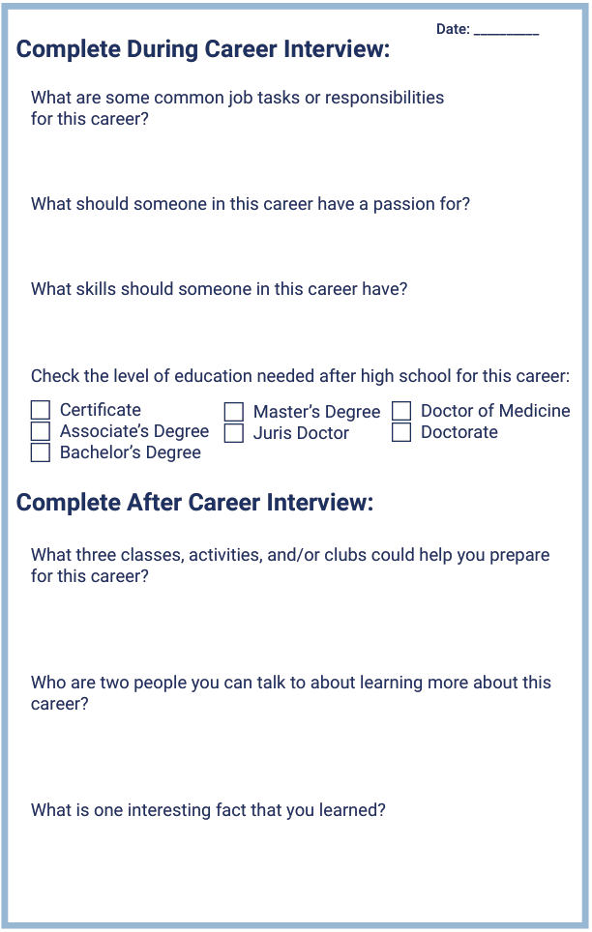
Career Journal
How can keeping a journal enhance student learning?
What are some difficulties you could foresee?

Slide 10

Career Cafe Scenarios Activity
Read through the sample coursework scenarios.
Individually or as a pair, answer questions based on the scenario.
Share with the rest of your table how classroom learning aligns with college and career readiness.

Slide 11
Coursework Connections
Mentoring Career Cafes help students recognize that career connections can be embedded into everyday instruction.
These talks help bridge the gap between what students learn and how it’s used in the real world.

Slide 12


GEAR UP - ICAP and Oklahoma Career Pathways Connections
ICAP
Awareness - Career Interest Survey
Exploration/Preparation - ZIYC/Career Cafes/C2CF
Action - Connections made
Career Pathways
Alignment with student Career Goals
Notes:
K20 Center. (n.d.). Fist to five. Strategies. https://learn.k20center.ou.edu/strategy/68

Slide 13

Connect Mentoring to Your School
Popular career cluster you see in your school.
Teachers that could potentially host career exploration events.
Helpful LEARN resources
  Career Talk
  K20 ZIYC playlist
  C2CF collection
Notes:
K20 Center. (n.d.). 3-2-1. Strategies. https://learn.k20center.ou.edu/strategy/117
K20 Center. (n.d.). Strategy harvest. Strategies. https://learn.k20center.ou.edu/strategy/135

Slide 14


How Can GEAR UP Help You?
Use blue colored sticky note for School Implementation.
Use orange colored sticky note for Questions we will follow up with.
  Be sure to add your contact information on the back.
When ready, place your sticky notes on each side of the T-chart posters around the room.

