Slide 2
Navigating Partnerships
Engaging Families through College and Career Readiness

Slide 3
Essential Question
How can we begin to view and implement family engagement as a strategy to achieve student success?

Slide 4
Learning Objectives
Identify GEAR UP METRO family engagement support and resources.
Recognize family engagement as a strategy for student success.
Evaluate family engagement activities that align to career pathway exploration.
Collaborate with peers to identify implementation strategies.

Slide 5


Forbidden Phrases
Select a card.
Read the word at the top silently.
You may use:
  Words and phrases
  Minimal hand movement
You may not use:
  Any part of the target word
  Any words listed below
  No acting or sound effects!
Notes:
(8 minutes)
Before starting, play a quick game. This activity is based on a K20 Instructional Strategy called Forbidden Phrases (similar to Taboo). For the purpose of this session, it has been adapted to college and career readiness terms.
Ask for two volunteers.
Let the group know they will be playing 2 rounds (each volunteer will do 2-3 depending on the time) of Forbidden Phrases (also known as Taboo).
Each volunteer will get a card and will have 60 seconds to give the group all clues to guess the word on the card they have.
Rules: Participants cannot use the banned word as a part of a compound word or any words embedded in the forbidden word.
Participants cannot use any words listed under the forbidden word.
They may not act it out. Minimal hand movement is allowed.
Discussion questions:
Which term(s) were harder to explain without using the typical “insider” words or descriptors?
What did participants typically revert to in order to help define the terms? Did they use acronyms or educational jargon, a longer explanation or a story?
How do these efforts mirror what a family hears when we use this language without “translating” it?
K20 Center. (n.d.). Forbidden phrases. Strategies. https://learn.k20center.ou.edu/strategy/3342
K20 Center. (2021). 1-Minute Timer. YouTube. https://www.youtube.com/watch?v=6ilD555O_RE

Slide 6
Forbidden Phrases
Which terms were more difficult to explain without using the typical “insider” words or descriptors?
What did you typically revert to? Using acronyms or educational jargon? Giving a longer explanation?
Do you think this mirrors what a family hears?

Slide 7
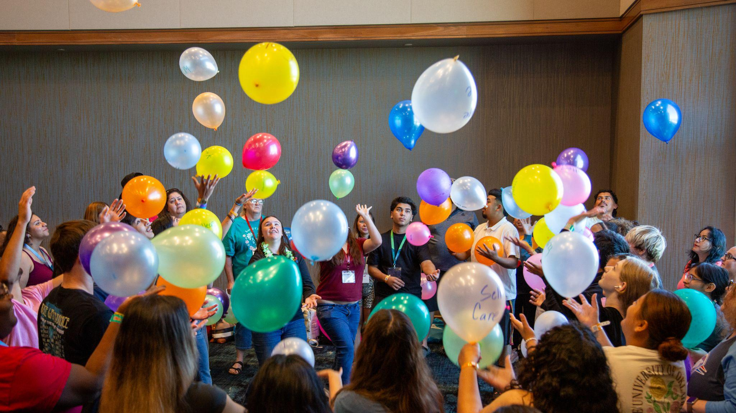
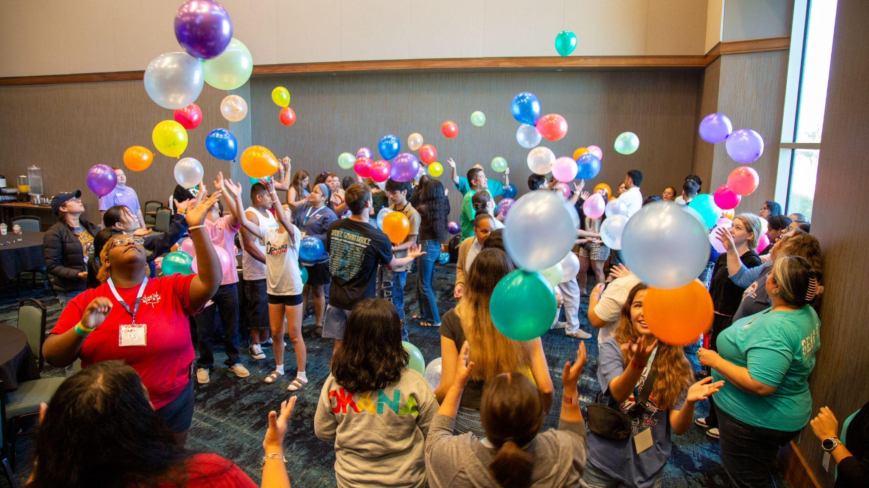
What do we know about Family Engagement?
Parent engagement and shared leadership roles result in higher achievement in high school, increased graduation rates, increased PSE admission rates, and a higher percentage of students enrolled in PSE (Plagens, 2011; Velez, 2020).

Slide 8
What do we know…?
Despite the challenges we often face with family engagement in schools, research has shown time and again that parents/families who are engaged in their child’s learning are one of the ingredients in academic success for students.
Over the last decade, family engagement research has helped evolve our thinking around defining what it looks like for parents/guardians/family members to be involved in their student’s education.

Slide 9


I Notice, I Wonder
Download and open a copy of “Five Roles Families Play to Accelerate Student Learning.”
Read the document.
Write down something you notice (a true statement) and something you wonder about (a question).
k20.ou.edu/r1
Notes:
Flamboyan Foundation. (2022). Five roles families play. https://flamboyanfoundation.org/wp-content/uploads/2022/11/Five-Roles-Families-Play_Flamboyan-Foundation.pdf
K20 Center. (n.d.). I notice, I wonder. Strategies. https://learn.k20center.ou.edu/strategy/180
K20 Center. (2021). 5-Minute Timer. YouTube. https://www.youtube.com/watch?v=EVS_yYQoLJg

Slide 10

Card Sort: CCR Family Standards
Knowledge | Skills | Attitude
Information that families need to understand CCR (College and Career Readiness) | Actions or abilities that families practice to support their student’s CCR | Beliefs, confidence, or mindsets that encourage CCR

Slide 11
Discussion
Knowledge | Skills | Attitude
Which category had the most activities?
Are there any categories that your school’s Family Engagement programming tends to emphasize more than others?

Slide 12
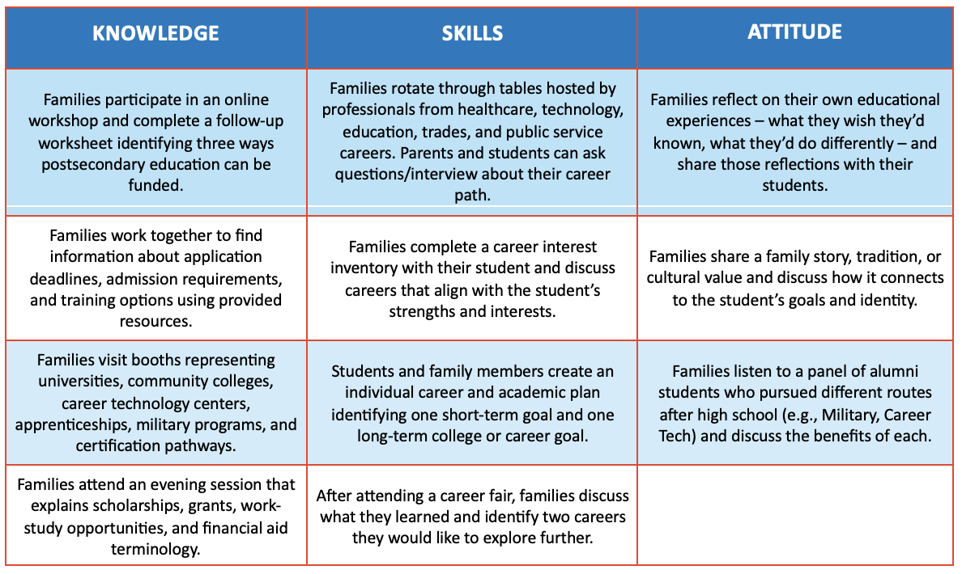
Notes:
(5-8 minutes)
After completing the activity, at your table take 3-5 minutes to discuss:
Are there any categories your school’s family engagement programming tends to emphasize more than others?
Is there a particular activity that you would like to implement at your school? Why?

Slide 13

Think–Pair–Share
Knowledge | Skills | Attitude
Which category could your school strengthen? Why?
Choose an activity from that category. How could you implement that activity?
What modifications would you make?

Slide 14
