Slide 2
Instructional Strategy Café
Shelby Blackwood, Professional Learning Coordinator
Bailie Cobble, Professional Learning Facilitator
Karen Scheaffer, Professional Learning Facilitator
James Doyle, Educator Micro-Credentialing Specialist

Slide 3

Micro-Credentialing Courses
Online Professional Development
  https://k20center.ou.edu/micro-credentialing/
  90 minutes of self-paced learning
  Swivl a lesson to demonstrate learning
T.I.M.E. Courses ($200 each)
  New Course! Exit Strategies
  Classroom Procedures
  Classroom Culture
ADEPT Badge Courses ($1700 total)
  Core content teachers
  Series of six courses focus on student-centered teaching
Notes:
4 min

Slide 4

Sticky Bars
Which of these instructional strategies would you like to explore?
Strike Out
Create the Problem
Strategy Harvest
GramIt
3-2-1
Synectics

Slide 5
Today’s Objectives
Evaluate the basics of six instructional strategies used to engage, formatively assess, and give closure.
Through hands-on collaboration, explore three instructional strategies more in-depth.
Reflect on opportunities to use the strategies in your classrooms.
Notes:
Lacy

Slide 6

Strike Out
What skills do you need for college readiness?
Write down the skills.
Pass your paper to the right to a different group.
Based on the answers given, strike out one item that you believe is the least significant on each paper you receive.
Discuss the skills that remain with members of your group.

Slide 7
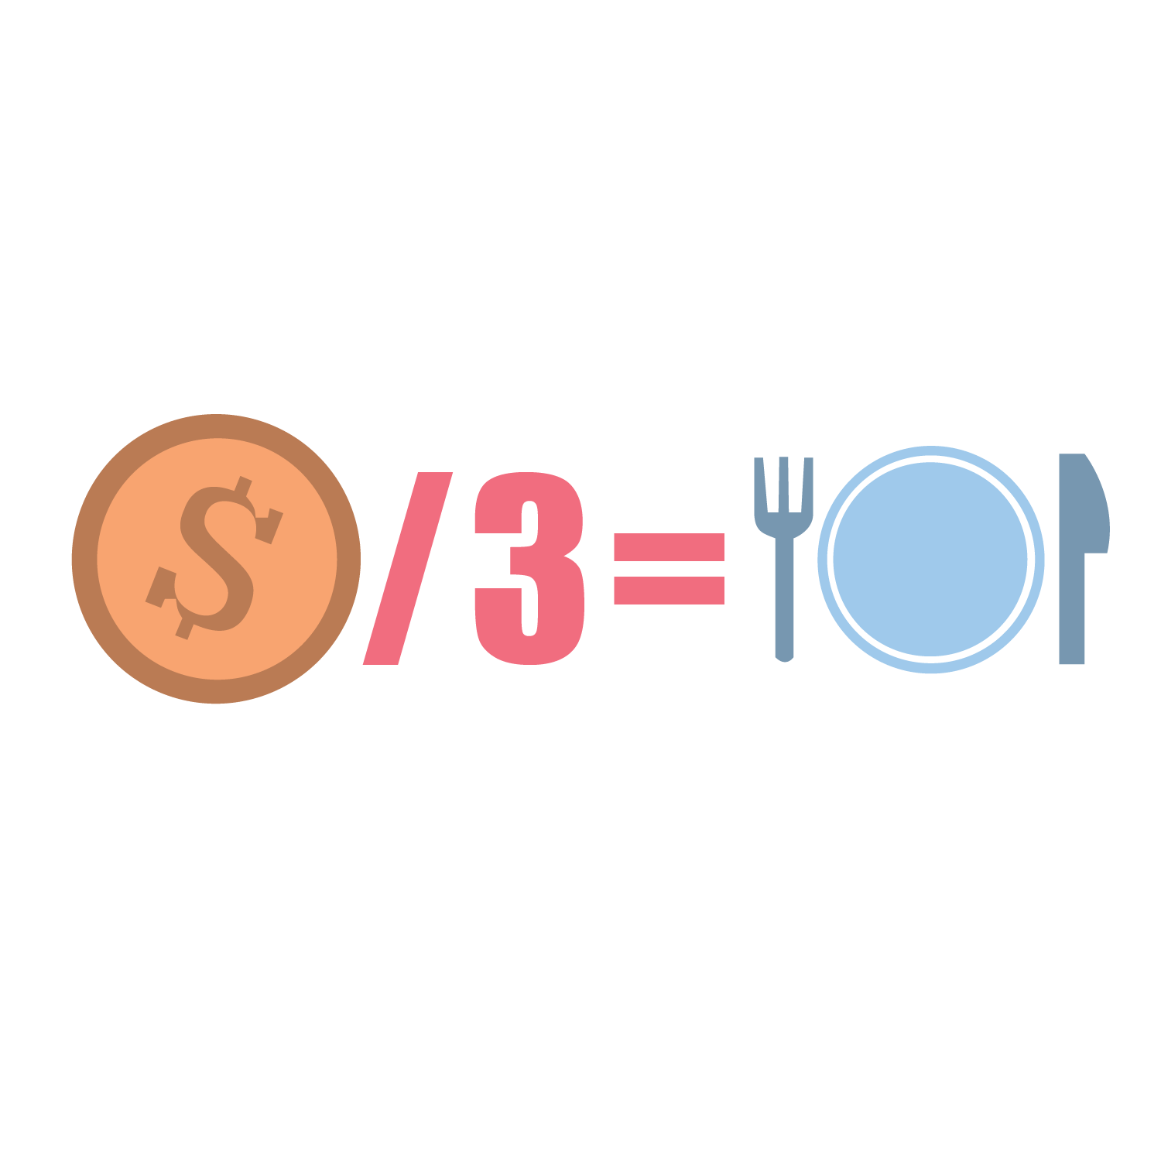
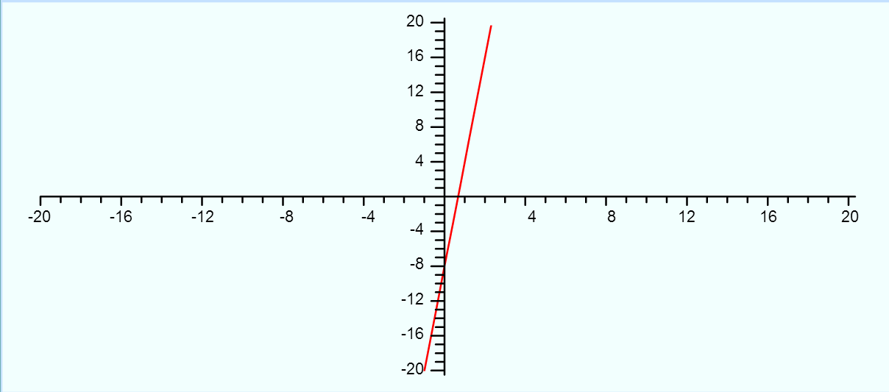
Create the Problem
Using the given information, create a problem in context that would result in the given solution.

Slide 8
Use This Information to Create a Problem
The temperature on the days before and after the wedding rose steadily. The day before the wedding, it was -20 degrees outside, and the day of the wedding, it was -8 degrees.
What was the temperature the day after the wedding? Draw a graph to represent the change in temperature if this were to continue.
Write an equation representing this graph.
Notes:
Possible equation, y = mx + (-b) or y = 12x + (-8).

Slide 9

Strategy Harvest
A rectangular box holds 36 cubes. When she opened the top, Marcia could see 12 on the top. If she opened it from the side, how many cubes would she see?
Notes:
I drew a picture to show the 12 on the top, and I knew that, by making an array for 3 x 4 and 2 x 6, the side would either be two, three, four, or six.

Slide 10

GramIt!
On your paper, illustrate the main idea of the infographic on the next slide. Add a hashtag that summarizes your understanding.

Slide 11

Students today must learn how to move beyond basic comprehension. #Critical Thinking

Slide 12
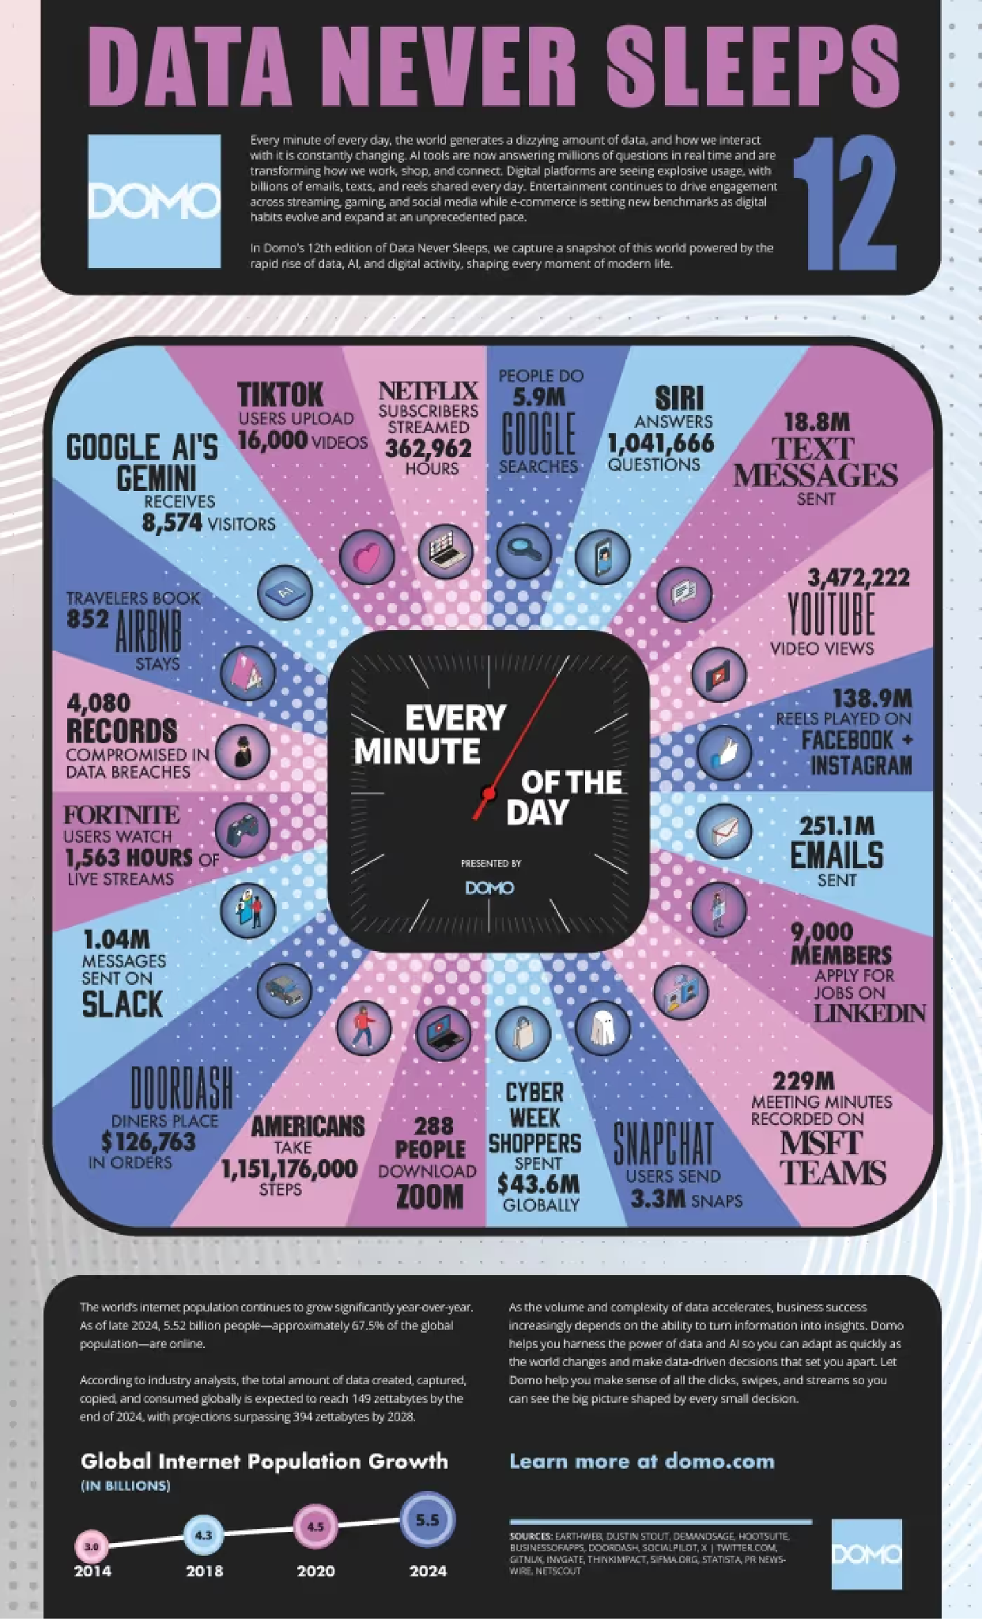
Data Never Sleeps
Notes:
data never sleeps domo.com
https://www.domo.com/learn/infographic/data-never-sleeps-12 2024

Slide 13
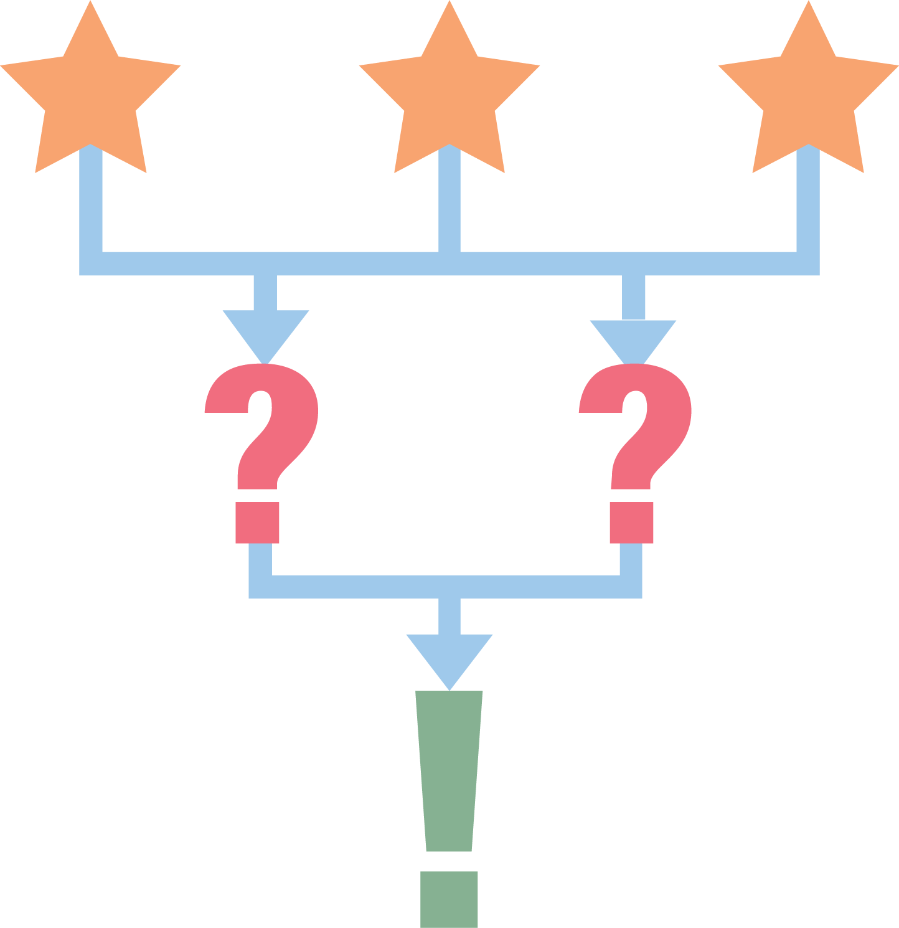
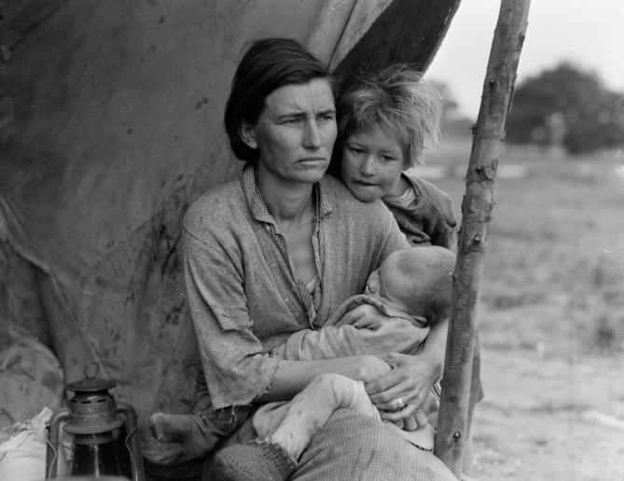
3-2-1
3 things you notice.
2 things you can infer based on your knowledge of the Dust Bowl.
1 question you have.

Slide 14

Synectics
A cell is like a _____ because _________.
  Shopping mall
  A Bowl of Jell-o
  Brick Wall
  City

Slide 15
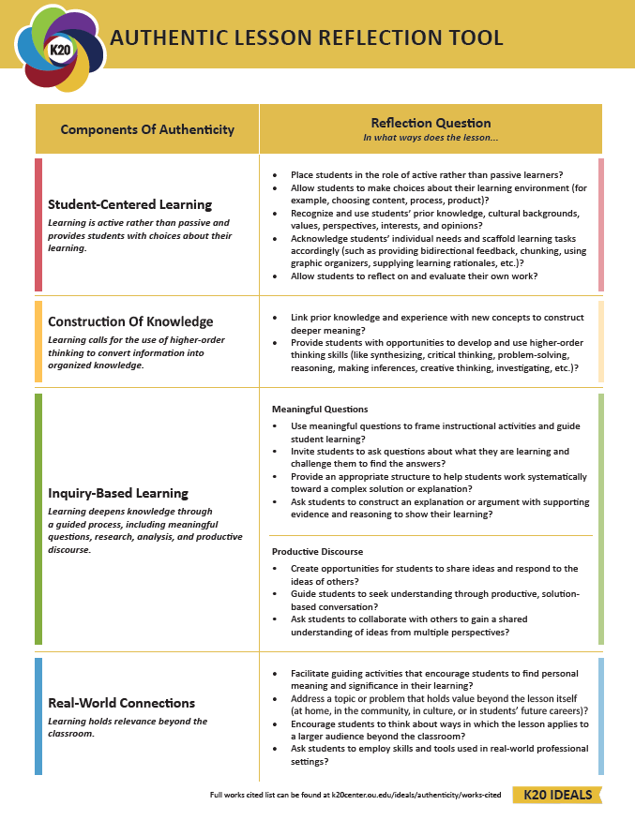
Authentic Lesson Reflection Tool
Notes:
Shelby
Use the authentic reflection tool to discuss the Rumplestiltskin activity.

Slide 16
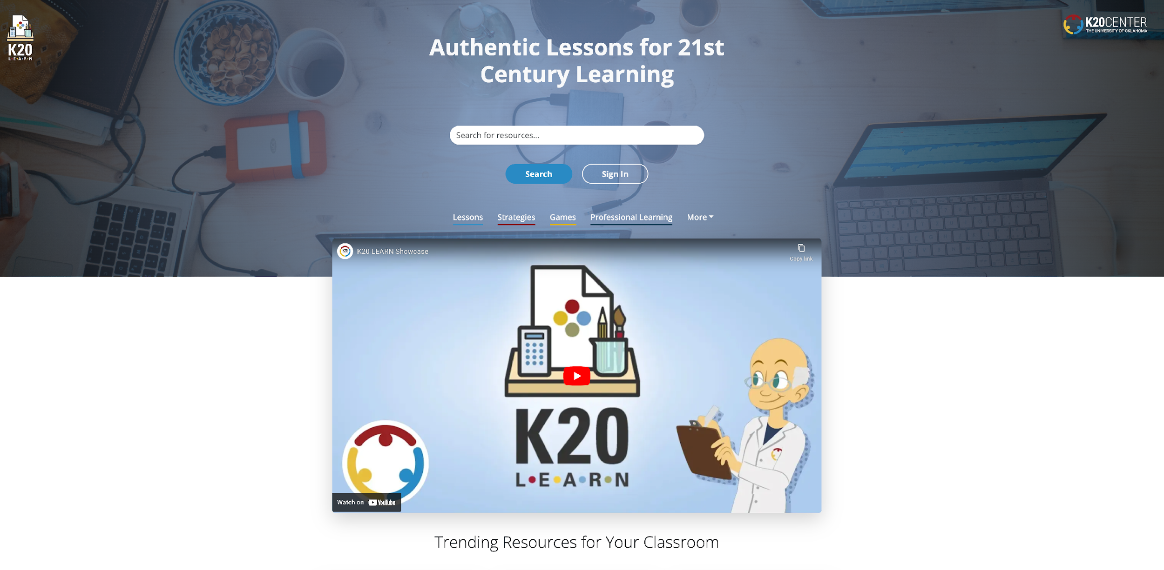
LEARN Instructional Strategies
learn.k20center.ou.edu
Notes:
Lacy

Slide 17



Instructional Strategy Note Sheet
Strike Out
Create the Problem
Strategy Harvest
GramIt
3-2-1
Synectic

Slide 18
EXIT ACTIVITY
Explain how you will use one strategy you have learned about in your own classroom this week.
Write your response on a sticky note and post on the wall or on a sheet of poster paper to share with your colleagues.

Slide 19

We would love your feedback!
trek.k20center.ou.edu/survey/TMBVURF8

