Slide 1
Monitoring Student Learning: Formative Assessment Strategies
Aimee Myers
Lindsay Williams

Slide 2
First Word Last Word
ASSESSMENT
Notes:
First discuss the “whys” for using this strategy. It is used to engage but also allows teacher to look for prior knowledge and gauge growth and fill in gaps.
After they fill out in groups, they share out.
*Make sure they keep it to use at end of session

Slide 3
Instructional Strategies
Notes:
Pass out “Instructional Strategy Note Sheet”

Slide 4
OBJECTIVES
Participants will be able to identify the differences between formative and summative assessments.
Participants will be able to understand the reasons for using formative assessments.
Participants will be able to select instructional strategies that support gathering student data in order to adapt instruction.

Slide 5
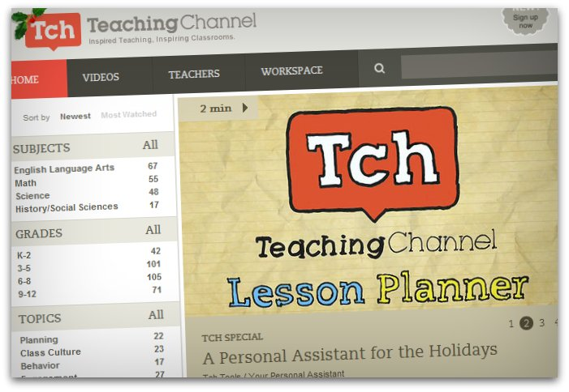
Guiding Questions:
How is the assessment in the video different than traditional assessment?
How could the data gathered from this strategy be used to guide instruction?
How can students use this strategy to assess their own understanding?
https://www.teachingchannel.org/videos/ups-strategy-as-assessment-tool
Notes:
Point out that the assessment strategy in the video is an example of formative assessment.
NOTE: Video is not embedded but is linked from below the preview image. Please be sure to have Internet access for this feature to work.

Slide 6
Paired Verbal Fluency
How can students use this strategy to assess
their own
understanding?
How is the assessment in the video different
than traditional
assessment?
How could the data
gathered from this
strategy be used to
inform instruction?
Notes:
Discuss “whys” of strategy
Explain paired verbal fluency is a way to structure collaborative discussions. Mention there will be three rounds, each round will get a little bit more time as the questions get a little more difficult
Round One: 15 sec each
Round Two: 30 sec each
Round Three: 50 sec each

Slide 7
First Turn/Last Turn
Read your assigned selection and highlight 3-4 things you found significant or meaningful
First person shares a highlighted part and reads it out loud, but they cannot give any commentary
Each person in the group goes around, round-robin style, and comments on the highlighted text. No cross talk during the round-robin.
Last person should be the person who originally shared the highlighted text. They now get to share their comments on the highlighted text.
Notes:
Form groups of three (must have one person from each reading section). Each member reads a different section of text. They highlight parts of the text that stood out to them. In their circle, the first person shares one thing they highlighted; they DO NOT give commentary—they only read part they highlighted. Go around circle and other people share their thoughts on that highlighted sentence/phrase. Lastly, the person who shared the highlighted text gets to share their thoughts. Do this through several rounds.
Link to article http://edglossary.org/formative-assessment/

Slide 8
Inside Out
Get into groups of 3
Jot down any prior knowledge over Formative Assessments in the innermost circle of your graphic organizer
Read your assigned part of the reading
Take turns sharing key information within your group
Write down shared key information
Notes:
Form groups of three (must have one person from each reading section). Each member reads a different section of text. They highlight parts of the text that stood out to them. In their circle, the first person shares the new and important information gained from the text; Go around circle and continue to share from the other parts of the text that were read. Each group member will fill in their circles as each person shares in their group.
Can allow a whole group share out if time allows.

Slide 9
Synectics
Notes:
A way to encourage higher level abstract thinking , thinking outside of the box

Slide 10
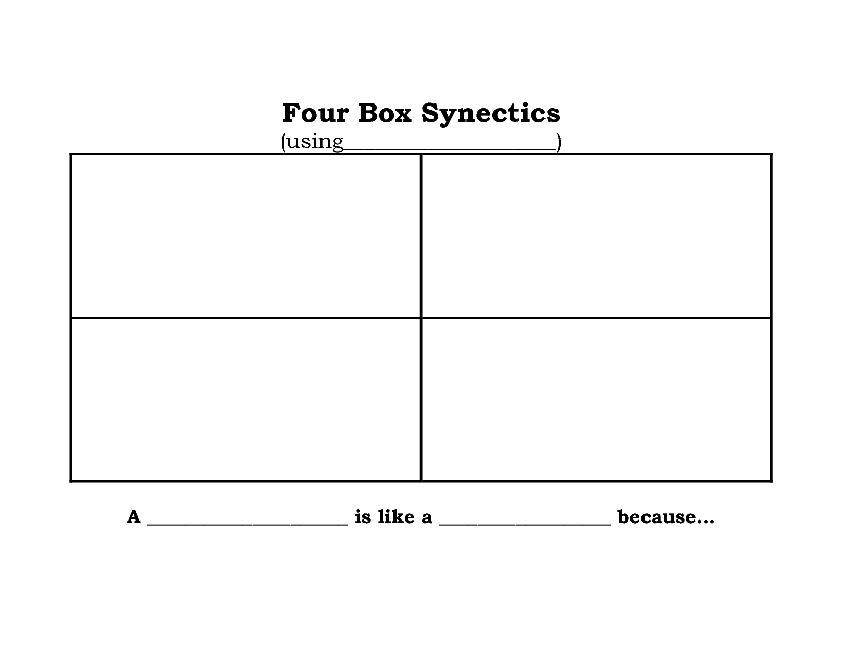
The Constitution
a school
a tricycle
a guitar
a Walmart store
The Constitution is like a tricycle because it divides the government into three branches and because a tricycle has three wheels.
Notes:
This is an example of how to do Synectics in a history class. Mention scaffolding opportunity: you delete the examples after a while, and the students have to come up with the ideas.

Slide 11
the speed limit
a college degree
Summative Assessments
voting
death
Summative Assessments are like _________ because ___________________.
a trip to the doctor
a map
Formative Assessments
painting
shoe shopping
Formative Assessments are like __________ because ___________________.
Notes:
Discuss the “why” for this. Really pushes abstract thinking. It’s another way of assessing a student’s depth of knowledge.

Slide 12
First Word Last Word
ASSESSMENT
Notes:
First discuss the “whys” for using this strategy. It is used to engage but also allows teacher to look for prior knowledge and gauge growth and fill in gaps.
After they fill out in groups, they share out.
*Make sure they keep it to use at end of session

Slide 13
Instructional Strategies
Notes:
Give participants 3 minutes to jot down ideas for the strategies

Slide 14
Higher-Order Thinking
Disciplined Inquiry
Authentic
Teaching
Value Beyond School
Implicit View of Students
Notes:
Distribute rubric and have them discuss with an elbow partner what they are already doing in classroom that meets authenticity. * if you have time only

Slide 15
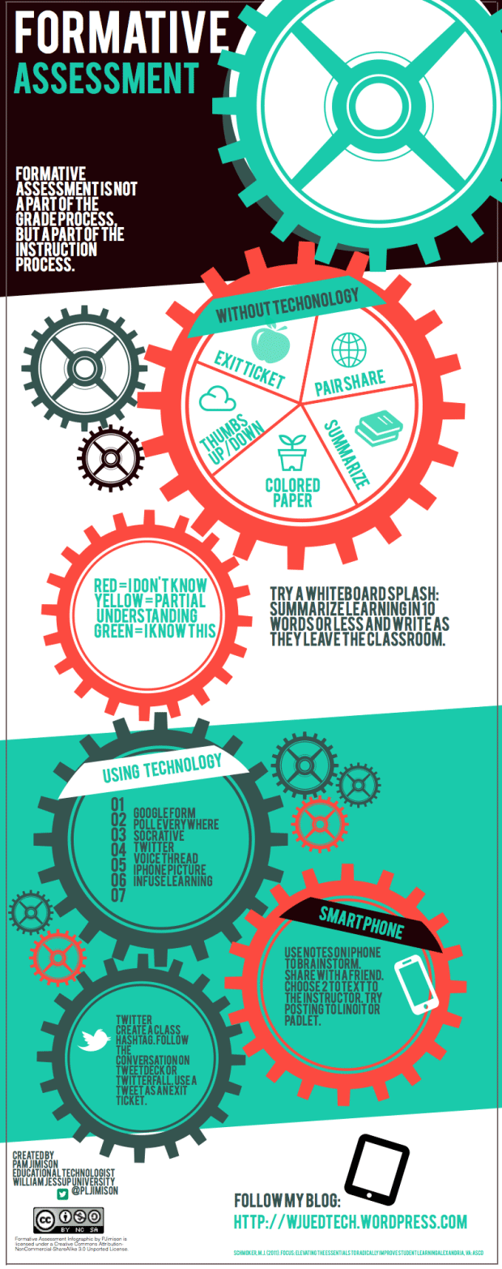
COLLABORATION TIME

Slide 16
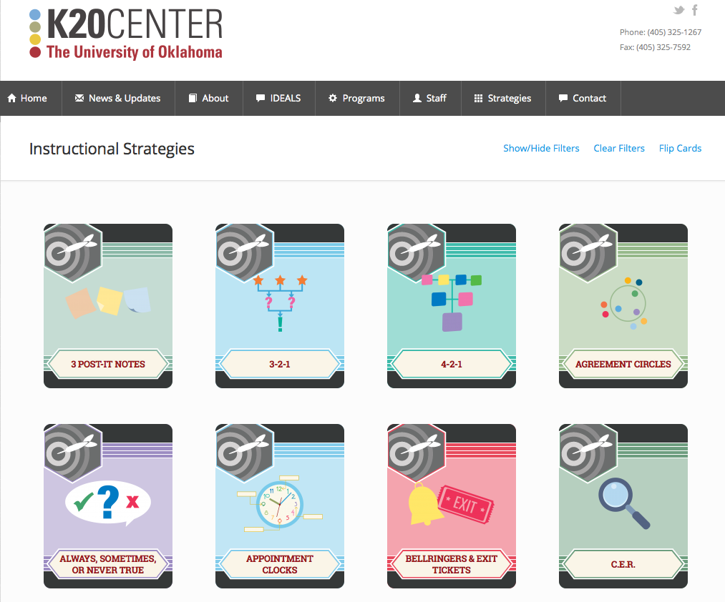
K20 STRATEGIES
https://learn.k20center.ou.edu/strategy/find.html
Notes:
Website to Instructional Strategies used in session

Slide 17
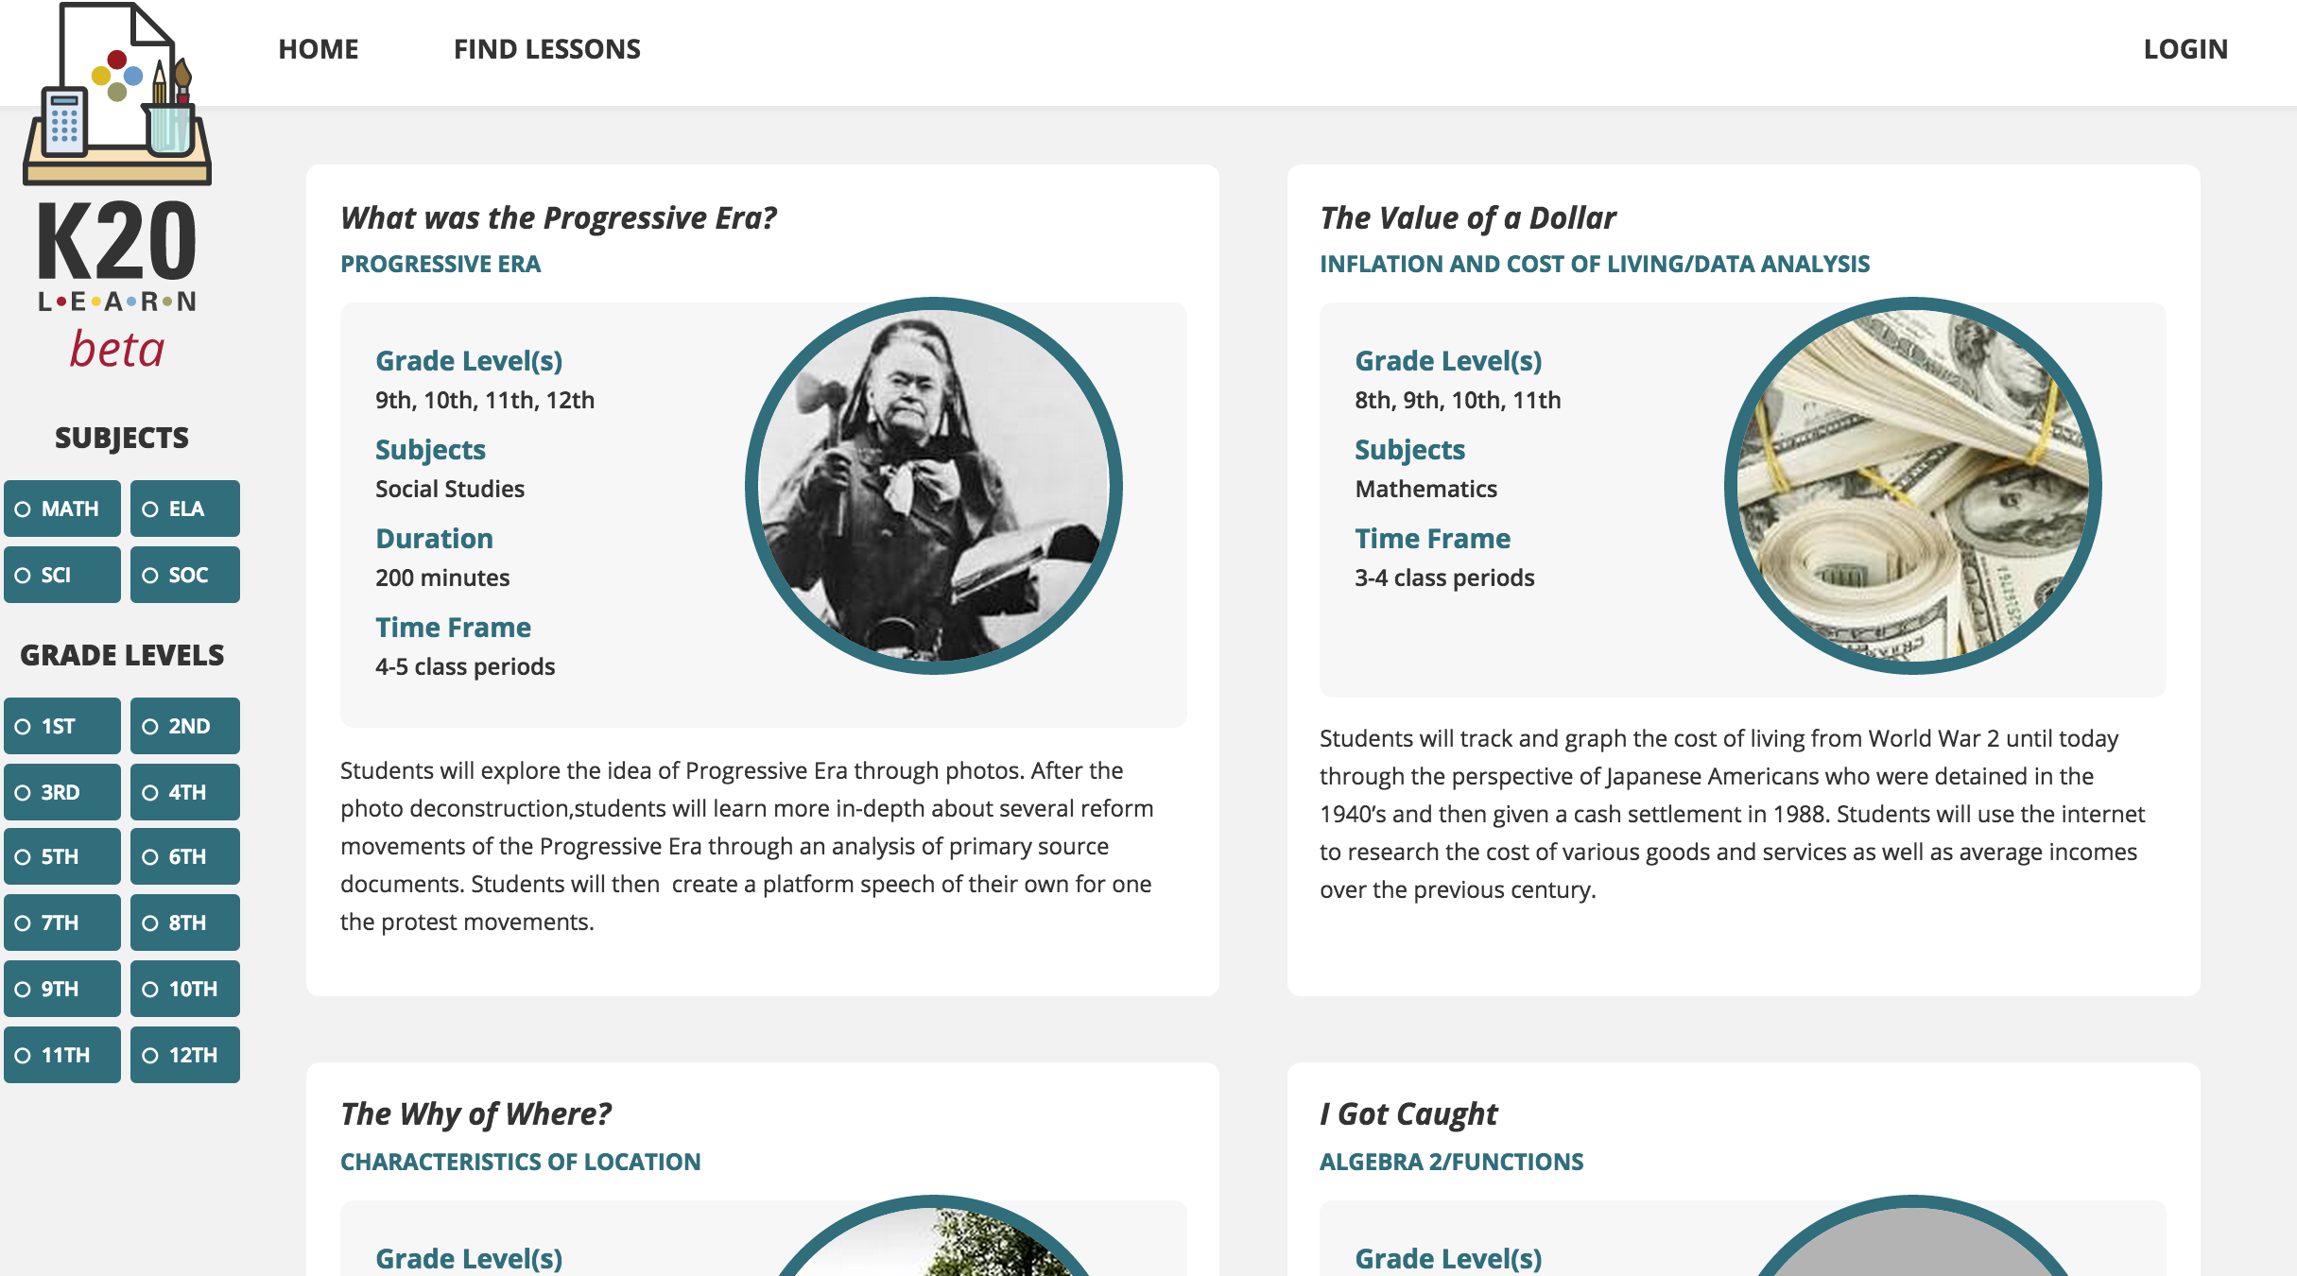
K20 LEARN
learn.k20center.ou.edu

Slide 18
HOW DID WE DO?
Participants will be able to identify the differences between formative and summative assessments.
Participants will be able to understand the reasons for using formative assessments.
Participants will be able to select instructional strategies that support gathering student data to inform instruction.

