Slide 2
What’s Everyone Talking About?: Student Conversations
Presenter Name Here

Slide 3
GEAR UP OKC Goals
Increase students’ engagement in learning.
Increase students’ academic preparation for PSE upon graduation.
Increase schools’ high school graduation and PSE enrollment rates.
Increase students’ and their families’ knowledge of PSE options, preparation, and financing.

Slide 4
Observations From the Field
A teacher wanted to increase student voice.
I went to observe a teacher trying out a new strategy.
We Swivled this observation.
Let’s debrief it together.
Notes:
Facilitator Notes: Set the scene for your participants! Be serious- play it up as a genuine experience.

Slide 5
South Park Season 17 Episode 2
Notes:
Parker, T. (Writer & Director). (2013, October 2). (Season 17, Episode 2) [TV series episode]. In Agnone II, F. C., Garefino, A., Parker, T., & Stone, M. (Executive Producers), South park. Paramount Home Entertainment.

Slide 6
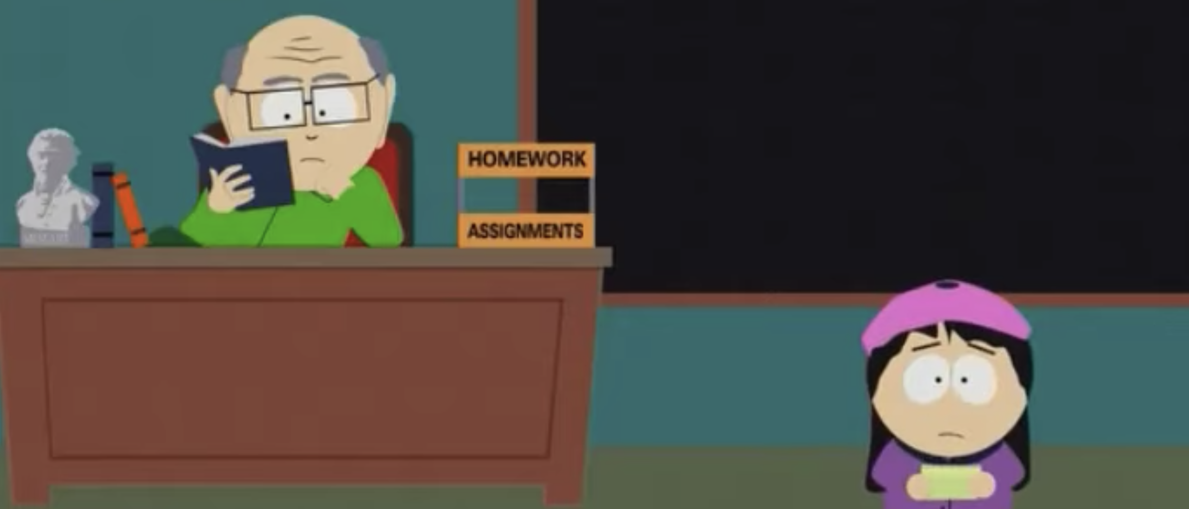
Debrief
What did the teacher do well?
What are areas that have room for improvement?
Notes:
Facilitator Notes: Roundabout Debrief
Instruct the participants to find a teacher across the room and walk over and answer the two questions. After they have done this one time, have them do it a second. Instruct them to go across the room and find a different teacher to discuss these questions. Once participants have had an opportunity to discuss the two questions with at least two different people, have them share out their thoughts with the whole group.

Slide 7
Objectives
Participants will recognize strategies for supporting student conversations in their classrooms.
Participants will explore why student conversations are important.
Participants will identify how student conversations are integrated within the Summit platform.
Participants will develop a plan for increasing student conversations.

Slide 8
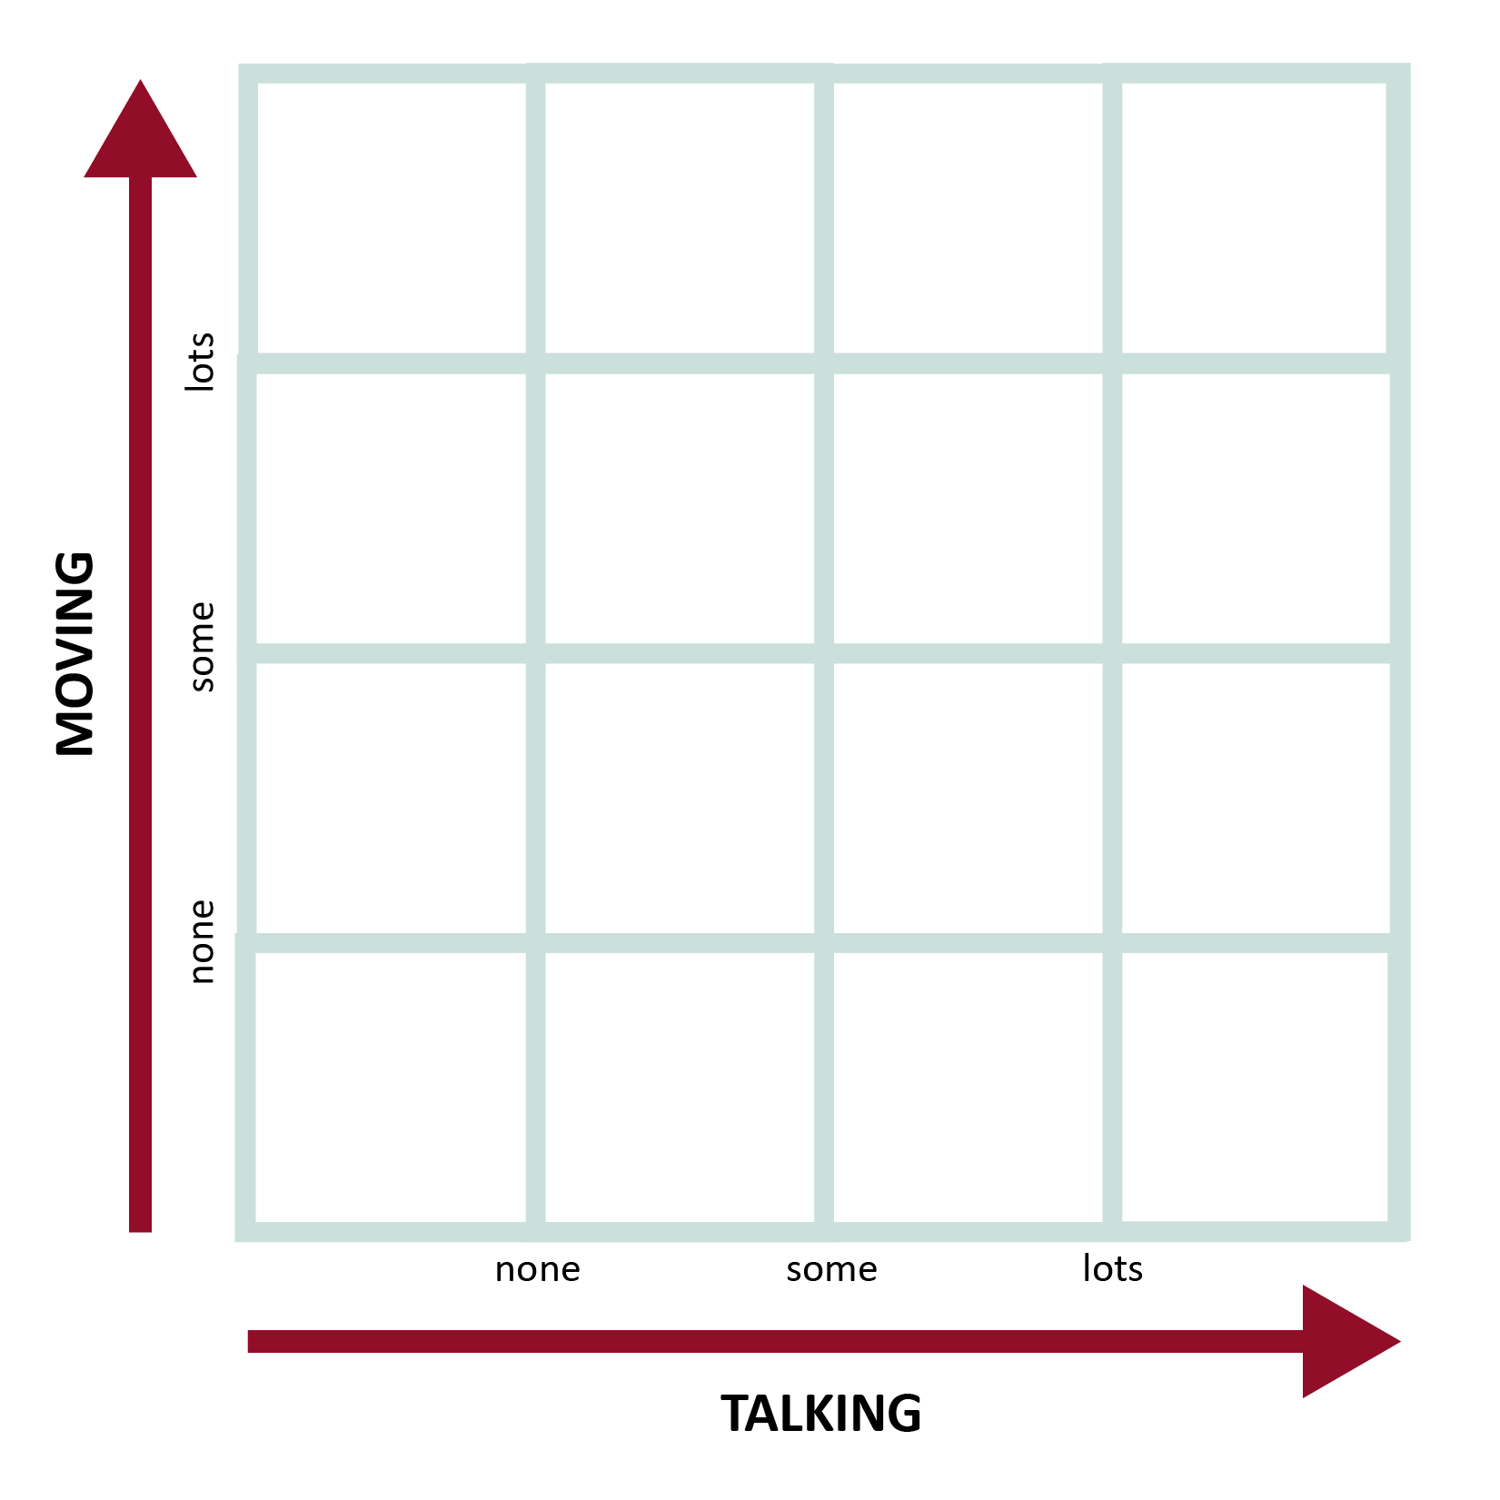
Ways Students Interact
How can we add student conversation to our classrooms safely and productively?
Two problems frequently mentioned are:
noise level
student movement
On your scatter plot, mark where you think the Roundabout Conversations strategy falls for both talking and moving.

Slide 9
Magnetic Statements
Decide if you are “attracted” to or “repelled” by each statement.
Then, have a low-voice conversation with your elbow partner about how you feel, and why you feel that way.
Finally, jot down your thoughts and your partner’s thoughts.
Notes:
Facilitator Notes:
Explain that this strategy can support student conversations within your classroom.
Today we are going to use it to discuss student conversations.

Slide 10
Statement 1
A personalized learning platform like Summit gives teachers a deeper understanding of each child, sparks student conversations, and increases motivation.
Attracted or Repelled?
Talk with your neighbor.
Notes:
Facilitator Notes: After the participants talk to each other about if they are attracted or repelled and provide an explanation, have them share out their thoughts.

Slide 11
Statement 2
When students interact with peers in a way that is on task and involves higher-order thinking processes, it leads to higher student engagement.
Attracted or Repelled?
Talk with your neighbor.
Notes:
Facilitator Notes: After the participants talk to each other about if they are attracted or repelled and provide an explanation, have them share out their thoughts.
(Johnson, P. May/2015)

Slide 12
Statement 3
When students are collaborating, discussing topics, etc., the teacher is responsible for interacting and engaging with the groups.
Attracted or Repelled?
Talk with your neighbor.
Notes:
Facilitator Notes: After the participants talk to each other about if they are attracted or repelled and provide an explanation, have them share out their thoughts.

Slide 13
What Does This Mean?
There are specific, non-content skills that, according to research, support deep, lifelong learning.
Literacy—including speaking, listening, and communicating—is represented in all standards.
From Magnetic Statements, you may have concerns; today, we’ll work on constructing solutions.
Notes:
Facilitator Notes: Research shows that often speaking and listening are ignored on our standards. They aren’t something we ”test” over. They are still crucial to student rigor!

Slide 14
How Can I Use This?
On your scatter plot, mark where you think the Magnetic Statements strategy falls.
Notes:
Facilitator Notes:
How might you use this strategy in your classroom?
Have participants share out the strategy ideas.
No movement- modified to meet the needs of rooms- not all talking equals movement. Not letter of the law Jot down thoughts on Note catcher

Slide 15
Instructional Strategy Note Catcher
On the back of your sheet, there is an Instructional Strategy Note Catcher.
Fill in the “How Was It Used?” and “How Will I Use It?” columns for Roundabout Conversations and Magnetic Statements.
Notes:
Facilitator Notes:
Allow time for participants to reflect and complete their LEARN Strategy Reflection on the Instructional Strategy Notes handout.

Slide 16
Why Do Student Conversations Matter?
Notes:
Facilitator Notes:
Before moving onto the next slide, ask participants to share out their thoughts on this question.

Slide 17
Why Do Student Conversations Matter?
English Language Arts Literacy Standards
Speaking and Listening
Reading Foundations with Reading and Writing Process
Critical Reading and Writing
Vocabulary
Language
Research
Multimodal Literacies
*Independent Reading and Writing
Notes:
Facilitator Notes:
It’s in the standards!
**Although this doesn’t necessarily include student conversations, it still is an ELA standard.
Why do you think we included reading and writing as a standard supported by student conversations?

Slide 18
Why Do Student Conversations Matter?
The 4 Cs of 21st Century Skills:
Communication
Collaboration
Critical Thinking
Creativity
Notes:
Facilitator Notes:
It’s in the standards!
To be competitive in today’s society and world at large, students need these skills.

Slide 19
Why Do Student Conversations Matter?
Marzano’s TLE:
Using questions to help students elaborate on content
Facilitate a student brainstorm
TLE Conditions for learning: organizing students to interact with content
Providing grouping strategies and interaction
Interacting responsibly
Handling controversy
Various group processes and activities to reflect the taxonomy level learning targets
Notes:
Facilitator Notes:
It’s in the standards! They are also a part of your teacher observations.

Slide 20
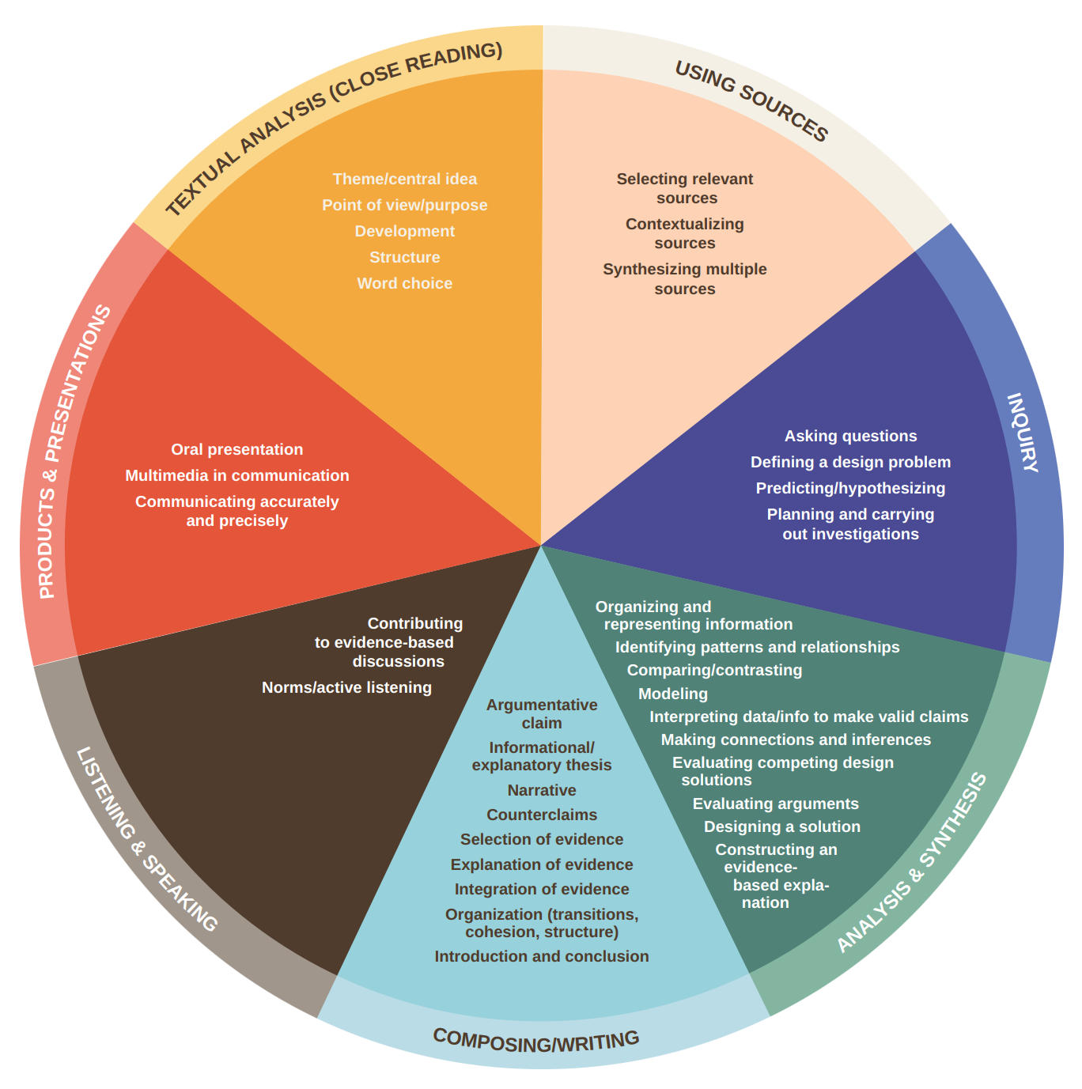
Why Do Student Conversations Matter?
Summit Learning and Stanford Center for Assessment. (n.d.) Cognitive Skills Rubric. Cognitive Skills Standards Alignment. Retrieved from https://cdn.summitlearning.org/assets/marketing/Cognitive-Skills-Document-Suite.pdf
Notes:
Facilitator Notes:
Summit Cognitive Rubric
Developed in collaboration with the Stanford Center for Assessment, Learning, & Equity. May, 2017.
Summit Learning and Stanford Center for Assessment. (n.d.) Cognitive Skills Rubric. Cognitive Skills Standards Alignment. Retrieved from https://cdn.summitlearning.org/assets/marketing/Cognitive-Skills-Document-Suite.pdf

Slide 21
Chain Notes
Without talking, read through the passage and highlight things that matter to you in your classroom.
Notes:
Facilitator Notes:
Pass out the Student Conversations ARE Learning Reading!
Remember to connect this back to annotation strategies and tie to Authenticity.
This strategy is close to Why-Lighting. As you are highlighting, annotate where you highlighted.

Slide 22
Trying Chain Notes
In box 1 on the table, write one generic example of a non-substantive conversation.
In box 2, building on what was written in box 1, write a generic example of a substantive conversation.
Pass your paper to the person on your right.
Notes:
Facilitator Notes:
Explain to the group that you are going to explain the strategy in full first.
If I were doing this with a class for the first time, I would practice the procedure with a non-academic topic and keep the cognitive demand low while they are learning the procedure.

Slide 23
Trying Chain Notes
Read what was written in boxes 1 and 2. In boxes 3 and 4, write a specific example of non-substantive and substantive conversations that connect to the generic statement.
Pass the paper to the person on your right and repeat with another example of generic and specific examples.

Slide 24
Trying Chain Notes
Non-Substantive Conversations | Substantive Conversations
Two students take turns reading an article, then answer the questions at the bottom of the page.
Students manipulate factual content into an argument, conclusion, or hypothesis through negotiation with a partner.
Students read factual content and discuss in pairs.
Students use a discussion with a peer to guide their progress through an experiment. They take their data and observations and work to draw a conclusion.
Notes:
Facilitator Notes:

Slide 25
How Can I Use This?
On your scatter plot, mark where you think the Chain Notes strategy falls.
Notes:
Facilitator Notes:
Share out the strategy ideas. LOW Talking low movement
How might you use chain notes in your classroom?

Slide 26
Instructional Strategy Note Catcher
Fill in the “How Was It Used?” and “How Will I Use It?” columns for Chain Notes.
Notes:
Facilitator Notes:
Allow time for participants to reflect and complete their LEARN Strategy Reflection on the Instructional Strategy Notes handout.

Slide 27
I Think/We Think
Where would student conversations occur on the Summit platform?
I Think: Personal Reflection
Summit Teachers: Where in Summit’s focus areas or projects do I include student conversations?
Non-Summit Teachers: How can I structure student conversations so that they are productive and increase critical thinking?
Notes:
Facilitator Notes:
Talk it out: Now that we’ve talked about some of these, the only way to get kids used to having conversations is to actually engage in conversations.
Independent (Pass out the I Think/We Think paper on the back of SMART Goals paper.)
“I think” on piece of paper independently
How it looks in my room may look different than it does in yours.

Slide 28
I Think/We Think
With your team members, department, or grade level, come to a consensus on where student conversations occur.
Start by looking for commonalities and differences in your personal reflections.
What can be combined?
What is too generic or vague?
Notes:
Facilitator Notes:
Group with like pairs;
Summit and non-Summit and like subject area
Poll audience for true grouping based on attendees
Posters with questions that were just answered are on walls. In like groups come to an agreement about student conversations and write thoughts on posters.
We should be on the same page, what are the 3 ways we can be on the same page, how will you make it uniquely yours??
Create Norms Poster for both Summit and non-summit teachers. Depending on the number of people in the PD session, may need more than two posters.
After norms posters are created share out to whole group.
How might you use I Think/We Think in your classroom?

Slide 29
Putting It Together
On your scatter plot, mark where you think the I Think/We Think strategy falls.
Based on your scatter plot, do student conversations happen in just one way?
I Think/
We Think
Roundabout Conversations
Chain Notes
Magnetic Statements
Notes:
Share out the strategy ideas.
Facilitator Notes: The strategies will appear with one click (for each) once participants have had a chance to mark down their I Think/We Think and discussed the guiding question.

Slide 30
Instructional Strategy Note Catcher
Fill in the “How Was It Used?” and “How Will I Use It?” columns for I Think/We Think.
Notes:
Facilitator Notes:
Allow time for participants to reflect and complete their LEARN Strategy Reflection on the Instructional Strategy Notes handout.

Slide 31
Goal Setting: Classroom Conversations
Writing a SMART Goal
When and where will I increase student conversations in my class?
How much and how often will student conversations occur? By what percentage will they increase?
What steps will I take to implement my SMART goal?
Who can help me with this goal? How will I know I have achieved an increase?
When will this begin?
PLC Accountability Partners
Notes:
Facilitator Notes:
Pass out the SMART Goals paper!
It’s not just about writing a goal. You have to hold yourself accountable, but sometimes that can be hard! Find someone who is not at your table, but is in your PLC. You will be discussing you progress with each other throughout the remainder of the year in your PLC.

Slide 32
Rapid Feedback
Notes:
Facilitator Notes:
Insert a QR Code for the TREK Evaluation prior to the PD

