Slide 2
Virtual Career Expo
Improving Access, Connecting Communities, and Increasing PSE Awareness

Slide 3
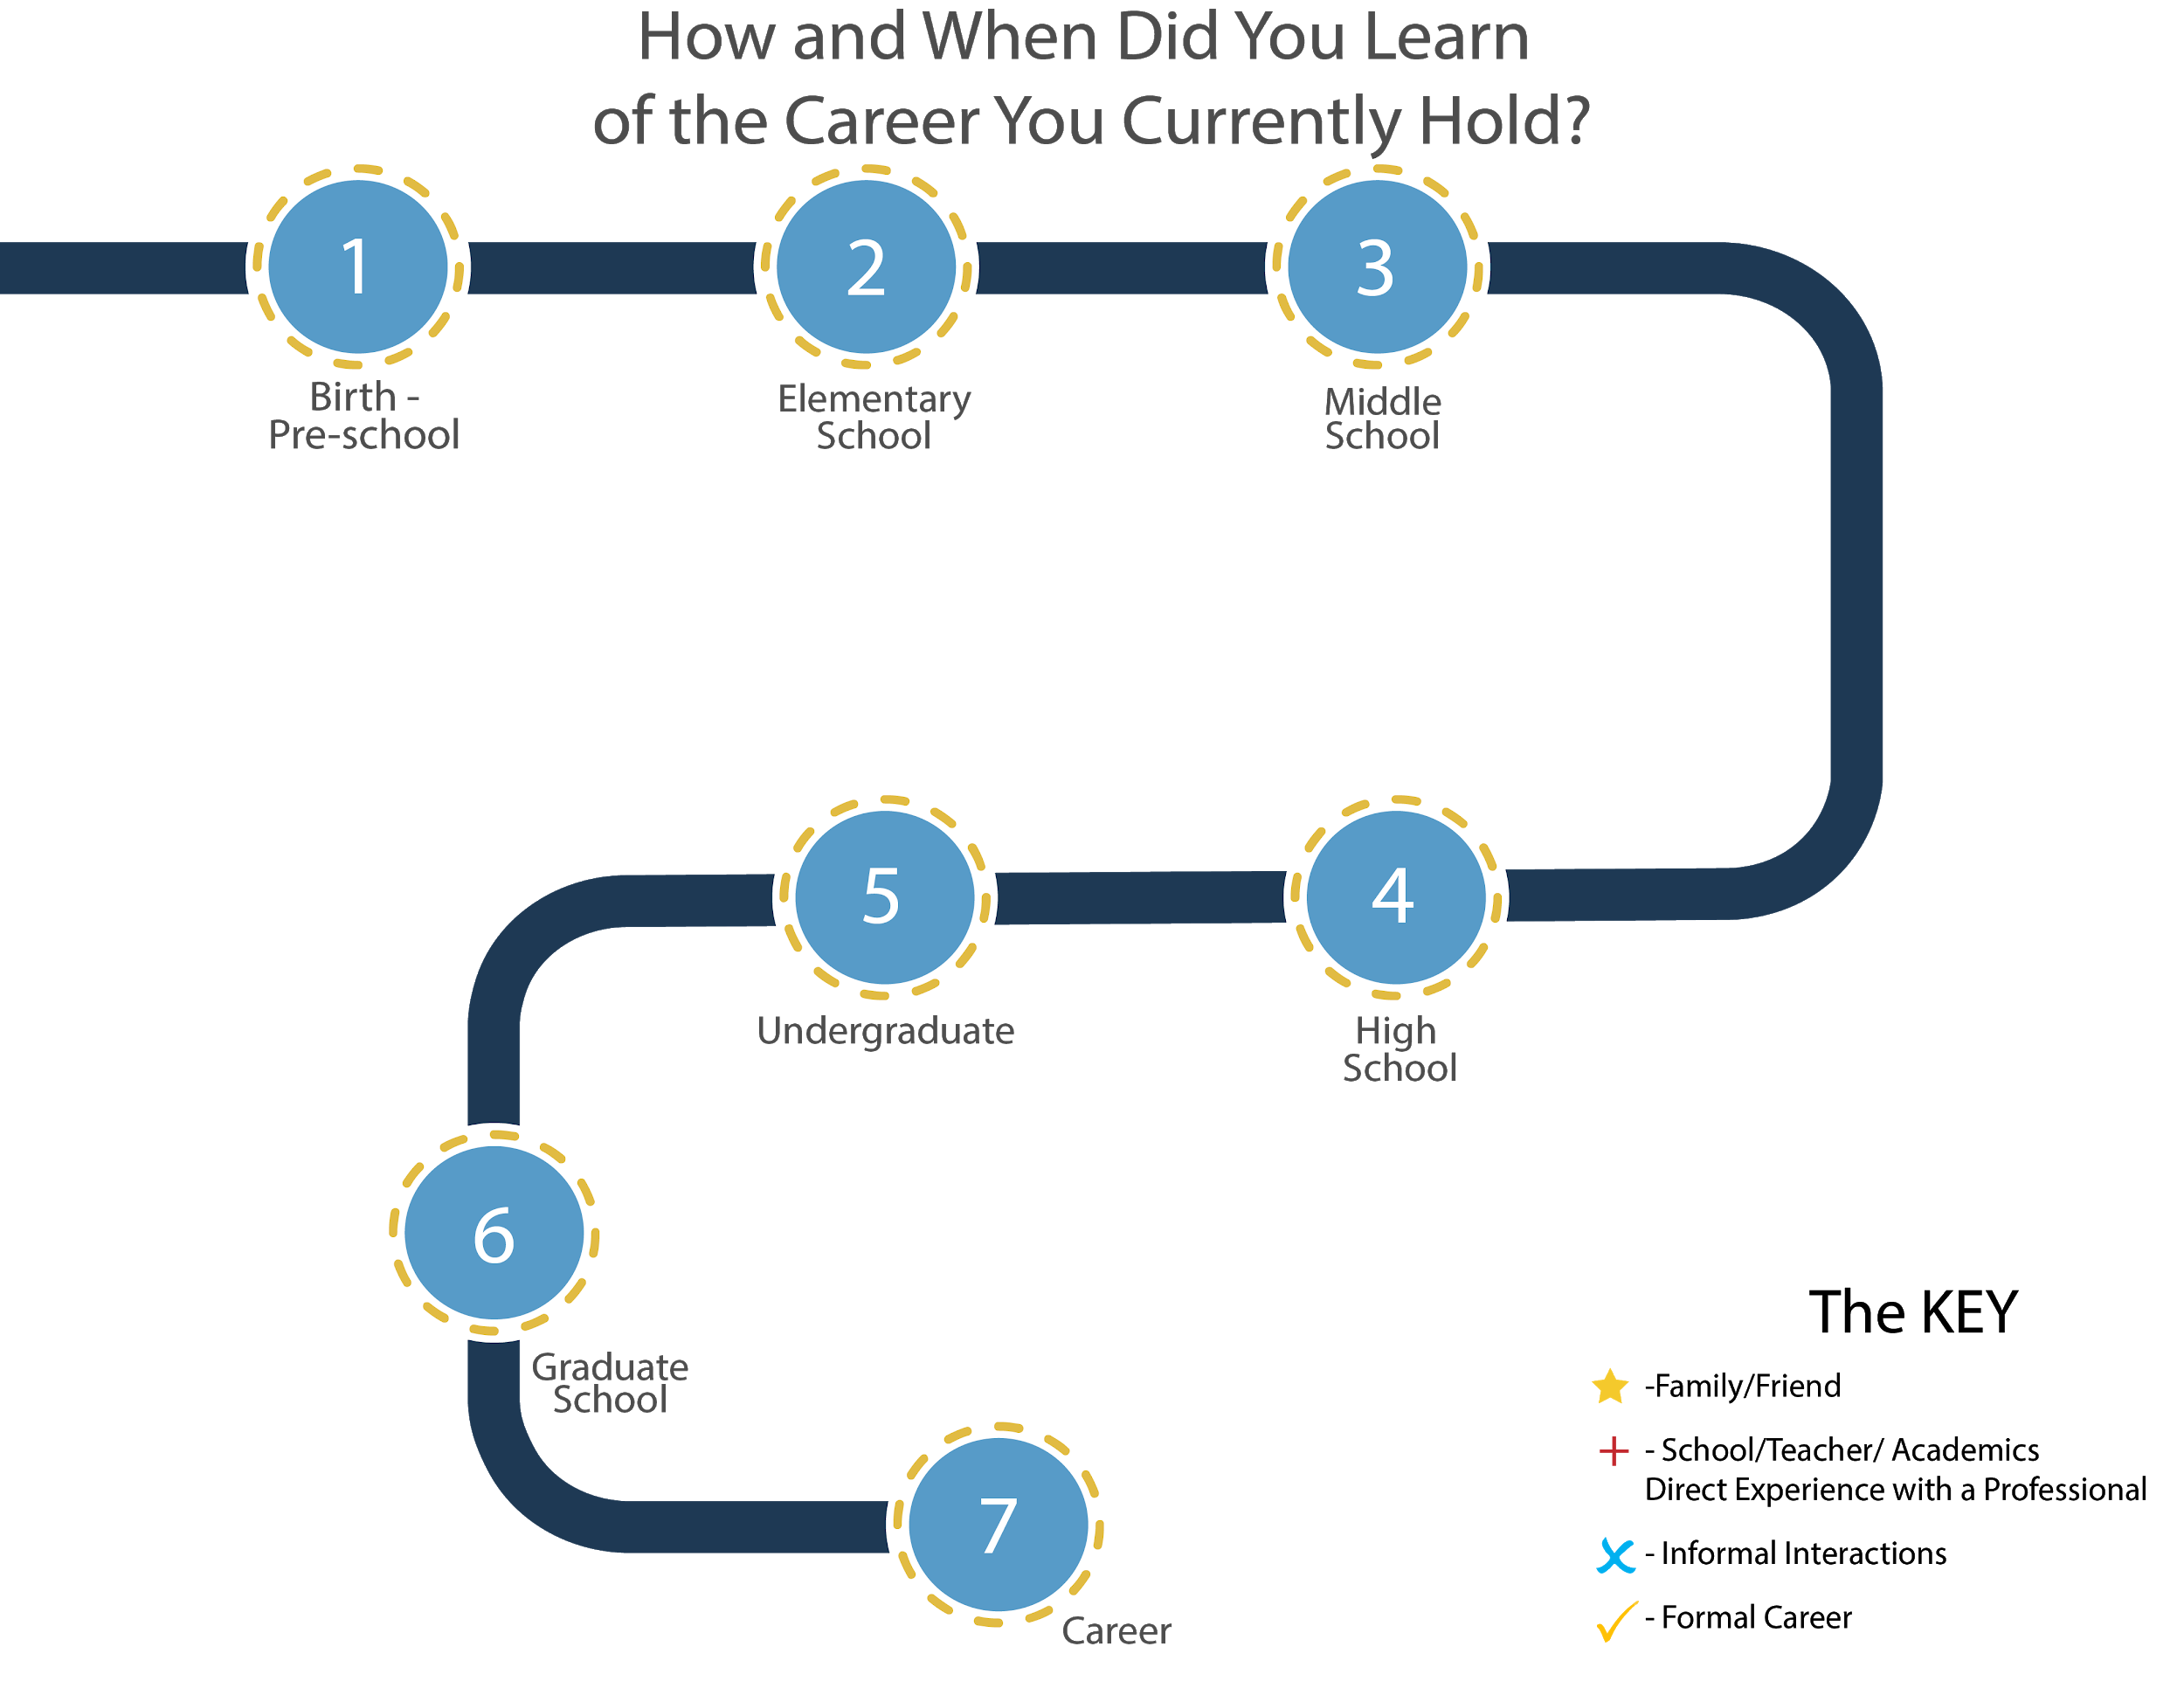

Slide 4
When should career exploration be introduced to students?

Slide 5
When were you introduced to career exploration?

Slide 6
When did you learn about the career you currently hold?

Slide 8
GEAR Up for the FUTURE Goals
1. Increase cohort academic performance and preparation for postsecondary education (PSE)
2. Increase high school graduation and PSE participation
3. Increase student educational expectations and increase student and family knowledge of PSE options, preparation, and financing
Notes:
Instructor/Facilitator Notes:

Slide 9
GEAR UP OKC Goals
Increase students’ engagement in learning.
Increase students’ academic preparation for PSE upon graduation.
Increase schools’ high school graduation and PSE enrollment rates.
Increase students’ and their families’ knowledge of PSE options, preparation, and financing.

Slide 10
GEAR UP for MY SUCCESS Goals
Increase cohort academic performance and preparation for PSE.
Increase High School graduation and PSE participation.
Increase student educational expectations and increase student and family knowledge of PSE options, preparation, and financing.

Slide 11
Essential Question
How can your community help support your goal in improving access among the students while increasing Post-Secondary Education (PSE) awareness?

Slide 12
Learning Objectives
Participants will:
Engage in a virtual career experience
Envision implementation of the virtual experience into their program
Assess the value of virtual career experiences

Slide 13

Collaborative Word Cloud
While watching the video, take note of any keywords that stand out to you.

Slide 14
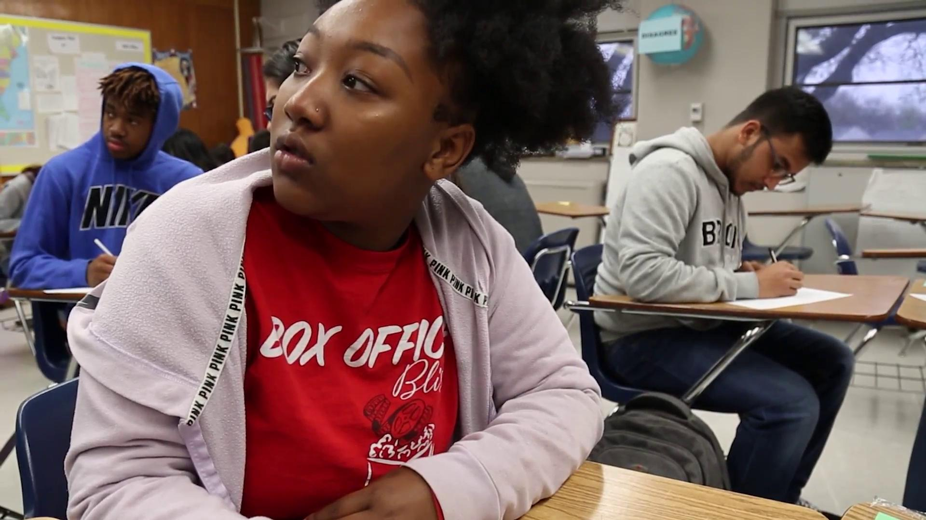
Notes:
2:41 tarah- 3:19 (speaker highlight)

Slide 15
Collaborative Word Cloud
With your group:
Discuss the list of keywords you have
Why did those stand out to you?
Create a word cloud

Slide 16
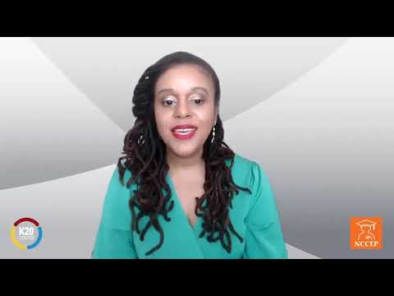

Slide 17
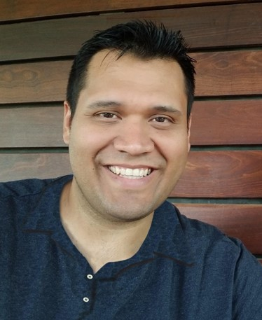
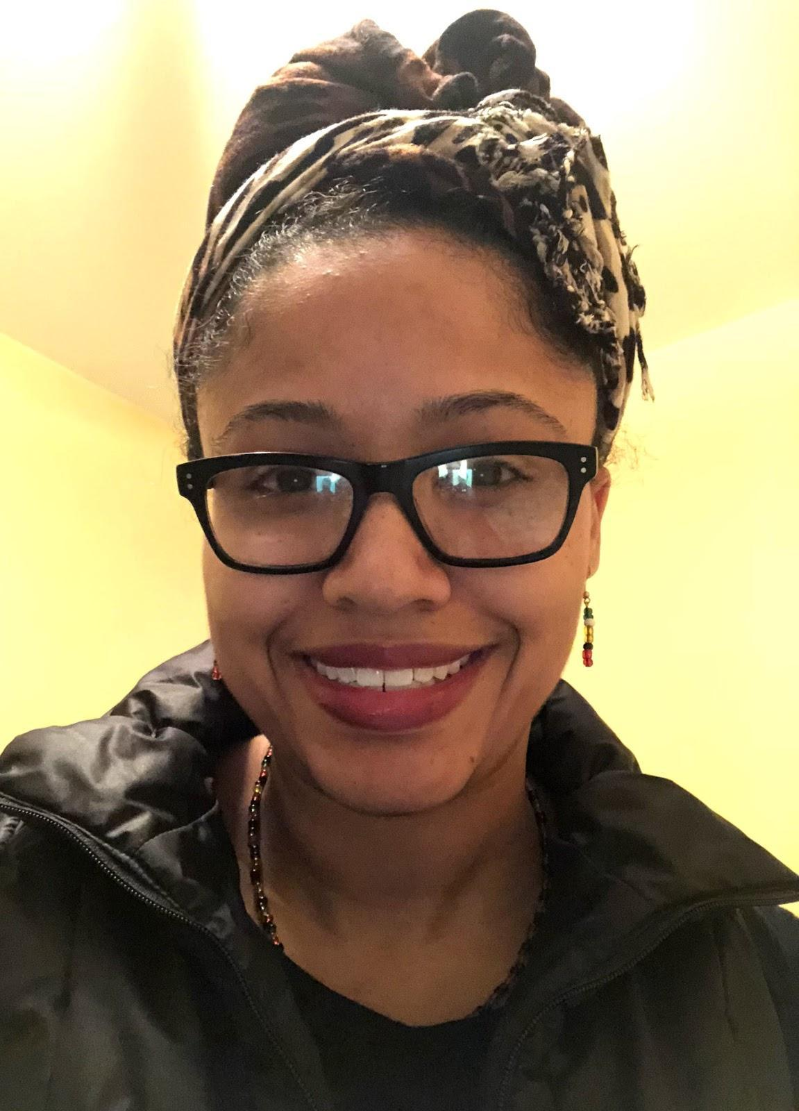
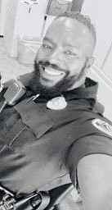
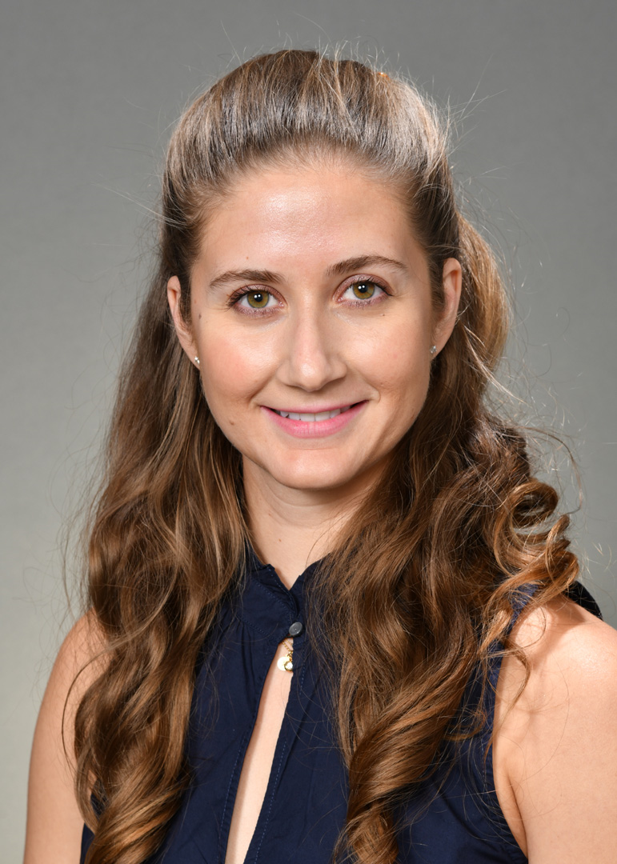
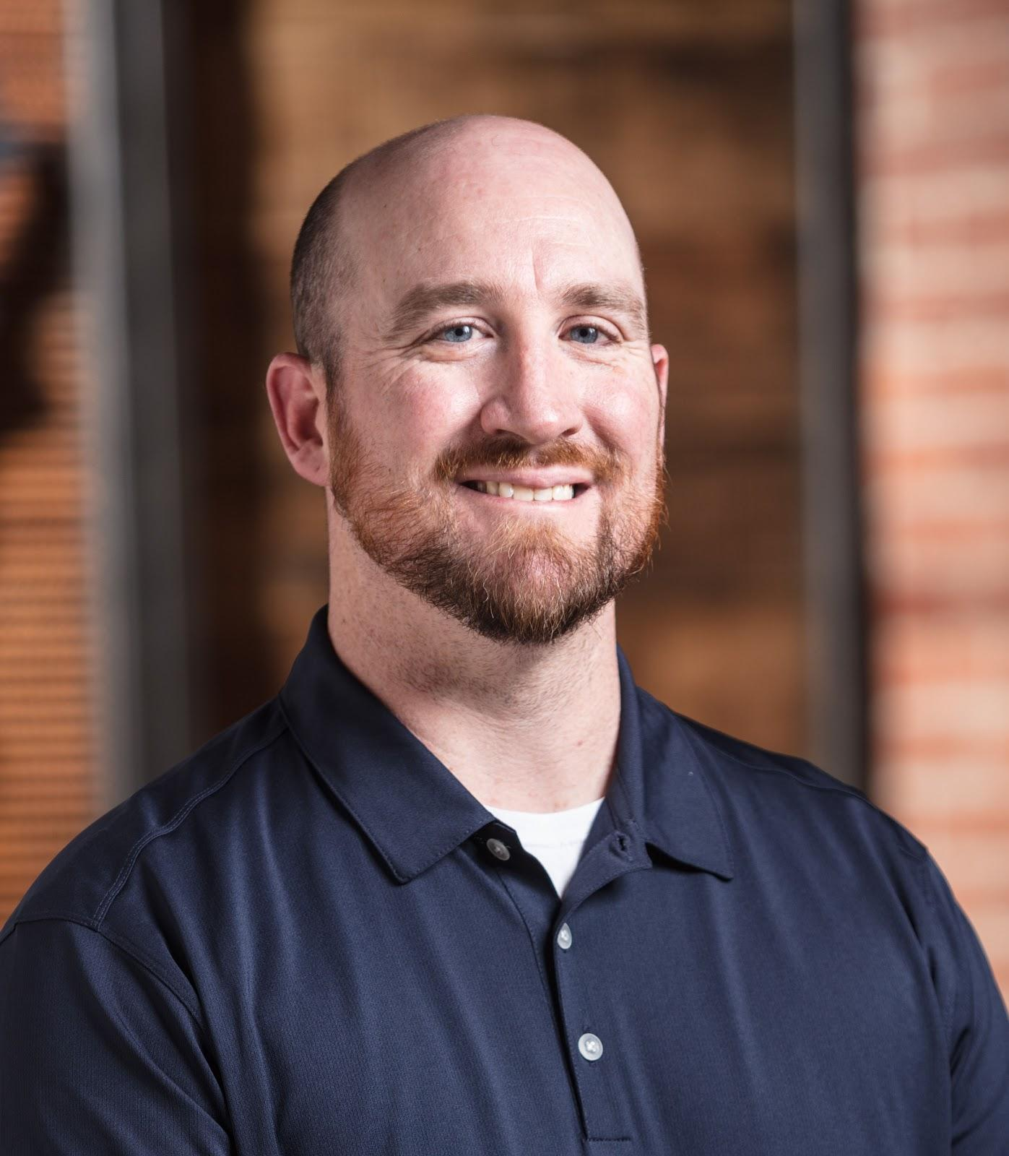
Career Expo Speakers
Thinking of your students and community needs, which of these speakers, if any, could be a good fit for your students?
Why?
Greg (Technology)
Terese (Health
Science)
Rod (Public Safety)
Tarah (Engineering)
Tyler (Construction)

Slide 18

Collective Brain Dump
What types of speakers could you recruit from your community?

Slide 19
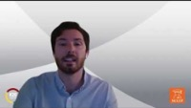

Slide 20
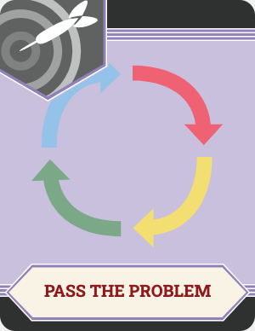

Pass the Problem
With your partner, come up with a solution to the problem presented on your card.

Slide 21
Pass the Problem
Find another pair who has a different problem than you
Swap problems
With your partner, read the possible solution and either:
  Build on the solution
  Present an alternative solution

Slide 22
Pass the Problem
With your partner:
Build on the solution
Present an alternative to the solution

Slide 23

POMS: Point of Most Significance
What was the most significant idea you gained from this session today?

Slide 24
Learning Objectives
Participants will:
Engage in a virtual career experience
Envision implementation of the virtual experience into their program
Assess the value of virtual career experiences

