Slide 2
Envisioning Your Future

Slide 3
Four Corners or Four Columns
What is the most important aspect of your college experience that you think students would be interested in?
[Insert link to Padlet & QR code here]
Notes:
Change to the “Four Corners” slide. Ask participants if they have ever used this strategy before and let a few share how if anyone says yes. Ask participants to think about the question, If you were to capture the most important aspect of your college experience that you think students would be most interested in, what would you feature? As they begin to ponder, show them the four columns board on Padlet. (The columns should be financial aid, sorority/fraternity, clubs and athletics and other. Participants will use the link to list their name under the column that best represent their answer. Have a few participants share why they chose that column and why they think students would benefit from knowing that aspect of their experience. (especially from the “other” category).

Slide 4
Grant Goals
Increase cohort academic performance and preparation for postsecondary education (PSE)
Increase high school graduation and PSE participation
Increase student educational expectations and increase student and family knowledge of PSE options, preparation, and financing

Slide 5
Essential Question
What kind of experiences can we provide to empower students regarding their PSE goals?

Slide 6
Learning Objectives
Analyze a variety of resources, including tech tools, that can help support your ICAP initiative.
Illustrate multiple pathways to college and career attainment to create a postsecondary vision board.

Slide 7
Zoom Into Your Career Bingo
Access your bingo card at bit.ly/ZIYCBingo
Watch the video and mark your bingo card when you hear one of the words on your card.
Notes:
College and Career exposure and awareness is important and we want to make sure you have multiple tools so that you can choose the right one for your class and your students. Other resources that we have available to teachers and students are a library of videos of on the job career professionals, as part of our mentoring ...
Mentoring activity

Slide 8
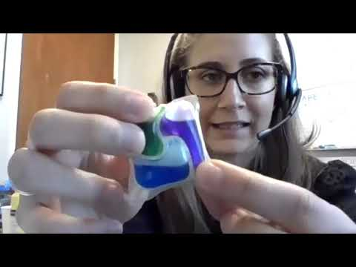
Notes:
Video source: K20 Center. (July 2020). Chemical Engineer - Tarah Schneberger - Zoom Into Your Career. YouTube. https://www.youtube.com/watch?v=55BeMSeHOKY

Slide 9
Zoom Into Your Career Resources
Take some time to review the following and complete the handout:
Helpful Resources handout
K20 Virtual Career Expos (https://tinyurl.com/K20VCEVideos)

Slide 10
Why ICAP?
ICAP is a student-driven, ongoing process that actively engages students and enables them to:
understand their own interests, strengths, values, and learning styles;
create a vision for their future;
develop individual goals; and
prepare a personal plan for achieving their vision and goals.

Slide 12
Mentimeter
What are some other things you should consider when choosing a potential career?
[Insert link to Padlet & QR code here]

Slide 13
Vision Board Research
Take some time to explore My Next Move:
Research careers
Using the data from My Next Move complete the Shared Google Doc
Notes:
Image source: My Next Move. (n.d.) Chemical Engineers. https://www.mynextmove.org/profile/summary/17-2041.00

Slide 14
Vision Board Creation
Create your own using one of the templates or freestyle your own board.
Notes:
Vision Board Resources video: https://www.youtube.com/watch?v=8GkkYo0b_9Q

Slide 15
ICAP Revisited
ICAP is a student-driven, ongoing process that actively engages students and enables them to:
understand their own interests, strengths, values, and learning styles;
create a vision for their future;
develop individual goals; and
prepare a personal plan for achieving their vision and goals.

Slide 16
POMS: Point of Most Significance
Think about all the resources we explored today.
ICAP lesson activities
Career Expo videos
Vision boards
LMS class headers
Which resource works best for you and your students? Why?

Slide 17
Learning Objectives
Analyze a variety of resources, including tech tools, that can help support your ICAP initiative.
Illustrate multiple pathways to college and career attainment to create a postsecondary vision board.

Slide 18
TREK

