Slide 2
AUTHENTICITY …
IT’S NOT JUST A FAIRY TALE
K20 Center

Slide 3
Blast from the Past! Or Maybe Last Week…
Think about your most meaningful learning experience.
Fold your paper in half.
Write as many adjectives as you can about this experience on your paper.
Notes:
K20 Center. (n.d.). Commit and toss. Strategies. https://learn.k20center.ou.edu/strategy/119

Slide 4
Guiding Question
“How can the components of authenticity help teachers prepare students for pursuing post-secondary educational opportunities?”
Notes:
Connect this to the next slide.

Slide 5
Session Objectives
We will:
Experience a collaborative, authentic lesson with a variety of instructional strategies and examine the components of authentic teaching and learning.
Compare different classroom environments and how they support authentic teaching and learning.
Connect authentic teaching and learning practices with the goals of the GEAR UP grant.

Slide 6
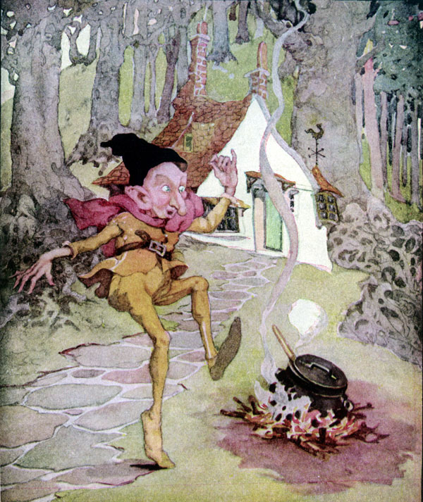
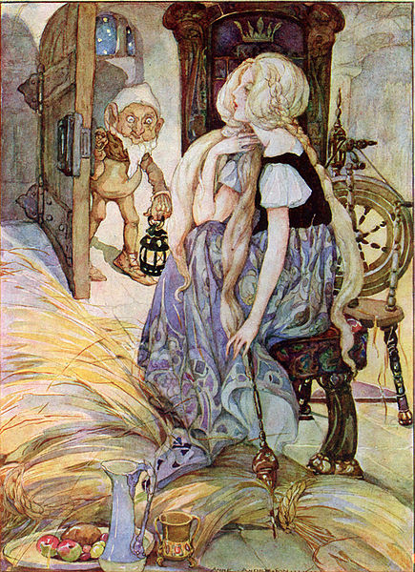
The Story
Happily Ever After
UNTIL…
Notes:
Keep this slide up while participants read the Rumpelstiltkin story.
Left image source: Anderson, A. (n.d.). Rumplestiltskin is my name. Public domain. Retrieved from https://en.m.wikipedia.org/wiki/File:Rumplestiltskin_-_Anne_Anderson.jpg
Right image source: Anderson, A. (n.d.). The miller’s daughter. Public domain. Retrieved from https://commons.wikimedia.org/wiki/File:The_Miller%27s_Daughter_by_Anne_Anderson.jpg
K20 Center. (n.d.). Fold the line. Strategies. https://learn.k20center.ou.edu/strategy/171

Slide 7
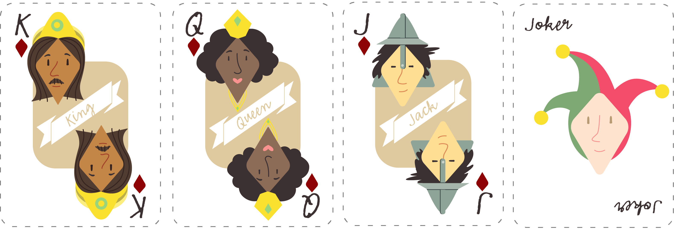
Playing Cards
King
The King
Queen
The Miller’s Daughter/Queen
Jack
The Miller
Joker or 2
Rumpelstiltskin

Slide 8
The Imaginary People’s Court
The justice system caught up with these reprehensible “characters.”
The Miller: Charged with bribery, human trafficking,
and tax fraud.
The King: Being impeached for accepting illegal tax contributions, intimidation, and unlawful detention.
Rumpelstiltskin: Charged with extortion, attempted kidnapping, and coercion.
The Miller’s Daughter/Queen: Charged with child abandonment, child endangerment, and human trafficking.

Slide 9
CUS and Discuss
CIRCLE any mention of your character.
UNDERLINE any actions taken by your character.
STAR any emotions or important adjectives.
Discuss the defense of your character’s innocence.

Slide 10
CER Example
Claim – Chromebooks are better school technology tools than laptops.
Evidence – Most applications on a Chromebook are web-based and store data online.
Reasoning – Because data is stored online, students can use any device to access it. This prevents loss of student work and provides them with the ability to work both from school and home.

Slide 11
Pair Square Legal Team
Get together with your card group (jokers with jokers, queens with queens, etc.).
Share your CER and your defense.
Come to a consensus about the defense of your client.
Choose your spokesperson, known as the lead defense attorney.

Slide 12


HEAR YE! HEAR YE!
ALL RISE!
The Honorable Judge declares that court is in session.
Present your arguments.

Slide 13
Beyond Rumpelstiltskin
This was a lesson on process of instruction for students to think more critically.
The goal was to construct a logical and supported argument based on a guiding question.
Notes:
The content, Rumpelstiltskin, is not what was significant or the point. The goal was the students’ construction of a logical and supported argument based on evidence from a text. The use of an essential question helps stimulate the higher order thinking.

Slide 14


LEARN Strategy Reflection
CUS and Discuss
Claim, Evidence, Reasoning (CER)
Notes:
CUS and Discuss – This is an annotation strategy that allows for processing of a document before students are expected to share. Each letter can be modified for the purposes or goals of the reading (ex: Circle is concrete such as the name of the character they are looking for; Underline and Star scaffold into deeper elements of the reading)
CER – typically a science strategy but can be used across content areas whenever students need to justify and provide evidence

Slide 15
CONSTRUCTION OF KNOWLEDGE
INQUIRY-BASED LEARNING
Authentic Teaching
Prior Knowledge
REAL-WORLD CONNECTIONS
STUDENT-CENTERED
LEARNING

Slide 16
Jigsaw and Why-Lighting
Why-Light your section, and then discuss the big ideas with your group.

Slide 17
Represent!
Using large poster paper, represent your component of authenticity in a visual way.
Add a GramIt description as a caption.
CHALLENGE: Include a hashtag. #OneToThreeWordSummary

Slide 18
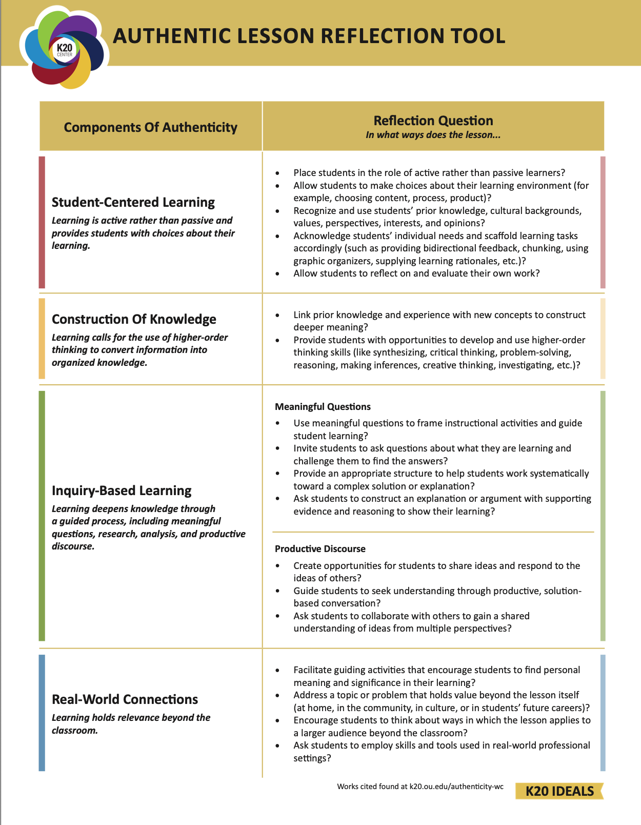
Authentic Lesson Reflection Tool

Slide 19
LEARN Strategy Reflection
Jigsaw
Why Lighting
GramIt
Notes:
These are all literacy strategies, so if you’re trying to find strategies that help with literacy skills, these are great.

Slide 20
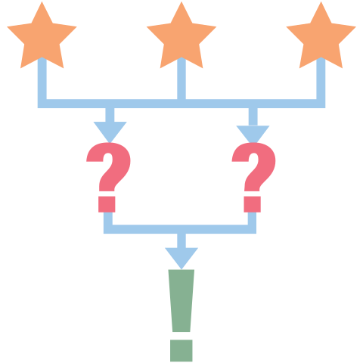
3-2-1
Three things that make a lesson authentic.
Two authentic things you plan to implement in this week's lessons.
One question you still have about authenticity or authentic lessons.

Slide 21
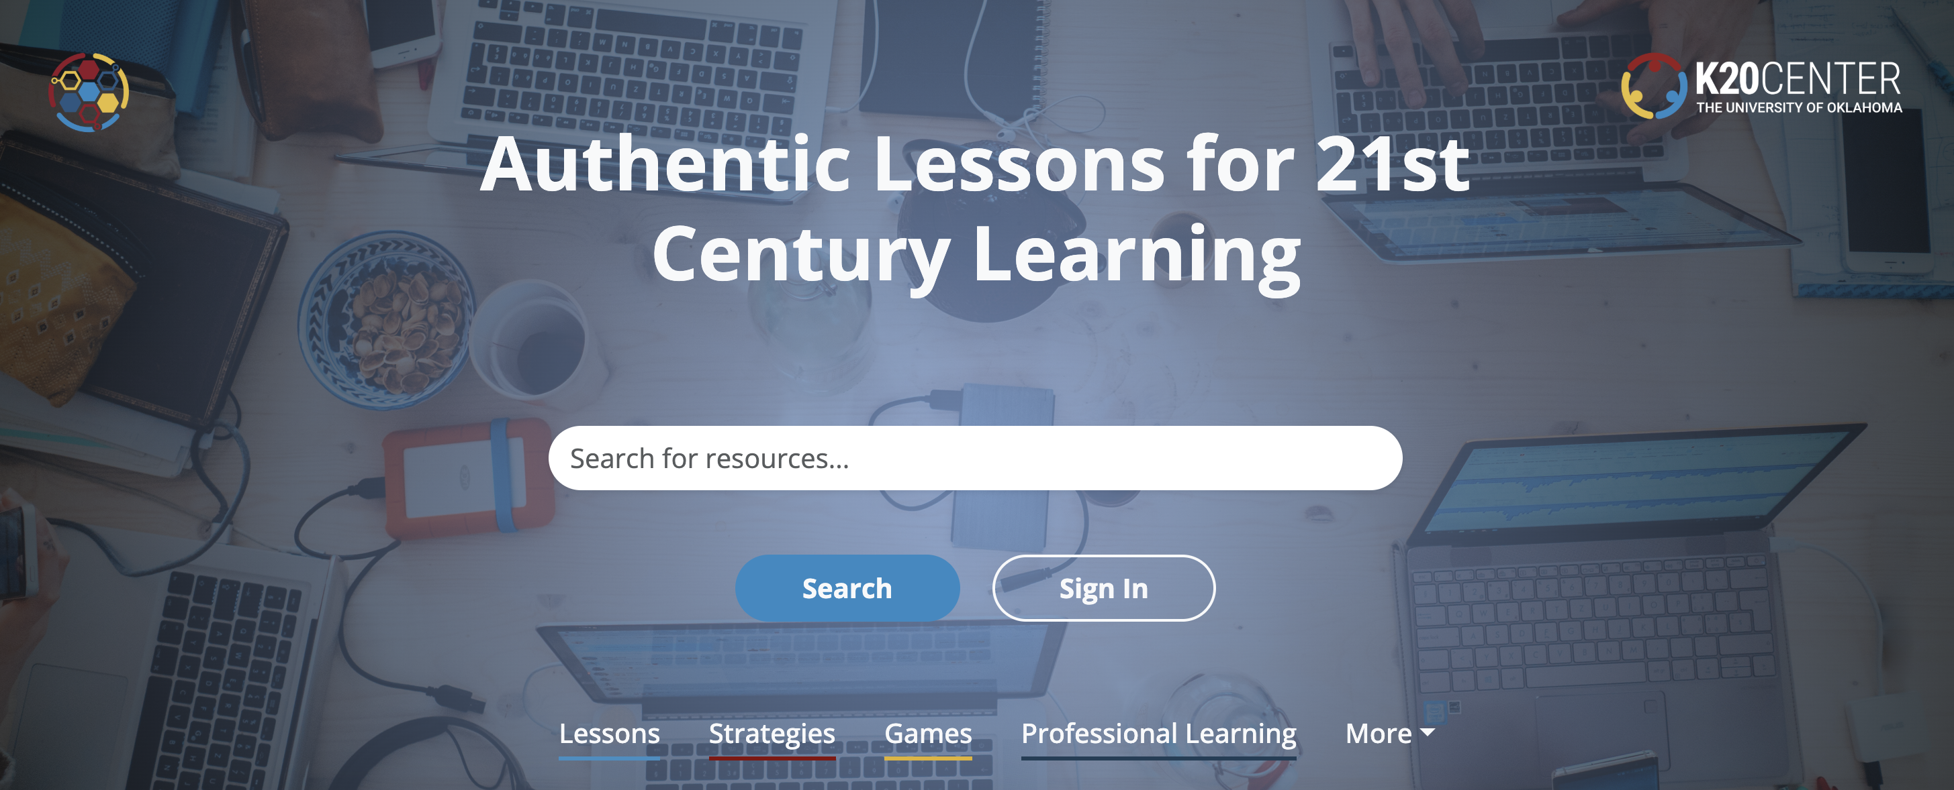
K20 LEARN
https://learn.k20center.ou.edu/
Notes:
Follow-up activity. Direct participants to the K20 Learn lesson repository for more example of authentic learning and teaching.

