Slide 1
A Recipe for Student Success

Slide 2
Chain Notes
Why is it important to educate students about career diversity?
Create groups of four
Using one sheet of paper per group, make a list using the given question
Pass papers to the group on the right
Read that info and then add any additional information
Notes:
Participants will get into groups of four with others near them.
Using one sheet of paper they will create a list answering the question, “Why is it important to educate students about career diversity?” Provide a few minutes for participants to create their list.
After a few minutes instruct groups to pass their papers to the right. Providing another minute, groups may add to the new list anything they believe should be added.
Once finished you may allow groups to pass again or share out if time is short.
This stimulates prior knowledge and allows participants a chance to process their values of Career Knowledge and it’s important to young students.

Slide 3
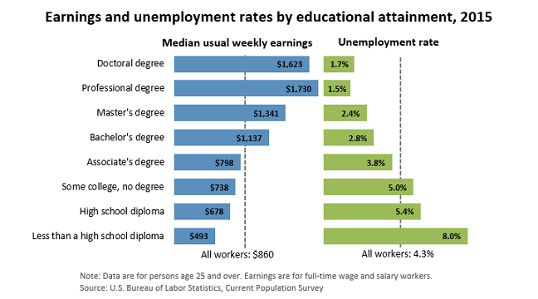
A study published in 2011 found that “roughly half of college students in engineering made that decision while still in high school, making this a critical time period.”
Research also shows that “students who demonstrate a strong talent and interest in STEM are most influenced to become interested in STEM through extracurricular experiences”.
Hall C, Dickerson J, Batts D, Kauffmann P, Bosse M (2011).
U.S. Bureau of Labor Statistics (March, 15, 2016)

Slide 4
Session Goals
I will learn about a Career Café.
I will learn the importance of a Career Café.
I will learn how to implement and host a Career Café.

Slide 5
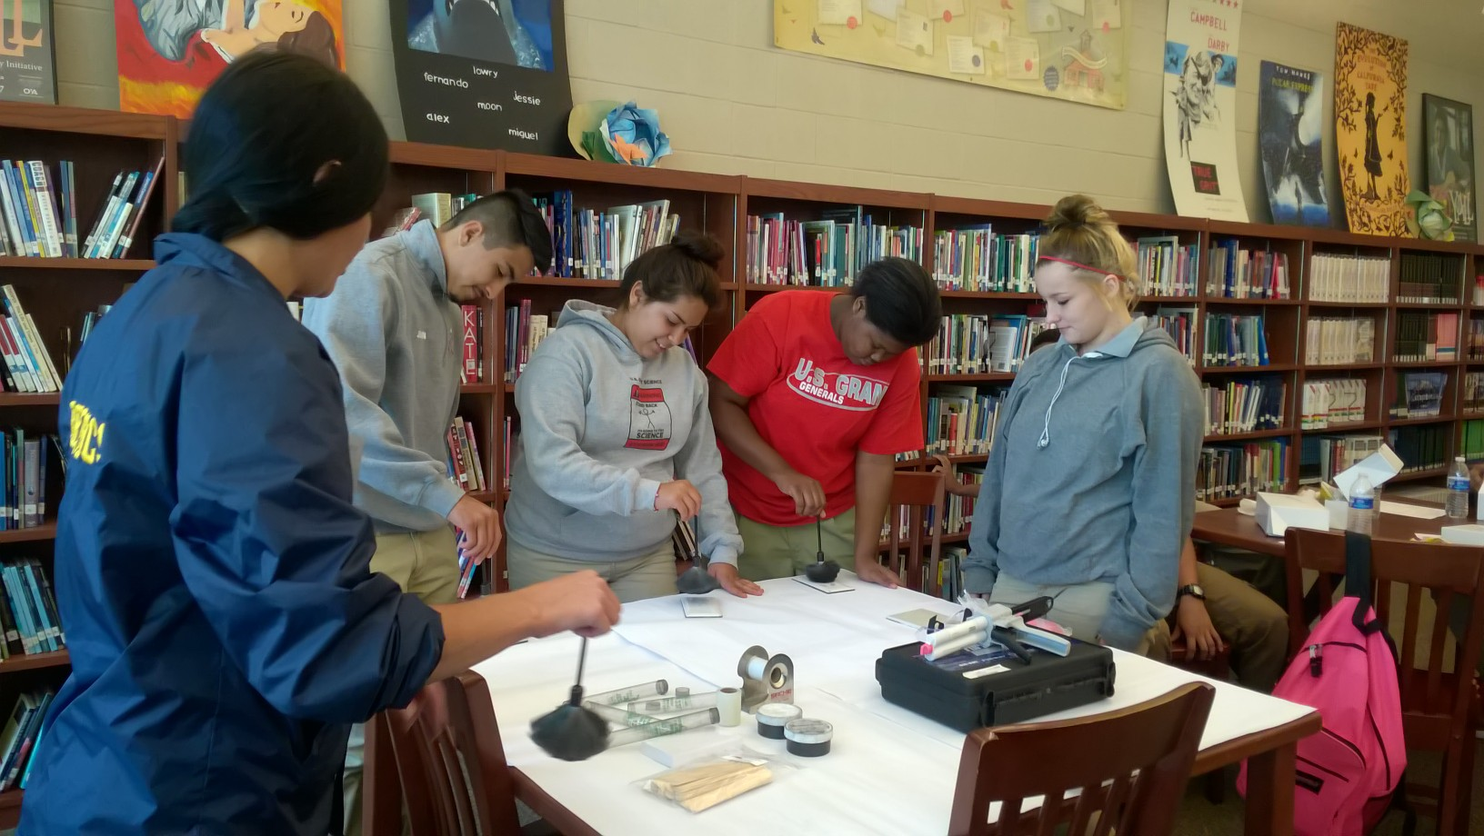
Guiding Questions
What are the goals of a Career Café?
What are the benefits and purpose of a Career Café?
What do you believe are the differences between a Career Café and a Career Day/Fair?
Notes:
Write down answers to these questions as the video plays. We will use an activity after the video to discuss and build on some of these questions.

Slide 6
Video: Career Cafés
Notes:
Play video after introducing guiding questions

Slide 7
Think-Pair-Share
Guiding Questions
Goals of a Career Café?
Benefits and purpose of a Career Café?
Differences between Career Café and Career Day?
Reflect on the video
Turn to an elbow partner and share your thoughts from the guiding questions.
Notes:
Participants will think and reflect about the video and questions presented.
Participants will find an elbow partner to share their thoughts to the questions.
Participants will share out their thoughts with the whole group.
Possible answers are available on the LEARN PD

Slide 8
What Student Say About Career Cafés
“I learned that no matter where you work if you are interested in your job you will always be good at it.”
“That you do have to work hard to get what you want and you have to stay focused in school.”
“Know the skills you’re good at. It'll help you make career focused decisions for study in college or technical school.”
“There are a lot of opportunities in this field. I also learned the difference between freelance and working for a major company.”
“Law firms do more than I thought they did.”
“My field is going to take a lot of work. But I am still going to for it.”
Top Four Influences on Career Choice Reported by Students:
Personal Interest
Parents
Earning Potential
Teachers
Notes:
Other things students have said after attending a Career Café:
“If I have a goal then go for it. Also the steps on how to get where I want to go.”
“Keep Pushing forward and never give up. I really enjoyed my self today (thanks)”
“That we are in charge of our own efforts or decisions and people can teach us all the things they know but it’s up to us to apply them.”
“You must be on top of things to be on top.”
“School is important and it can change your life completely.”
Ask: How do these things influence the goals and benefits?
Then show the 4 top influences and ask the question: Does this change anything about what you just said? How?

Slide 9
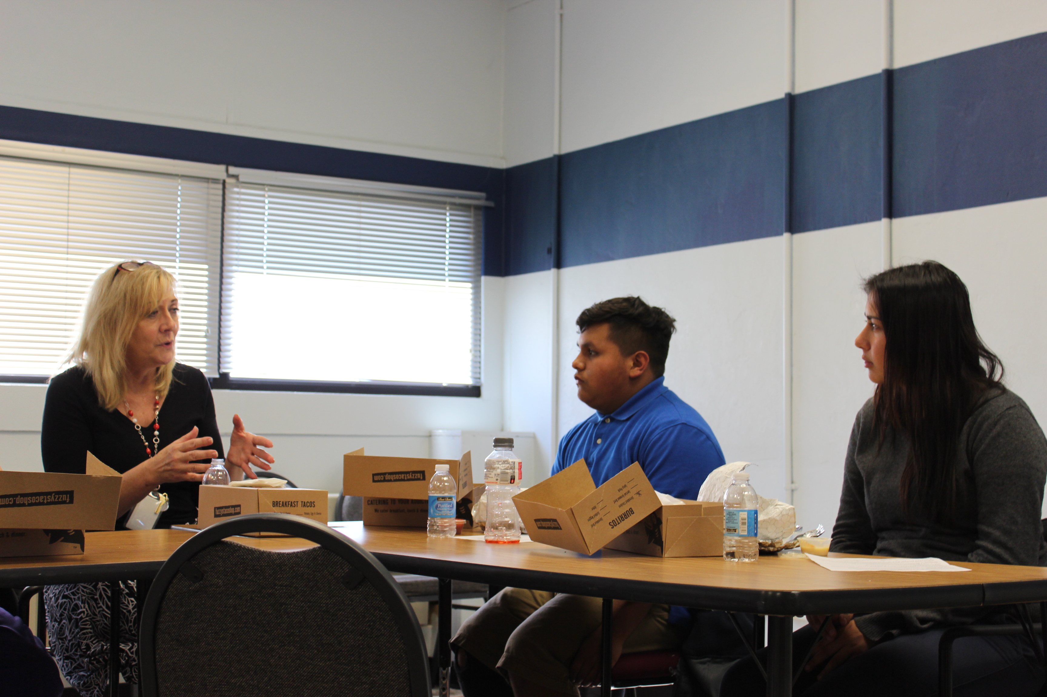
Creating a Career Café
What does a Career Café look like?
What steps do we need to take to implement a Career Café?
How do we promote this to the community, students, & staff?
What kind of speakers/job fields would our students want to hear about?
Notes:
What does a Career Café look like?
Sites will need to evaluate their school and clientele with student surveys.
Find a time when students will be able to attend and serve food. Is this breakfast, lunch, after school snack? Just remember that before and after school students may have transportation issues and extracurricular activities that conflicts with attendance. This creates a relaxed environment for students to not feel intimidated.
Welcoming
Special
Small group of students who have a special interest in the presenter career
Creates a safe atmosphere where students can learn and speak directly with community members about careers and college planning.
What steps do we need to take to implement a Career Café?
Find space, a faculty member to supervise, money for food (speak to PTA, PTO, businesses around the area to donate food, etc),
Developed a concept
Research
Introduced the concept to schools to get buy-in
Developed materials
Started with a small list of volunteers and provided training
Identified student need and interests
How do we promote this to the community, students, & staff?
Share with community leaders and organizations
post signs around the school
have a PD session with the staff and take note of those interested in helping support cafés
Send flyers home with students
Signup sheets for students to attend
Student interest survey
What kind of speaker/job fields would our students want to hear about?
Engineers
Designers
Technology Specialist
Game Developers
Oil
Accountants
Lawyers
Etc.

Slide 10
Info about the speaker
Date, time & location
Info about the speaker’s career
Interest questions
Notes:
Extend:
Have participants return to their seats. Pass out the Career Café Resource Handout and instruct participants to begin working in groups to create a plan for the career cafés they will be hosting in the near future. Tell participants to use what they just talked about during the roundabout conversations and use the packet to help guide and organize a plan of action.
What are our next steps?
Who is going to be the main contact person?
Do we create a sign up sheet with dates that different teachers are in charge of planning and organizing?
Where are we going to host? Which room or area of the school?
How are we going to fund the food for the lunches?
How do we promote?
How many students are we going to allow to attend each time?
Do we need one or two sessions each time (use lunches to help determine this schedule)?

Slide 11
3-2-1
On a sticky note write…
3 items learned from today’s Career Café session
2 actions you plan to do next to help implement the Career Café at your site
1 question you still have about Career Cafés

