Slide 1
Accepted! College Ready
[Type name of PSI here]

Slide 2
How are you feeling about your next school adventure?
[place the QR code for your copy of the padlet here]
Use the QR code to answer the questions on the padlet.
Notes:
Make a copy of this padlet: https://padlet.com/k20center2/a-cr-engage-az3evtcy59v20w5d
Insert the share link and or QR code to YOUR COPY of the padlet on this slide.

Slide 3
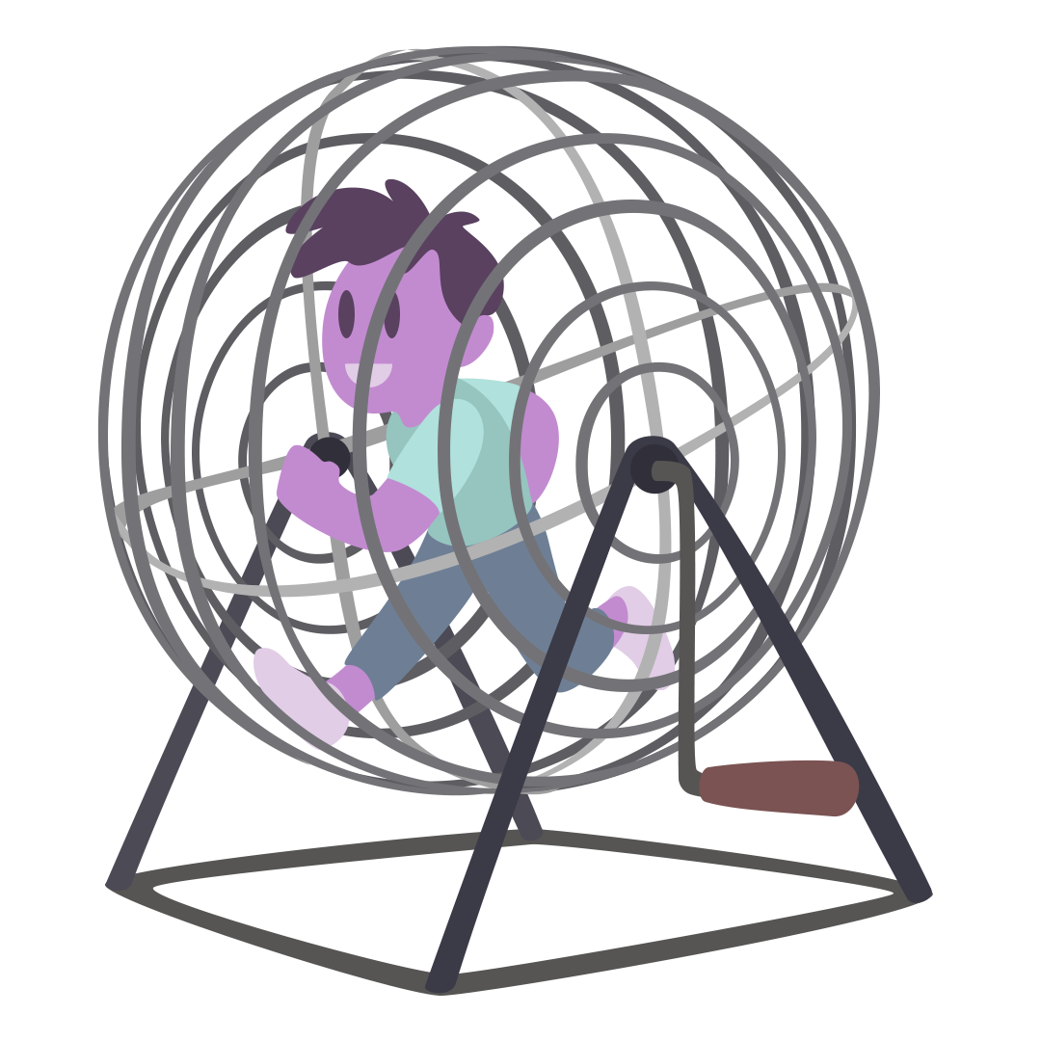
Human BINGO
Move around the room and find a person who has or can do something written in one of the squares.
Have each person write their first name legibly in the BINGO square they claim.
You can only have someone write their name ONE TIME on your BINGO card.
Be prepared to share out for each square you sign.

Slide 4
Beach Ball Talk and Toss
Toss the Beach Ball making sure everyone in your group has a turn. Answer the question that corresponds to the color where your right thumb lands when you catch the ball.
If you could have any superpower, what would it be? (RED)
What did you enjoy the most about your high school? (YELLOW)
What do you plan to major in at school next year? (WHITE)
What is your favorite movie/show? And why? (GREEN)
What is your favorite hobby? (BLUE)
If you could go anywhere in the world, where would it be? And why? (ORANGE)

Slide 5
Roundabout Conversations
Count of by 2. Ones form an an inside circle (almost shoulder to shoulder), facing right; Twos forms an outside circle, facing left.
Walk in a circle in the direction you are facing while music is playing.
Stop when the music stops.
Turn toward the person closest to you in the other circle, shake hands, introduce yourselves, discuss the prompt.

Slide 6
Would You Rather…
Have a REWIND button in life.
Have a PAUSE button in life.
<
>

Slide 7
Would You Rather…
Be able to talk to animals.
Speak any human language.
<
>

Slide 8
Would You Rather…
Make a big difference in one person’s life.
Make a small difference in lives.
<
>

Slide 9
Would You Rather…
Wear a costume every day.
Never have Halloween again.
<
>

Slide 10
Would You Rather…
Always know the truth, even if it hurts.
Remain blissfully unaware.
<
>

Slide 11
Would You Rather…
Experience a zombie apocalypse.
Experience a robot takeover.
<
>

Slide 12
Would You Rather…
Lose all past memories.
Never be able to make new memories.
<
>

Slide 13
Would You Rather…
Have unlimited pizza.
Have unlimited ice cream.
<
>

Slide 14
Would You Rather…
Be super fast.
Be super strong.
<
>

Slide 15
Keynote
[Type information about your speaker here]
Notes:
Include name, tile, and photo if you have one of your keynote speaker.

Slide 16
Celebration

Slide 18
Feedback
What part of today was most helpful?
What questions do you still have?
What kind of support do you need during your first semester of college?
Would you like GEAR UP to check in with you this summer and next fall? If yes, how can we best reach you?

