Slide 1
Animate Your Name
Information Technology Career Cluster Activity

Slide 2
Step 1
Go to https://tinyurl.com/Newnamescratch.
This will take you to Scratch, MIT’s coding website.

Slide 3
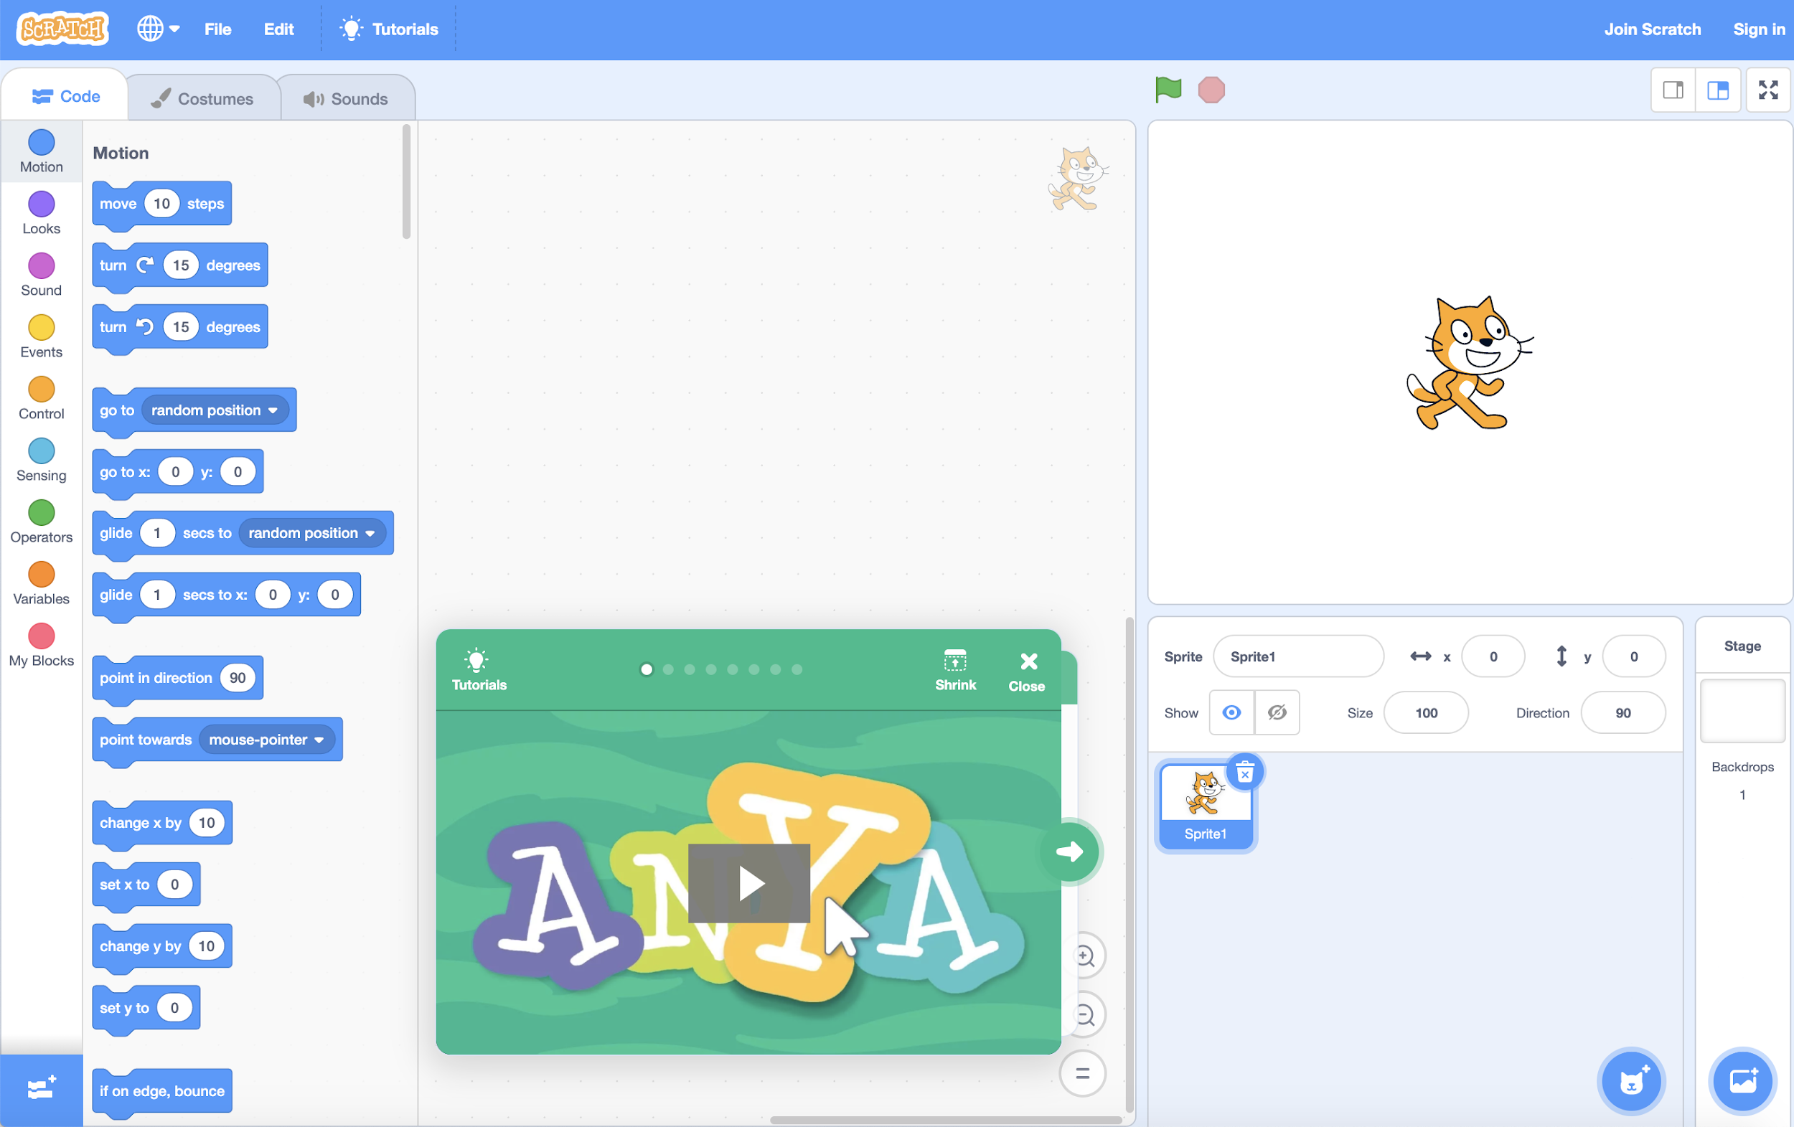
Step 2
Click the cat icon to get started.

Slide 4
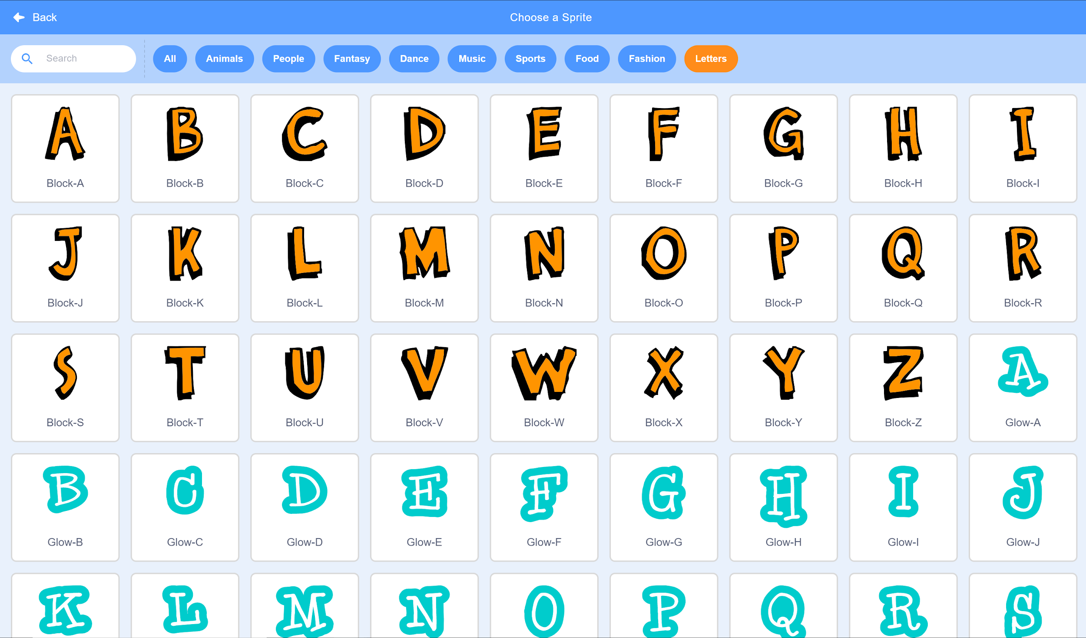
Step 3
Select the “Letters” menu, and then click the first letter of your first name. These are called Sprites.

Slide 5
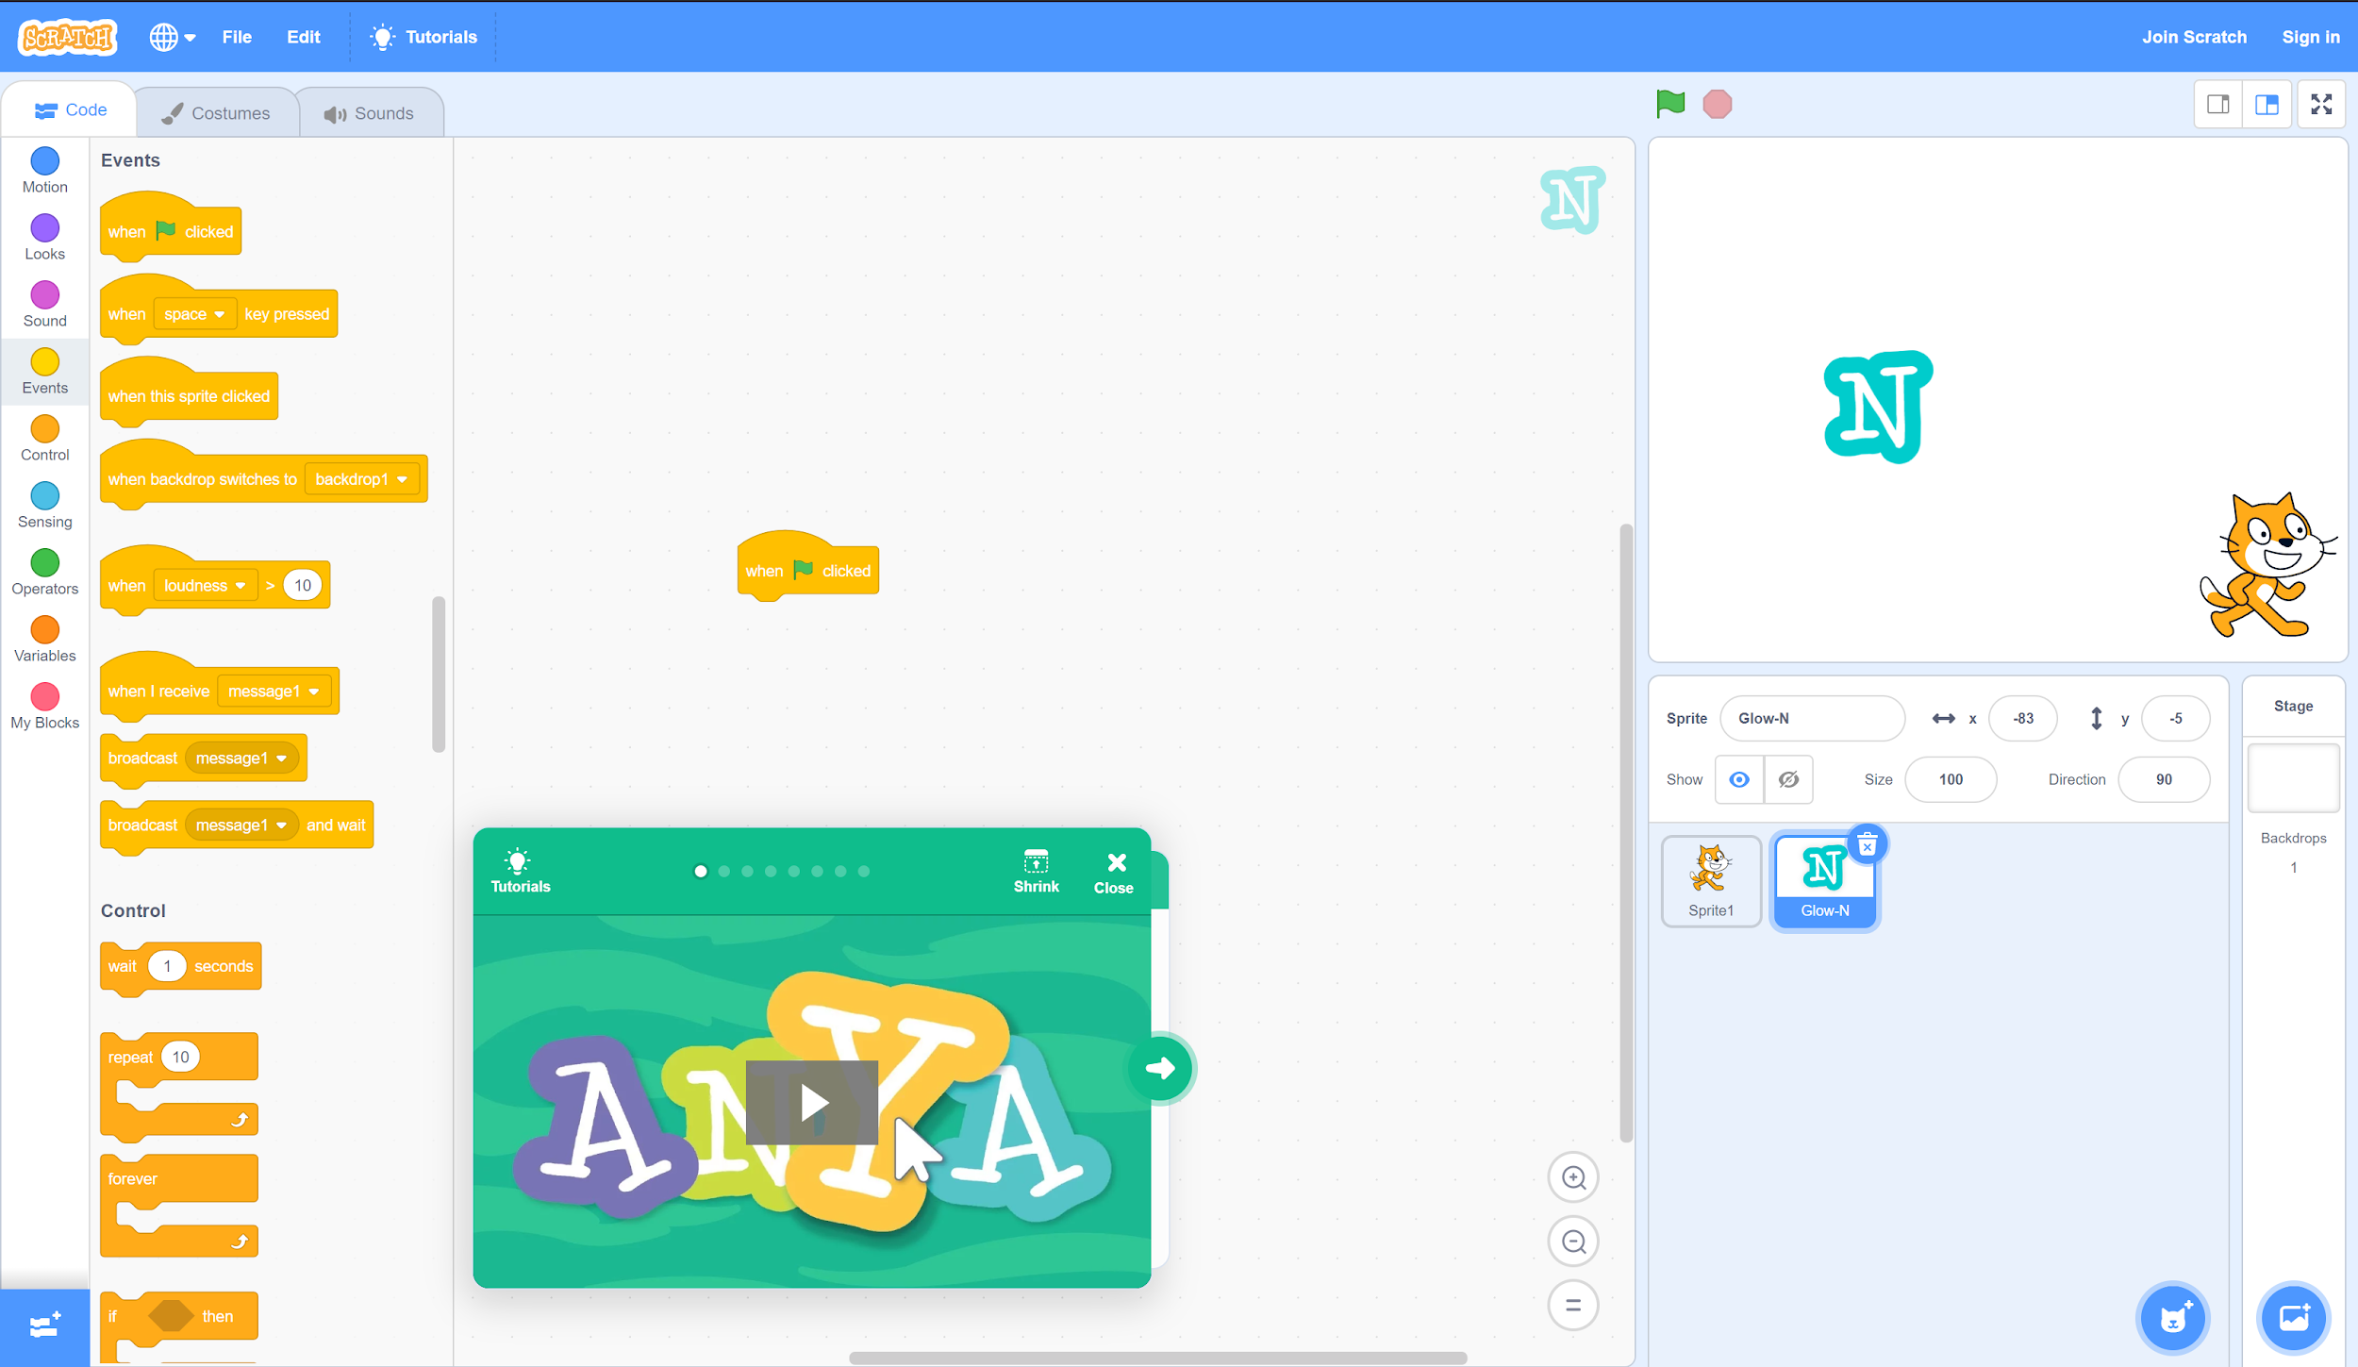
Step 4
A. In the left pane, select the “Events” tab.
B. Find the “when ⚐ clicked” event. Click and drag this command to the workspace in the middle of the window.

Slide 6
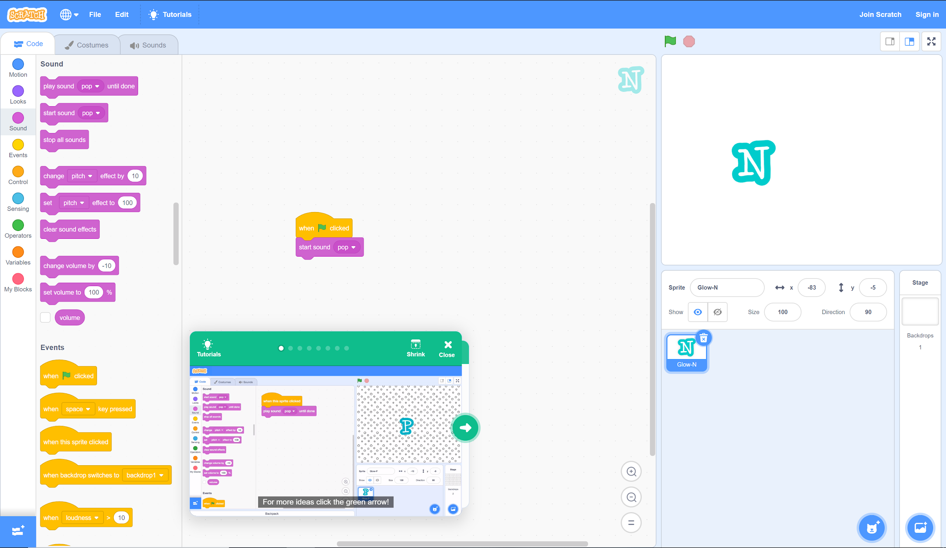
Step 4, Cont.
B. Find the “start sound” command. Click and drag this command to the area below the “when ⚐ clicked” command so that they connect.
A. Select the “Sound” tab.

Slide 7
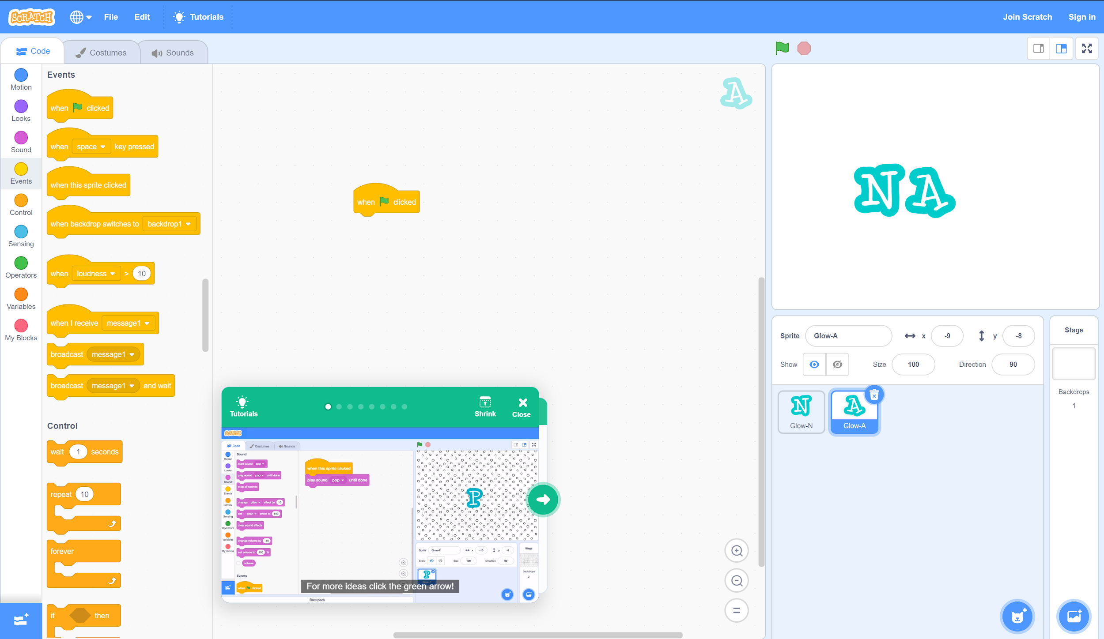
Step 5
A. Repeat step 3 and select the second letter of your name. (You can move sprites by clicking and dragging them in the upper-right pane, and you can delete sprites and letters in the lower-right pane.)
B. Select the second letter in the lower-right pane and return to the “Events” tab.
C. Find the “when ⚐ clicked” event. Click and drag this command to the workspace in the middle of the screen.

Slide 8
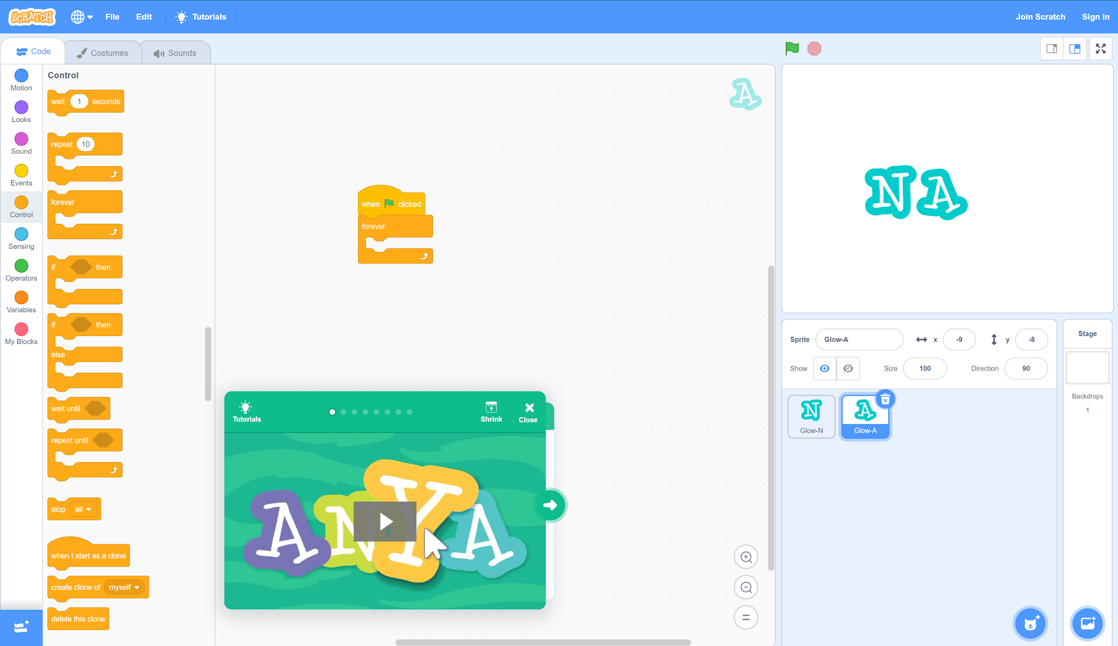
Step 5, Cont.
A. Select the “Control” tab.
B. Find the “forever” command. Connect this command below the “when ⚐ clicked” command.

Slide 9
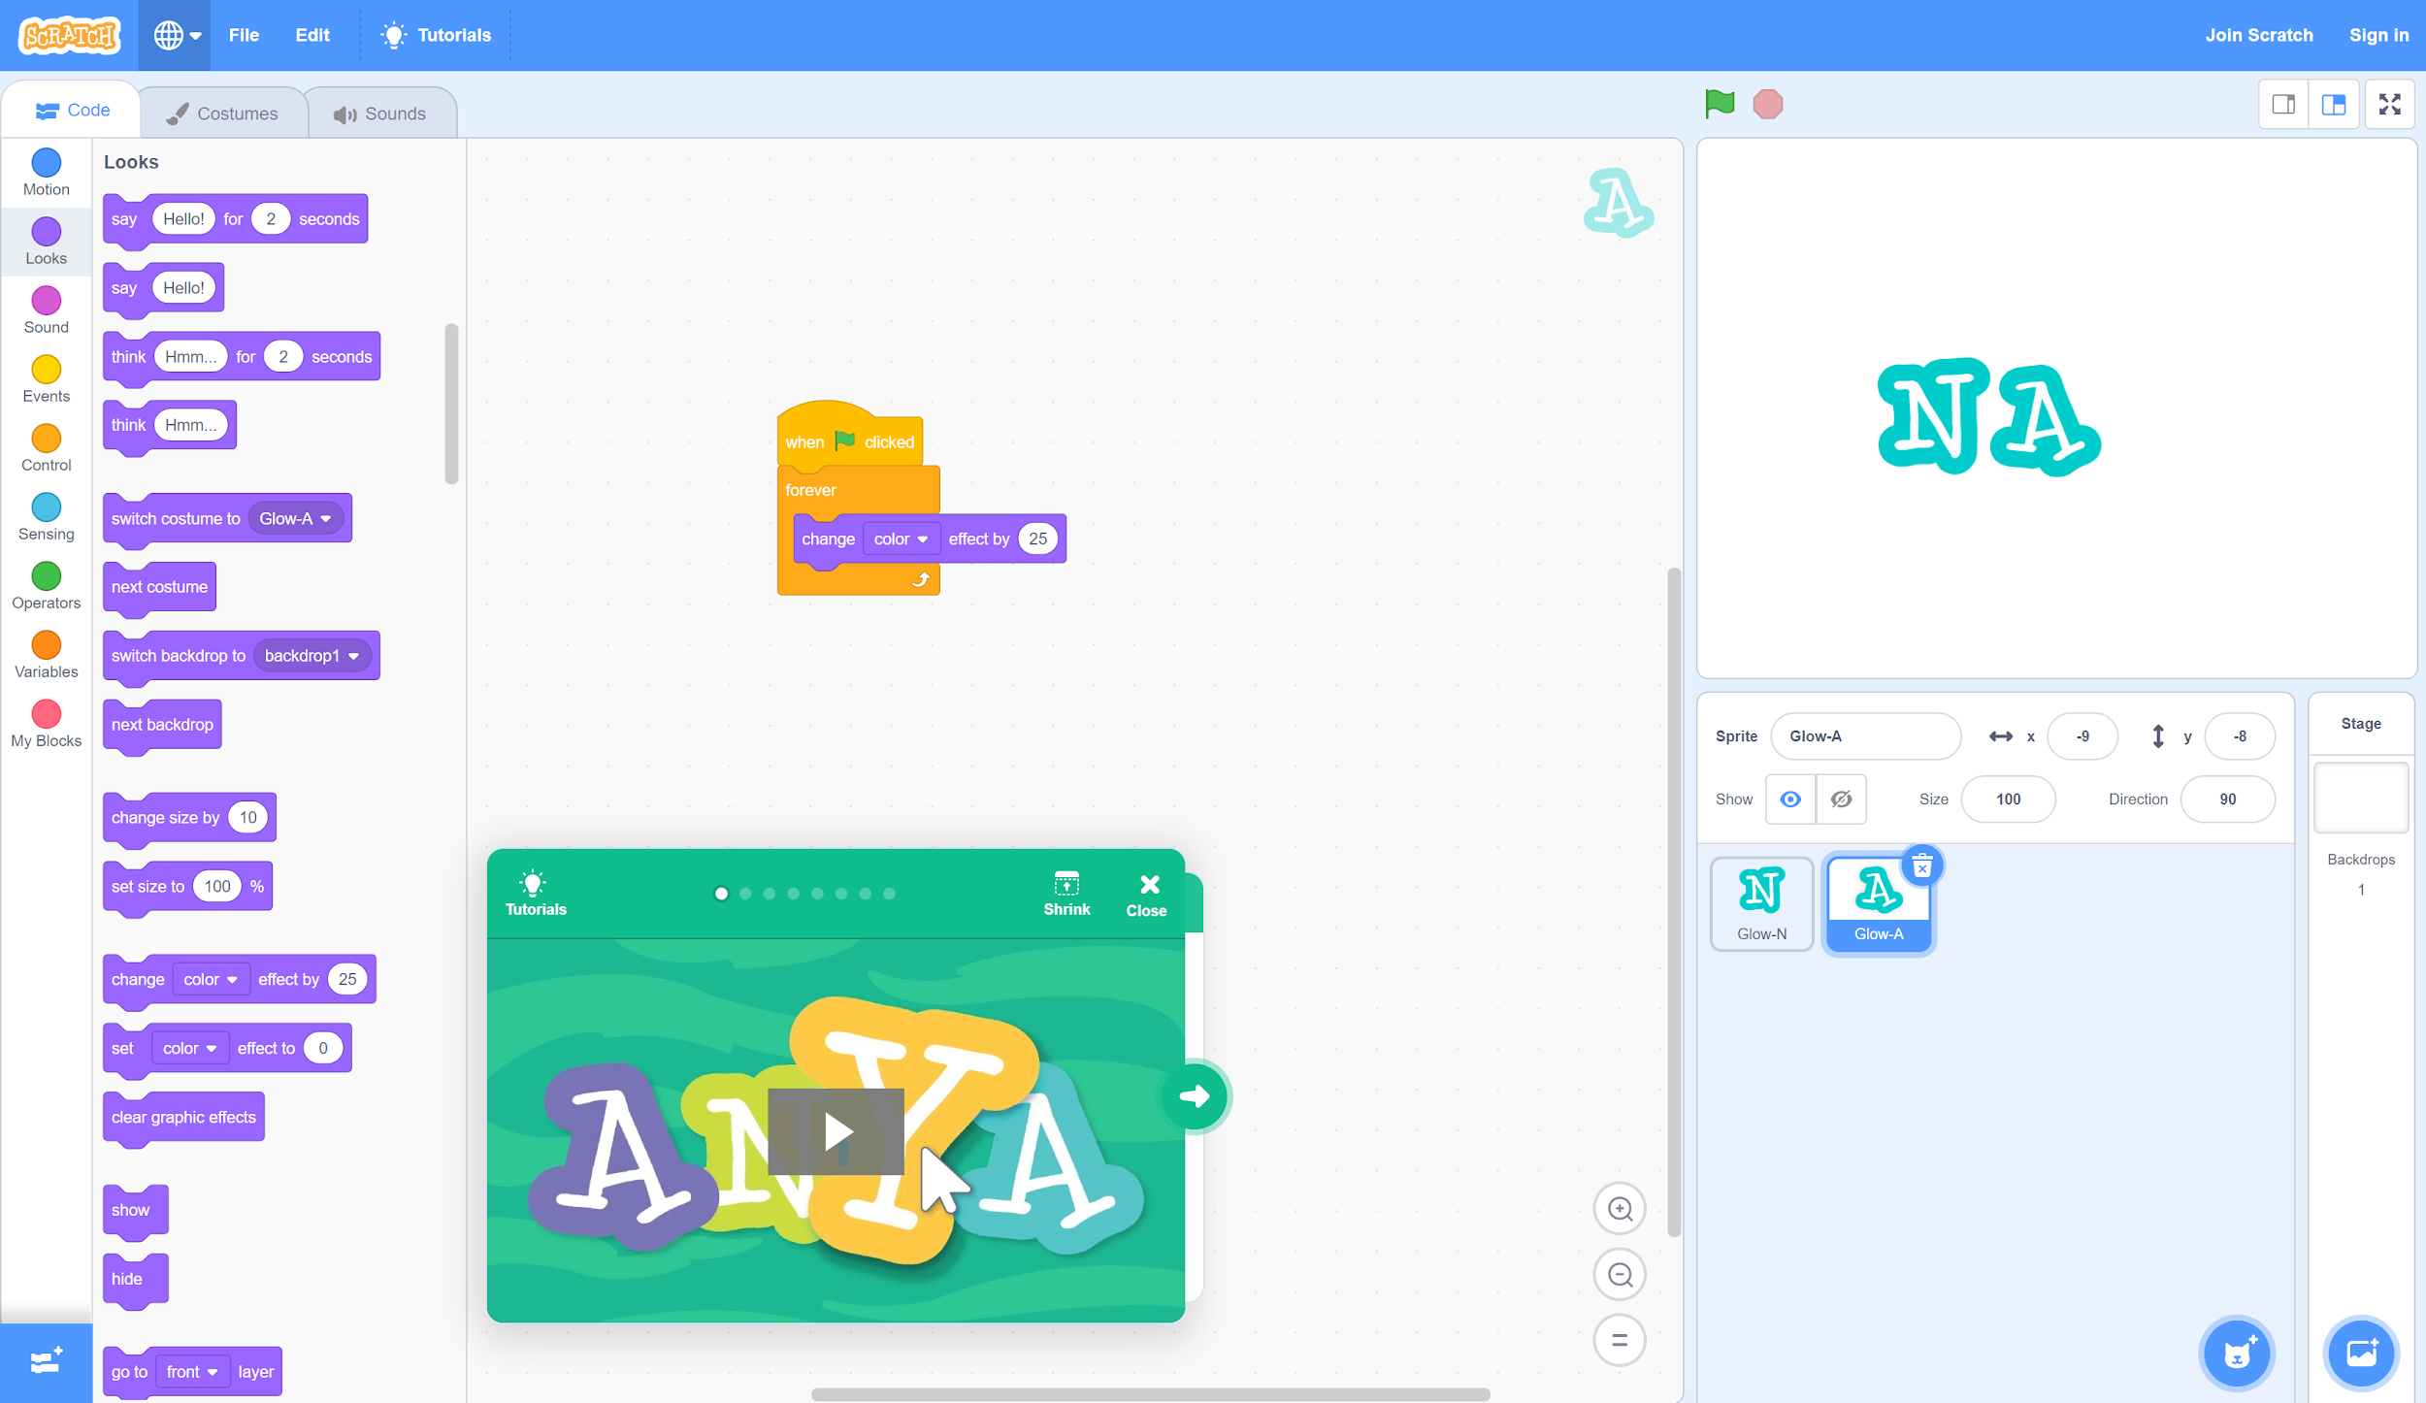
Step 5, Cont.
A. Select the “Looks” tab.
B. Drag and drop the “change (color) effect by (25)” command inside the “forever” command.

Slide 10
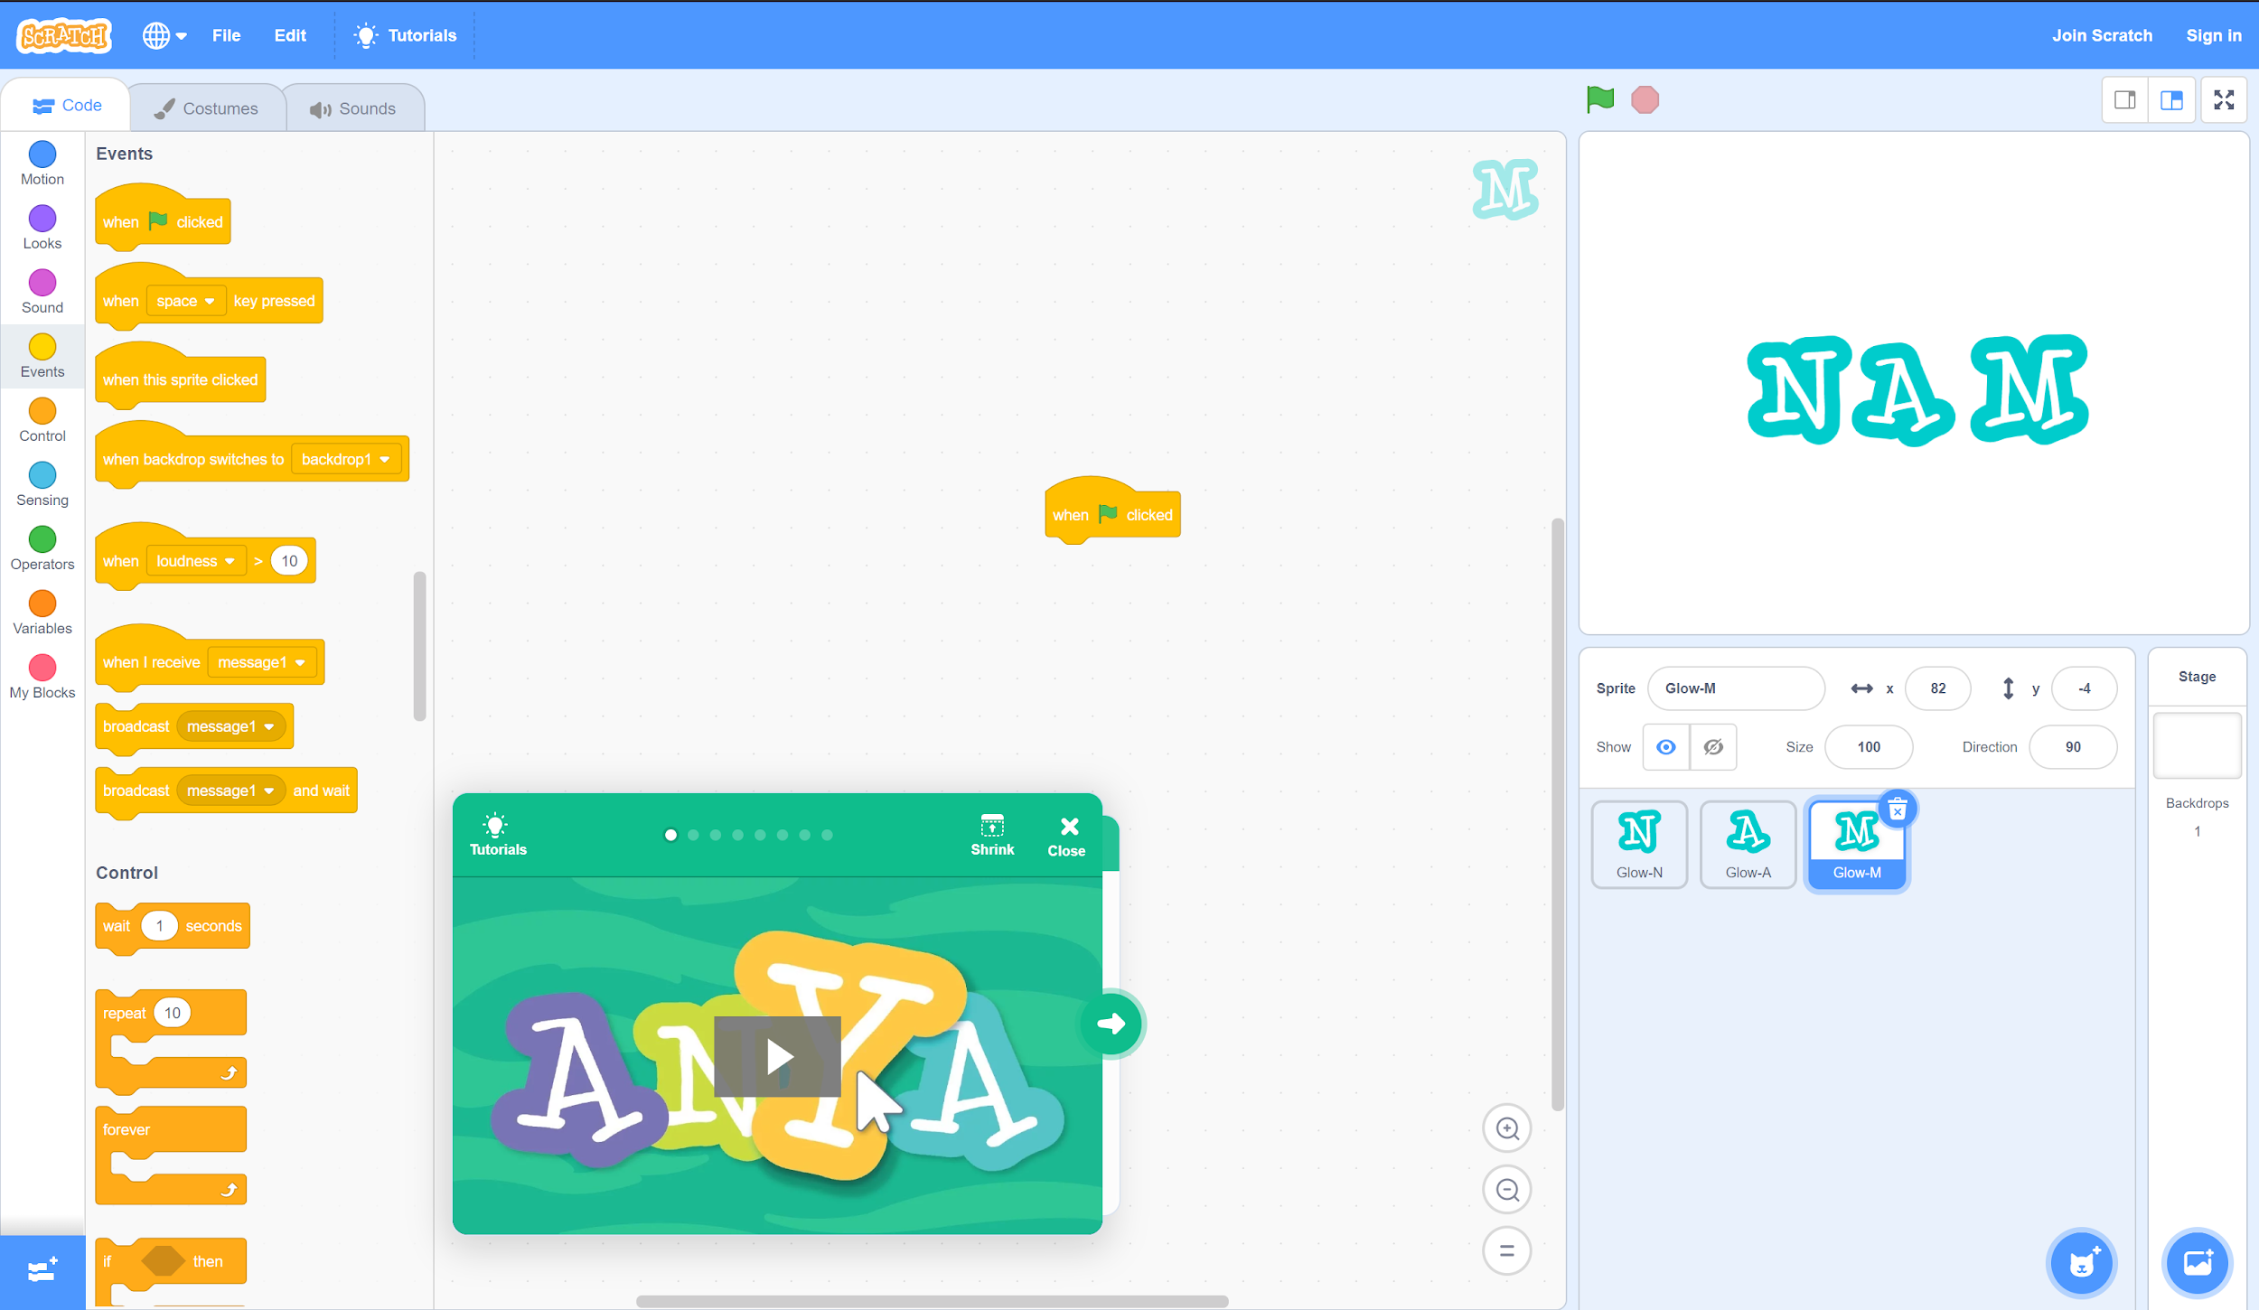
Step 6
A. Repeat step 3 and select the third letter of your name. (Remember, you can move sprites by clicking and dragging them in the upper-right pane, and you can delete sprites and letters in the lower-right pane.)
B. With your third letter selected in the lower-right pane, return to the “Events” tab.
C. Drag and drop “when ⚐ clicked” to the middle workspace.

Slide 11
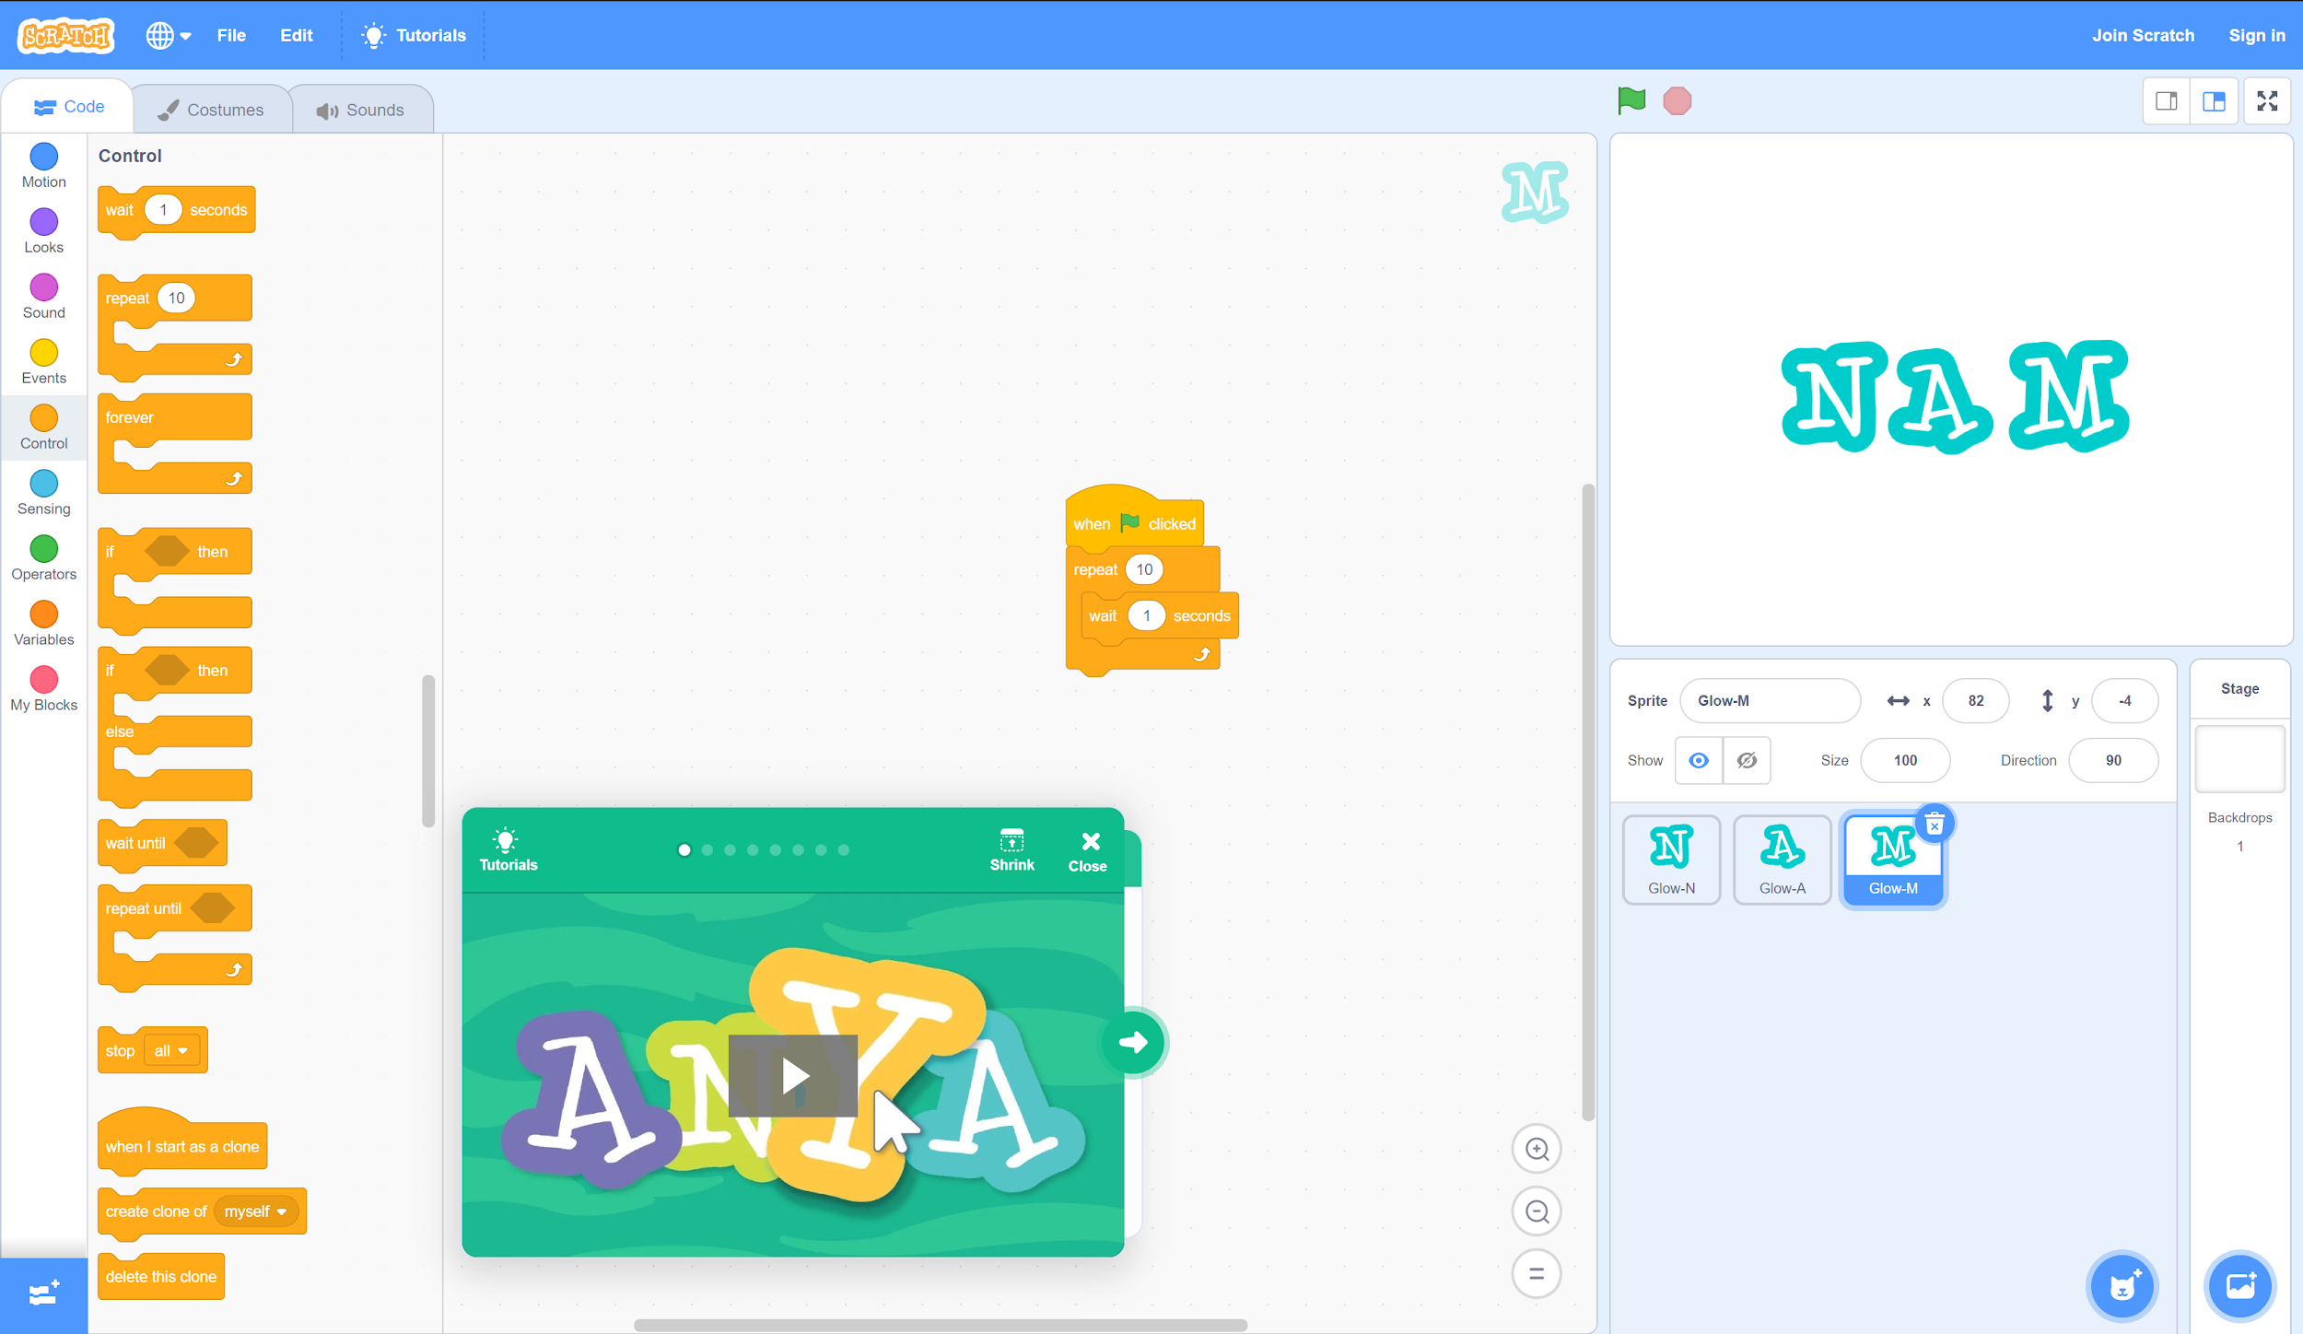
Step 6, Cont.
C. Drag and drop the “wait (1) seconds” command inside the “repeat (10)” function.
A. Select the “Control” tab.
B. Connect the “repeat (10)” command below “when ⚐ clicked.”

Slide 12
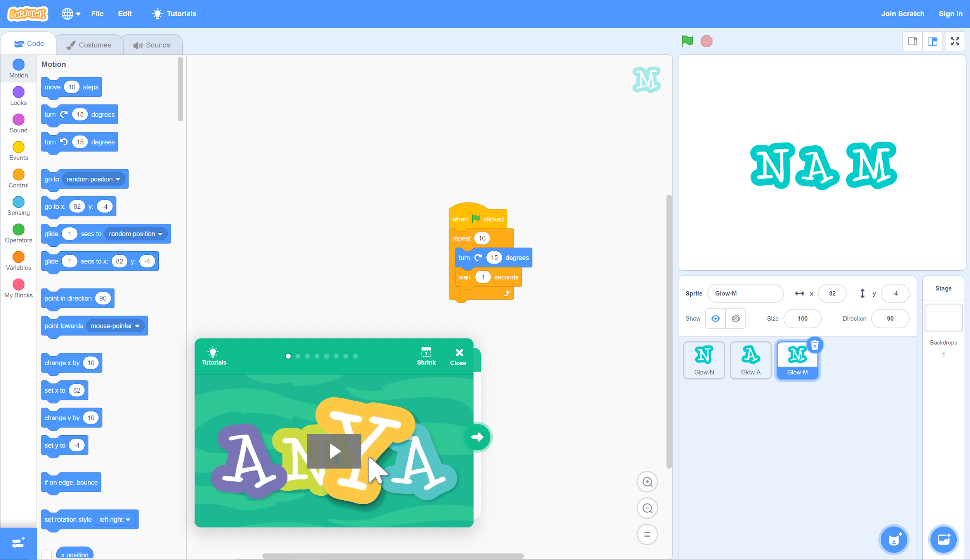
Step 6, Cont.
B. Drag and drop the “turn (15) degrees” command into the “repeat (10)” function, above “wait (1) seconds.”
A. Select the “Motion” tab.
Note: If there are no more letters in your name, skip to step 9.

Slide 13
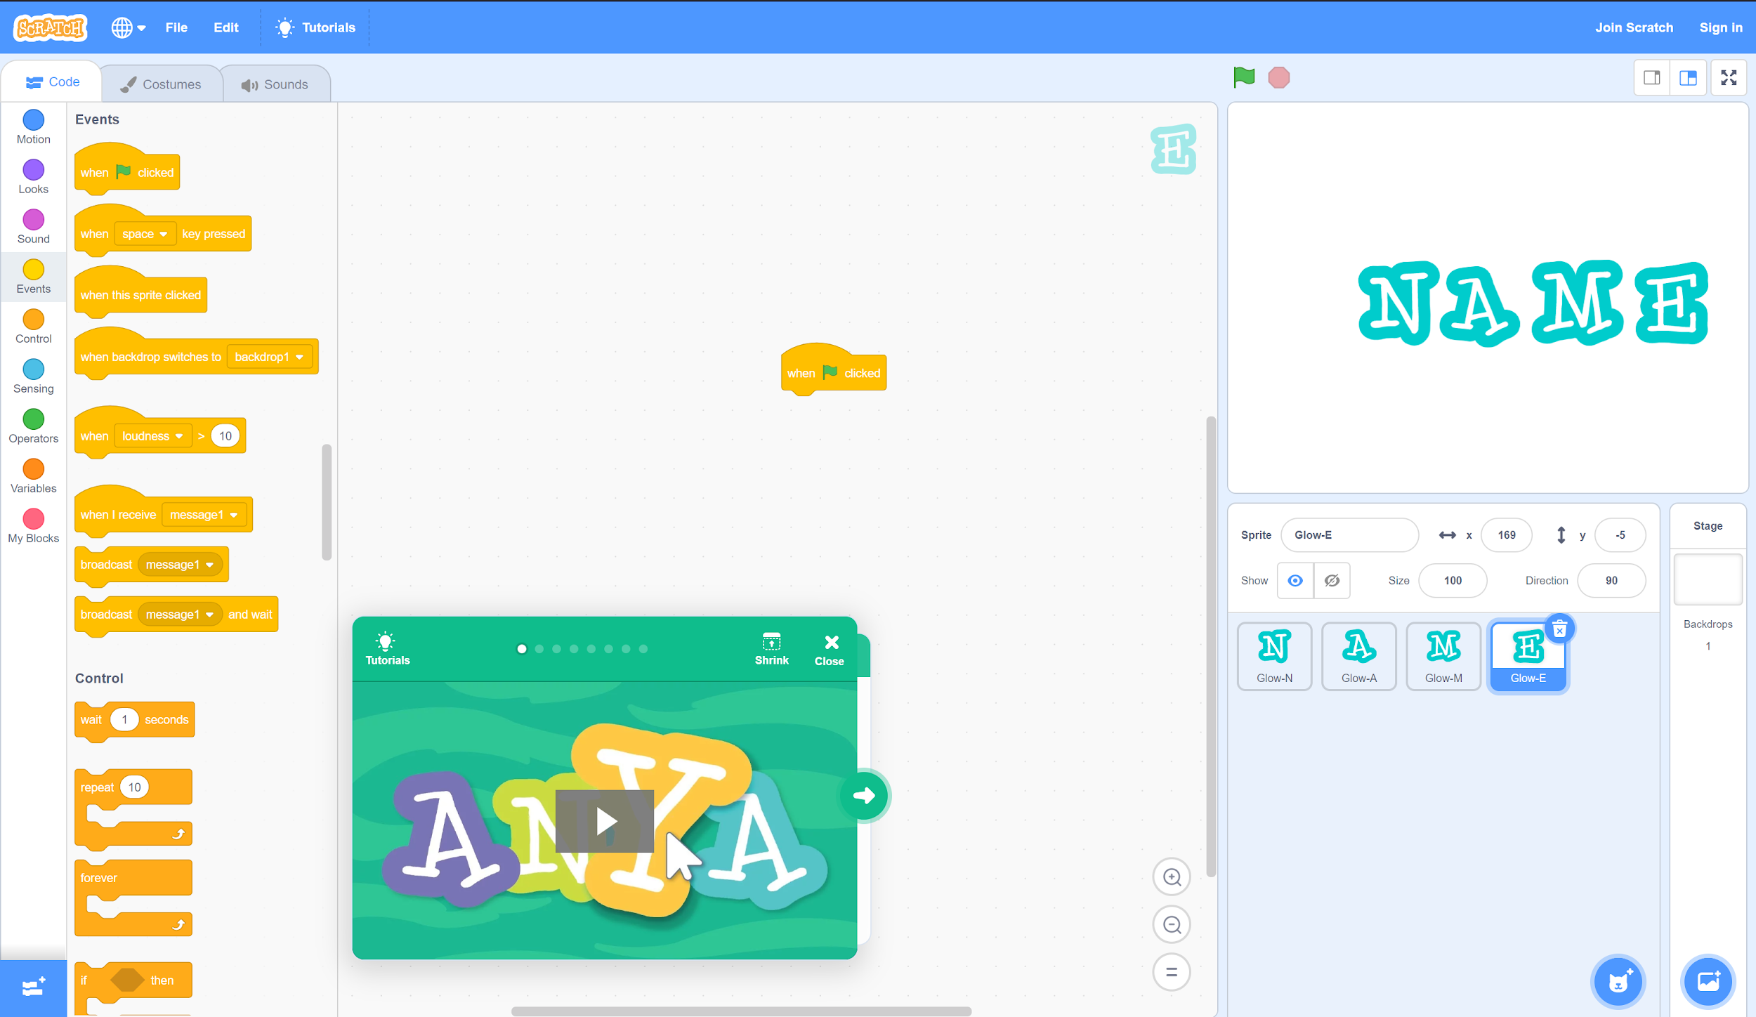
Step 7
A. Repeat step 3 and select the fourth letter of your name.
B. With the fourth letter selected in the lower-right pane, return to the “Events” tab.
C. Drag and drop “when ⚐ clicked” into the middle workspace.

Slide 14
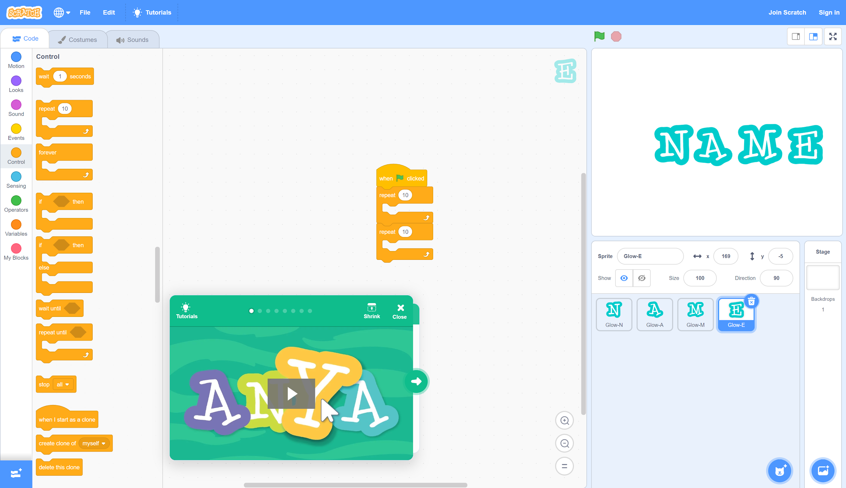
Step 7, Cont.
B. Connect two “repeat (10)” commands below “when ⚐ clicked.”
A. Select the “Control” tab.

Slide 15
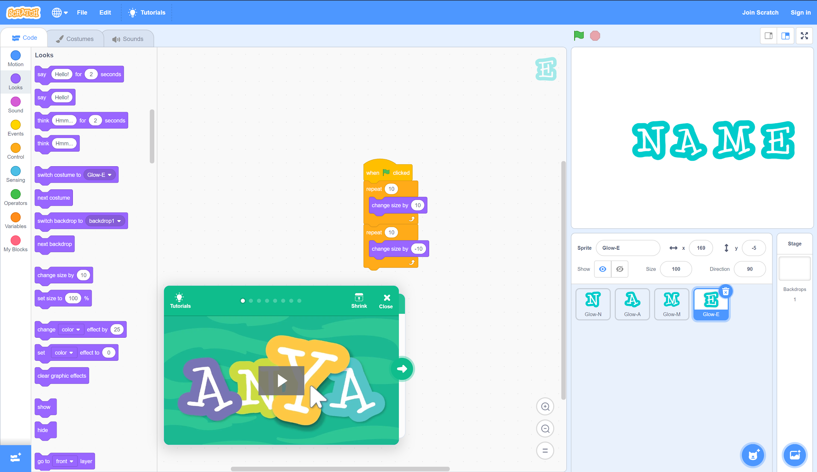
Step 7, Cont.
B. Modify the second command to be “change size by (-10).”
A. Drag and drop a “change size by (10)” command inside each “repeat (10)” function.
Note: If there are no more letters in your name, skip to step 9.

Slide 16
Step 8
Repeat any or all of steps 4-7 for the remaining letters in your name.
You can also try to coming up with your own code. For example, with the turn function, try changing “wait (1) seconds” to a shorter time, such as “wait (.5) seconds,” for a faster spin.
Or, try applying multiple code sets to the same letter. For example, try programming a letter to change colors and spin at the same time.

Slide 17
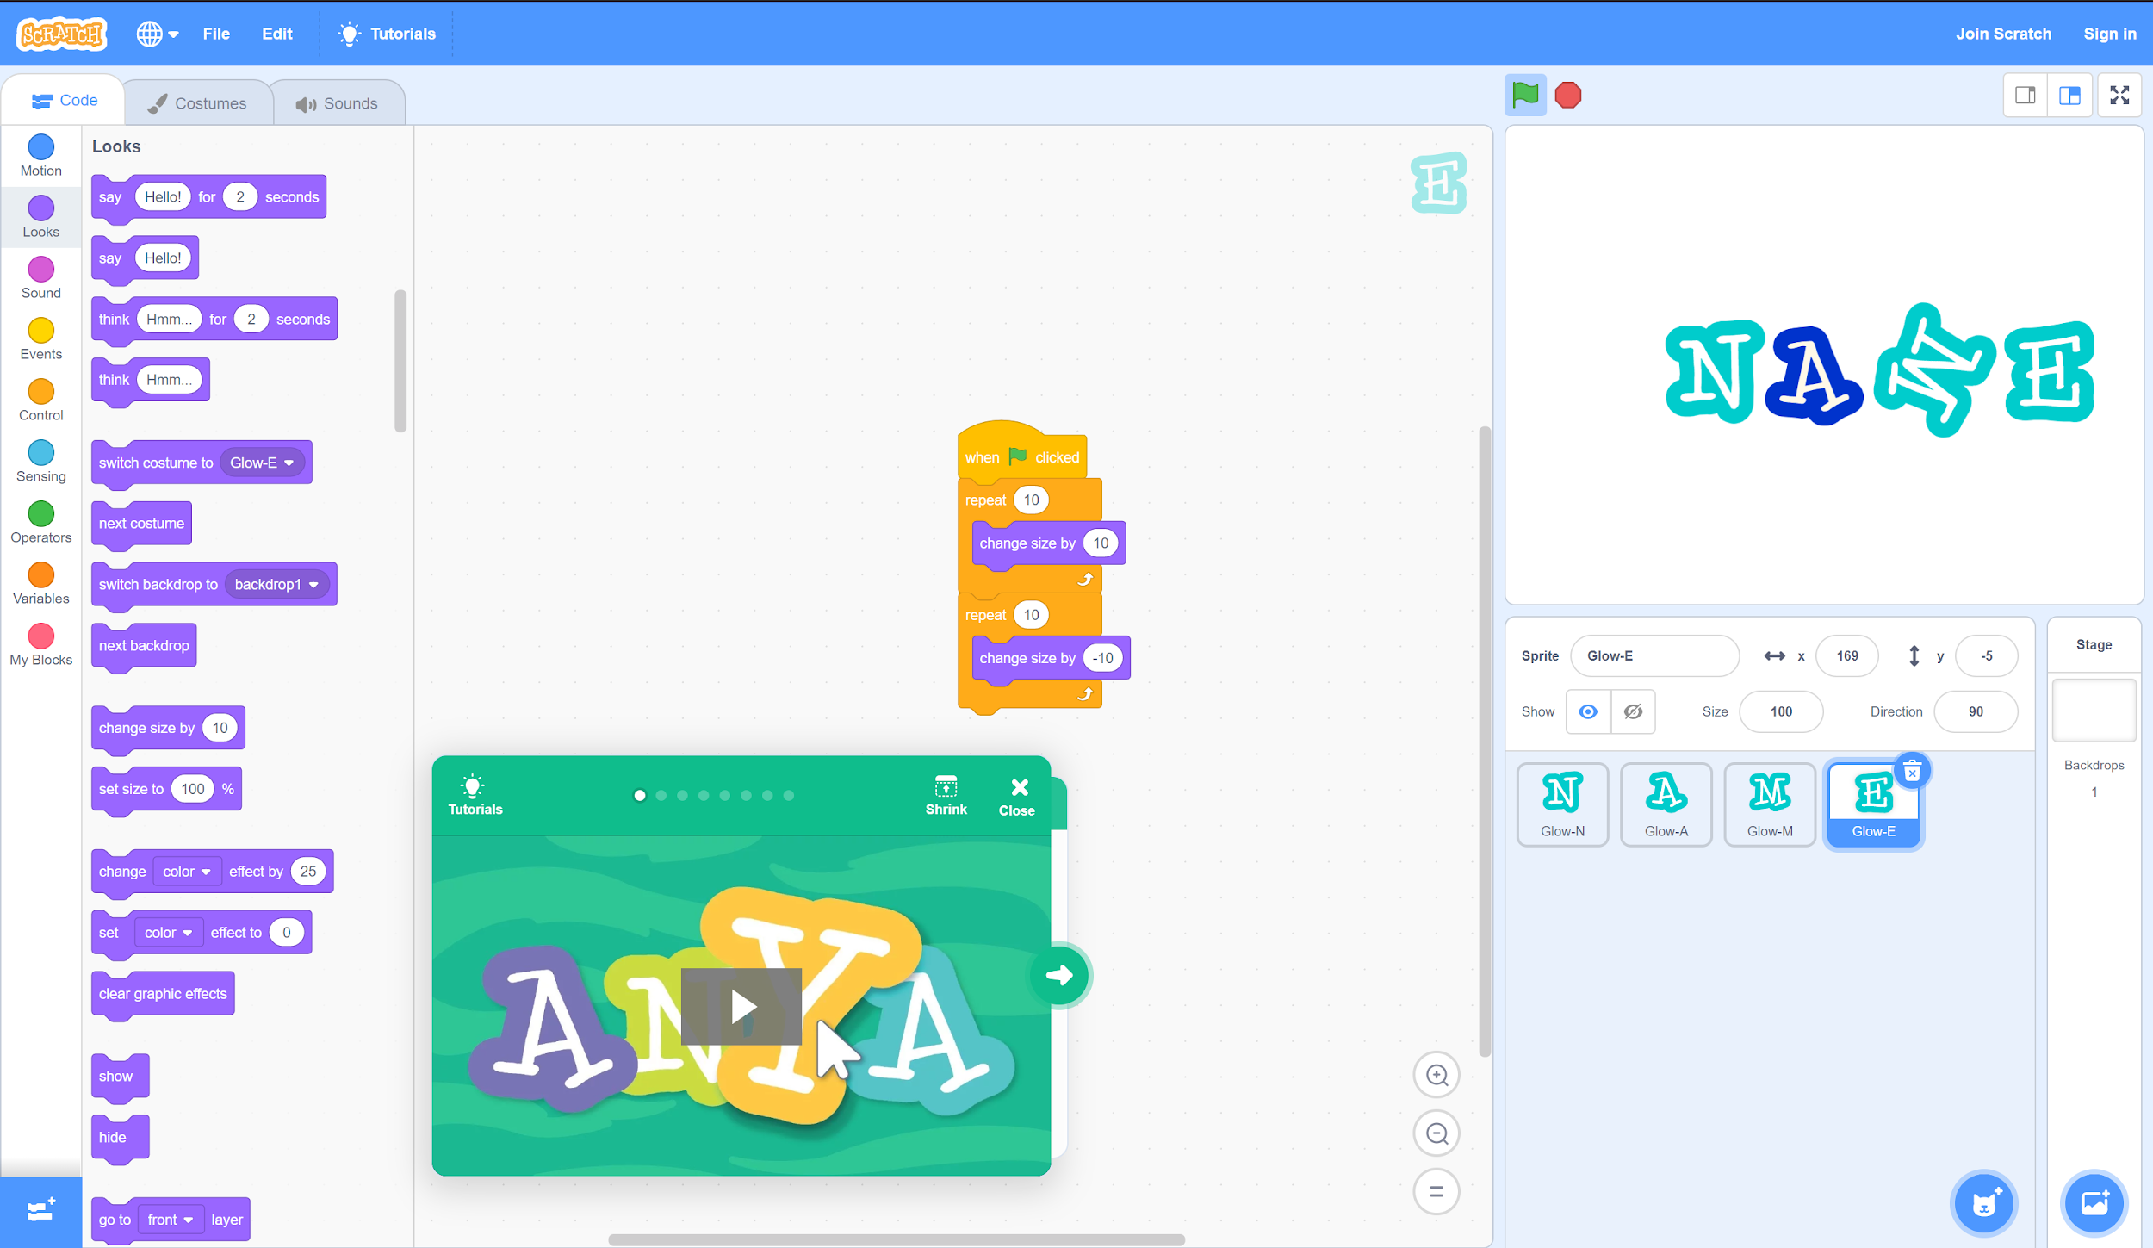
Step 9
When you are finished, click the green flag to test your code!
If something isn’t working the way you want, check your code again to see what might be wrong. Don’t worry if you don’t get something right the first time. Just keep trying until you find a combination that works!

Slide 18
What’s Next?
Move on to Activity 2: Balloon Popper Game.
There, you will create your own game. You can even challenge friends and family to play when you’re finished!

