Slide 1
Balloon Popper Game
Information Technology Career Cluster Activity

Slide 2
Step 1
Go to https://tinyurl.com/Newclickergame.
This will take you to Scratch, MIT’s coding website.

Slide 3
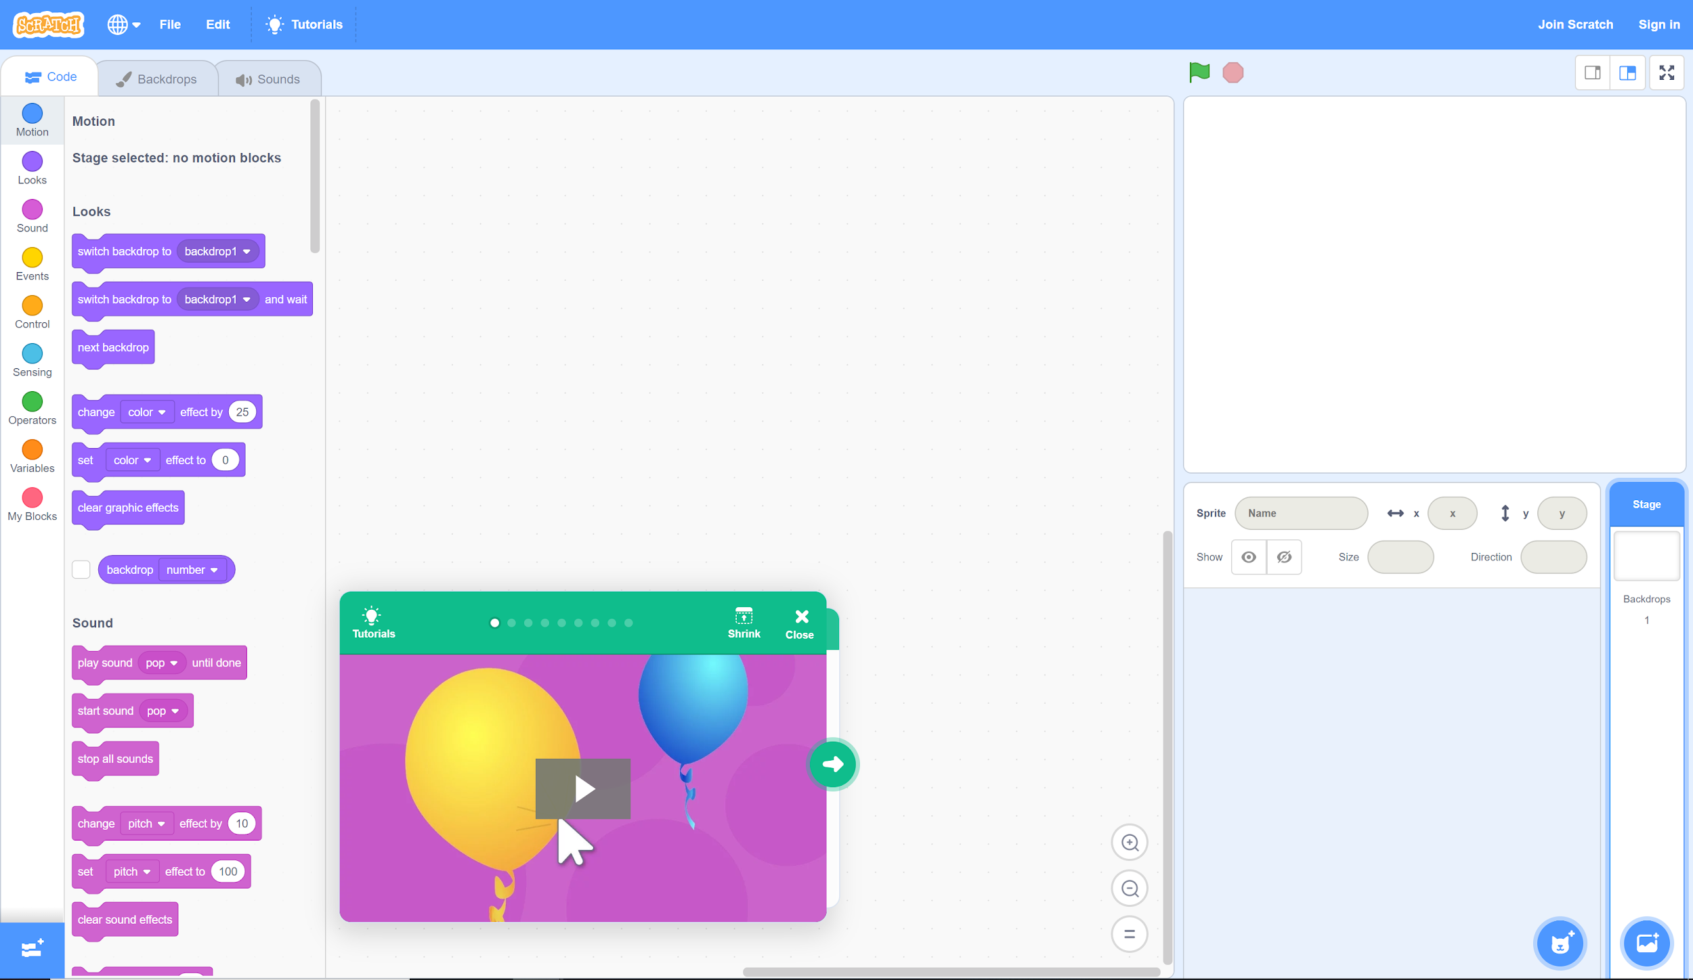
Step 2
Click the cat icon to get started.

Slide 4
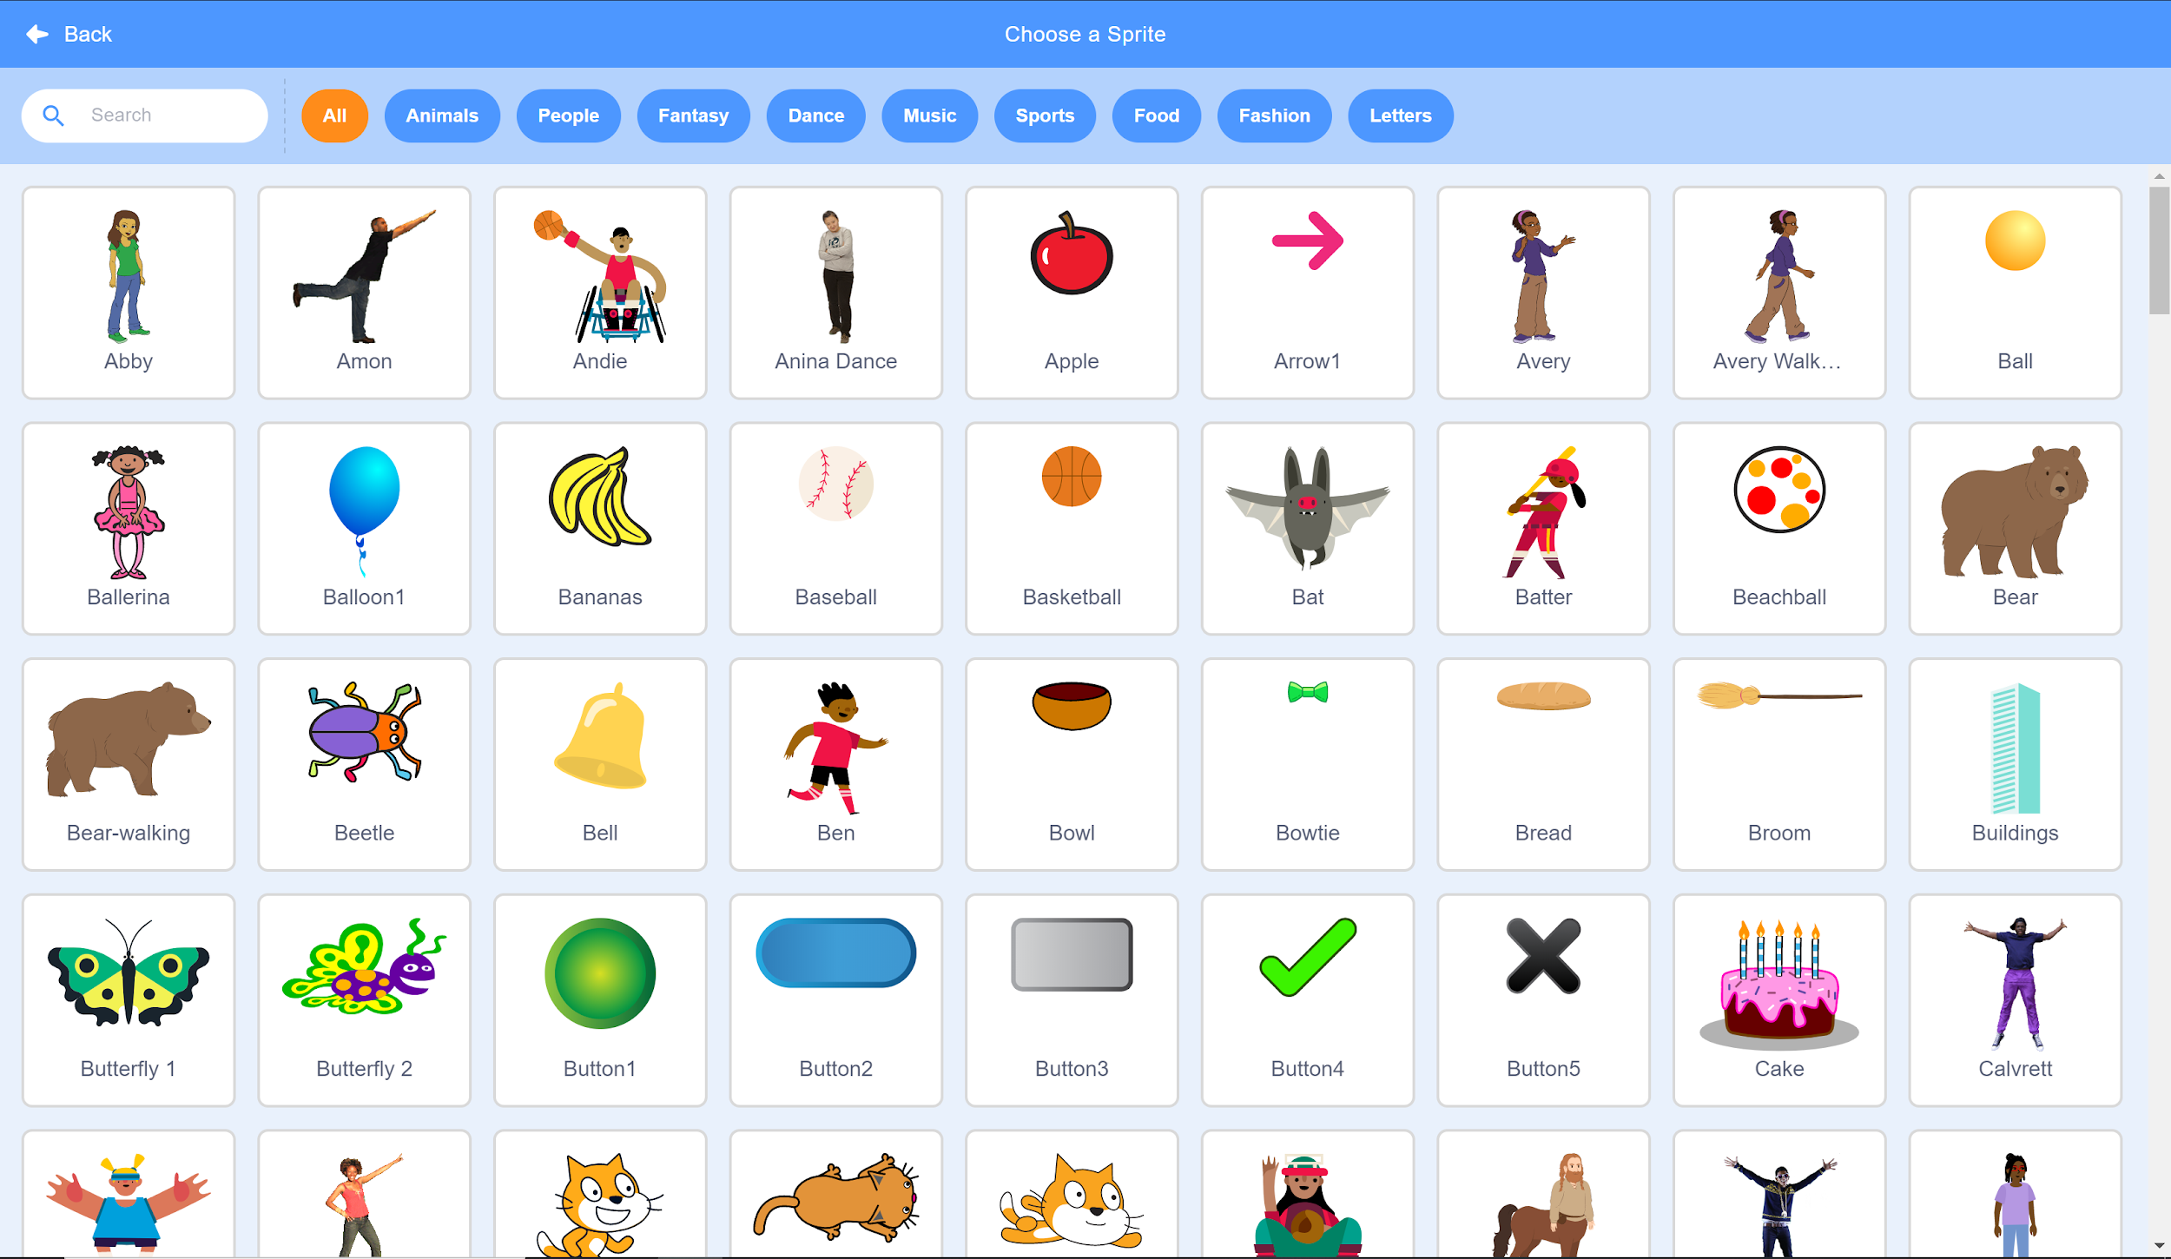
Step 3
Select the “Balloon1” Sprite.

Slide 5
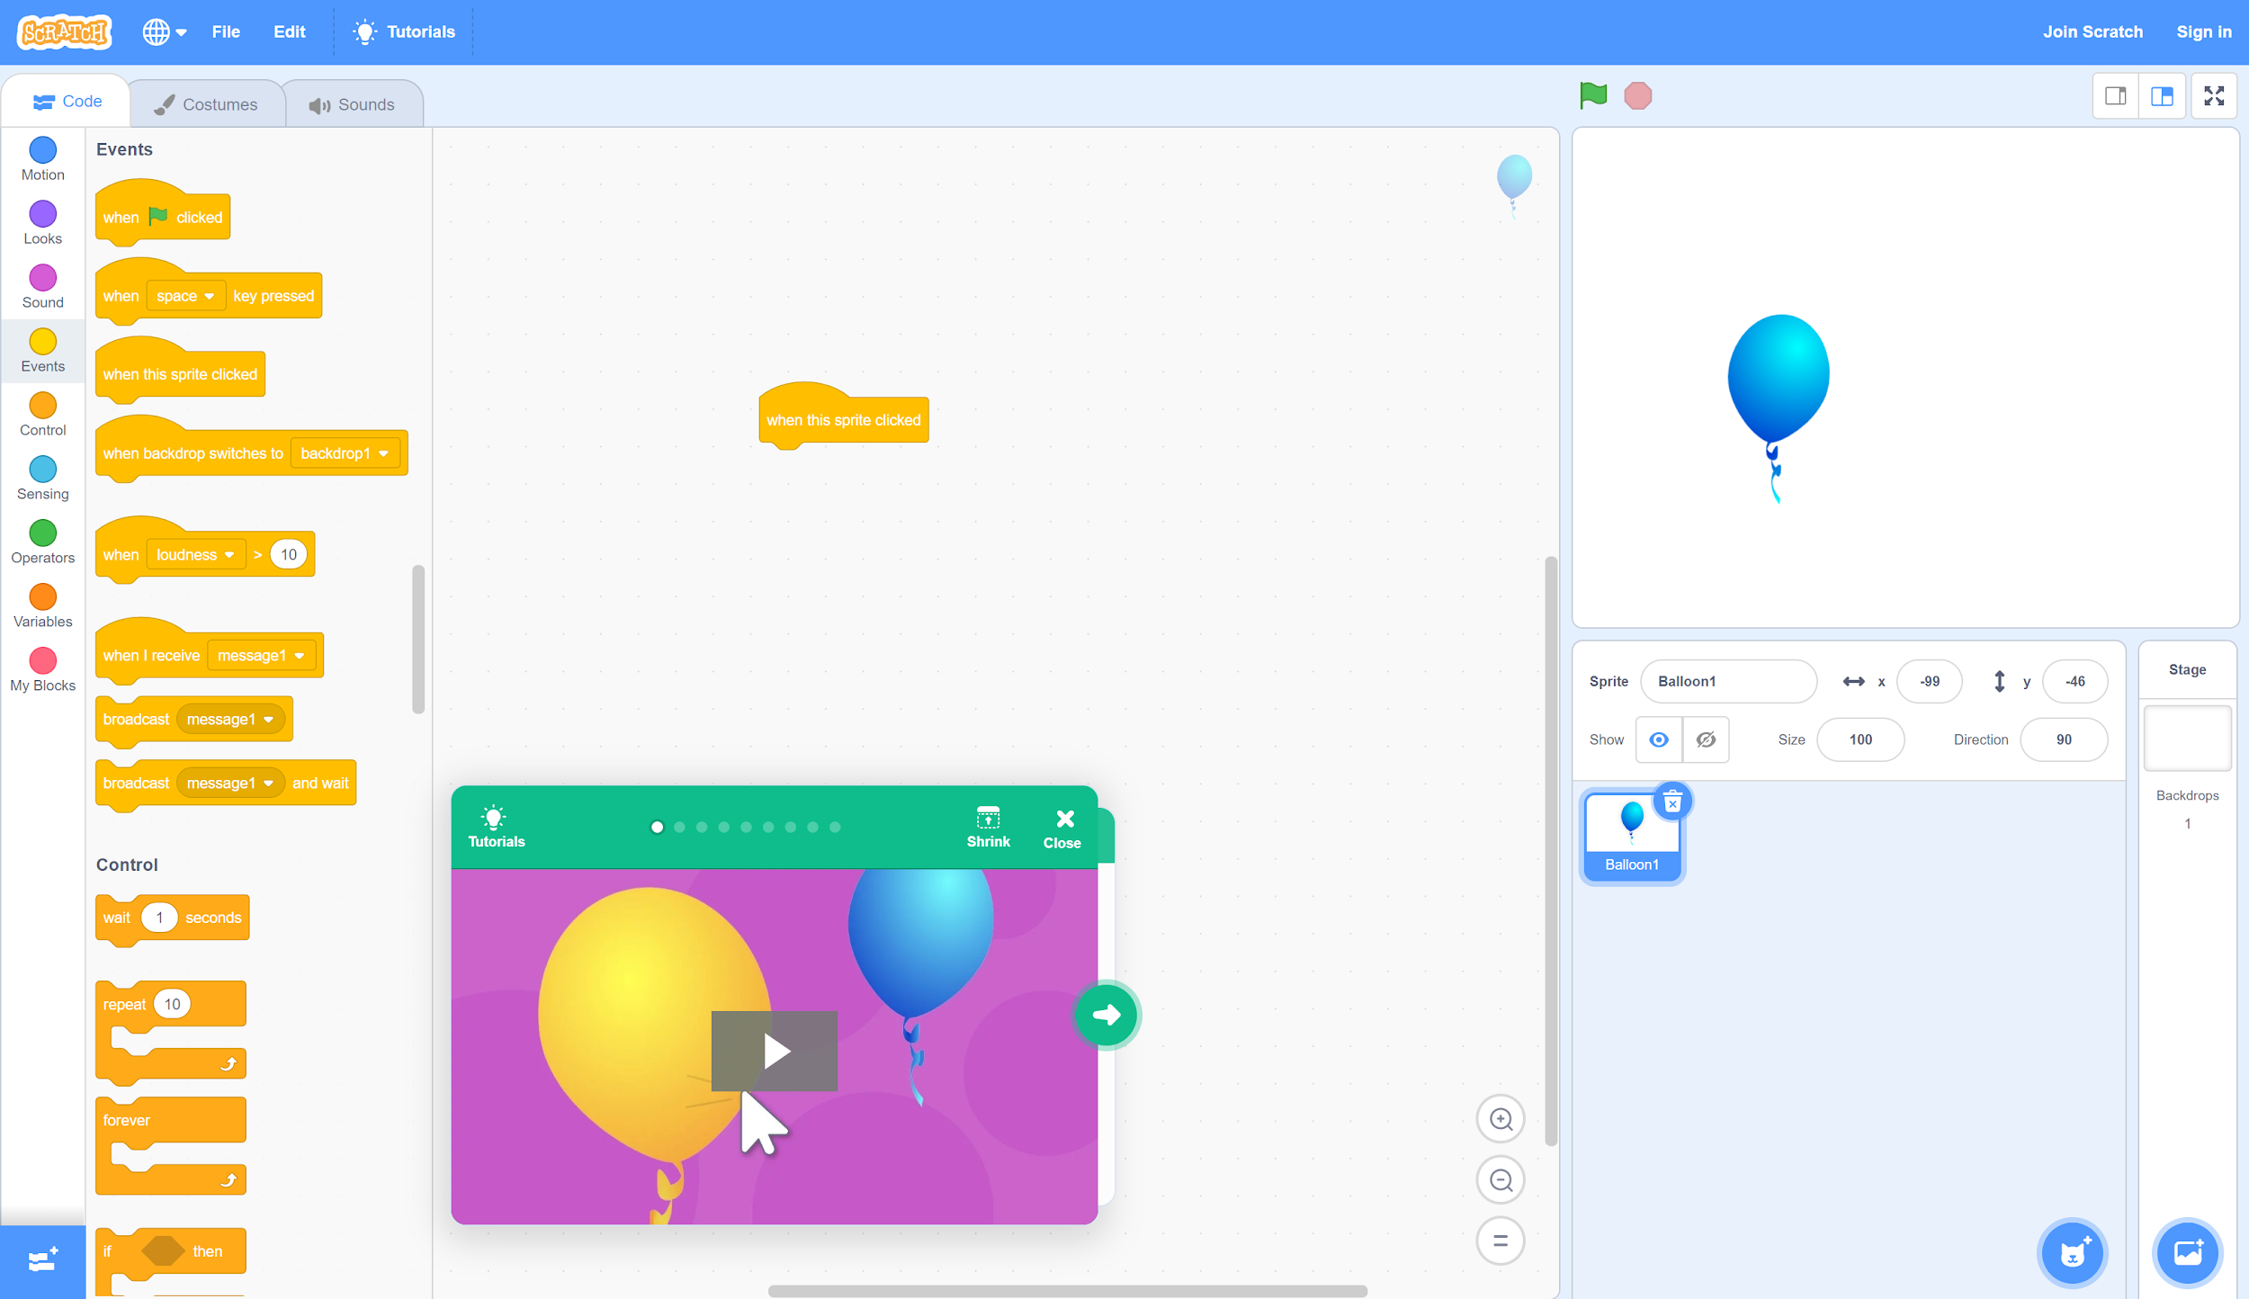
Step 4
B. Find the “when this sprite clicked” event. Click and drag this command to the workspace in the middle of the window.
A. In the left pane, select the “Events” tab.

Slide 6
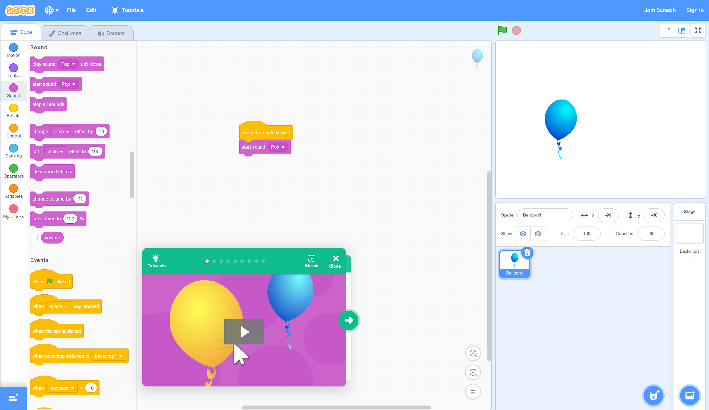
Step 4, Cont.
A. Select the “Sound” tab.
B. Find the “start sound (pop)” command. Click and drag this event to the area below the “when this sprite clicked” command so that the two connect.

Slide 7
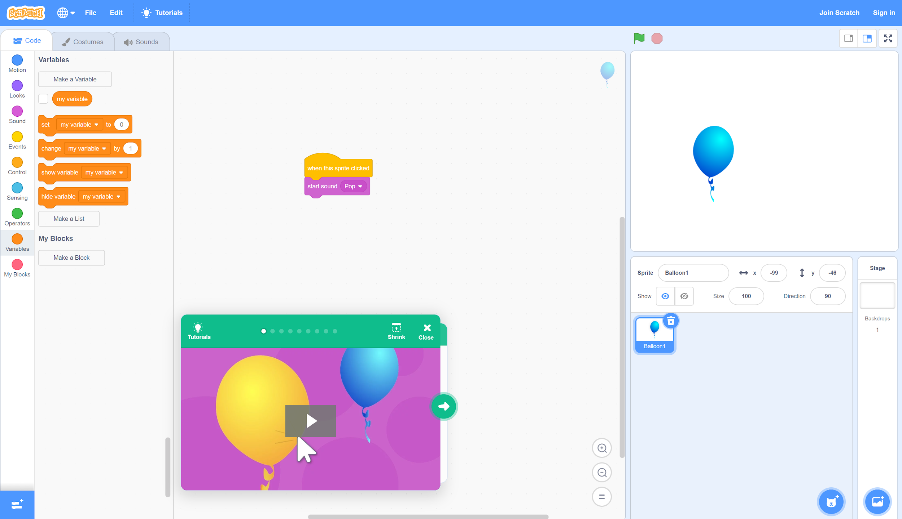
Step 5
B. Click “Make a Variable.”
A. Select the “Variables” tab.

Slide 8
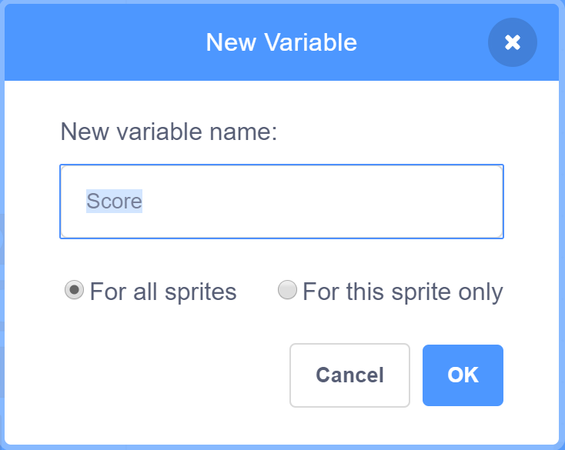
Step 5, Cont.
In the window that appears, enter “Score” in the “New variable name” field, and then click OK.

Slide 9
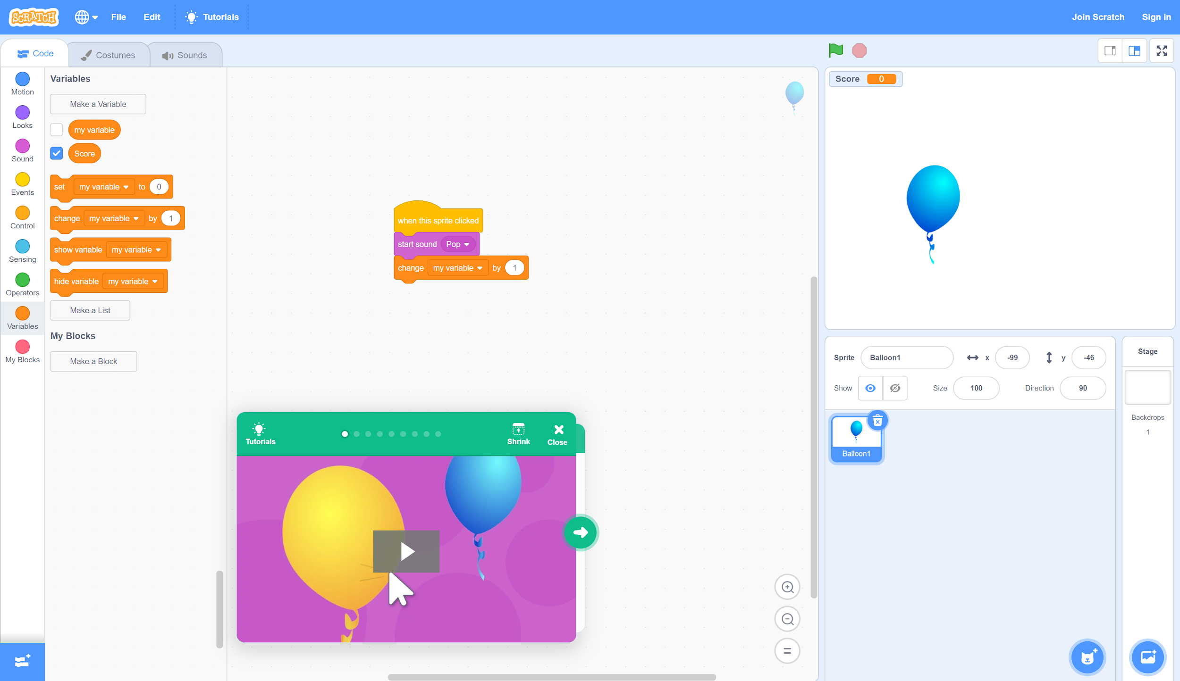
Step 6
Drag and drop the “change my variable by (1)” command under the “start sound (pop)” command so that the two connect.

Slide 10
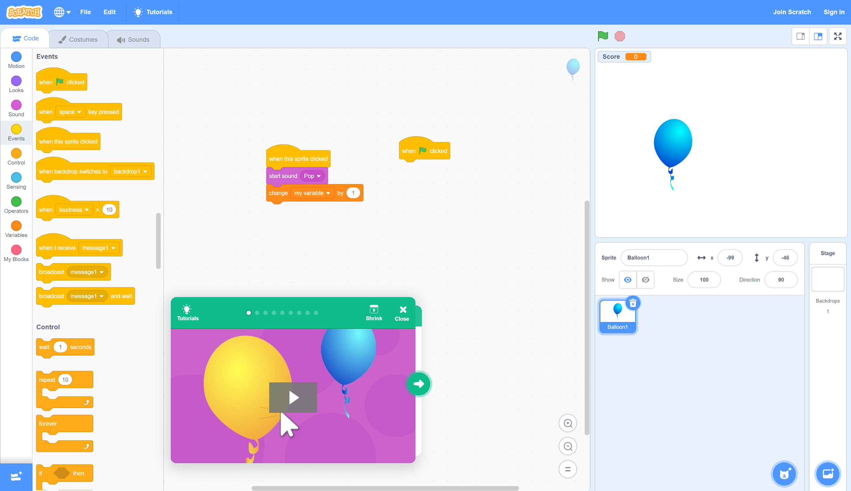
Step 7
Let’s make the balloon move!
B. Drag and drop the “when ⚐ clicked” event into the workspace, but don’t connect it to the existing commands.
A. Select the “Events” tab.

Slide 11
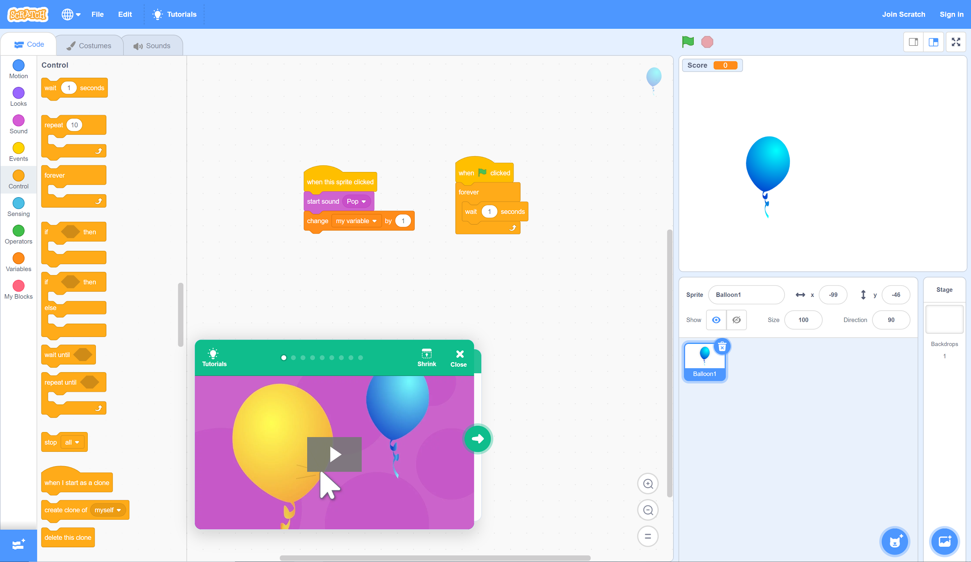
Step 7, Cont.
C. Drag and drop the “wait (1) seconds” command into the “forever” function.
A. Select the “Control” tab.
B. Drag and drop the “forever” function below the “when ⚐ clicked” command so that the two connect.

Slide 12
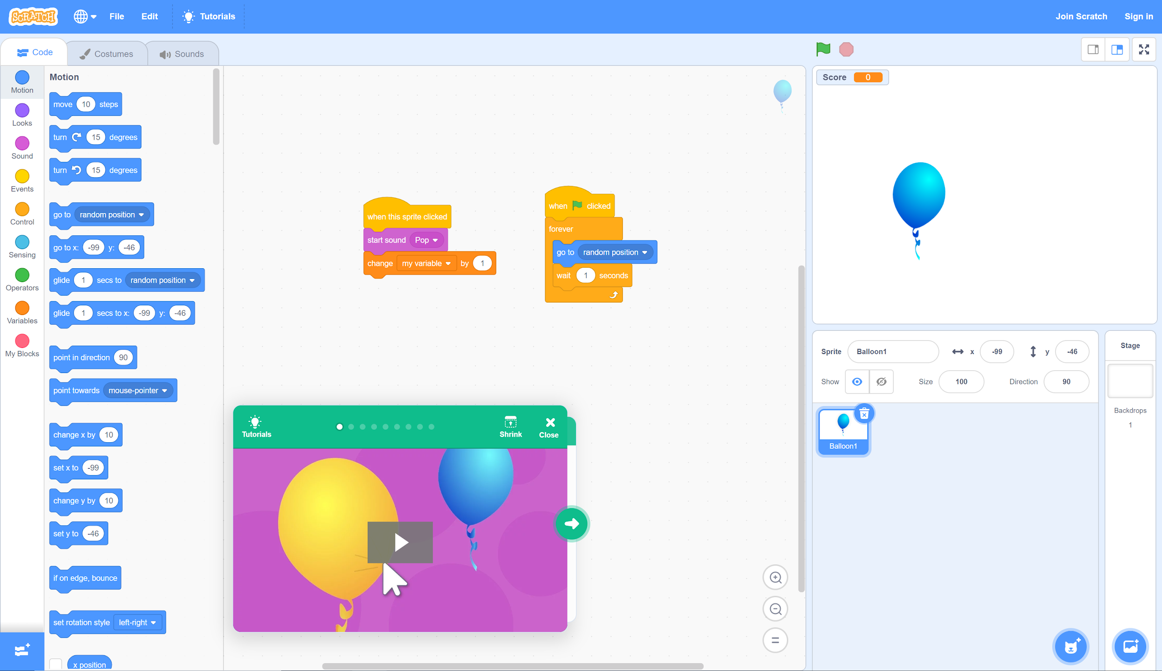
Step 7, Cont.
B. Drag and drop the “go to random position” command into the “forever” function above “wait 1 seconds.”
A. Select the “Motion” tab.

Slide 13
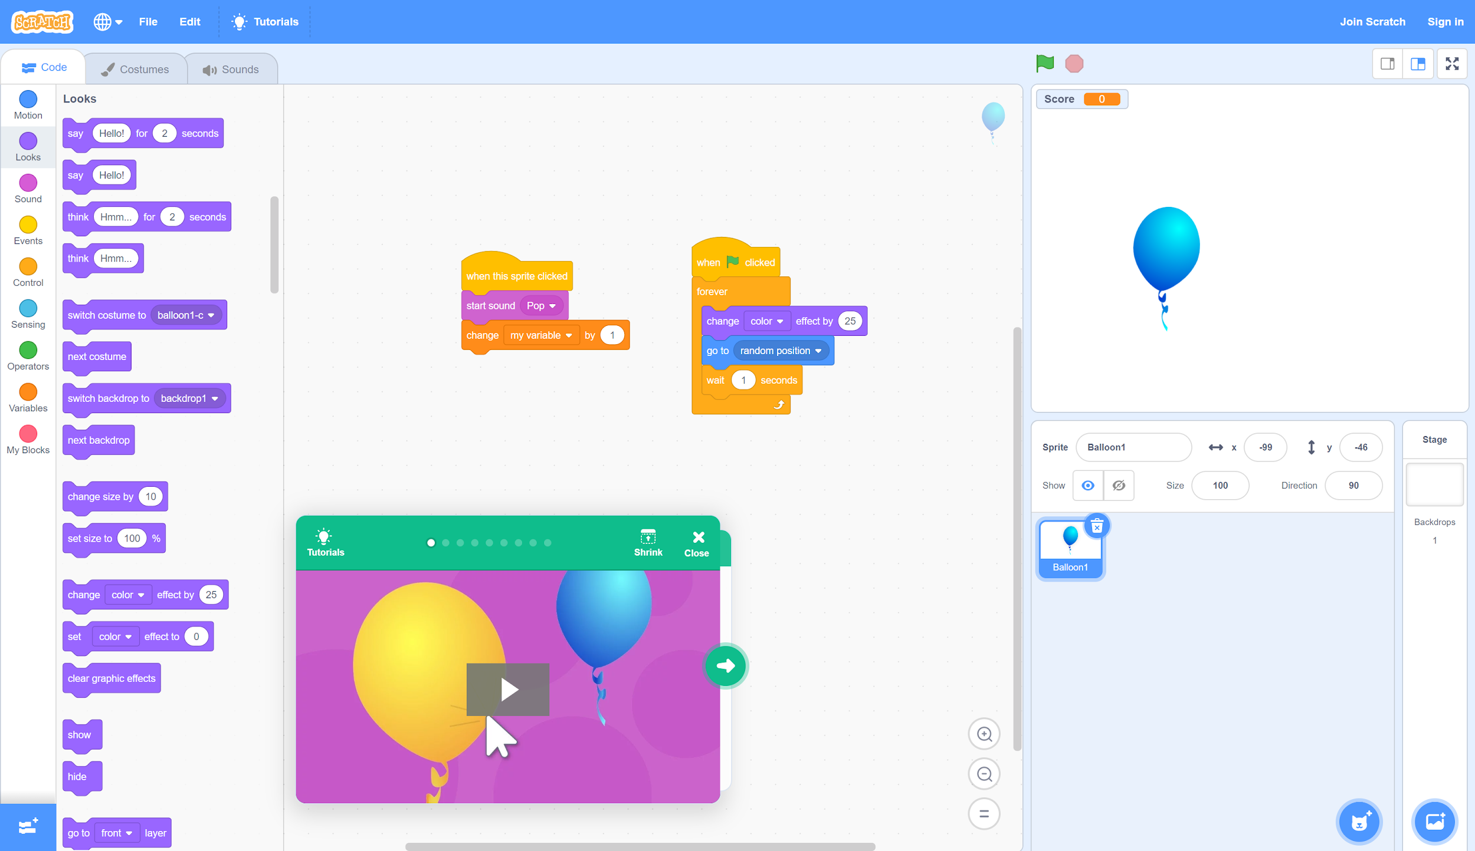
Step 7, Cont.
A. Select the “Looks” tab.
B. Drag and drop the “change color effect by (25)” command into the “forever” function above “go to random position.”

Slide 14
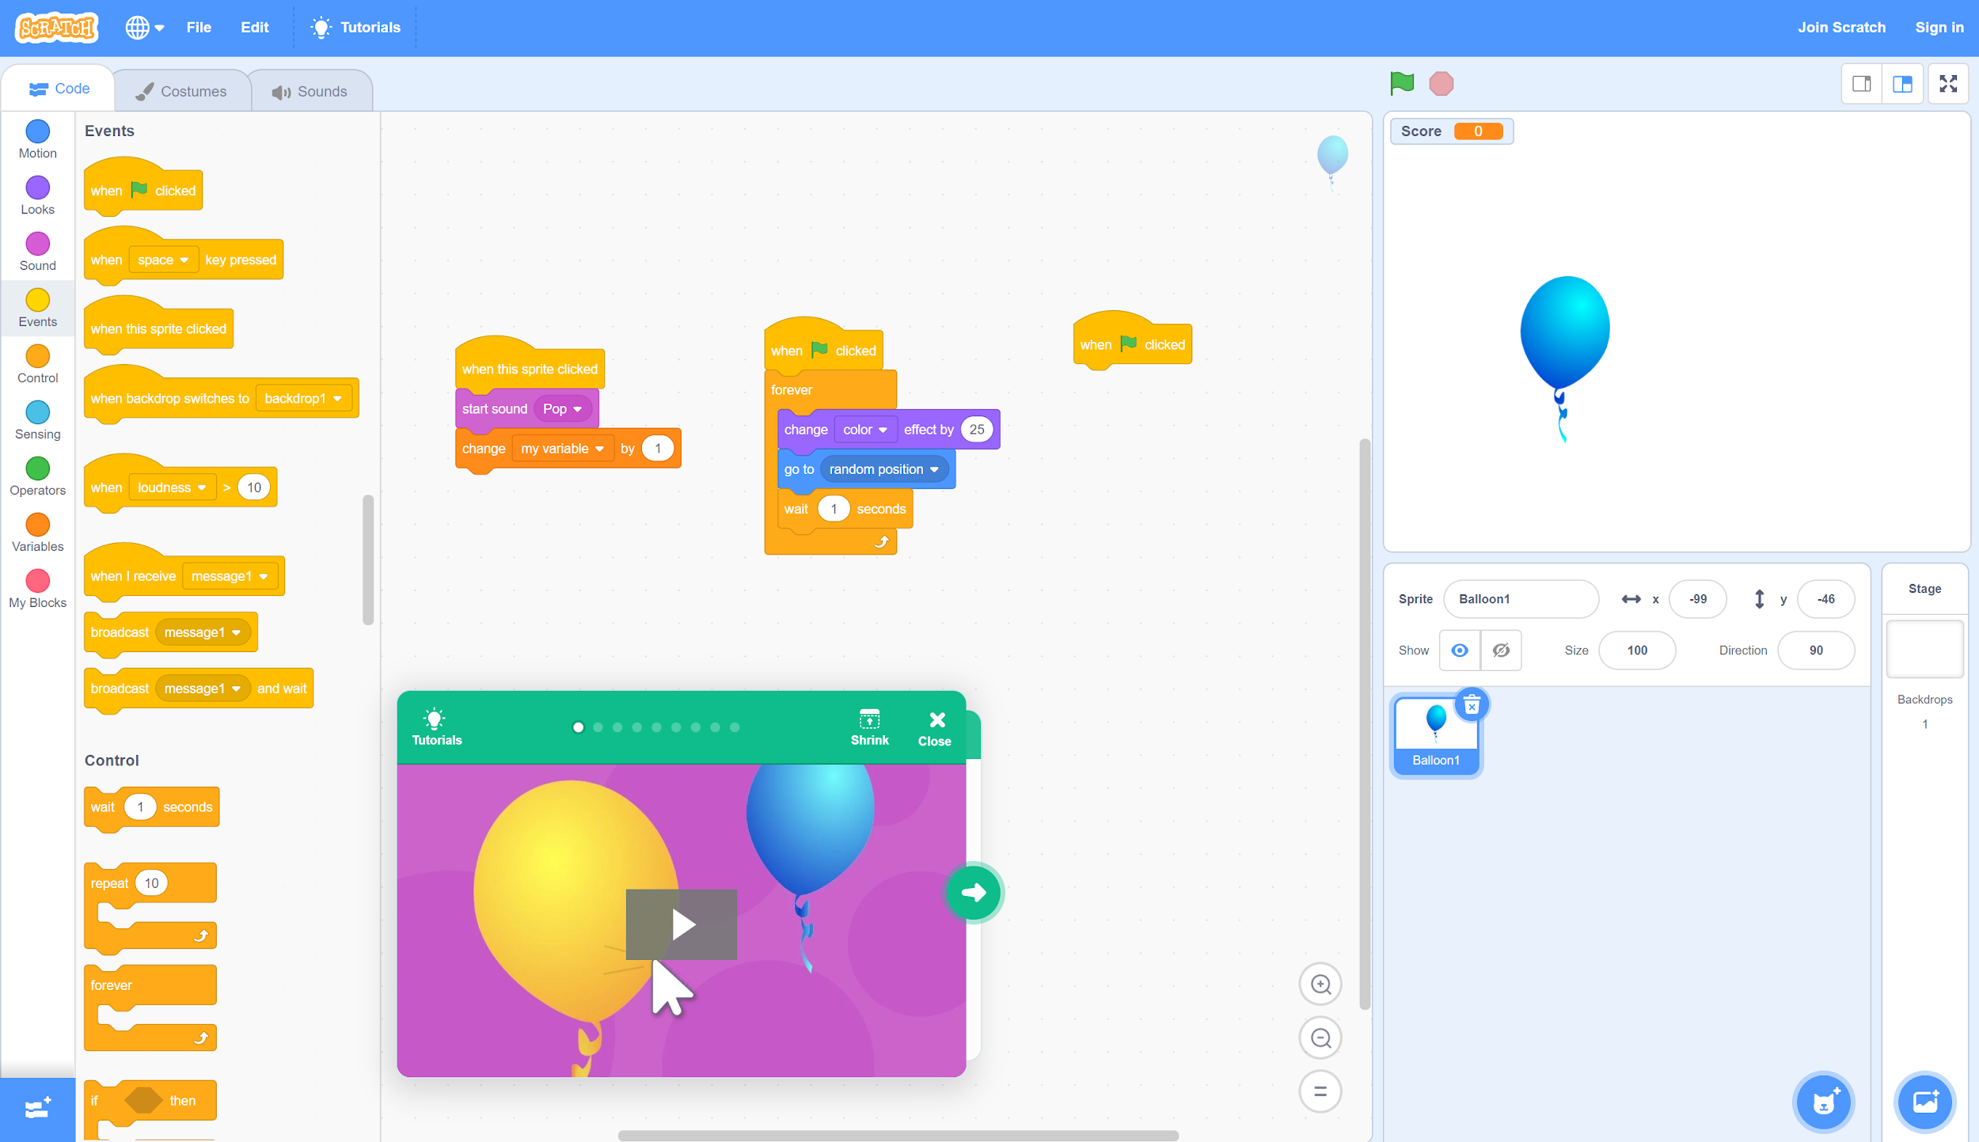
Step 8
B. Drag and drop the “when ⚐ clicked” event into the workspace, but don’t connect it to the existing commands.
A. Select the “Events” tab.

Slide 15
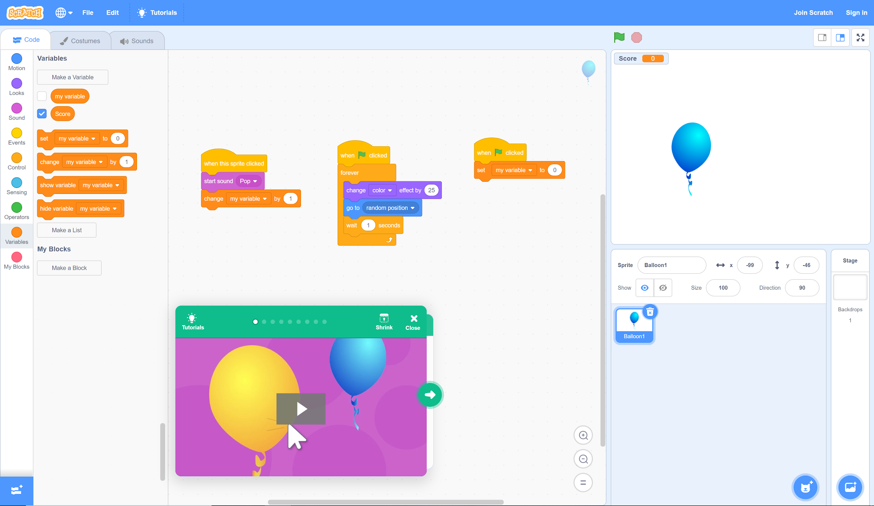
Step 8, Cont.
B. Drag and drop the “set my variable to (0)” command below the “when ⚐ clicked” command.
A. Select the “Variables” tab.

Slide 16
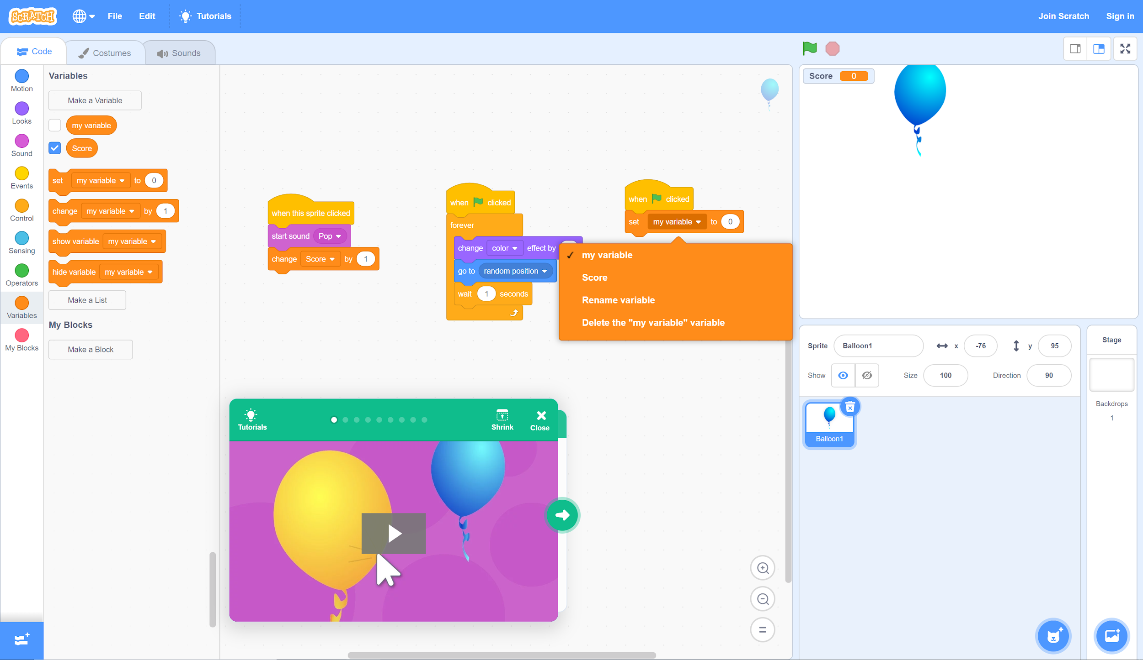
Step 9
For both variable functions, change “my variable” to “Score.”

Slide 17
Step 10
Click the green flag to test your code!
If something isn’t working the way you expect, check your code again and see what the issue might be. Don’t worry if you don’t get something right the first time. Keep trying until you find a combination that works!

Slide 18
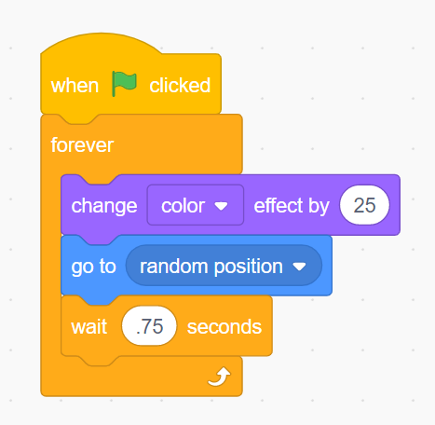
Step 11
Challenge your friends or family to play your game!
Who can click the most balloons in 30 seconds? If the balloon is too slow, try going back to your second code set—change “wait (1) seconds” to “wait (.75) seconds” by clicking the number and typing in a new one. You can adjust the number higher or lower as needed like this:

Slide 19
What’s Next?
Next, complete the “How Am I Feeling? What Am I Thinking?” activity found in the activity guide to reflect on your exploration in Scratch.

